Slide 1
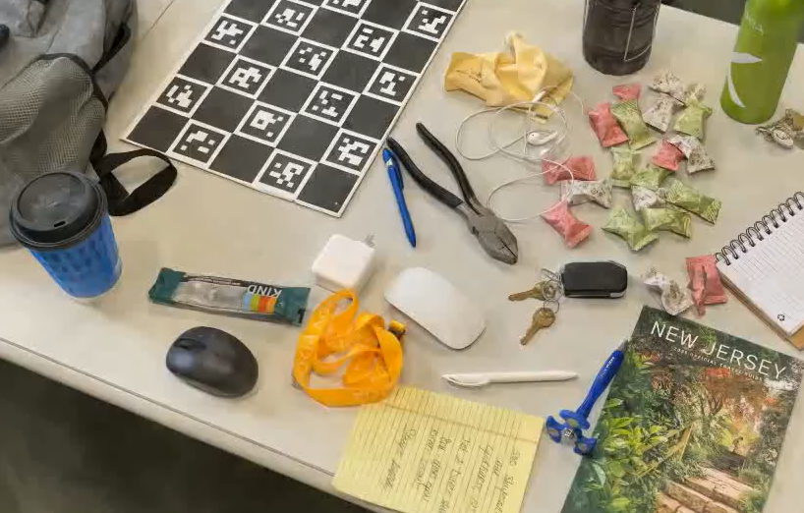
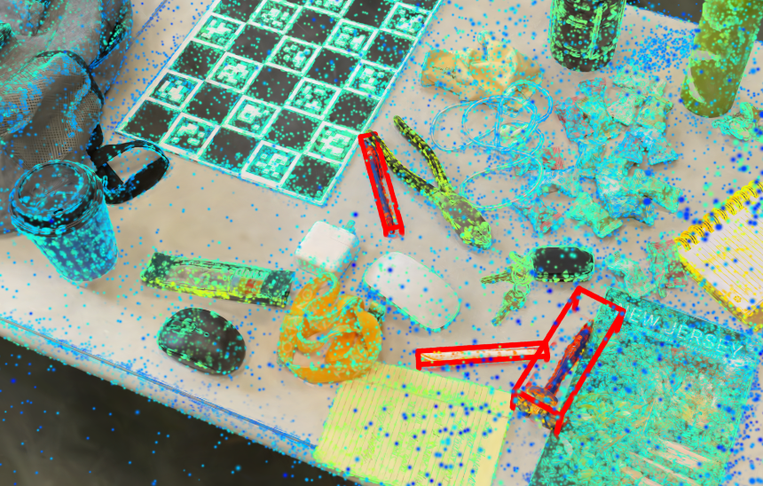
Query input: “pen”
3DGS rendering
+ localized query objects
Query input: “pen”
3DGS + localized objects

