Slide 1
CUSTOMER EXPENSIVE PREDICTION
Aruneema
Harshit Joshi
Danila Rozhevskii
Vaishnav Kanekar
Shweta Suhas Rane

Slide 2
AGENDA
Goal
Data Description
Exploratory Insights
Expensive Customer Definition
Business Insights
Specific Recommendation

Slide 3
Business Question
Identify the key driver of healthcare costs (factors affecting)
Predict customers who will be spending a lot of money on healthcare for next year
Specific business recommendations

Slide 4
ABOUT THE HMO DATA
Children
Yearly Physical
Married
Gender
Hypertension
Dataset Contains 14 Variables Person’s Info With 7582 Rows in 7 states of US:
Age
Location
Location Type
Exercise
Smoker
Bmi
Educational Level
Cost
Important Variables:
Age
Bmi
Smoker
Exercise

Slide 5
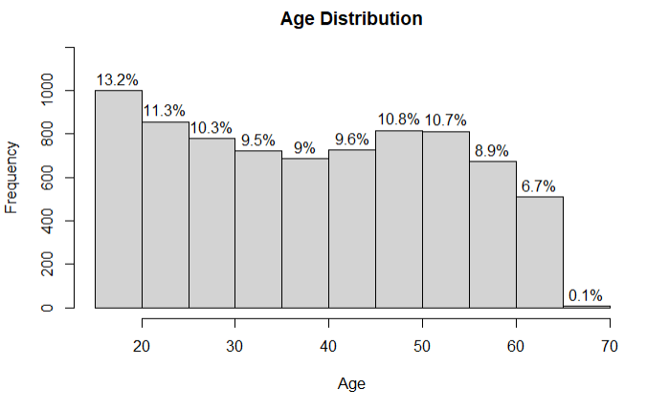
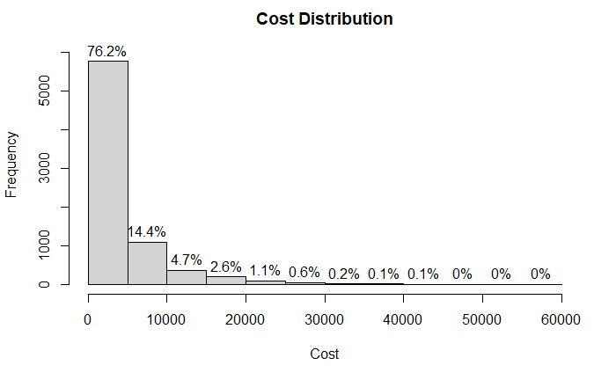
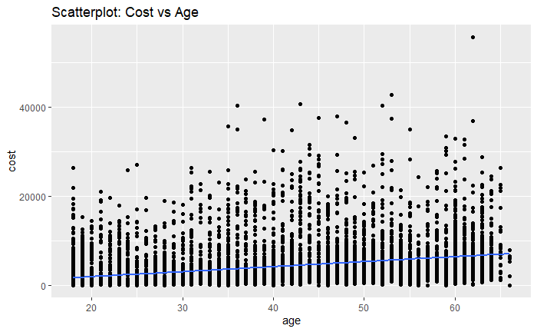
EXPLORATORY INSIGHTS:AGE

Slide 6
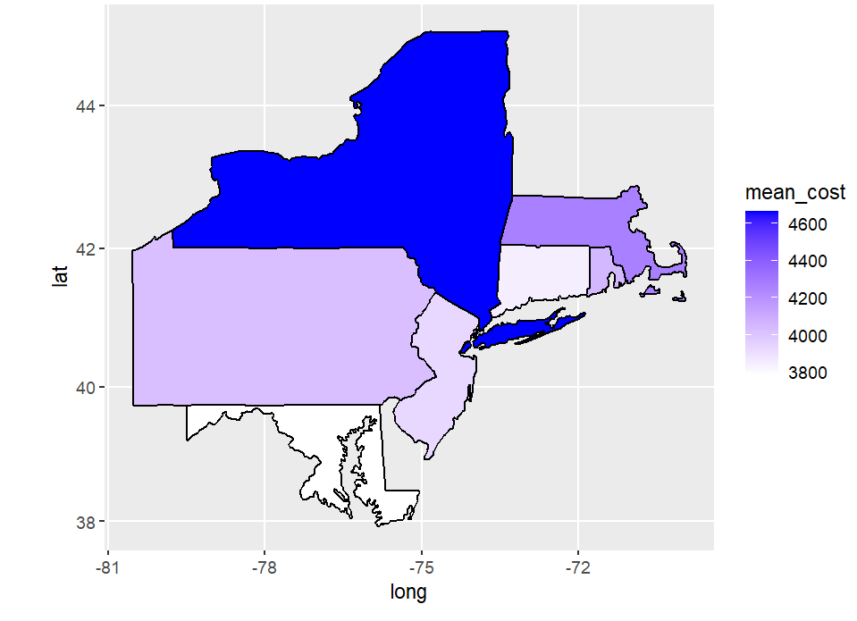
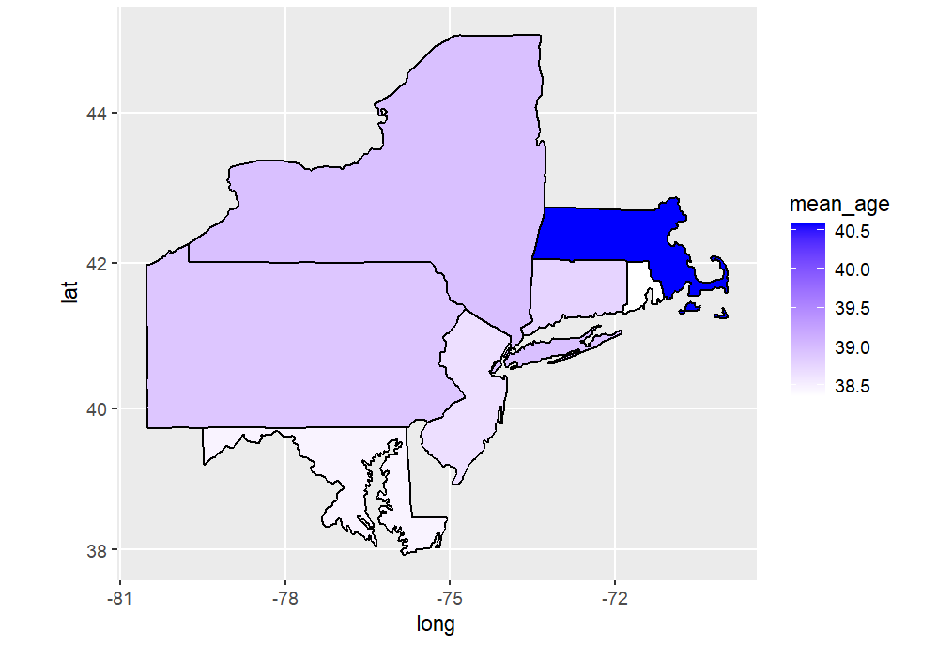
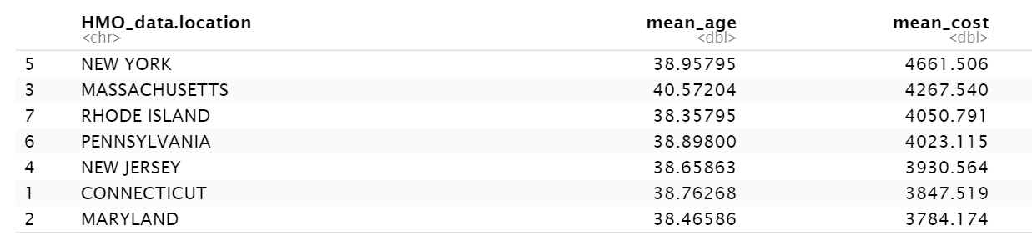
EXPLORATORY INSIGHTS
Cost Distribution in 7 States
Age Distribution in 7 States
NY
NY
MA
MA
CT
CT
PA
NJ
PA
NJ
Maryland
Maryland

Slide 7
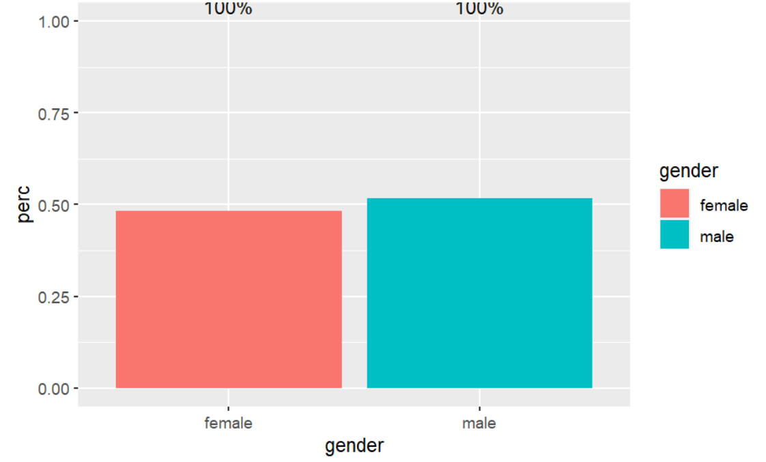
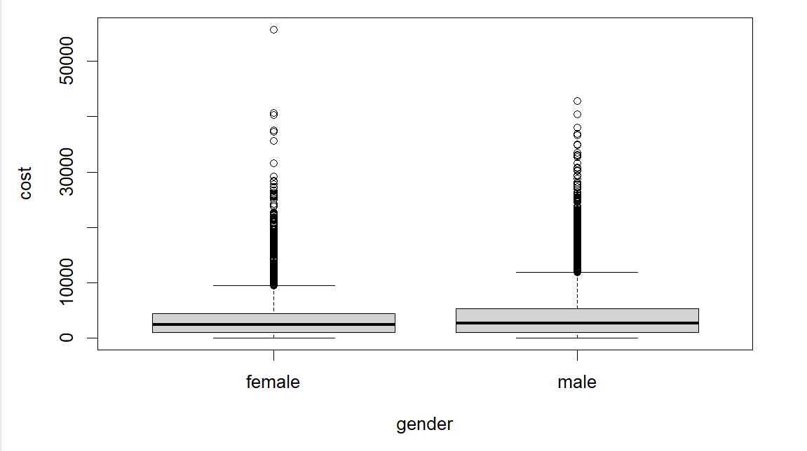
EXPLORATORY INSIGHTS: Gender

Slide 8
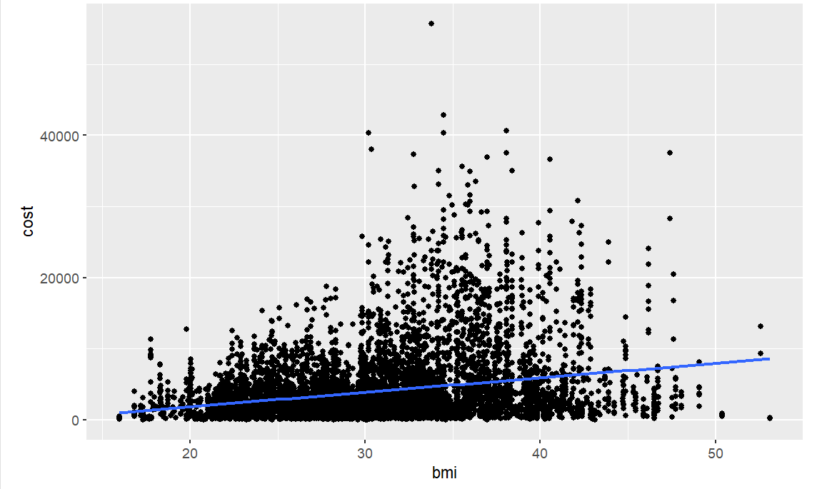
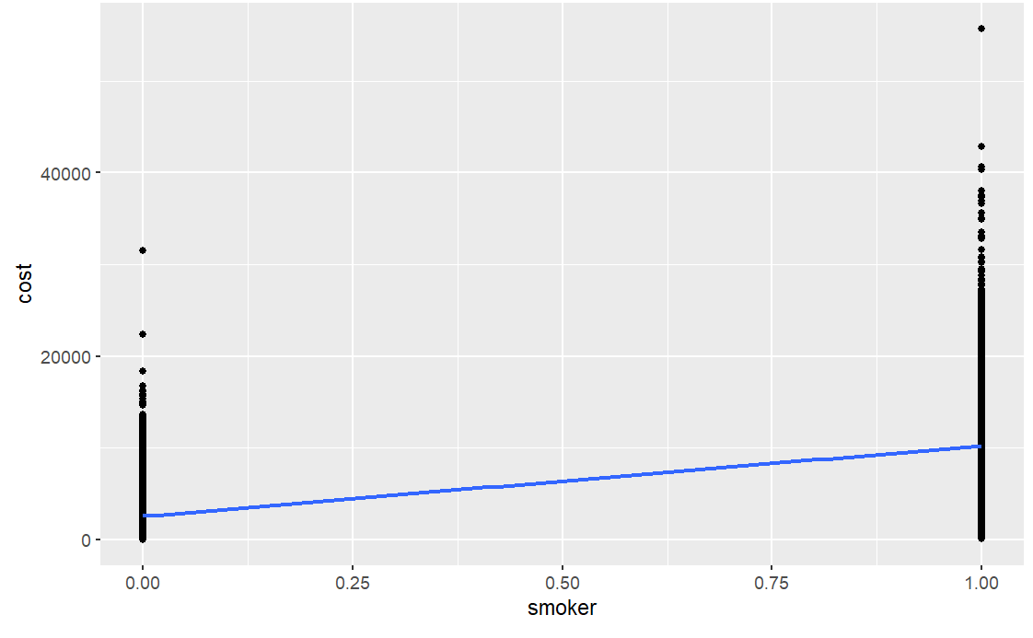
EXPLORATORY INSIGHTS : BMI AND SMOKER
Cost increases as BMI increases and smoking status changes from non-smoking to smoking

Slide 9
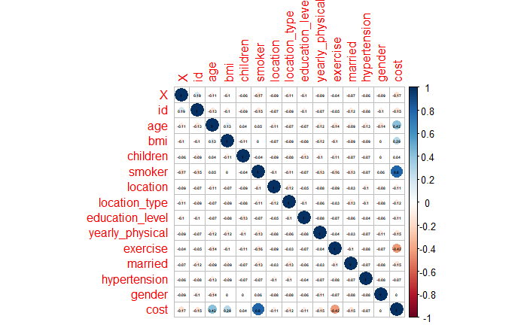
EXPENSIVE CUSTOMER DEFINITION
Defining characteristics:
Smoker
Exercise
Age
Bmi

Slide 10
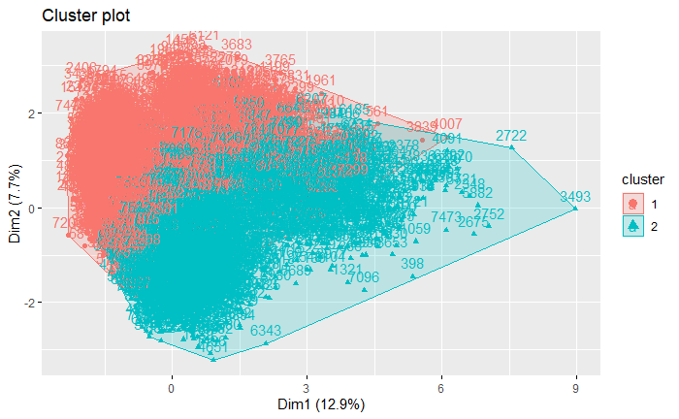
EXPENSIVE CUSTOMER DEFINITION
Defining characteristics:
Smoker
Exercise
Age
Bmi
SVM model output
Sensitivity of SVM- 97.93%
Accuracy- 86.61%

Slide 11
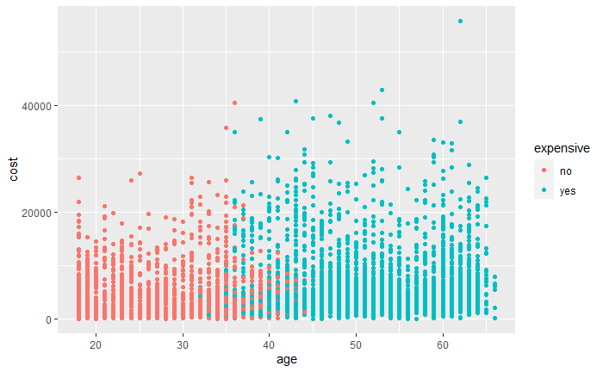
BUSINESS INSIGHTS
Average cost threshold:
$4,775 (3rd quantile)
Average Expensive: $5607
Average Non-Expensive: $2474
Average Age Expensive: 51
Average Age Non- Expensive: 27

Slide 12
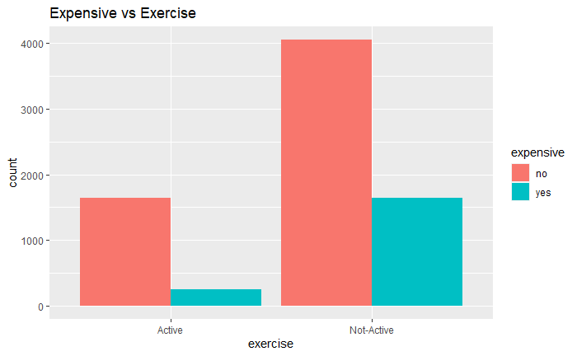
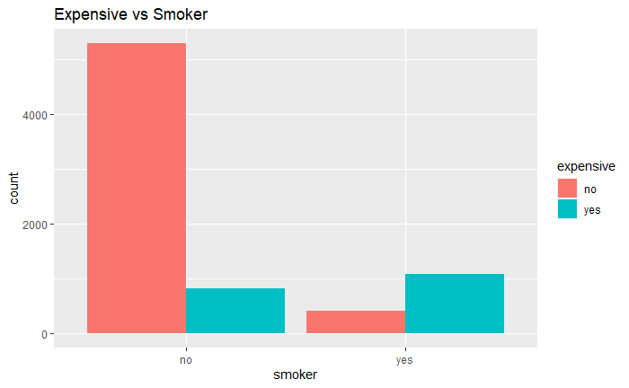
INSIGHTS & RECOMMENDATIONS
INSIGHTS
(<BMI) + (<AGE) + (<SMOKER) + (>EXERCISE) = < Health Cost

Slide 13
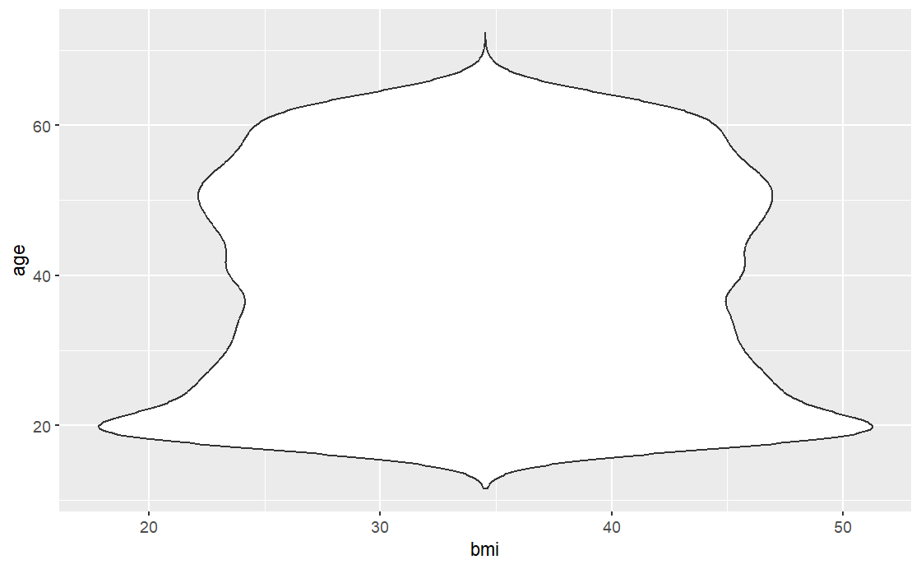
INSIGHTS & RECOMMENDATIONS
Specific Business Recommendation
To HMO:
Focus on people in their early 20s and 50s
Prioritize states where current health costs are the highest (New York and Massachusetts)
Encourage and support active lifestyle initiatives and programs
Fight against smoking habits
Notes:
Start focussing on states with high health cost - New York, Massachusetts
Focus on people aged above 40
Develop and launch programs that reduces smoking habits and encourages exercise and healthy eating by partnering with fitness providers

Slide 14


INSIGHTS & RECOMMENDATIONS
General Recommendation:
The only thing we can’t change: AGE
What can we change?
Smoking habits, Exercising Routine,
Eating Healthy
Notes:
Start focussing on states with high health cost - New York, Massachusetts
Focus on people aged above 40
Develop and launch programs that reduces smoking habits and encourages exercise and healthy eating by partnering with fitness providers

Slide 15
THANK YOU

