Slide 1



Random Variable and Distributions
G. Narahari Sastry
CSIR-North East Institute of Science and Technology
Jorhat, Assam
Indian Institute of Technology Hyderabad
(15th – 29th November, 2022)

Slide 2
Contents
Random Variable
Probability Density Function
Central Limit Theorem
Bayes Theorem

Slide 3
Understanding of “Randomness”
A phenomenon in which the outcome of a single repetition is uncertain, but there is a regular distribution of relative frequencies in a large number of repetitions.
Gregory Chaitin depicts randomness as a - “n-bit string that has maximum or near
maximum complexity or whose complexity is approximately equal to the maximum
complexity of any n-bit string”
Three types of number sequences proves adequate as the “random numbers” -
True-random number sequence
Pseudo-random number sequence
Quasi-random number sequence
True-random number sequence
A true random number generator uses entropy sources that already exist instead of inventing them.
Real word events such as coin flips have a high degree of entropy, because it is almost impossible to accurately predict what the end result will be
It is the source of entropy that makes a true random number generator unpredictable.
Statistics
Notes:
References:
1. Probability and Statistics The Science of Uncertainty, Second Edition Michael J. Evans and Jeffrey S. Rosenthal University of Toronto
2. Warnock, T. (1987). Random-number generators. Los Alamos Science, 15(1987), 137-141.

Slide 4
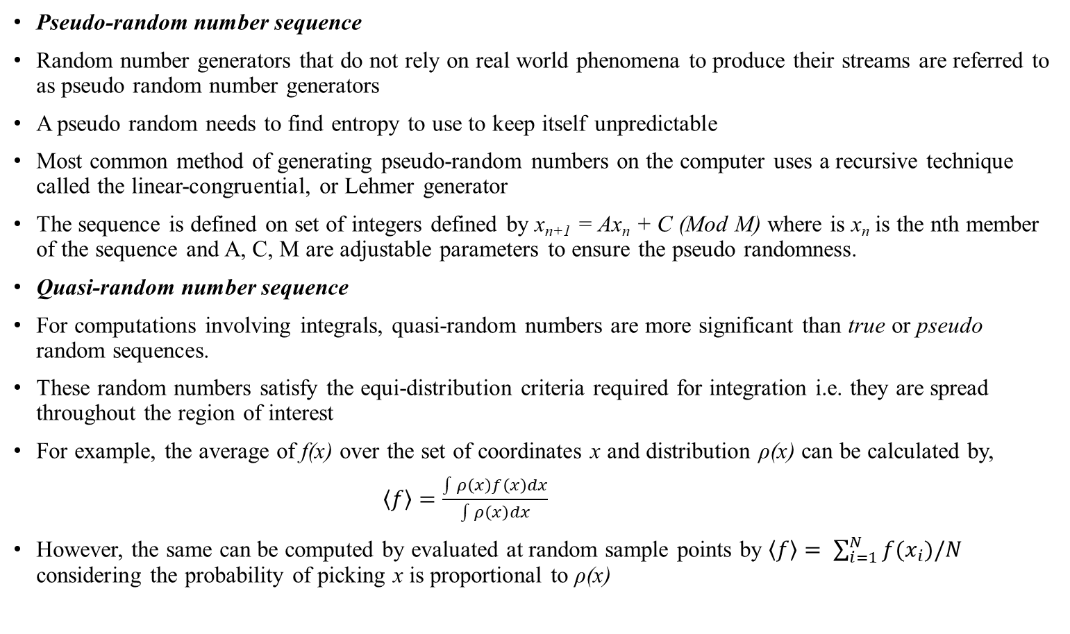
Understanding of “Randomness”
Pseudo-random number sequence
Random number generators that do not rely on real world phenomena to produce their streams are referred to as pseudo random number generators
A pseudo random needs to find entropy to use to keep itself unpredictable
Most common method of generating pseudo-random numbers on the computer uses a recursive technique called the linear-congruential, or Lehmer generator
The sequence is defined on set of integers defined by x_{n+1} = Ax_{n} + C (Mod M) where is x_{n} is the nth member of the sequence and A, C, M are adjustable parameters to ensure the pseudo randomness.
Quasi-random number sequence
For computations involving integrals, quasi-random numbers are more significant than true or pseudo random sequences.
These random numbers satisfy the equi-distribution criteria required for integration i.e. they are spread throughout the region of interest
For example, the average of f(x) over the set of coordinates x and distribution ρ(x) can be calculated by,
$\left\langle f\right\rangle =\frac{\int{ρ\left(x\right)f\left(x\right)dx}}{\int{ρ\left(x\right)dx}}$
However, the same can be computed by evaluated at random sample points by $\left\langle f\right\rangle = \sum_{i=1}^{N}{f(x_{i})/N}$ considering the probability of picking x is proportional to ρ(x)
Notes:
Reference :
1. Warnock, T. (1987). Random-number generators. Los Alamos Science, 15(1987), 137-141.

Slide 5
Generating Random Sequences
Linear Congruential Method
- Most commonly used generator for pseudorandom numbers
x_{n} = (ax_{n-1} + b) mod m
m: modulus, a: multiplier & b: additive constant
- Period: max period: 2^{m}-1 and m is usually chosen to be either prime of a power-of-two
Shift-Register Generators
- based on the following recursion
- a_{i} and x_{i} are either 0 or 1
Lagged-Fibonacci Generators (LFG)
- Additive Lagged-Fibonacci Generators
- Multiplicative Lagged-Fibonacci Generators
- LFG has a much longer period than LCGs (2^{k}-1)2^{m-1}
Notes:
Reference:
1. Dutang, Christophe, and Diethelm Wuertz. "A note on random number generation." Overview of Random Generation Algorithms 2 (2009).

Slide 6
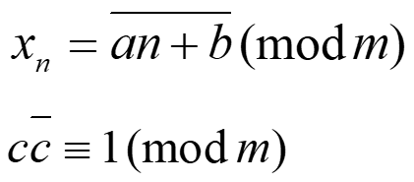

Generating Random Sequences
Inversive Congruential Generators (ICGs)
- Recursive ICGs
- Explicit ICGs
Combined Generators
- Combining different recurrences can increase the period length
- Improve the structural properties of pseudorandom generators
- Construct a new random sequence
- where can be exclusive-or operator, addition modulo or addition of floating-point random numbers modulo 1
Random Choices from a Finite Set
- A random integer X between 0 and k-1
- U is a random number uniformly distributed in [0,1)
Notes:
Reference:
1. Dutang, Christophe, and Diethelm Wuertz. "A note on random number generation." Overview of Random Generation Algorithms 2 (2009).

Slide 7
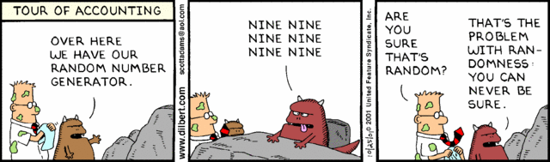
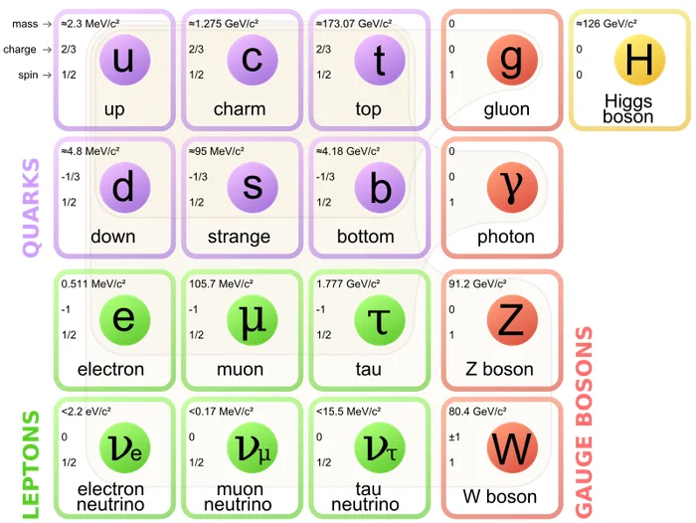

How random is “random”?
Randomness is an “elusive” concept
Anything that is not predictable is actually random
The outcome of dice was seemingly random till 2012 when
*researchers from Poland and Scotland could predict he outcome considering air viscosity, table friction and
acceleration of gravity
The radioactive decay of an atom, which according to Quantum theory is impossible to predict is “random”
The world is made of 12 fundamental particles and interact in 4 predictable ways, if position and velocity of each of these can be determined, then there will be nothing will be unpredictable and hence there will be no “random” left in the universe. If this happens then, as Laplace said – “The future, like the past would be present before us”
Source: https://www.dilbert.com/
Notes:
Reference:
Kapitaniak, Marcin, et al. "The three-dimensional dynamics of the die throw." Chaos: An Interdisciplinary Journal of Nonlinear Science 22.4 (2012): 047504.

Slide 8
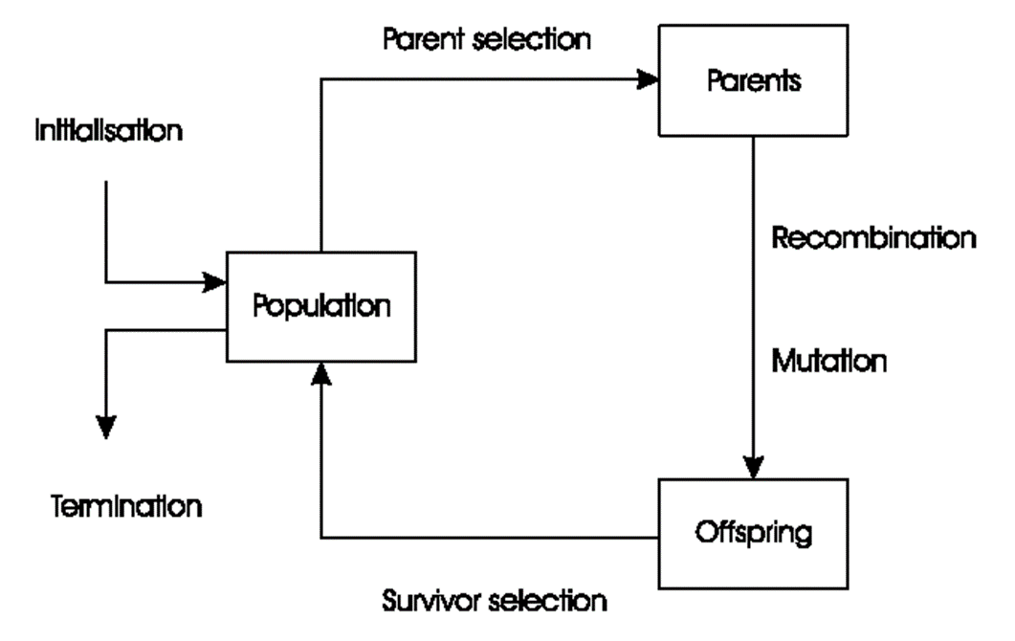
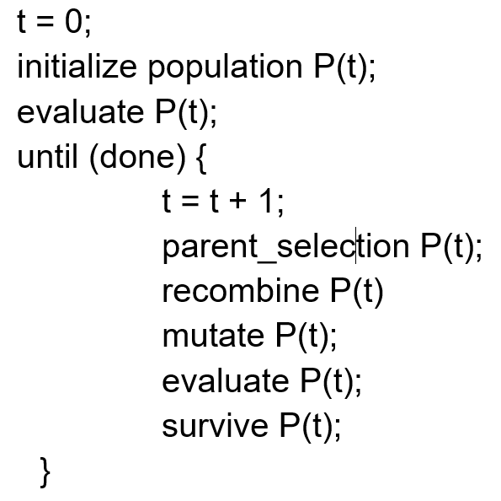
Evolutionary Computing
Random selection of initial population is one of the common aspects
in any evolutionary computing algorithm
Genetic algorithm is one such example where the initial population
is selected using any random techniques
Global Optimization: search for finding best solution x* out of some fixed set S
Deterministic approaches
- e.g. box decomposition (branch and bound etc)
- Guarantee to find x* , but may run in super-polynomial time
Heuristic approaches (generate and test)
- rules for deciding which x ϵ S to generate next
- no guarantees that best solutions found are globally optimal

Slide 9
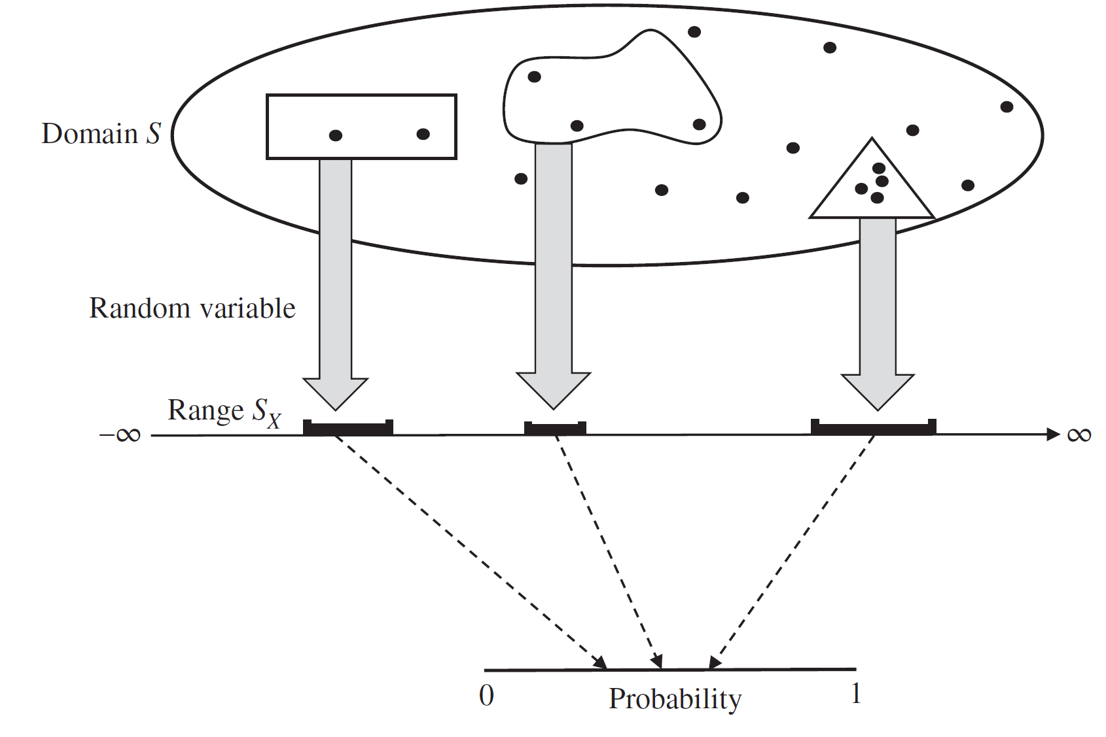
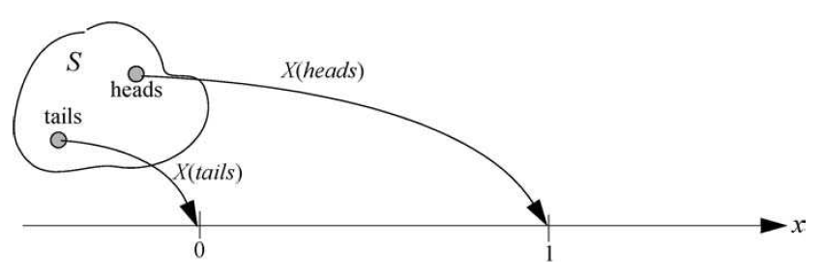
Concept of Random Variables
In mathematics, a variable is an entity whose value or meaning can change, causing the evaluation of an expression to change
The term random variable is a misleading nomenclature, as it is not random nor is it a variable
Definition - A random variable X is a deterministic function that assigns a real number to each outcome in the sample space S, i.e. a mapping from the sample space to the set of real numbers R, X : S→R
The sample space S is the domain of the random variable and the set of all values taken on by the random variable, denoted by S_{X}, is the range of the random variable.
The range S_{X} is a subset of all real numbers (−∞,∞).
For example - A coin-tossing experiment has two sample points: heads and
tails. Thus, we may define the random variable X associated with the experiment
as follows: X(heads) = 1 X(tails) = 0
Two random variables are said to be equal if and only if the probability of the set of points in the sample space on which they differ has zero probability
Notes:
Reference:
Probability, Random Variables, Statistics, and Random Processes Fundamentals & Applications, Ali Grami
Probability, Statistics, and Stochastic Processes, Peter Olofsson and Mikael Andersson, Wiley

Slide 10
Events defined by Random Variables
Let X be a random variable and x be a fixed real value.
The event A_{x} define the subset of S that consists of all real sample points to which the random variable X assigns the number x.
A_{x} = {w | X(w) = x} = [X = x]
Since A_{x} is an event, it will have a probability, which we define as follows:
p = P[A_{x}]
Example –
Consider an experiment in which a fair coin is tossed twice. The sample space consists of four equally likely sample points: S = {HH,HT,TH,TT}. Let X denote the random variable that counts the number of heads in each sample point. Thus X has the range {0, 1, 2}.
If we consider [X ≤ 1], which is the event that the number of heads is at most 1, we obtain
[X ≤ 1] = {TT, TH, HT} &
P[X ≤ 1] = P[TT] + (P[TH] + P[HT])
= P[X = 0] + P[X = 1]
= (1/4 + 1/2) = 3/4
Notes:
Reference:
1. Probability, Random Variables, Statistics, and Random Processes Fundamentals & Applications, Ali Grami

Slide 11
Types of Random Variables
There are fundamentally two distinct types of random variables:
- discrete random variables and continuous random variables.
Discrete random variable - the range of the random variable assumes values from a countable set
Continuous random variable - the range can take infinitely many real values, it is then a.
There are random variables that are neither discrete nor continuous, but are a mixture of both.
A mixed random variable has a range with both continuous and discrete parts i.e. the range of a
mixed random variable has at least one value with nonzero probability as well as values that
include at least one interval of real numbers.
Randomly selecting a nonnegative integer out of a countably infinite list, i.e. {0, 1, 2, …}, is an example of a discrete random variable, whereas randomly selecting a nonnegative real number out of an uncountable infinite list, i.e. [0, ∞), is an example of a continuous random variable
Notes:
Reference:
Probability, Random Variables, Statistics, and Random Processes Fundamentals & Applications, Ali Grami
Notes:
The defining characteristic of a discrete random variable is that the set of possible values in the range can all be listed, where it may be a finite list or a countably infinite list.
The determining feature of a continuous random variable is that the set of possible values in the range cannot all be enumerated, as it is an uncountable infinite list.

Slide 12

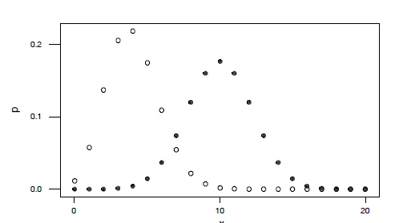

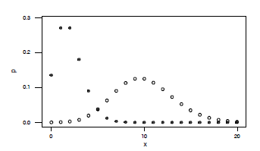
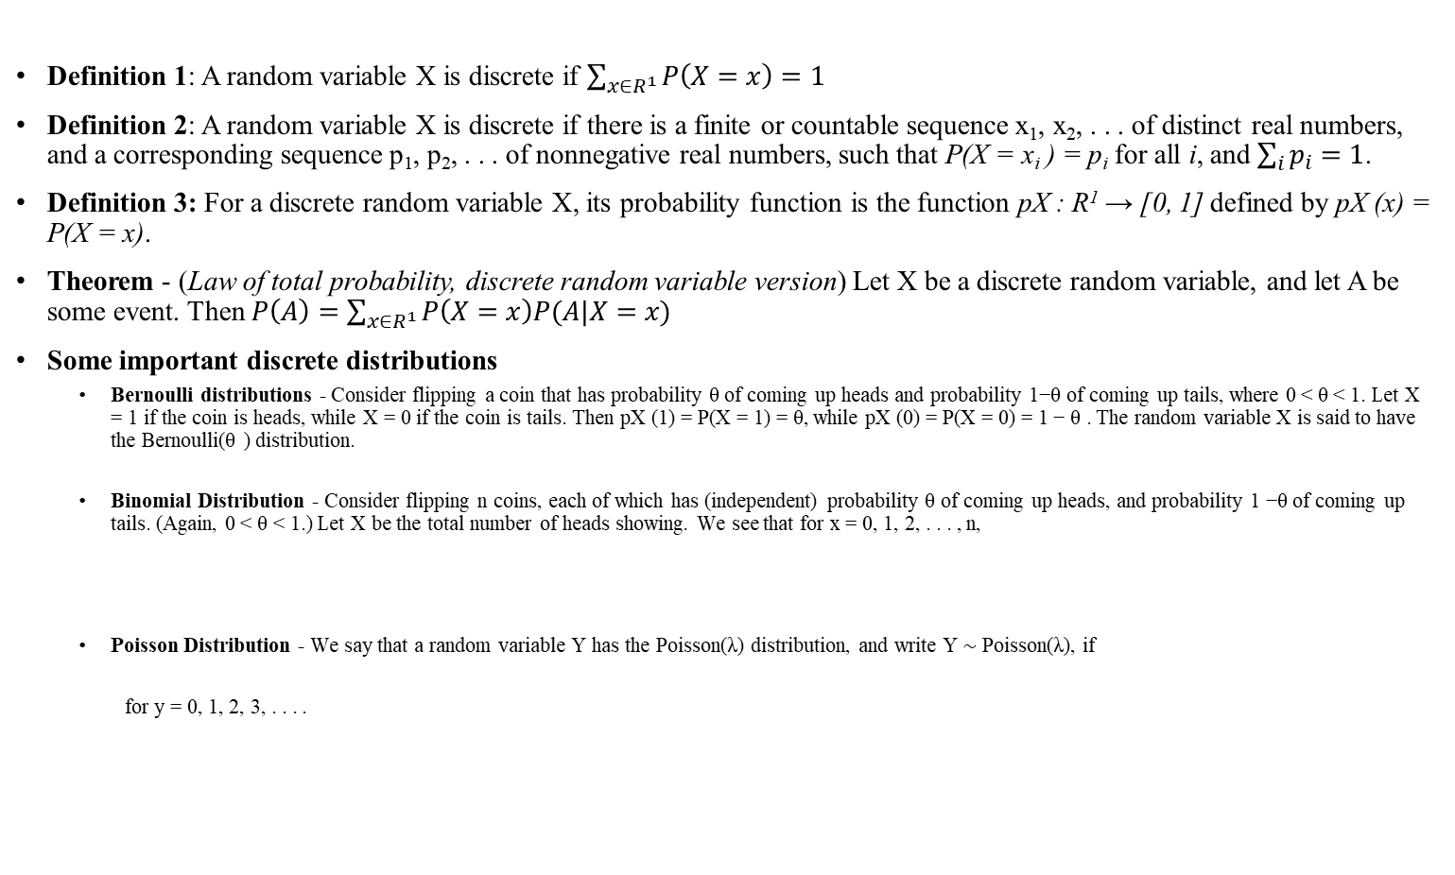
Defining Discrete Random Variables
Definition 1: A random variable X is discrete if $\sum_{{x∈R}^{1}}{P\left(X=x\right)=1}$
Definition 2: A random variable X is discrete if there is a finite or countable sequence x₁, x₂, . . . of distinct real numbers, and a corresponding sequence p₁, p₂, . . . of nonnegative real numbers, such that P(X = x_{i} ) = p_{i} for all i, and $\sum_{i}{p_{i}=1}$.
Definition 3: For a discrete random variable X, its probability function is the function pX : R¹ → [0, 1] defined by pX (x) = P(X = x).
Theorem - (Law of total probability, discrete random variable version) Let X be a discrete random variable, and let A be some event. Then $P\left(A\right)=\sum_{{x∈R}^{1}}{P\left(X=x\right)P(A|X=x)}$
Some important discrete distributions
Bernoulli distributions - Consider flipping a coin that has probability θ of coming up heads and probability 1−θ of coming up tails, where 0 < θ < 1. Let X = 1 if the coin is heads, while X = 0 if the coin is tails. Then pX (1) = P(X = 1) = θ, while pX (0) = P(X = 0) = 1 − θ . The random variable X is said to have the Bernoulli(θ ) distribution.
Binomial Distribution - Consider flipping n coins, each of which has (independent) probability θ of coming up heads, and probability 1 −θ of coming up tails. (Again, 0 < θ < 1.) Let X be the total number of heads showing. We see that for x = 0, 1, 2, . . . , n,
Poisson Distribution - We say that a random variable Y has the Poisson(λ) distribution, and write Y ∼ Poisson(λ), if
for y = 0, 1, 2, 3, . . . .
Binomial distribution
Poisson distribution
Notes:
References:
1. Probability and Statistics The Science of Uncertainty, Second Edition Michael J. Evans and Jeffrey S. Rosenthal University of Toronto

Slide 13
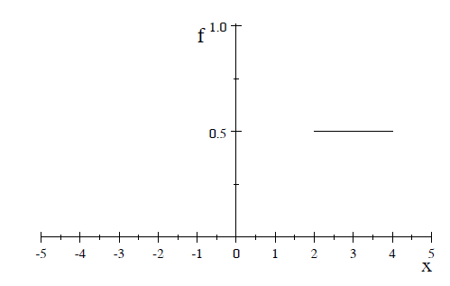


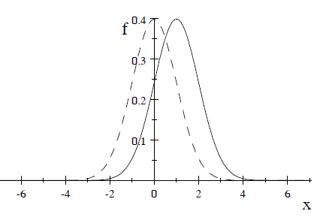

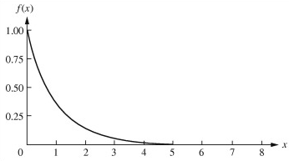

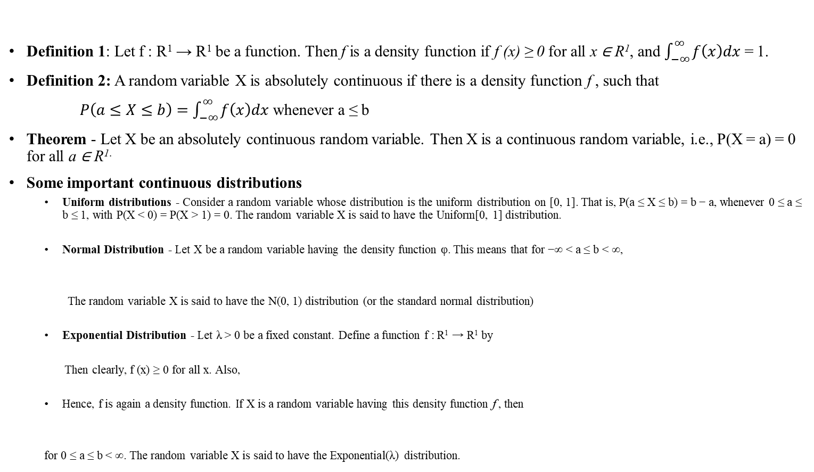
Defining Continuous Random Variables
Definition 1: Let f : R¹ → R¹ be a function. Then f is a density function if f (x) ≥ 0 for all x ∈ R¹, and $\int_{−∞}^{∞}{f\left(x\right)dx}$ = 1.
Definition 2: A random variable X is absolutely continuous if there is a density function f , such that
$P\left(a≤X≤b\right)=\int_{−∞}^{∞}{f\left(x\right)dx}$ whenever a ≤ b
Theorem - Let X be an absolutely continuous random variable. Then X is a continuous random variable, i.e., P(X = a) = 0 for all a ∈ R^{1.}
Some important continuous distributions
Uniform distributions - Consider a random variable whose distribution is the uniform distribution on [0, 1]. That is, P(a ≤ X ≤ b) = b − a, whenever 0 ≤ a ≤ b ≤ 1, with P(X < 0) = P(X > 1) = 0. The random variable X is said to have the Uniform[0, 1] distribution.
Normal Distribution - Let X be a random variable having the density function φ. This means that for −∞ < a ≤ b < ∞,
The random variable X is said to have the N(0, 1) distribution (or the standard normal distribution)
Exponential Distribution - Let λ > 0 be a fixed constant. Define a function f : R¹ → R¹ by
Then clearly, f (x) ≥ 0 for all x. Also,
Hence, f is again a density function. If X is a random variable having this density function f , then
for 0 ≤ a ≤ b < ∞. The random variable X is said to have the Exponential(λ) distribution.
Uniform distribution
Normal distribution
Exponential distribution
Notes:
References:
1. Probability and Statistics The Science of Uncertainty, Second Edition Michael J. Evans and Jeffrey S. Rosenthal University of Toronto

Slide 14
Bibliography
Evans, Michael J., and Jeffrey S. Rosenthal. Probability and statistics: The science of uncertainty. Macmillan, 2004.
Grami, Ali. Probability, random variables, statistics, and random processes: Fundamentals & applications. John Wiley & Sons, 2019.
Olofsson, Peter, and Mikael Andersson. Probability, statistics, and stochastic processes. John Wiley & Sons, 2012.
Warnock, T. (1987). Random-number generators. Los Alamos Science, 15 (1987), 137-141.
Notes:
References:
1. Probability and Statistics The Science of Uncertainty, Second Edition Michael J. Evans and Jeffrey S. Rosenthal University of Toronto

