Slide 2
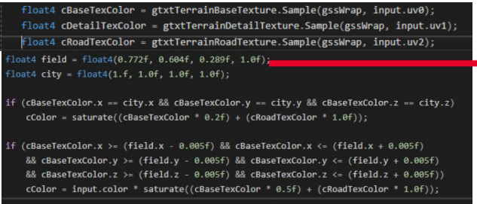
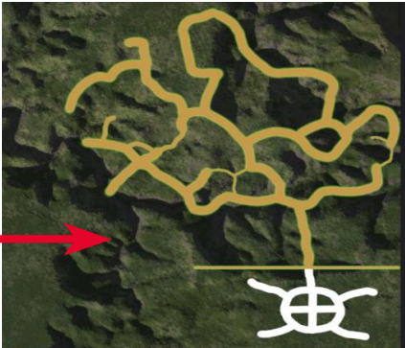
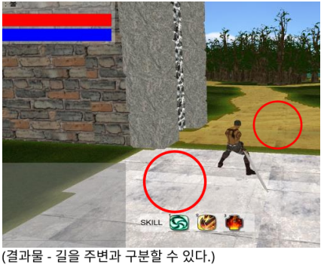
간단한 텍스쳐 수정을 통한 보도 블록과 흙길 표현
(u, v)
City Color?
Screen
Base Texture
yes
대체
Load Texture
no
Field Color?
yes
Field Texture
블렌딩
no
Detail Texture
블렌딩

Slide 3
case OP_ACCEPT: {
SOCKET c_socket = reinterpret_cast<SOCKET>(ex_over->wsabuf.buf);
int client_id = get_new_client_id();
if (client_id != -1) {
clients[client_id].x_pos = 0.0;
clients[client_id].y_pos = 0.0;
clients[client_id].z_pos = 0.0;
clients[client_id].id = client_id;
clients[client_id].name[0] = 0;
clients[client_id].remain_size = 0;
clients[client_id].socket = c_socket;
CreateIoCompletionPort(reinterpret_cast<HANDLE>(c_socket), g_h_iocp, client_id, 0);
clients[client_id].do_recv();
c_socket = WSASocket(AF_INET, SOCK_STREAM, 0, NULL, 0, WSA_FLAG_OVERLAPPED);
}
else {
cout << "Sever is Full" << endl;

