Slide 1
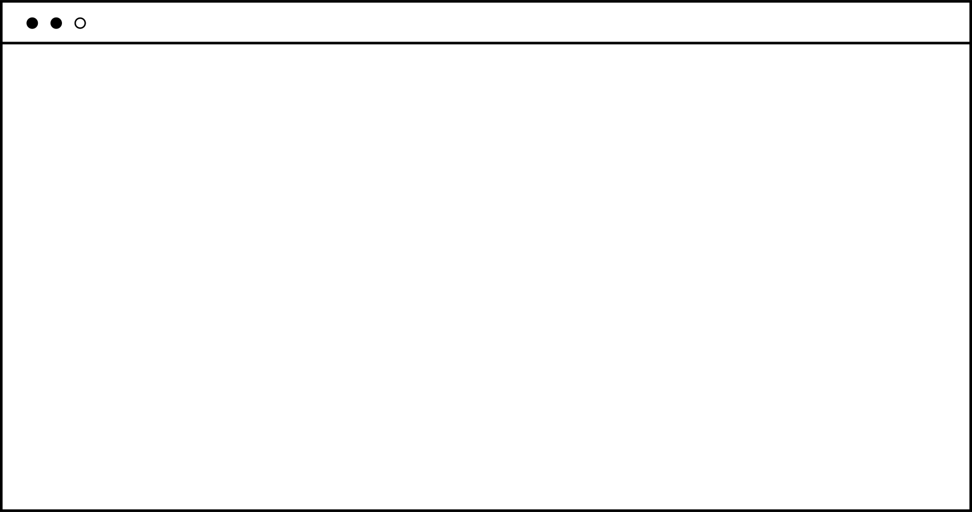





Slide 2



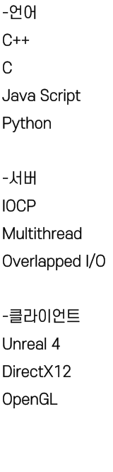



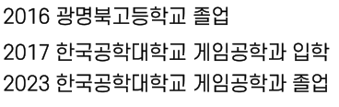


C++11

Slide 3











Slide 4





Slide 5


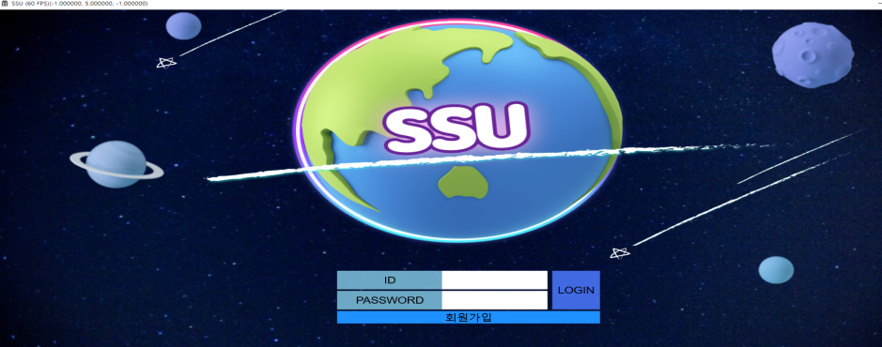
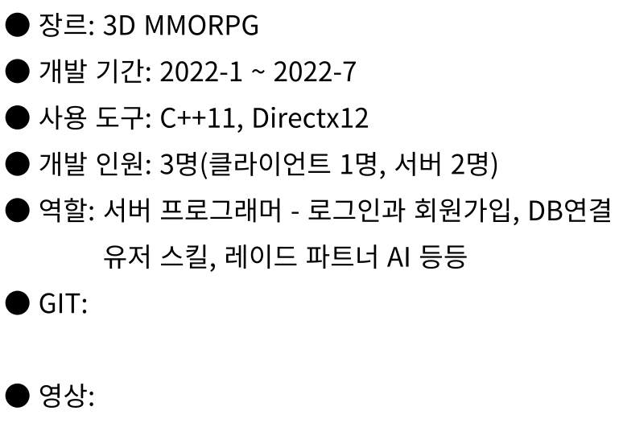


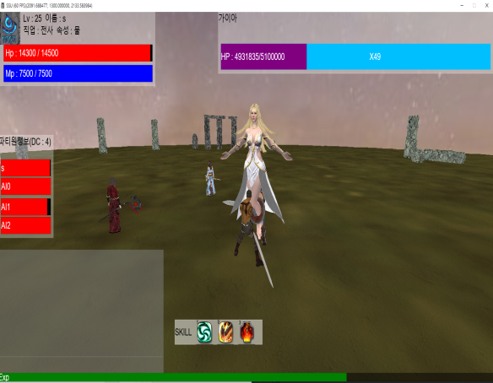
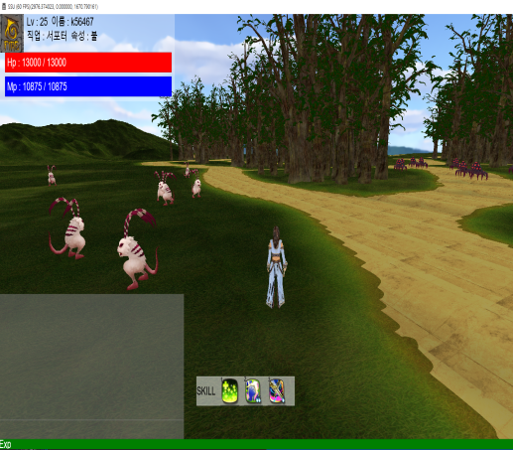
https://github.com/uibeom/SSU_Project
https://youtu.be/fhhUwBnLrzw

Slide 6


ALTER PROCEDURE [dbo].[Search_PLAYER] @Param1 NCHAR(10), @Param2NCHAR(10)
AS
BEGIN
SET NOCOUNT ON;
SELECT player_id, player_password, player_name, player_x, player_y,
player_z, player_hp, player_level, player_exp, player_maxhp,
player_job, player_mp, player_maxmp, player_element
FROM SSU_Table WHERE player_id = @Param1 AND player_password = @Param2
END
ALTER PROCEDURE [dbo].[Add_UserData] @Param0 NCHAR(10), @Param1 NCHAR(10), @Param2 NCHAR(10), @Param3 INT, @Param4 INT, @Param5 INT, @Param6 INT,
@Param7 INT, @Param8 INT, @Param9 INT, @Param10 INT, @Param11 INT,
@Param12 INT, @Param13 INT
AS
IF NOT EXISTS (SELECT player_id FROM SSU_Table WHERE player_id = @Param0)
BEGIN
SET NOCOUNT ON;
INSERT INTO SSU_Table(player_id, player_password, player_name, player_x, player_y, player_z, player_hp, player_level, player_exp, player_maxhp, player_job, player_mp,player_maxmp, player_element)
VALUES(@Param0,@Param1,@Param2,@Param3,@Param4,@Param5,@Param6,@Param7,@Param8, @Param9,@Param10,@Param11,@Param12,@Param13);
END
ELSE
BEGIN
RETURN @@ERROR;
END
ALTER PROCEDURE [dbo].[save_player_info] @Param0 NCHAR(10), @Param1 INT,
@Param2 INT, @Param3 INT,@Param4 INT,@Param5 INT, @Param6 INT,
@Param7 INT,@Param8 INT,@Param9 INT
AS
BEGIN
SET NOCOUNT ON;
UPDATE SSU_Table Set player_x = @Param1, player_y = @Param2,
player_z = @Param3, player_hp = @Param4, player_level = @Param5,
player_exp = @Param6,player_maxhp = @Param7,player_mp = @Param8,
player_maxmp = @Param9
FROM SSU_Table WHERE player_id = @param0;
END

Slide 7

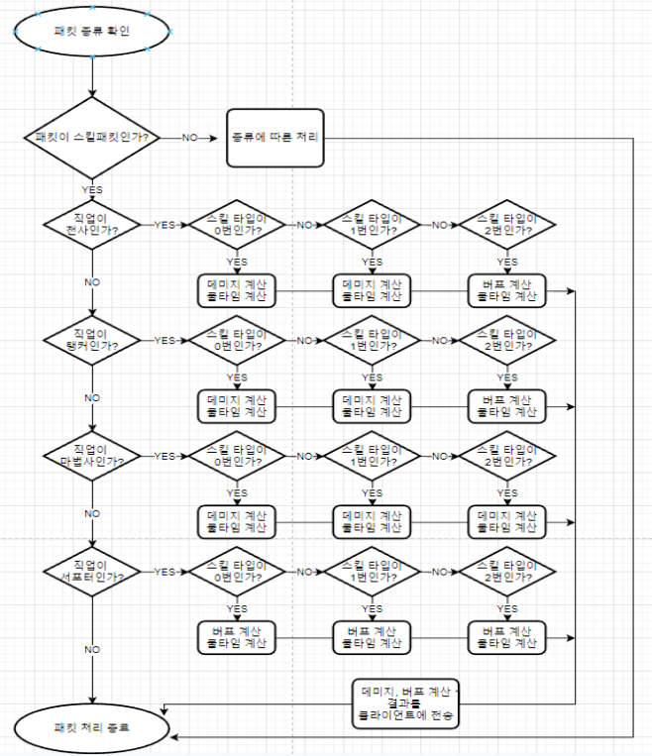
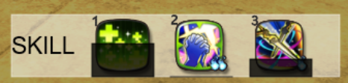
case J_TANKER: {
switch ((int)packet->skill_type)
{
case 0: // 물리 공격 스킬
switch ((int)packet->skill_num)
{
case 0: //밀어내기
skill_cooltime(client_id, chrono::system_clock::now() + 3s, 0);
pl->set_mp(pl->get_mp() - pl->get_lv() * 10);
send_status_change_packet(pl);
if (!pl->join_dungeon_room) {
for (int i = NPC_ID_START; i <= NPC_ID_END; ++i) {
players[i]->state_lock.lock();
if (players[i]->get_state() != ST_INGAME) {
players[i]->state_lock.unlock();
continue;
}
players[i]->state_lock.unlock();
if ((players[i]->get_x() >= pl->get_x() - 15 && players[i]->get_x() <= pl->get_x() + 15) && (players[i]->get_z() >= pl->get_z() - 15 && players[i]->get_z() <= pl->get_z() + 15)) {
pl->set_skill_factor(packet->skill_type, packet->skill_num);
pl->phisical_skill_success(players[i], pl->get_skill_factor(packet->skill_type, packet->skill_num));
players[i]->set_pos(players[i]->get_x() + pl->get_look_x() * 40, players[i]->get_z() + pl->get_look_z() * 40);
players[i]->state_lock.lock();
if (players[i]->get_state() == ST_DEAD) {
players[i]->state_lock.unlock();
m_SectorManager->player_remove(players[i], true, players[client_id]);
}
else {
players[i]->state_lock.unlock();
}
send_move_packet(pl, players[i], 1);
players[i]->set_target_id(pl->get_id());
if (players[i]->get_active() == false && players[i]->get_tribe() == MONSTER) {
players[i]->set_active(true);
timer_event ev;
ev.obj_id = i;
ev.start_time = chrono::system_clock::now() + 3s;
ev.ev = EVENT_NPC_ATTACK;
ev.target_id = players[i]->get_target_id();
TimerManager::timer_queue.push(ev);
players[i]->push_npc_move_event();
}
}
}
}

Slide 8

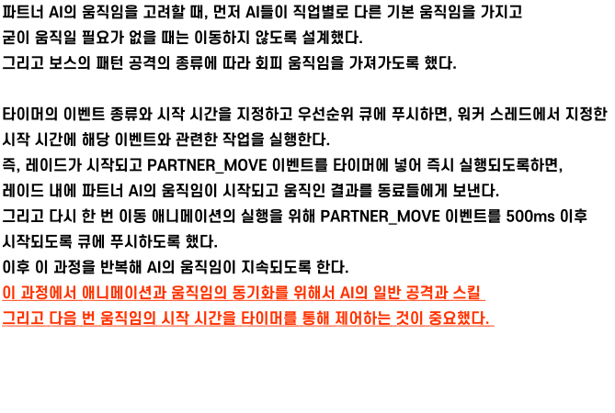
case J_TANKER: {
if (gaia->running_pattern == false) { //보스 패턴을 실행 안하면 가까이
if (sqrt(pow((gaia->get_x() - pa->get_x()), 2) + pow((gaia->get_z() - pa->get_z()), 2)) < 10.0f) return;
target_id = gaia->get_dungeon_id();
pos mv = pa->non_a_star(gaia->boss->get_x(), gaia->boss->get_z(), pa->get_x(), pa->get_z());
if (static_ObjectManager::get_objManger()->check_move_alright_indun(mv.first, mv.second)) pa->set_x(mv.first); pa->set_z(mv.second);
}
else if (gaia->running_pattern == true) { //보스가 패턴을 쓸 때, 패턴의 번호를 받아서 피할 수 있도록 하자
switch (gaia->pattern_num) {
case 0:
dis = 0;
for (int i = 0; i < 4; i++) {
int x = gaia->pattern_one_position[i].first;
int z = gaia->pattern_one_position[i].second;
if (dis < sqrt((pa->get_x() - x) * (pa->get_x() - x) + (pa->get_z() - z) * (pa->get_z() - z))){
dis = sqrt((pa->get_x() - x) * (pa->get_x() - x) + (pa->get_z() - z) * (pa->get_z() - z));
nearest_num = i;
}
}
move = pa->non_a_star(gaia->pattern_one_position[nearest_num].first + 30, gaia->pattern_one_position[nearest_num].second, pa->get_x(), pa->get_z());
if (static_ObjectManager::get_objManger()->check_move_alright_indun(move.first, move.second)) pa->set_x(move.first); pa->set_z(move.second);
break;
case 1:
dis = 0;
for (int i = 0; i < 2; i++) {
int x = gaia->pattern_two_safe_zone[i].first;
int z = gaia->pattern_two_safe_zone[i].second;
if (i == 0) dis = sqrt((pa->get_x() - x) * (pa->get_x() - x) + (pa->get_z() - z) * (pa->get_z() - z));
else {
if (dis > sqrt((pa->get_x() - x) * (pa->get_x() - x) + (pa->get_z() - z) * (pa->get_z() - z))) {
dis = sqrt((pa->get_x() - x) * (pa->get_x() - x) + (pa->get_z() - z) * (pa->get_z() - z));
nearest_num = i;
}
}
}
move = pa->non_a_star(gaia->pattern_two_safe_zone[nearest_num].first, gaia->pattern_two_safe_zone[nearest_num].second, pa->get_x(), pa->get_z());
if (static_ObjectManager::get_objManger()->check_move_alright_indun(move.first, move.second)) pa->set_x(move.first); pa->set_z(move.second);
break;
case 4:
move = pa->non_a_star(gaia->boss->get_look_x() + gaia->boss->get_right_x() * 30, gaia->boss->get_look_z() + gaia->boss->get_right_z() * 30,
pa->get_x(), pa->get_z());
if (static_ObjectManager::get_objManger()->check_move_alright_indun(move.first, move.second)) pa->set_x(move.first); pa->set_z(move.second);
break;

Slide 9

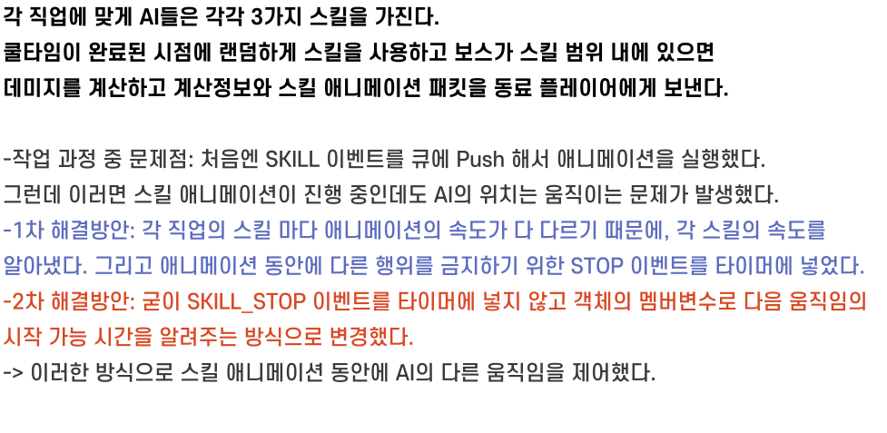
case 2: { //방어력 증가
skill_check = true;
pa->set_mp(pa->get_mp() - 1000);
pa->set_physical_defence(0.54 * pa->get_lv() * pa->get_lv() + 10 * pa->get_lv());
pa->set_magical_defence(0.4 * pa->get_lv() * pa->get_lv() + 10 * pa->get_lv());
ev.obj_id = _id;
ev.start_time = chrono::system_clock::now() + 5s; //쿨타임
ev.ev = EVENT_PARTNER_SKILL;
ev.target_id = _id;
TimerManager::timer_queue.push(ev);
start_skill[0] = chrono::system_clock::now();
running_pattern = true;
break;
}
default:
break;
}
if (skill_check) {
for (int i = 0; i < GAIA_ROOM; i++) {
if (party_player[i]->get_tribe() == HUMAN)
send_animation_skill(party_player[i], pa->get_id(), p);
}
skill_check = false;
}
break;
}

Slide 10



Slide 11


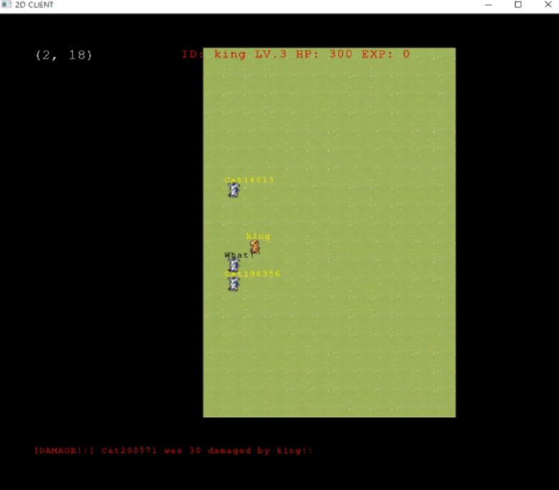
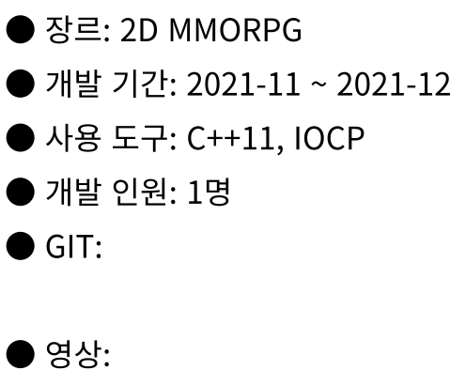
https://github.com/uibeom/GameServerProgramming
https://youtu.be/WDhXNJ-Ovcw

Slide 12
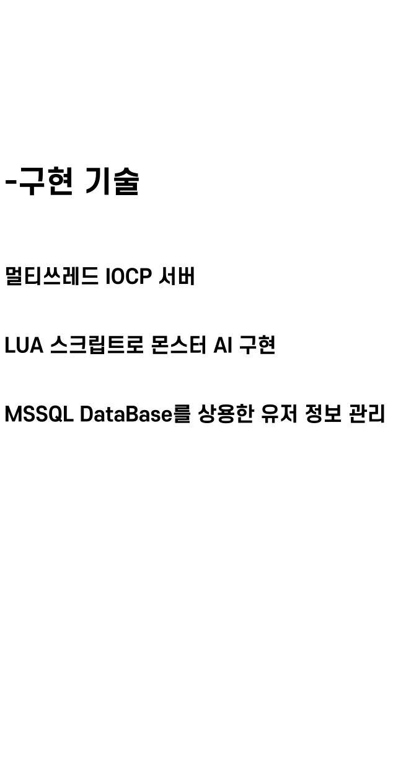


Slide 13

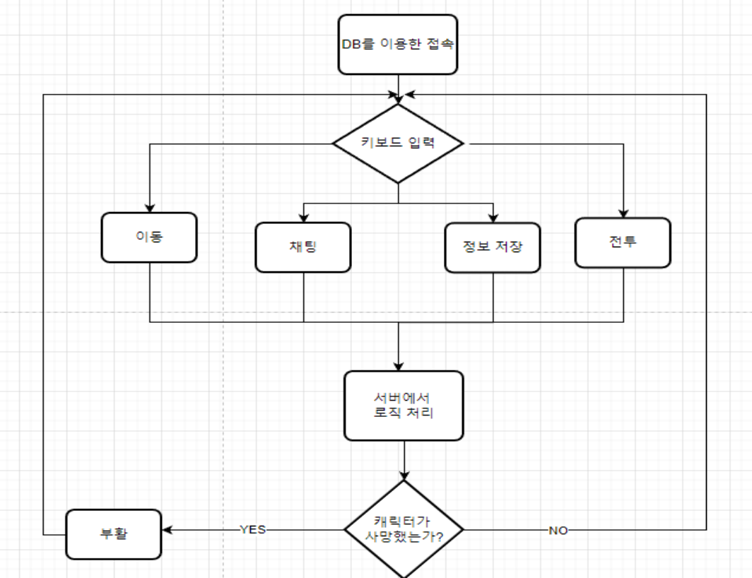
클라이어트에서 패킷 전송

Slide 14
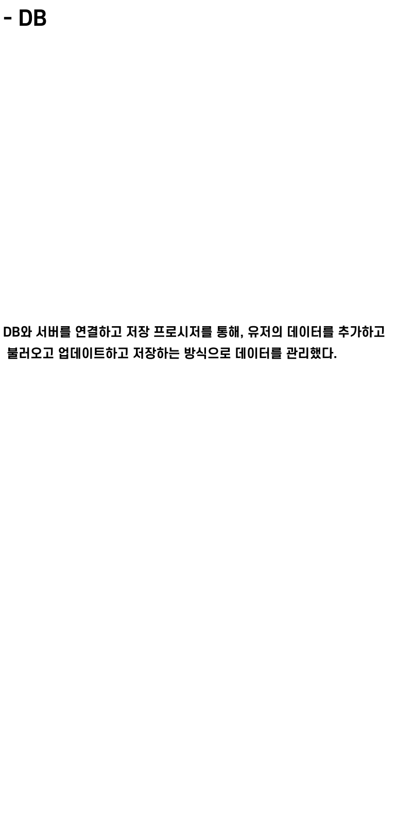

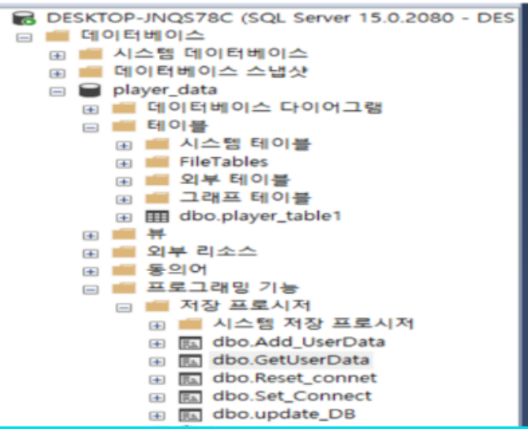

myid = 99999;
escape = 3;
function set_uid(x)
myid = x;
end
function event_player_move(player)
player_x = API_get_x(player);
player_y = API_get_y(player);
my_x = API_get_x(myid);
my_y = API_get_y(myid);
if (player_x == my_x) then
if (player_y == my_y) then
escape = 3;
API_SendMessage(myid, player, "KILL!!");
end
end
end
function event_npc_escape(player)
if (escape > 0) then
escape = escape - 1;
return 0;
else
API_SendMessage(myid, player, "ESCAPE!!");
return 1;
end
end
function npc_data()
name = "Cat";
maxhp = 100;
hp = 100;
level = 1;
return name, maxhp, hp, level;
end

Slide 15

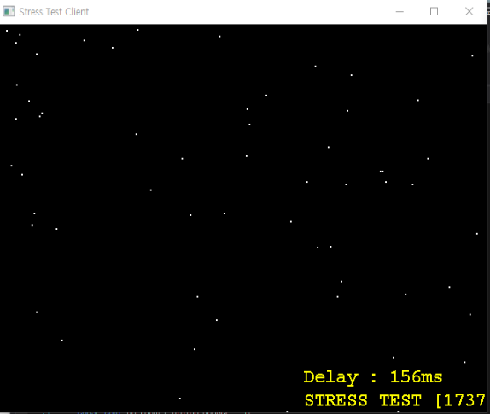
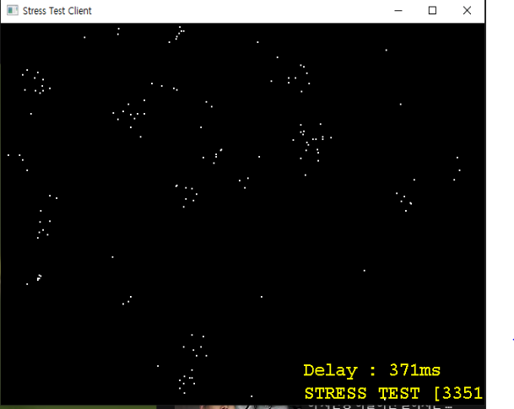

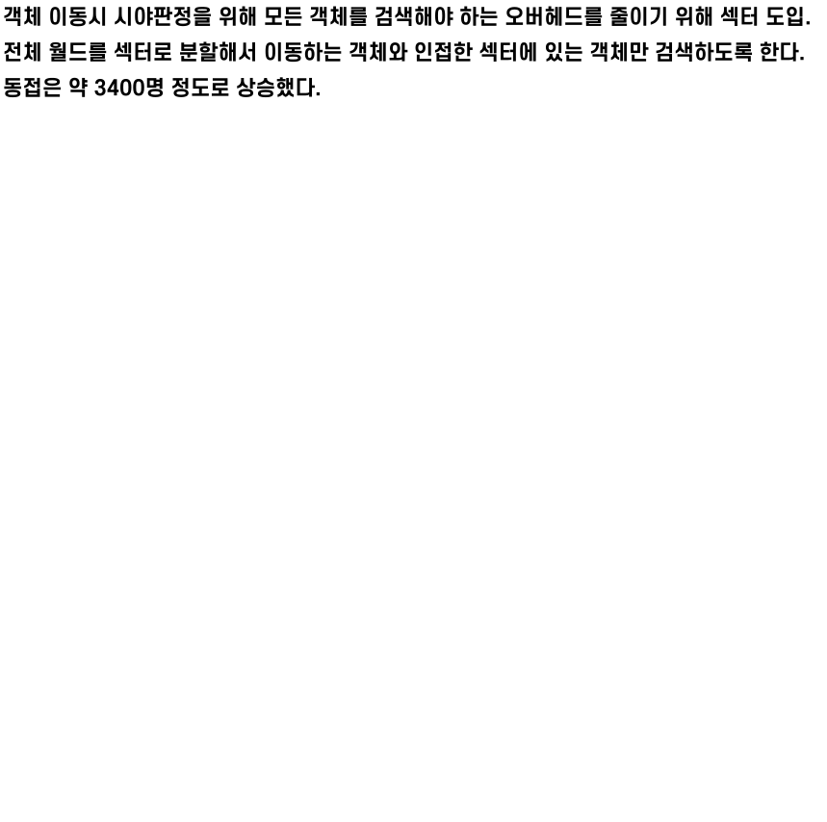

Slide 16



Slide 17


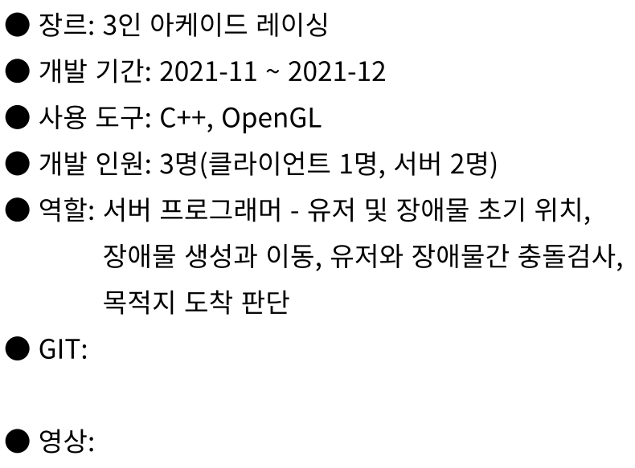
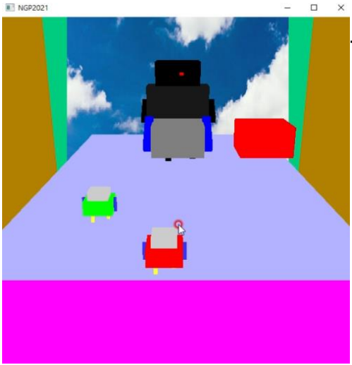
https://github.com/uibeom/NetworkGameProgramming
https://youtube.com/shorts/27nQXO0RWWQ?feature=share

Slide 18

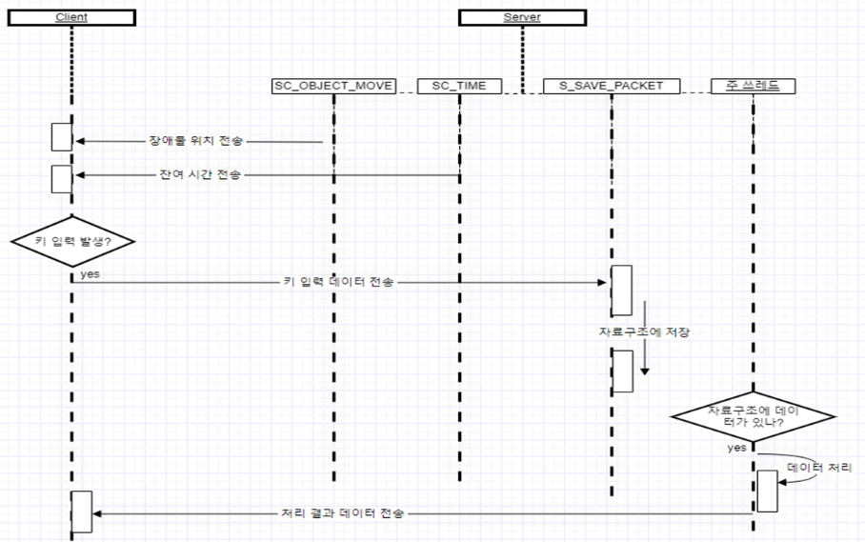
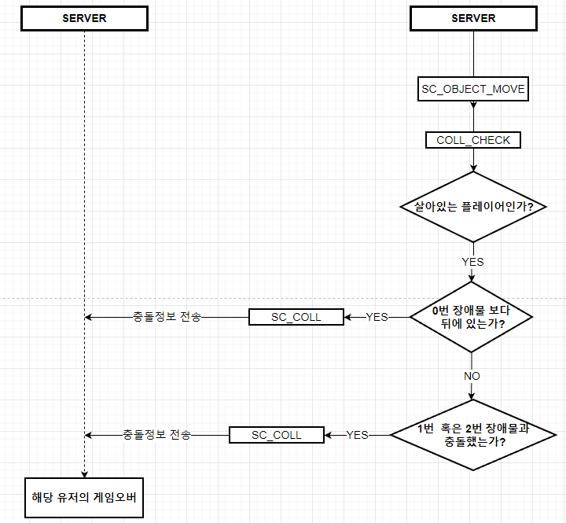
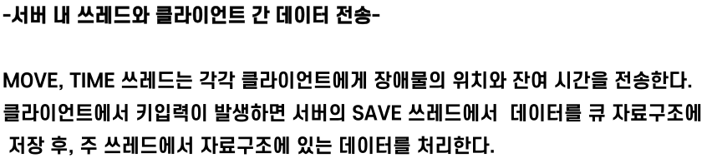
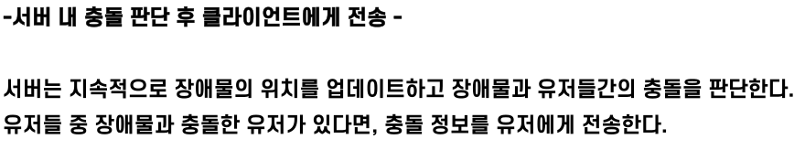
클라이언트

Slide 19



Slide 20

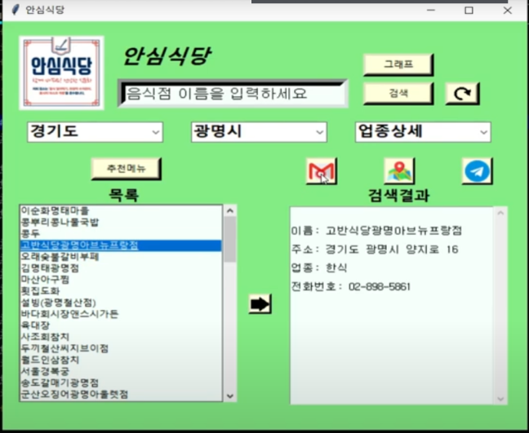
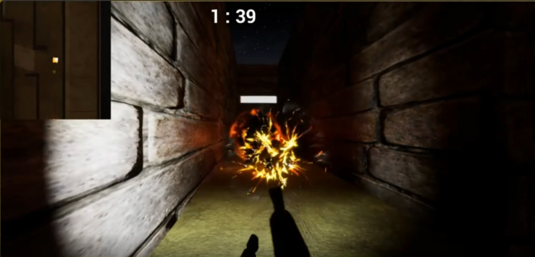


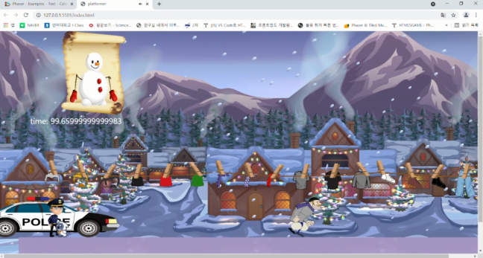
●개발 기간:2021-05~2021-06
●사용도구: Unreal 4
●개발 인원: 1인
https://youtu.be/euCd1OT0KQU
●개발 기간:2021-08~2021-08
●사용도구: Phaser, Spine
●개발 인원: 1인
●개발 기간:2021-05~2021-06
●사용도구: Python
●개발 인원: 2인
●역할: 검색 창, 버튼, 이메일 연동, 그래프, 지도 , 추천메뉴, C언어 연동,
https://github.com/uibeom/2021-HyunJang
https://github.com/uibeom/Script_Language
https://youtu.be/4iTQtCAyl4c
https://youtu.be/yiqiwSpOaDA

