Slide 1

Using MS-DOS DEBUG
Dr. Hadji J. Tejuco

Slide 2

Objectives
At the end of the tutorial you will learn the following.
Define Debug.
Define MS-DOS Debug
Enumerate different MS-DOS debug commands
Write examples using MS-DOS debug

Slide 3
What is Debug
Identify and remove errors from (computer hardware or software).
Debugging is the process of finding and resolving defects or problems within a computer program that prevent correct operation of computer software or a system.

Slide 4
What is MS-DOS Debug
Debug.com
is a debugging utility available in MS-DOS.
can act as an assembler, disassembler, or hex dump program allowing users to interactively examine memory contents (in assembly language, hexadecimal or ASCII), make changes, and selectively execute COM, EXE and other file types.

Slide 5
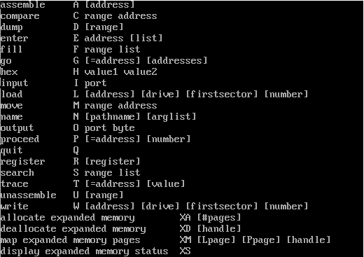
DEBUG Commands
Demo -> MS-DOS

Slide 6
DEBUG Commands
Q – Quit
Finishes the debug session and ends back to the DOS prompt.
H - Hexadecimal
Command that shows the sum and different of two 4 digit hexadecimal numbers. Coded as H <Hex Value> <Hex Value>
A – Assemble
It enables the user to create a program in mnemonics or symbolic code.
It also translate the assembly language code into machine code.

Slide 7
DEBUG Commands
D – Display / Dump
Display the content of the portion of the memory in Hex or in ASCII forms starting with the given address.
G – Go
Instruction used to execute the program as a whole in the memory and displays the result
R - Register
Instructions that allows to displays the content of all the registers and their values.
It also displays the content of the next instruction and permits the user to change the value of a particular register.

Slide 8
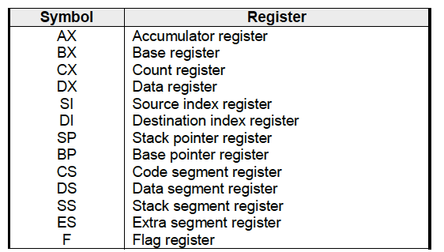
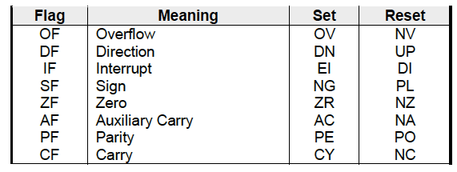
Registers Mnemonics

Slide 10
DEBUG Commands
E - Enter
It enables the user to key in data or machine instruction into the memory at a specific location address.
U - Unassemble
Lists all the instructions contained in the program beginning at the given address.
T - Trace
Instruction that runs the program in a single step mode. It also displays the new value of the register and the next instruction to be executed.

Slide 11
Basic Assembly Application in Debug.com
mov (move data)
Transfers a byte or word from source to destination. The source can be a register, an immediate number, or an address. The destination can be a register or an address.
Format:
mov <register>, <register>
mov <register>,<immediate data>
mov <register>, <memory
mov <memory>, <regs>
mov <memory>, <immediate>
Ex.
mov bl, 10
mov cl, 15
Note: mov <memory>,<memory> not supported

Slide 12
Basic Assembly Application in Debug.com
add (Add data)
Adds a source to a destination. The results is stored in the destination register.
Format:
ADD<register>, <register>
ADD<register>, <immediate data>
Ex.
mov bl, 10
mov cl, 15
add cl, bl

Slide 13
Basic Assembly Application in Debug.com
SUB (subtract data)
Subtracts a source from a destination. The result is stored in the destination register.
Format:
SUB<register>, <register>
SUB<register>, <immediate data>
Ex.
mov bl, 45
mov bh, 30
sub bl,bh

Slide 14
Basic Assembly Application in Debug.com
MUL (multiply)
(byte version) Multiplies AL by a source value. The source can be a register or an address The result will be stored in AX.
(word version) Multiplis AX by a source value. The source can be a register or an address. The high 16-bit result is stored in DX, the low 16-bit result is stored in AX.
.
Format:
Mul <register>
Ex.
Mov al, 15
Mov ah, 20
Mul ah, al

Slide 15
Basic Assembly Application in Debug.com
DIV (divide data)
(byte version) Divides AX by an 8-bit source value. The source can be a register or an address. The result is stored in AX. The quotient is in AL, and the remainder is in AH.
(word version) Divides AX by a 16-bit source value. The source can be a register or an address. The quotient is placed in AX, and the remainder is placed in DX.
Format:
DIV <register>
Ex.
DIV DL ;divides AX by DL quotient is in AL, remainder is in AH DIV BX ;divides AX by BX quotient is in AX, remainder is in DX

Slide 16
Basic Assembly Application in Debug.com
INC (increment by 1)
Increments a register by 1.
Format:
INC <register>
Ex.
MOV CL, 42 INC CL ; CL now equals 43

Slide 17
Basic Assembly Application in Debug.com
DEC (decrement by 1)
Decrements a register by 1.
Format:
DEC <register>
Ex.
MOV CL, 42 INC CL ;CL now equals 41

Slide 18
Basic Assembly Application in Debug.com
Loop
Decrements CX transfers program to address if CX>0, if CX=0 transfers program to next instruction,
Format:
LOOP <offset address>
Ex.
Loop 1234 ;loops to the offset address
1234

Slide 19
DEBUG Commands
N - Name
Gives a name to the program.
W – Write
Saves the program into disk

