Slide 1
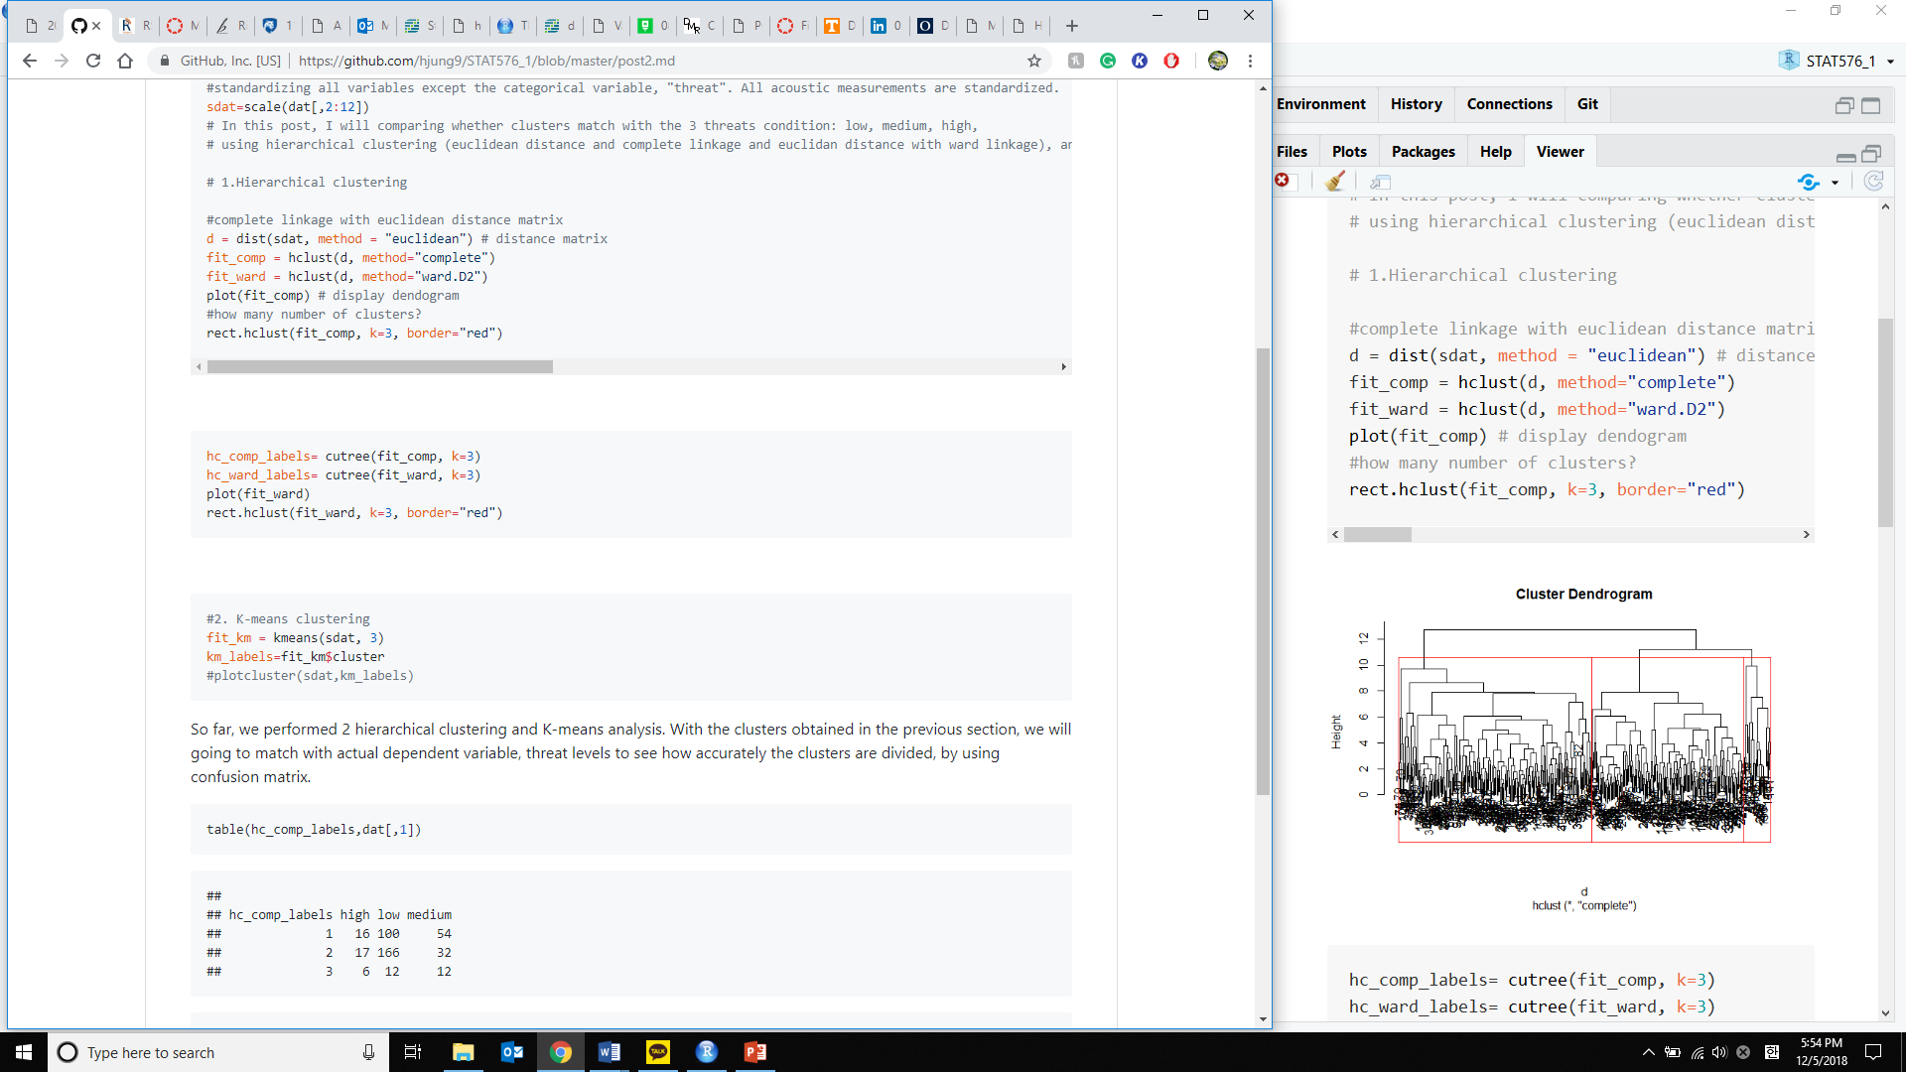
Plot x appear in website although appear in .md file

Slide 2
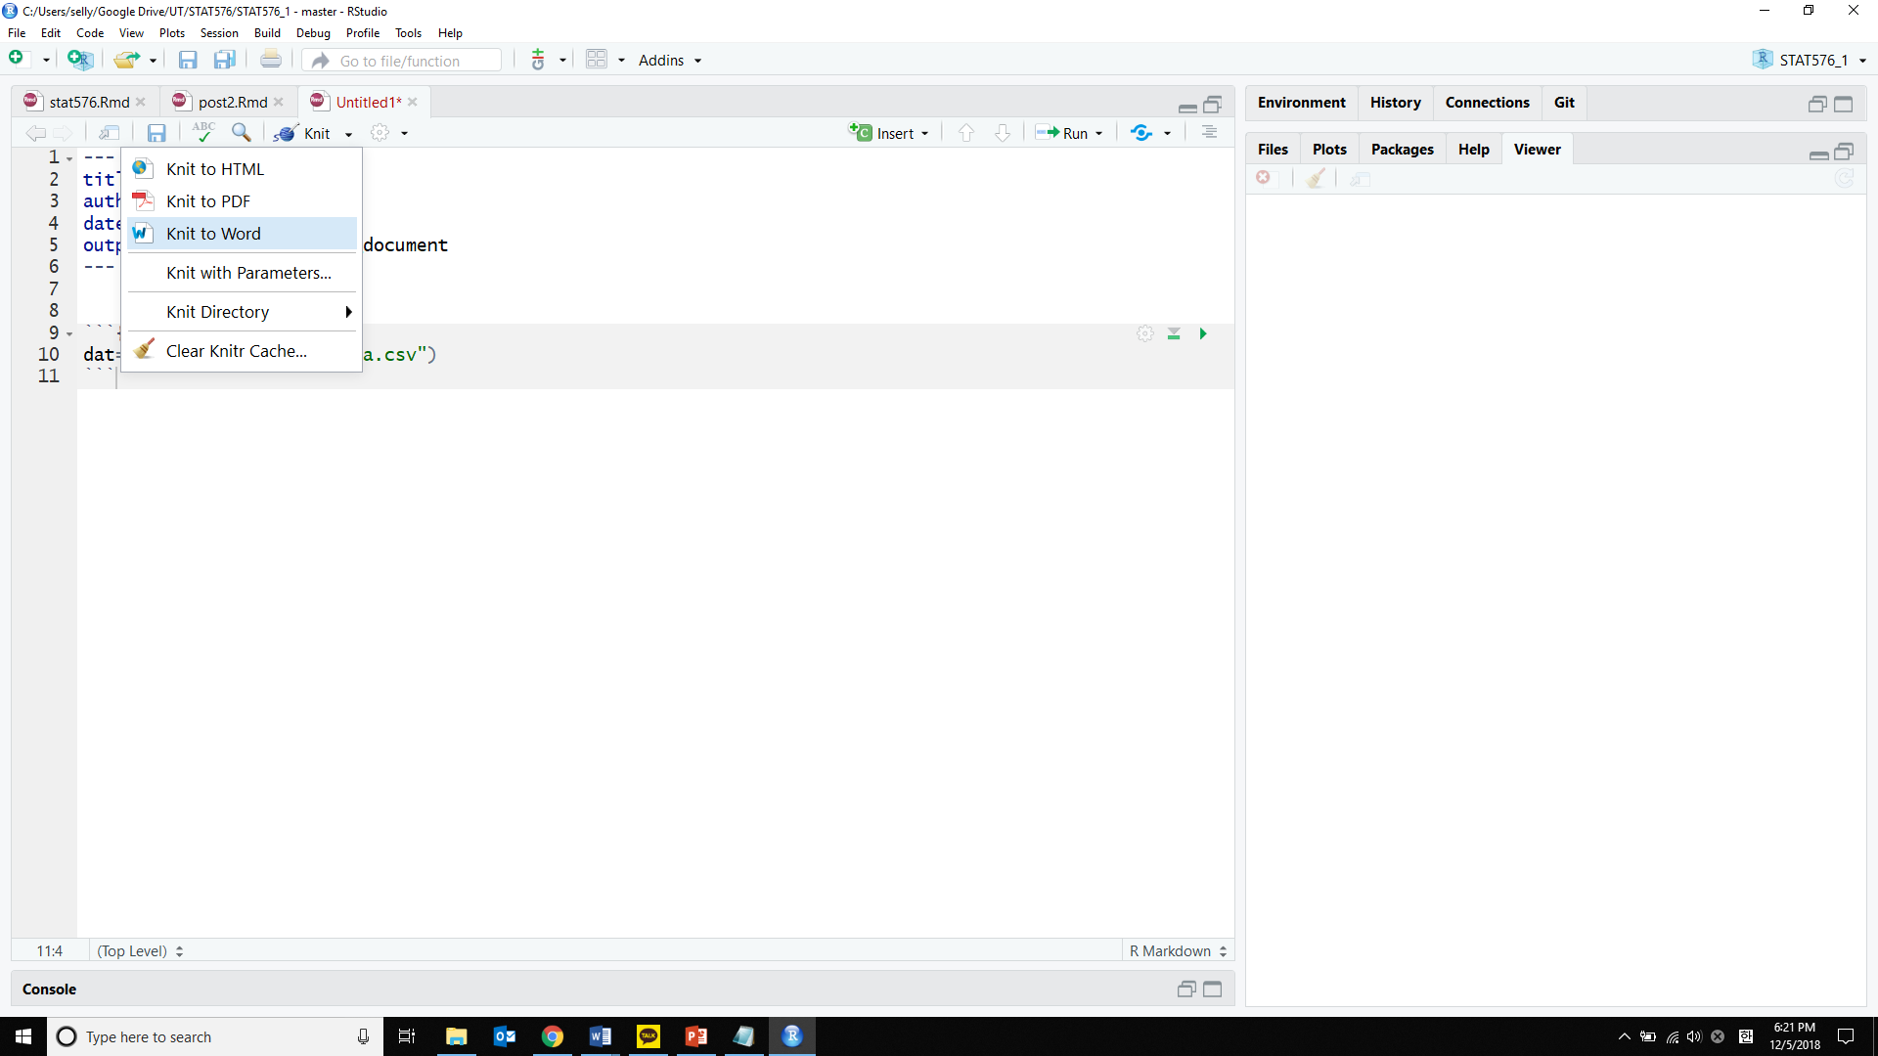
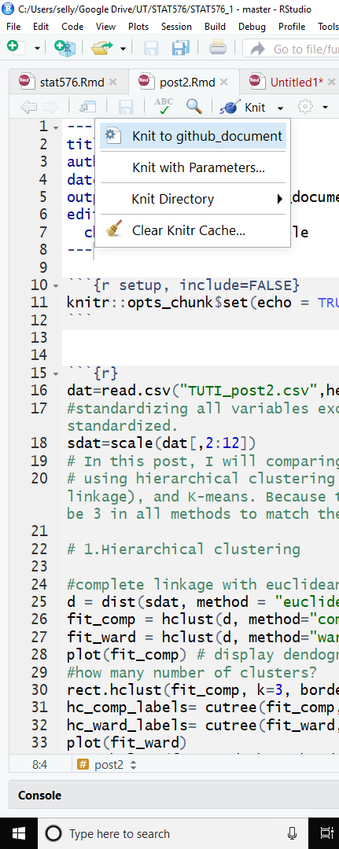
Only in post 3,
"knit to github_document“
X appear

Slide 3
Post3: x sure if I need to standardize or log-transform independent, dependent data. The example of forward, backward regression in the class material x go through standardization although the unit and the range of the data differ (car data)

Slide 4
Upon using regsubsets() for best sub model,
R session kept aborting
Maybe too many rows (10000) be a problem.
Worked well for smaller dataset (vp.csv)

