Slide 1
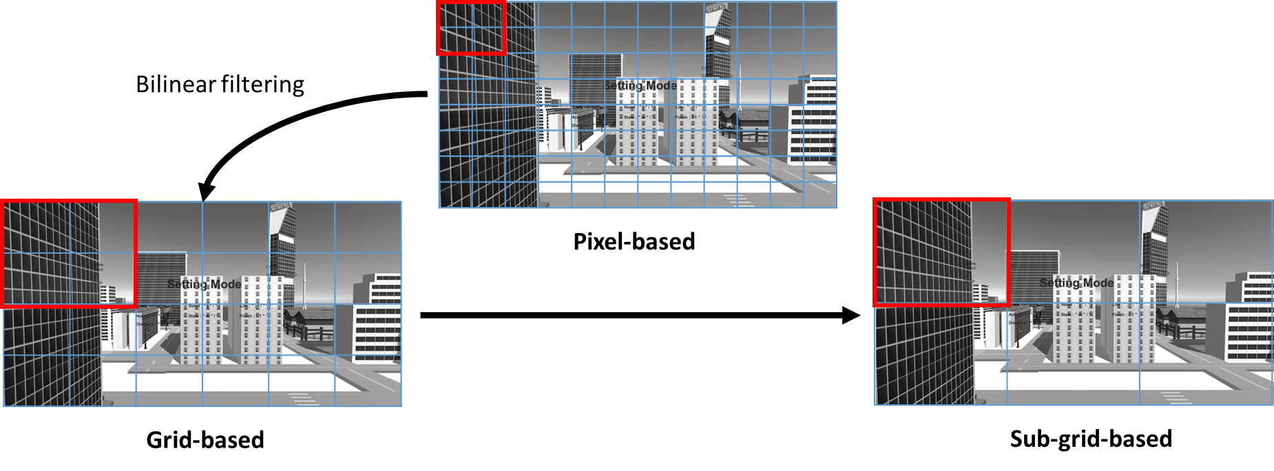
Obstacle Density-aware Compressed Grid Map

Slide 2




Distance-based Gray Scale Leveling

Slide 3
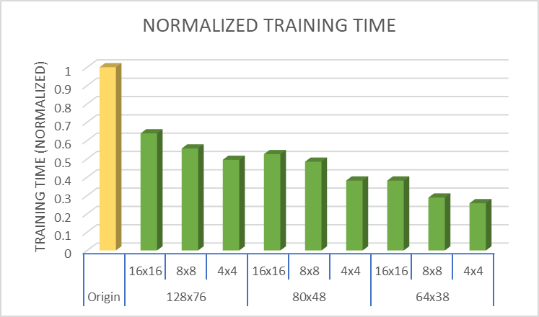
Evaluation on Training Time Efficiency

Slide 4
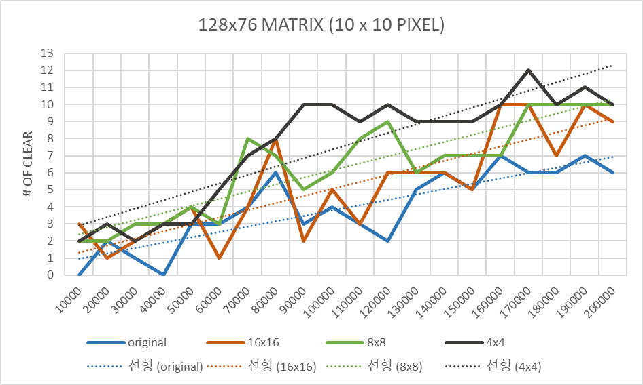
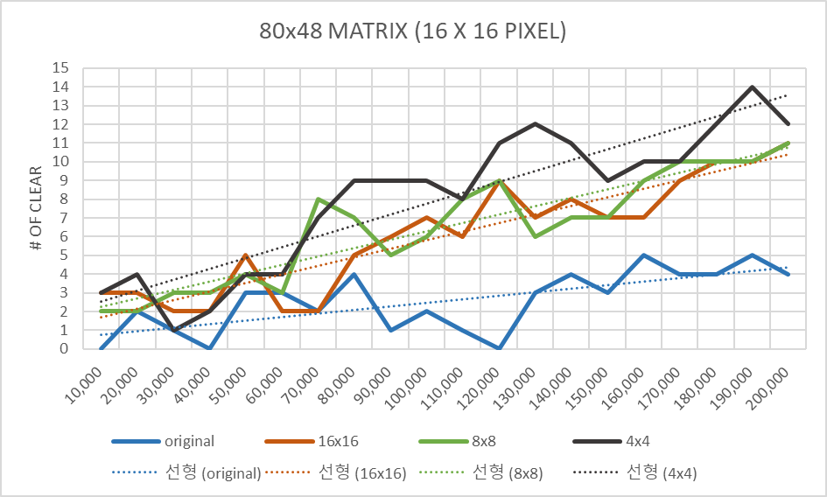
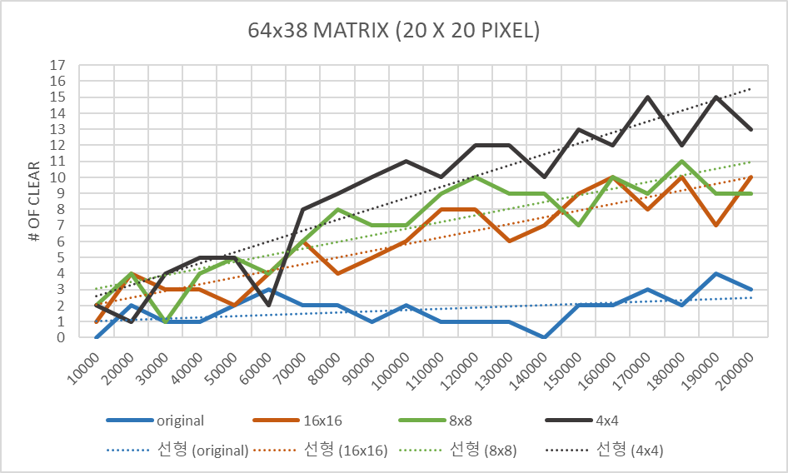
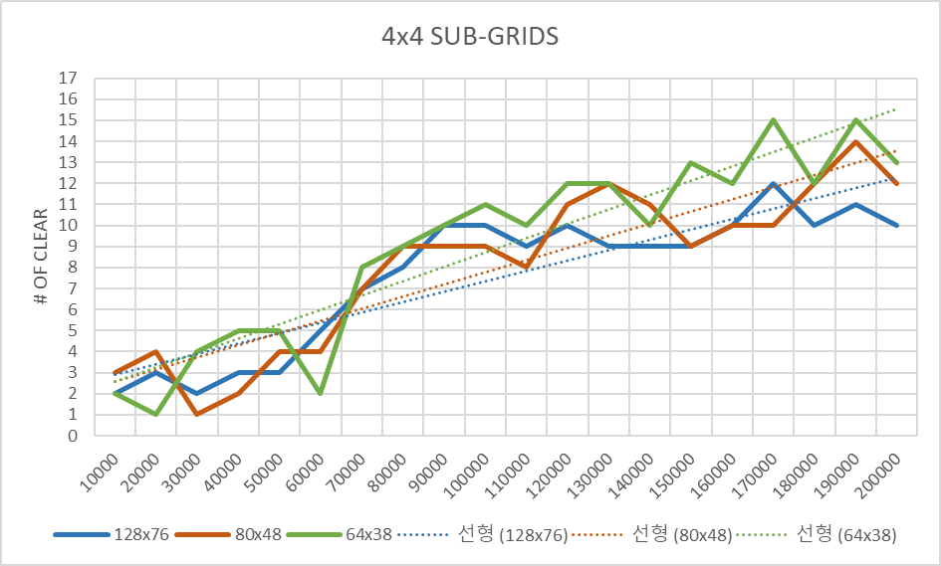
Evaluation on the Number of Clear

