Slide 1


Automating DOI Lookups Within ILLiad Webpages
Heidi Webb
IDS Peer Advisor and Logic Specialist | IDS Project
Head of Discovery and Technology Services | Upstate Medical University
IDS Project Fall User Group 2023

Slide 2


Synopsis
A demonstration on how to add a DOI and PMID lookup on your patron article request page and enable the use of ThirdIron's LibKey service to deliver subscribed and open access content and/or the Open Access button to pull open access content before hitting submit.
Notes:
https://openaccessbutton.org/
https://thirdiron.com/aboutus/

Slide 3

Outline
What is a DOI Resolver
Background Information
Some Usage Numbers
Step by Step Directions to Implement
Questions

Slide 4
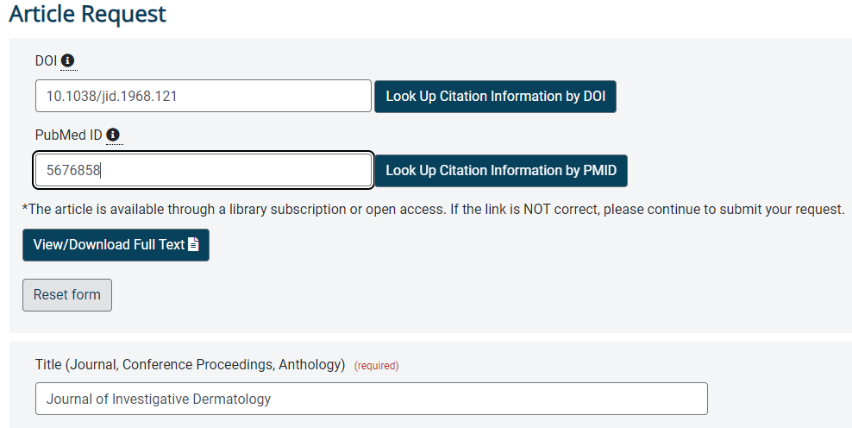
What? - “DOI Resolver”
Ability to enter a DOI or PMID to query Crossref and PubMed to fill out the article request form AND query your ThirdIron holdings for subscription or open access content.

Slide 5
Demonstration
DOI Resolver in Action

Slide 6
Background and History
DOI Resolver originally developed by Austin Smith
Demo-ed at some Atlas Systems sponsored sessions
Meredith Foster at West Chester University made some edits, wrote some directions, and shared on one of the ILL listservs
These versions used OpenAccess button in addition to Crossref and PubMed APIs
Staff at Upstate Medical University, Mike Campese and Heidi Webb, adjusted it further to query ThirdIron’s Libkey rather than OpenAccess button

Slide 7


Why?

Slide 8

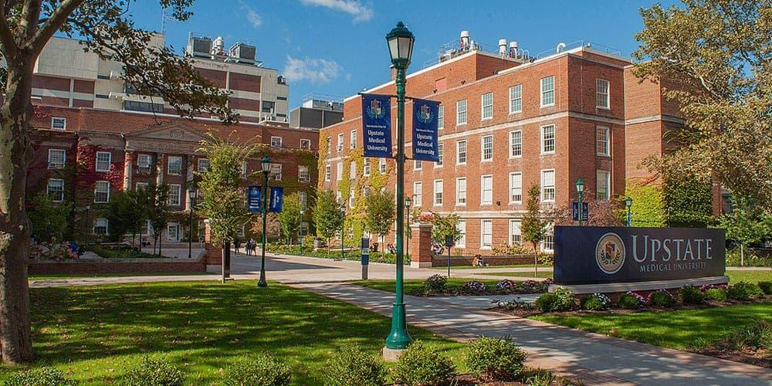
Upstate Medical University
Academic Medical Center
4 Colleges
1,600 Students
11,000 Employees
600 Residents
Two Hospitals
Additional Outpatient Facilities
752 Licensed Beds
https://www.upstate.edu/about/glance.php | https://www.upstate.edu/com/special_opps/md-mba/index.php | https://www.upstate.edu/nursing/units/

Slide 9
Reasons We Were Interested
Systematic Reviews and Literature Searches
Generates lists of resources where full text is desired
Increase accuracy
6-9% of ILLiad web page views is direct usage of the article form and not through an OpenURL
Potentially deliver some articles at time of inquiry

Slide 10
Usage September and October 2023

Slide 11
Article Form Submissions Sept/Oct 2023
 | Form Starts | Form Submissions | Submission Rate | Number Not Submitted | Percentage of Forms Started Without Hitting Submit
Direct Entry | 389 | 322 | 83% | 67 | 17%
OpenURL | 1322 | 1312 | 99% | 10 | 1%
Total | 1711 | 1634 | 95% | 77 | 5%

Slide 12
Article Form: Field Interactions Sept/Oct 2023
FIELD | INTERACTIONS | INTERACTIONS ON SUBMIT | INTERACTIONS WHEN UNSUBMITTED
DOI | 218 | 191 | 27
PhotoJournalTitle | 181 | 167 | 14
PhotoArticleTitle | 165 | 155 | 10
PhotoArticleAuthor | 137 | 130 | 7
PhotoJournalYear | 150 | 148 | 2
PMID | 131 | 85 | 46
PhotoJournalVolume | 106 | 105 | 1
Rush | 64 | 62 | 2
Notes | 80 | 75 | 5
PhotoJournalInclusivePages | 88 | 88 | -
PhotoJournalMonth | 63 | 62 | 1
PhotoJournalIssue | 58 | 58 | -
AcceptNonEnglish | 66 | 65 | 1
ISSN | 10 | 10 | -

Slide 13
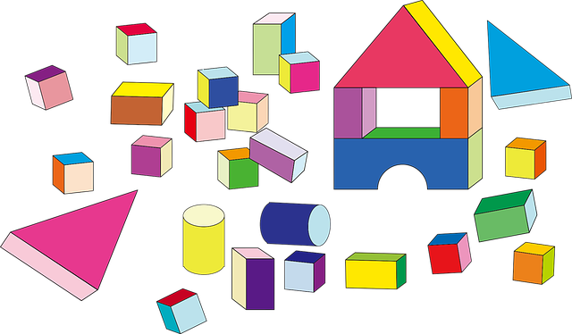
Step by Step
Don’t Forget testweb!

Slide 14
Files Impacted
DOIPMIDResolver_LK.js or DOIResolver.js (new file)
ArticleRequest.html (edit existing file)
Custom.css (edit existing file; optional)

Slide 15
Javascript File
Two File versions
DOIPMIDResolver_LK.js uses ThirdIron’s Libkey
Add your ThirdIron ID and an API key by editing lines 30 and 31
Need an API key? https://thirdiron.com/api-request/
DOIResolver.js uses OA.Works’ OpenAccess button
Edit Line 188 if you want to use an API key
API Information: https://openaccessbutton.org/api
Put .js file on webpage server in the folder called “js”

Slide 16
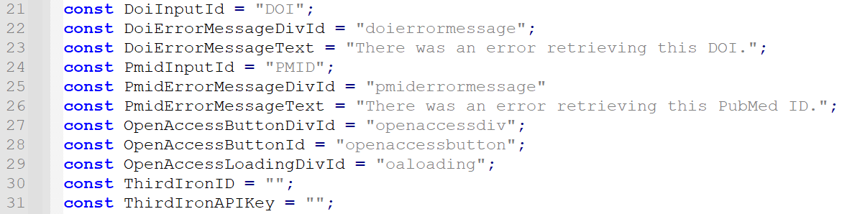
DOIPMIDResolver_LK.js Edits
const ThirdIronID = “[enter ThirdIron ID]";
const ThirdIronAPIKey = “[enter API key]";

Slide 17
Full JS File

Slide 18
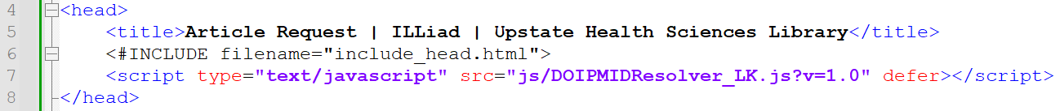
Article Request Page
Typically: ArticleRequest.html
Add the call to the javascript file in the head section
<script type="text/javascript" src="js/DOIPMIDResolver_LK.js?v=1.0" defer></script>
Edit DOI and PMID fields ...
Add LibKey or OpenAccess button links ...

Slide 19
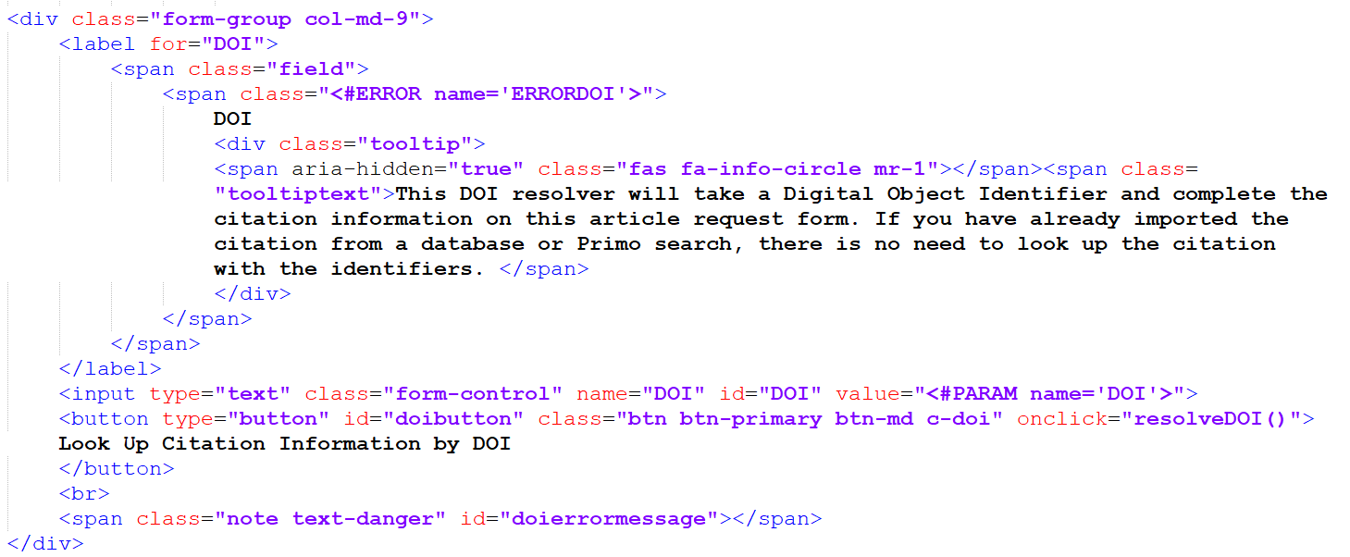



Article Request Page: DOI
Notes:
<div class="form-group col-md-9">
<label for="DOI">
<span class="field">
<span class="<#ERROR name='ERRORDOI'>">
DOI
<div class="tooltip">
<span aria-hidden="true" class="fas fa-info-circle mr-1"></span><span class="tooltiptext">This DOI resolver will take a Digital Object Identifier and complete the citation information on this article request form. If you have already imported the citation from a database or Primo search, there is no need to look up the citation with the identifiers. </span>
</div>
</span>
</span>
</label>
<input type="text" class="form-control" name="DOI" id="DOI" value="<#PARAM name='DOI'>">
<button type="button" id="doibutton" class="btn btn-primary btn-md c-doi" onclick="resolveDOI()">Look Up Citation Information by DOI
</button>
<br>
<span class="note text-danger" id="doierrormessage"></span>
</div>

Slide 20
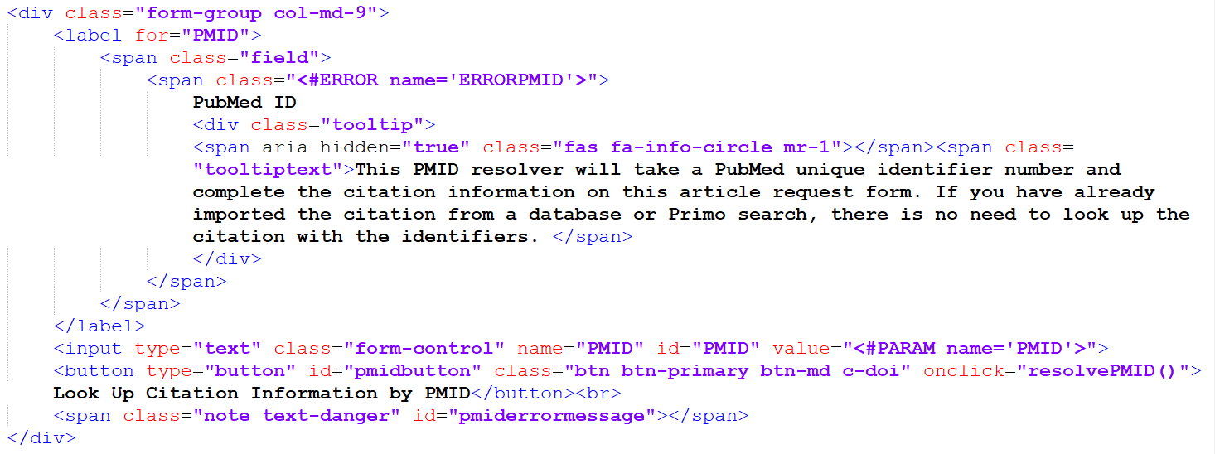
Article Request Page: PMID
Optional Tooltip
Notes:
<div class="form-group col-md-9">
<label for="PMID">
<span class="field">
<span class="<#ERROR name='ERRORPMID'>">
PubMed ID
<div class="tooltip">
<span aria-hidden="true" class="fas fa-info-circle mr-1"></span><span class="tooltiptext">This PMID resolver will take a PubMed unique identifier number and complete the citation information on this article request form. If you have already imported the citation from a database or Primo search, there is no need to look up the citation with the identifiers. </span>
</div>
</span>
</span>
</label>
<input type="text" class="form-control" name="PMID" id="PMID" value="<#PARAM name='PMID'>">
<button type="button" id="pmidbutton" class="btn btn-primary btn-md c-doi" onclick="resolvePMID()">Look Up Citation Information by PMID</button><br>
<span class="note text-danger" id="pmiderrormessage"></span>
</div>

Slide 21
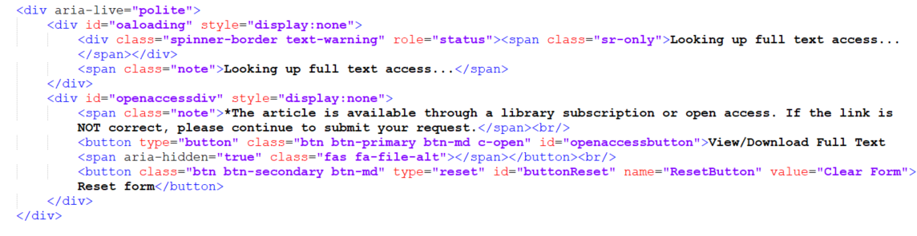
Article Request Page: Libkey or OpenAccess Link
Notes:
<div aria-live="polite">
<div id="oaloading" style="display:none">
<div class="spinner-border text-warning" role="status"><span class="sr-only">Looking up full text access...</span></div>
<span class="note">Looking up full text access...</span>
</div>
<div id="openaccessdiv" style="display:none">
<span class="note">*The article is available through a library subscription or open access. If the link is NOT correct, please continue to submit your request.</span><br/>
<button type="button" class="btn btn-primary btn-md c-open" id="openaccessbutton">View/Download Full Text <span aria-hidden="true" class="fas fa-file-alt"></span></button><br/>
<button class="btn btn-secondary btn-md" type="reset" id="buttonReset" name="ResetButton" value="Clear Form">Reset form</button>
</div>
</div>

Slide 22
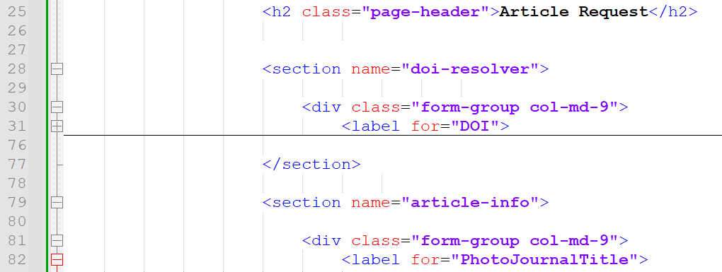
Article Page: Wrap as a Section
Add <section name="doi-resolver"> before the DOI, PMID, and full texts link code
Add </section> after the DOI, PMID, and full texts link code

Slide 23
Article Page: One Final Edit
Don’t forget to remove DOI and PMID fields from further down in your form, if relevant.

Slide 24
Full Article HTML Page

Slide 25
Reminder: Look and Feel

Slide 26

“Look and Feel” = Cascading Style Sheet
If desired, edit the custom.css in the css folder to alter the style
In examples shown, DOI and PMID buttons/input, tooltips, header 2, form section and form group have altered css from the default webpages

Slide 27
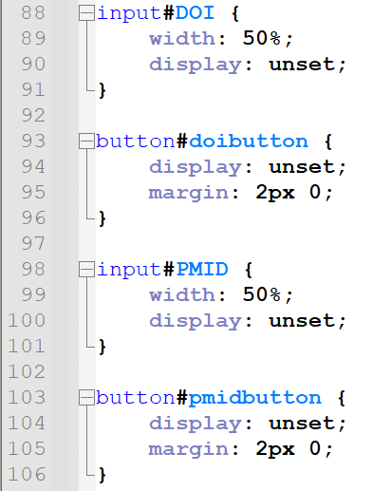
DOI and PMID Fields Specifically
Notes:
input#DOI {
width: 50%;
display: unset;
}
button#doibutton {
display: unset;
margin: 2px 0;
}
input#PMID {
width: 50%;
display: unset;
}
button#pmidbutton {
display: unset;
margin: 2px 0;
}

Slide 28
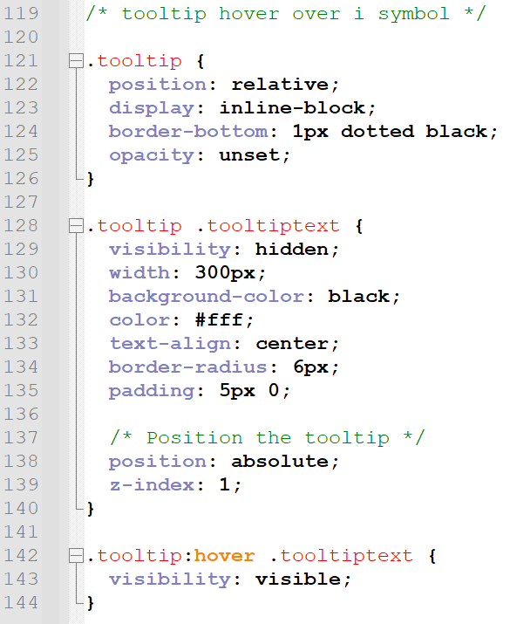
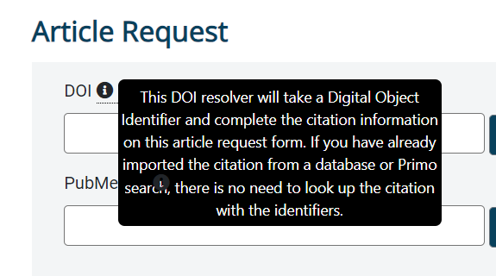
Tooltip
Notes:
.tooltip {
position: relative;
display: inline-block;
border-bottom: 1px dotted black;
opacity: unset;
}
.tooltip .tooltiptext {
visibility: hidden;
width: 300px;
background-color: black;
color: #fff;
text-align: center;
border-radius: 6px;
padding: 5px 0;
/* Position the tooltip */
position: absolute;
z-index: 1;
}
.tooltip:hover .tooltiptext {
visibility: visible;
}

Slide 29
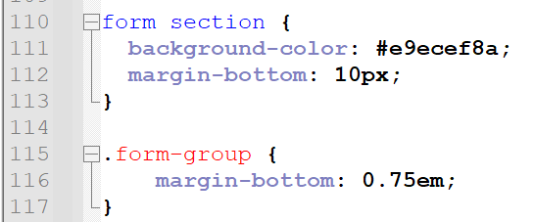
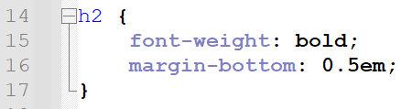
Additional CSS in Example Shown
To get a similar look and feel, the h2, form section, and form-group should also be added/edited to css
Notes:
h2 {
font-weight: bold;
margin-bottom: 0.5em;
}
form section {
background-color: #e9ecef8a;
margin-bottom: 10px;
}
.form-group {
margin-bottom: 0.75em;
}

Slide 30
Full CSS File

Slide 31

Questions
Heidi Webb
webbh@upstate.edu
https://pixabay.com/illustrations/question-mark-a-notice-duplicate-2153533/

