Slide 1
Functional Test
Application programming
Unit test
Unit test
Unit test
Unit test
Code
Code
Code
Code

Slide 2
Run the test.
Does it pass?
Write a test
Refactor (optional)
Write minimal code

Slide 3
No
Run the test.
Does it pass?
Does it need
refactoring?
Write a test
Yes
Write minimal code

Slide 4
No
Run the FT.
Does it pass?
Does
the application
need
refactoring?
Write a
Functional test
Yes
“Write minimal code”
Run the unit test.
Does it pass?
Does it need
refactoring?
Write a
Unit test
Yes
Write minimal code
Unit test / code cycle

Slide 5
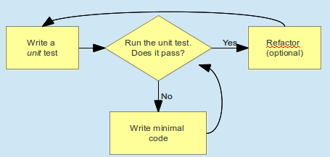
Run the functional test.
Does it pass?
Write a Functional test
Refactor (optional)
“Write minimal code”
Run the unit test.
Does it pass?
Write a
unit test
Refactor
(optional)
Write minimal
code

