Slide 1
Welcome!

Slide 2
Absolute beginners
Know another language
Intermediate Python
Science!

Slide 3
Python’s History

Slide 4
Free Software
Notes:
Model railway society

Slide 5
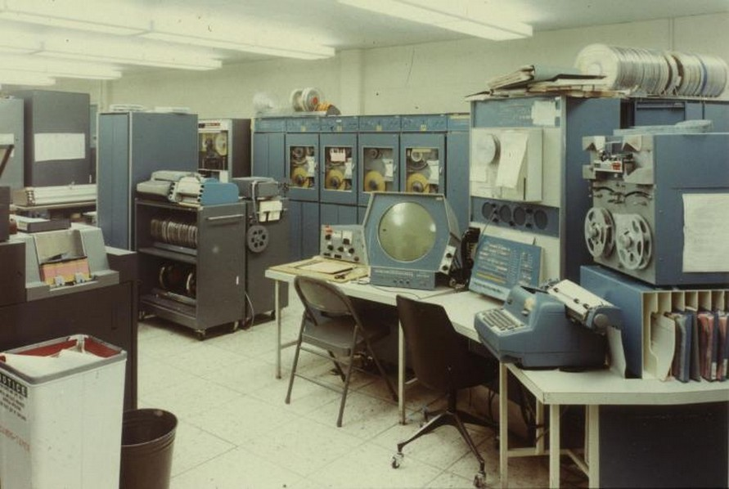
The MIT Hackers

Slide 6
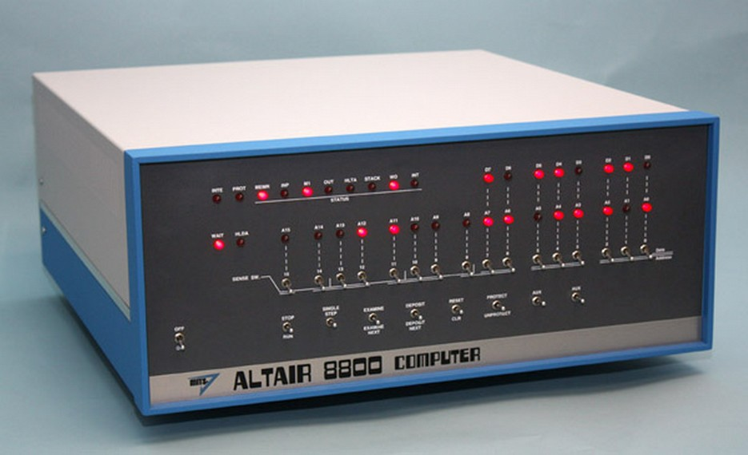
The first PC

Slide 7
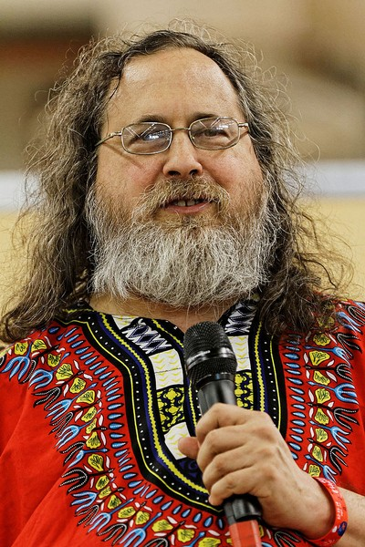
RMS
It's GNU/Linux!!

Slide 8
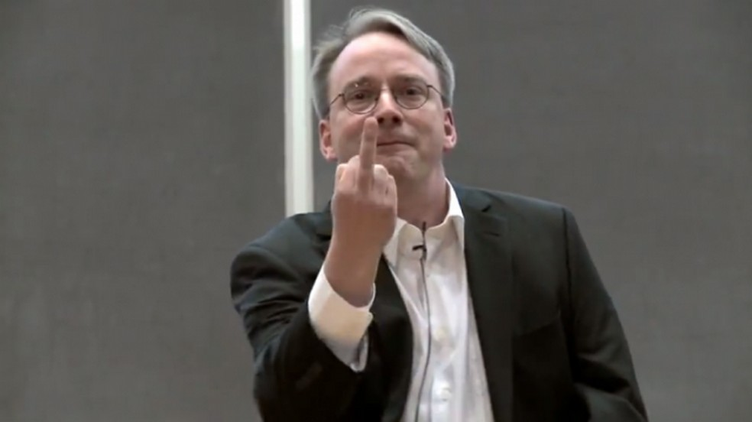
Linus

Slide 9
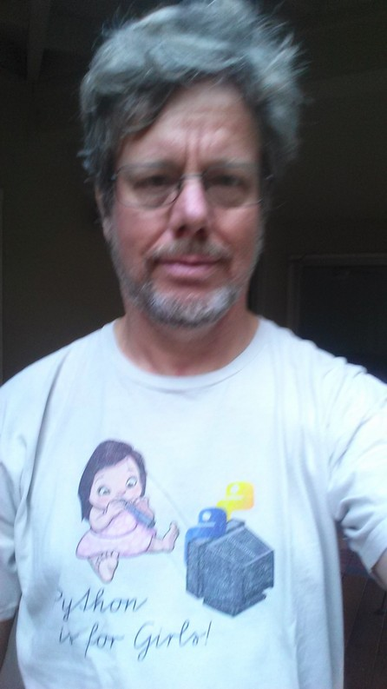
BD
FL

Slide 10
The Python story

Slide 11
Python
#include<stdio.h>
int main(void) {
printf("Hello World\n");
return 0;
}
print(“hello world”)

Slide 12
Import this
Notes:
The zen of python. Read this in your own time. Complements moshe's talk

