Slide 1
The Python Ecosystem

Slide 2
2.8
Notes:
This is a controversial t-shirt, an in-joke. Let me explain
-python story, python 2, standard library
- google, nasa
- resolver one
- python 3
- slow adoption
- starting to be honestly recommend
- adoption in education

Slide 3
pip install...

Slide 4
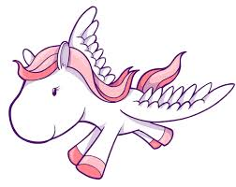
Ponies, Bottles, Flasks.
Notes:
Just talk about the different communities within python
- lots of web developers. Reddit, disqus, instagram, all built with python. Django, flask, bottle (whisky/ wsgi joke, sigh)
- scientists! Mad scientists. Numpy, scipy, pandas, matplotlib, astropy, ppl switching from old fortran libraries
- guis,
- embedded, raspberry pi(pi=python), microbit, lots more
- see notes

Slide 5
When pip fails
- download installers
- Anaconda

Slide 6
What is a git?
Notes:
Source code control
Collaboration online
Stay for the sprints!

Slide 7
Community

