Slide 1
CRF as RNN
康萌萌
Group meeting
2018.12.12

Slide 2
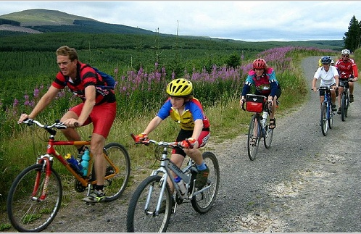
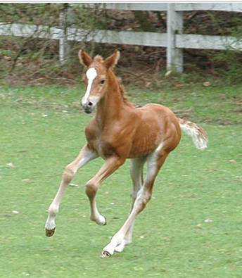
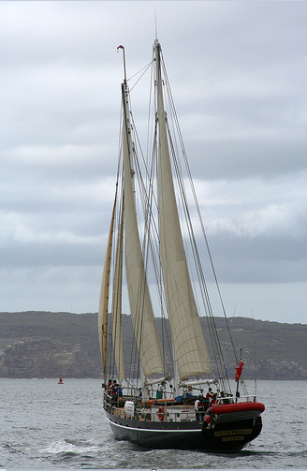
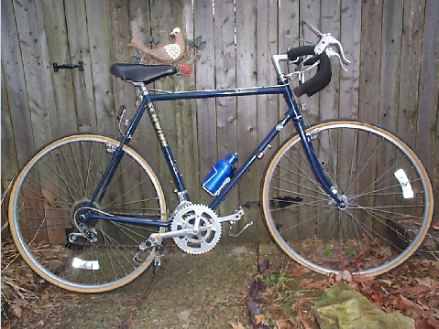
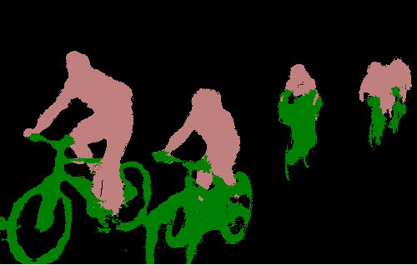

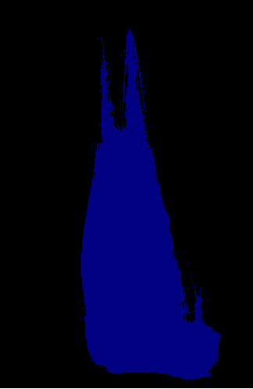

https://github.com/torrvision/crfasrnn

Slide 3
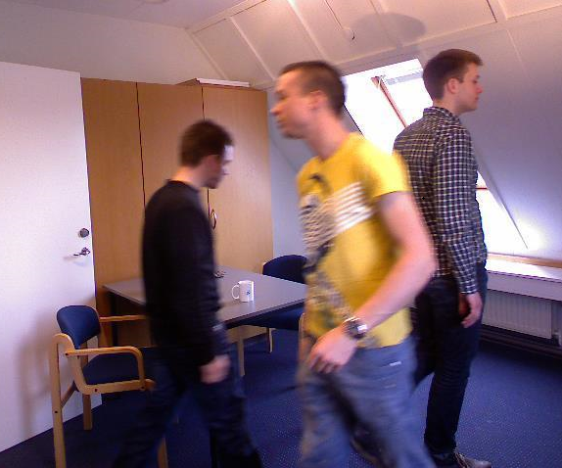
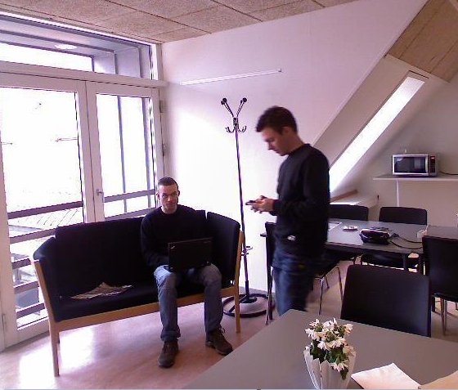

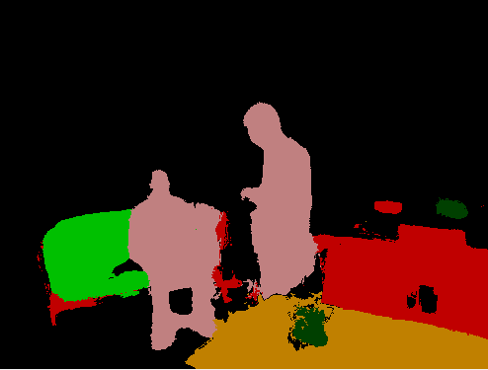
https://github.com/torrvision/crfasrnn

Slide 4
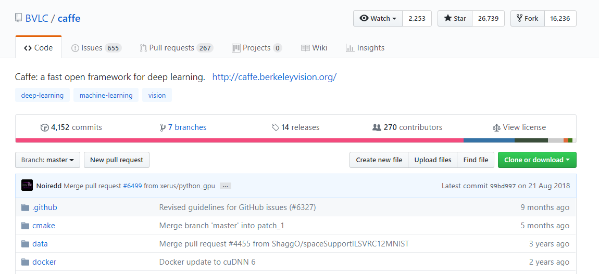
https://github.com/BVLC/caffe

Slide 5
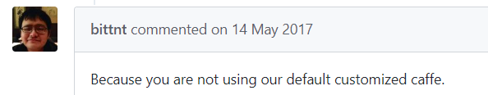
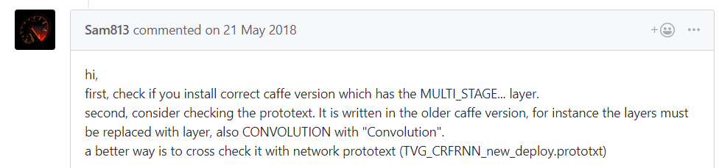
https://github.com/torrvision/crfasrnn

Slide 6
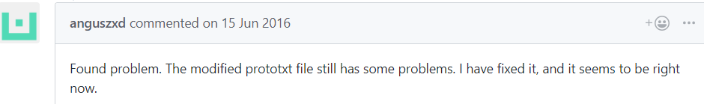
Crazy log file....
I0615 20:25:32.638391 26152 solver.cpp:258] Train net output #375520: data = -75.4584 I0615 20:25:32.638420 26152 solver.cpp:258] Train net output #375521: data = -80.4584 I0615 20:25:32.638450 26152 solver.cpp:258] Train net output #375522: data = -62.4584 I0615 20:25:32.638480 26152 solver.cpp:258] Train net output #375523: data = -59.4584 I0615 20:25:32.638509 26152 solver.cpp:258] Train net output #375524: data = -67.4584 I0615 20:25:32.638540 26152 solver.cpp:258] Train net output #375525: data = -79.4584 I0615 20:25:32.638571 26152 solver.cpp:258] Train net output #375526: data = -96.4584 I0615 20:25:32.638602 26152 solver.cpp:258] Train net output #375527: data = -100.458
…….

Slide 7
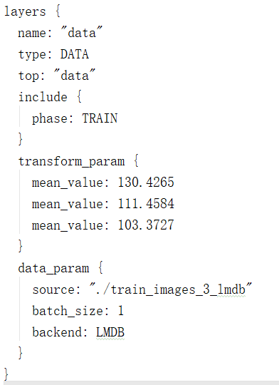
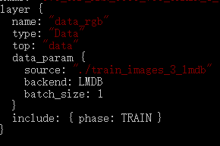
How to train the model
https://github.com/torrvision/crfasrnn/issues/17

Slide 8
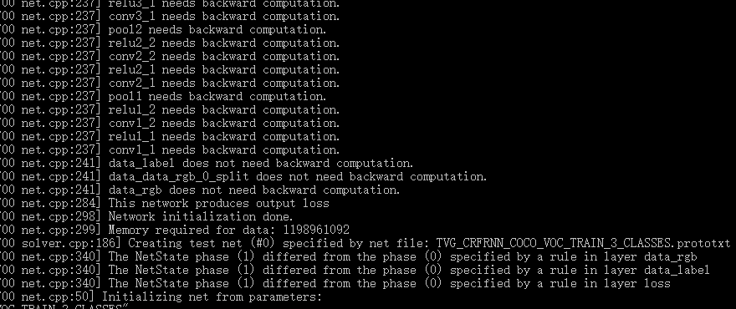
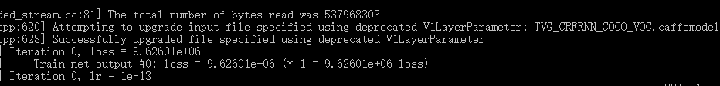

Slide 9
Thanks
康萌萌
2019.1.9

