Slide 1
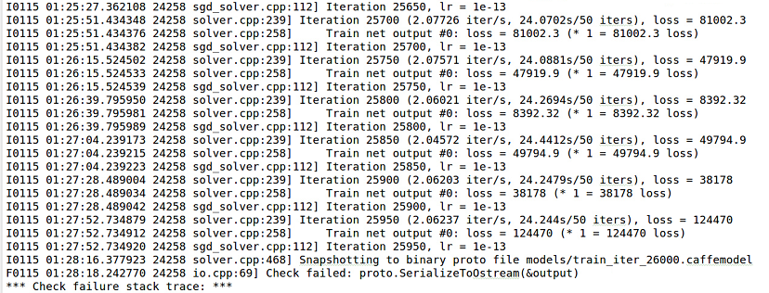

Slide 2
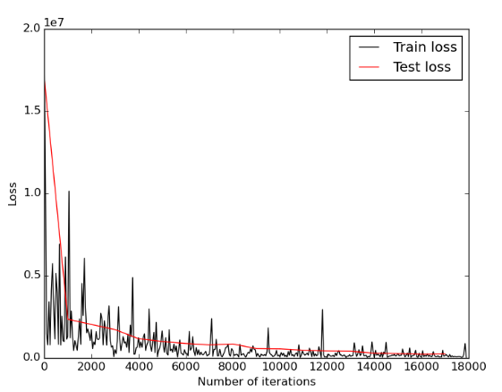

Slide 3
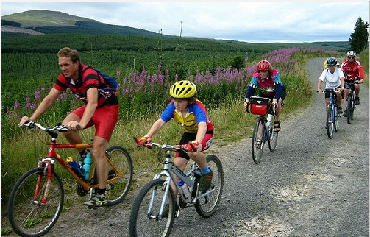
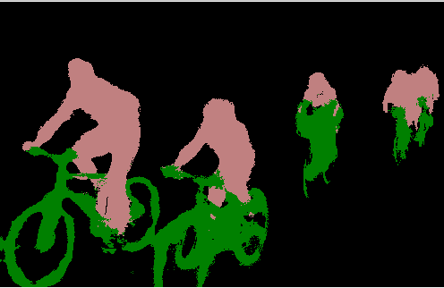
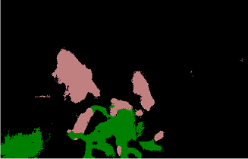
Input image
CPU Output image
GPU Output image
Time taken : 11.0329 seconds
Time taken : 0.7 seconds

Slide 4
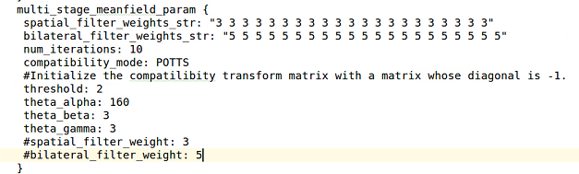

Slide 5
warning: non-static data member initializers only available with -std=c++11 or -std=gnu++11
bool init_gpu_ = false;

Slide 6
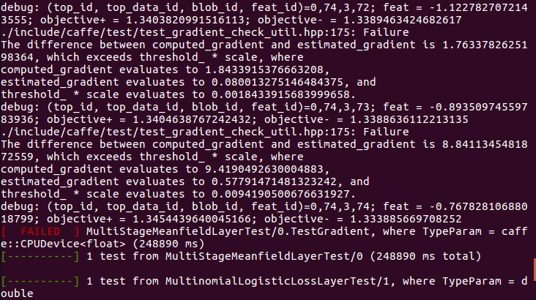
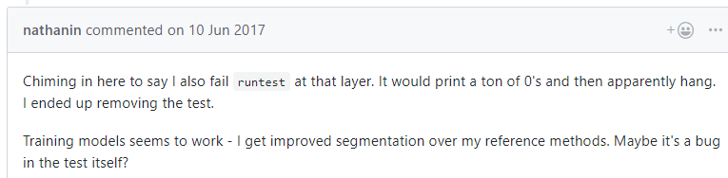

Slide 8
Thanks
康萌萌
2019.1.16

