Slide 1
进度汇报
胡敬玉
2019.1.17

Slide 2
Quo Z, Li X, Huang H, et al. Medical image segmentation based on multi-modal convolutional neural network: Study on image fusion schemes[C]//Biomedical Imaging (ISBI 2018), 2018 IEEE 15th International Symposium on. IEEE, 2018: 903-907.

Slide 3
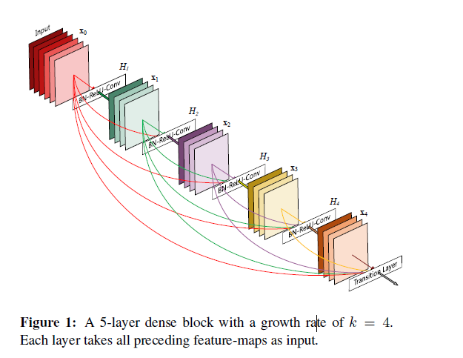
Huang G, Liu Z, Van Der Maaten L, et al. Densely connected convolutional networks[C]//2017 IEEE Conference on Computer Vision and Pattern Recognition (CVPR). IEEE, 2017: 2261-2269.

Slide 4
Dolz J, Gopinath K, Yuan J, et al. HyperDense-Net: A hyper-densely connected CNN for multi-modal image segmentation[J]. arXiv preprint arXiv:1804.02967, 2018.

Slide 5
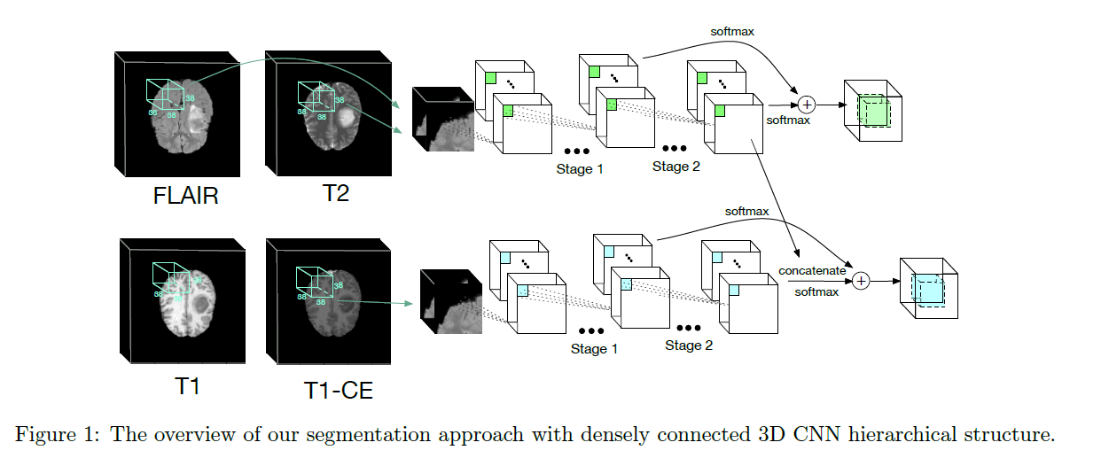
Chen L, Wu Y, DSouza A M, et al. MRI tumor segmentation with densely connected 3D CNN[C]//Medical Imaging 2018: Image Processing. International Society for Optics and Photonics, 2018, 10574: 105741F.

Slide 7
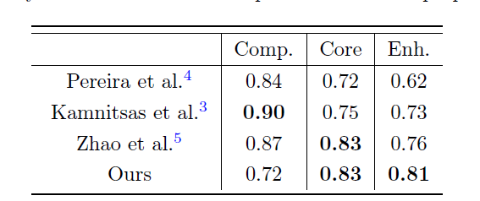
mean dice whole:
[0.77416498 0.05540441]
mean dice core:
[0.99640544 0.00410985]
mean dice enhance:
[0.99734054 0.00442083]

Slide 8
Thank You!

