Slide 1
VOC2012数据集 (train:1464) (320×320)
1）FCN_32s
meanIOU: 0.513829 pixel acc: 0.871206 (lr = 1e-4)
2）FCN_32s_crfasrnn
meanIOU: 0.526899 pixel acc: 0.876190 (lr = 1e-7 iter=5) meanIOU: 0.527062 pixel acc: 0.876321 (lr = 1e-7 iter=10) meanIOU: 0.521772 pixel acc: 0.876072 (lr = 1e-10 iter=5) meanIOU: 0.521772 pixel acc: 0.876072 (lr = 1e-13 iter=5)

Slide 2
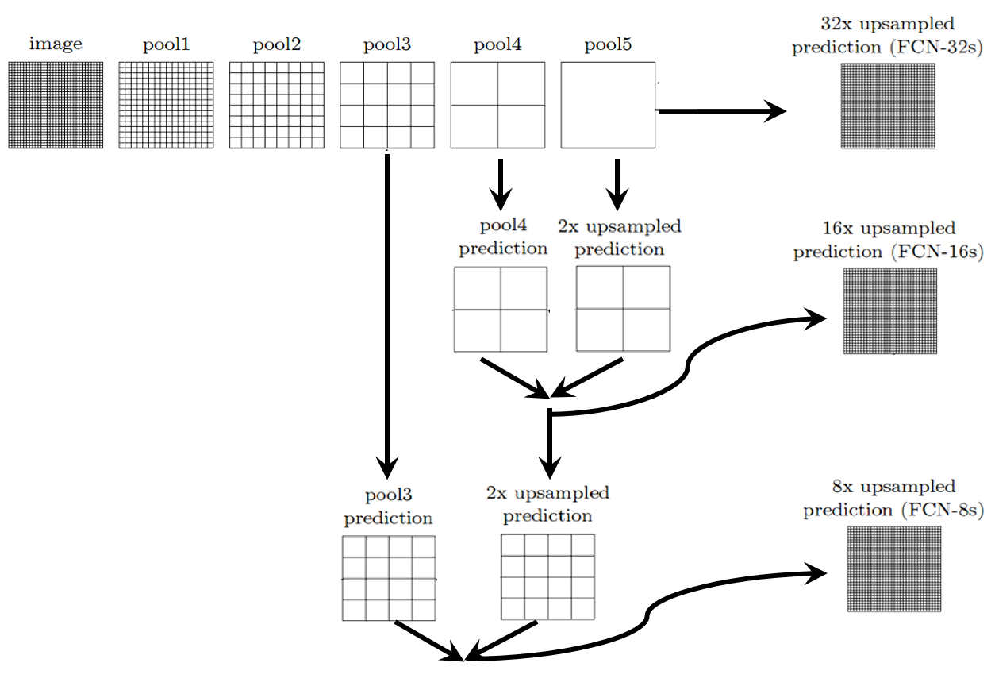

Slide 3
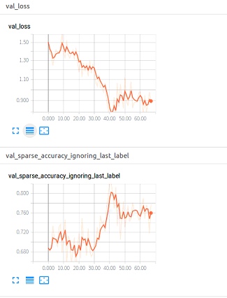
Vocbenchmark_release (train:8494) (500×500)
1）FCN_8s
2）FCN_8s_crfasrnn

Slide 4

2017 IEEE Conference on Computer Vision and Pattern Recognition

Slide 5
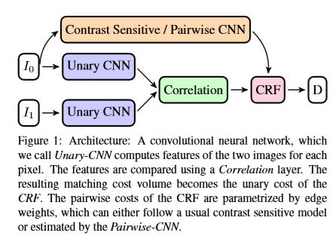

Slide 6
Thanks
2019.3.13

