Slide 1
组 会 报 告
蓝 鑫
2019年3月27日

Slide 2
目录
多模态语义分割网络小结
FuseNet
AdapNet
MFNet
RedNet
RTFNet

Slide 3
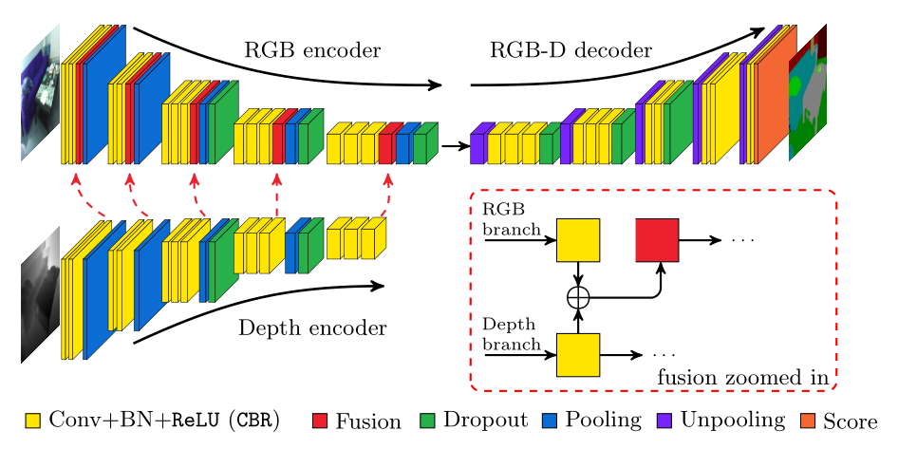
FuseNet
Hazirbas, C., Ma, L., Domokos, C., & Cremers, D. (2017). FuseNet: Incorporating Depth into Semantic Segmentation via Fusion-Based CNN Architecture. Paper presented at the ACCV 2016, Cham.

Slide 4
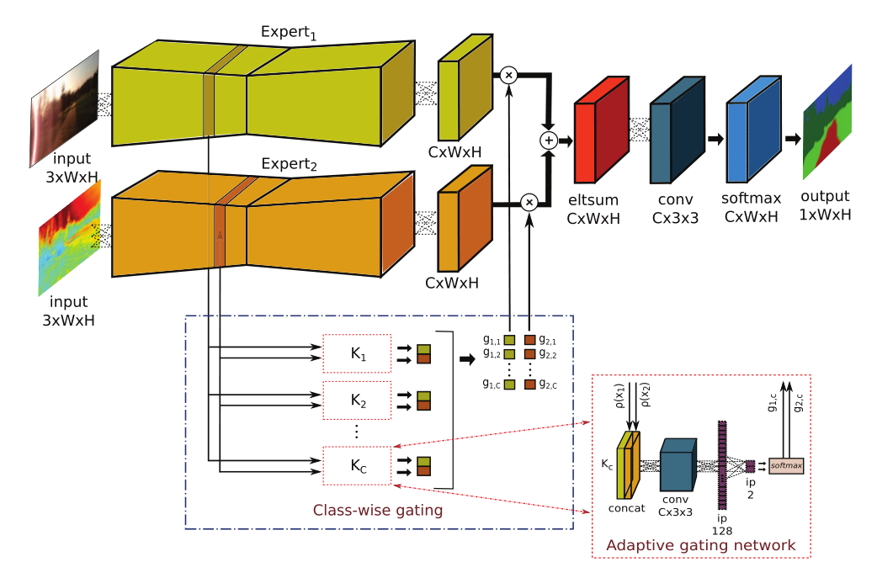
AdapNet
Valada, A., Vertens, J., Dhall, A., & Burgard, W. AdapNet: Adaptive semantic segmentation in adverse environmental conditions. 2017 IEEE International Conference on Robotics and Automation (ICRA).
引入了扩张卷积
门控网络作为乘法器，使得专家网络的输出在概率上形成融合表征

Slide 5
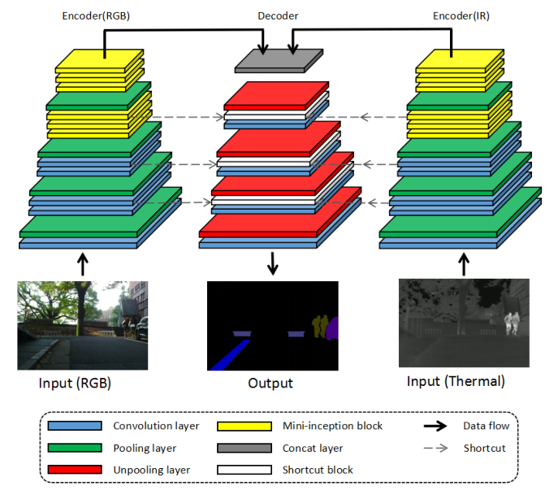
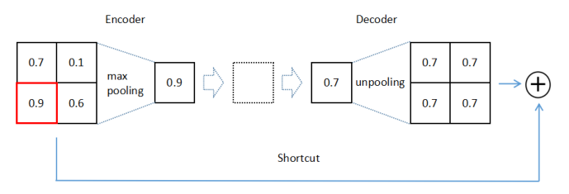
MFNet
Ha, Q., Watanabe, K., Karasawa, T., Ushiku, Y., & Harada, T. MFNet: Towards real-time semantic segmentation for autonomous vehicles with multi-spectral scenes. 2017 IEEE International Conference on Intelligent Robots and Systems (IROS).
主要目的是在准确率和推断速度间取得平衡
引入了扩张卷积
两个模态编码器的信息拼接，然后与解码器对应层相加

Slide 6
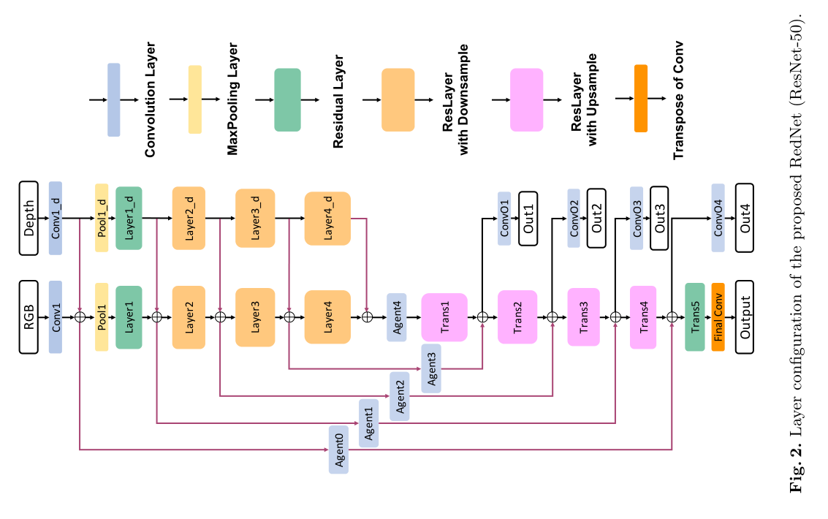
RedNet
Jiang, J., Zheng, L., Luo, F., & Zhang, Z. (2018). RedNet: Residual Encoder-Decoder Network for indoor RGB-D Semantic Segmentation. arXiv e-prints.
上采样层也为残差层
Agent 使用 1x1 卷积以匹配编码器和解码器通道数
使用金字塔监督，即 Out1-Out4 和 Output

Slide 7
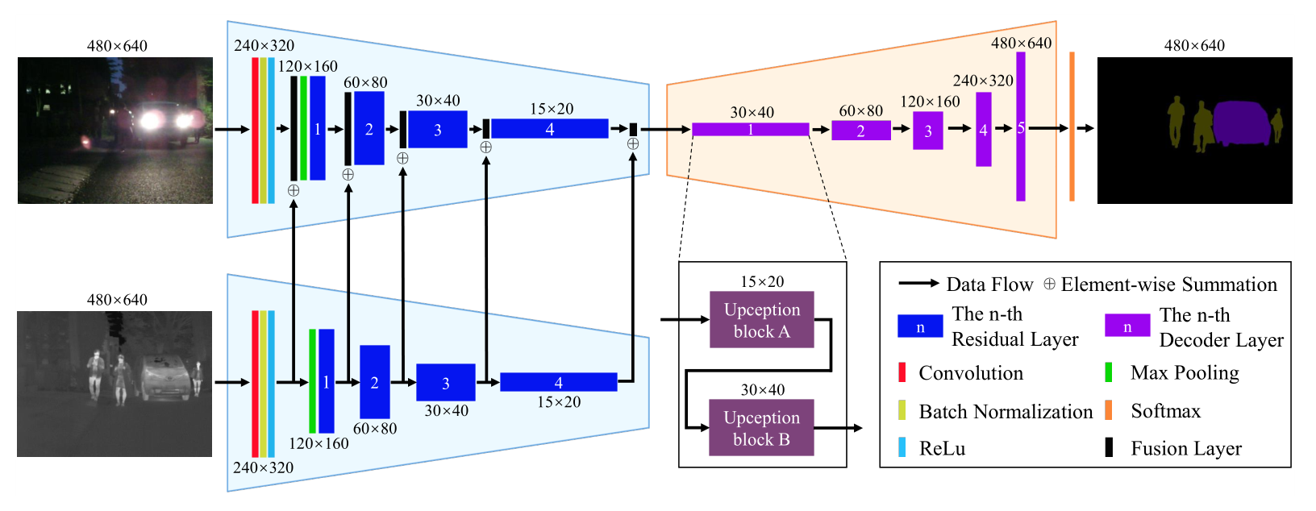
RTFNet
Sun, Y., Zuo, W., & Liu, M. (2019). RTFNet: RGB-Thermal Fusion Network for Semantic Segmentation of Urban Scenes. IEEE Robotics and Automation Letters, 1-1. doi:10.1109/lra.2019.2904733
解码器类似于 RedNet

Slide 8
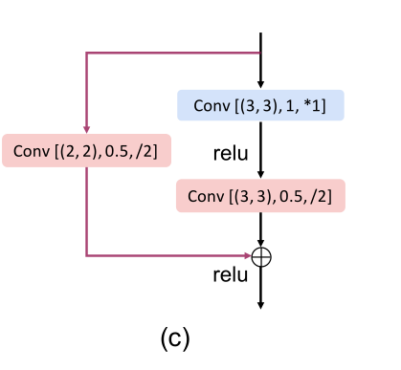
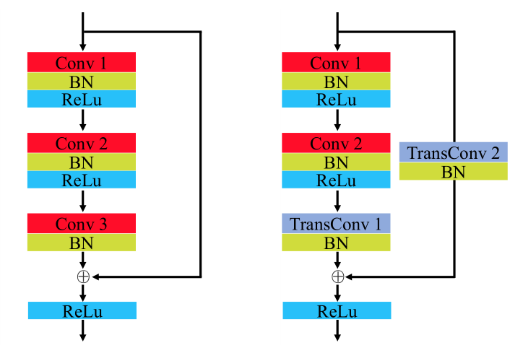
RedNet RTFNet 解码器对比
RedNet
RTFNet

