Slide 1
密集连接
batchsize =2 size=320*320 epoch=140
网络 | 原始级联 | 密集连接1 | 密集连接2 | 密集连接3
Acc | 92.94 | 91.65 | 92.53 | 93.28
Miou | 69.48 | 67.29 | 69.69 | 68.57
Data:A_200
网络 | 原始级联 | 密集连接1 | 密集连接2
Acc | 88.05 | 88.09 | 88.53
Miou | 53.81 | 52.76 | 54.59
Data:B_541

Slide 2
down1
up1
down2
up2
down3
up3
down4
up4
down5
up5

Slide 3
down1
up1
down2
up2
down3
up3
down4
up4
down5
up5

Slide 4
down1
up1
down2
up2
down3
up3
down4
up4
down5
up5

Slide 5
将ir通道数由 ir_chs = [64,128,256,512,512] 改成 ir_chs = [32,64,128,256,256]
batchsize =2 size=320*320 epoch=140
网络 | 原始级联 | 通道减少
Acc | 92.94 | 92.29
Miou | 69.48 | 67.38
Data:A_200

Slide 6
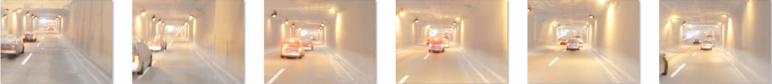
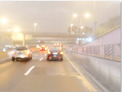
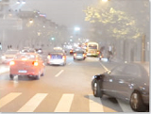
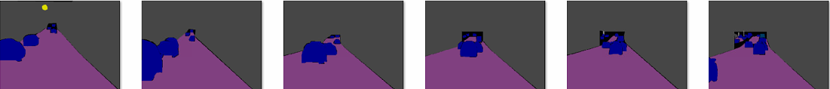
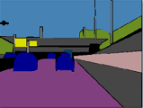
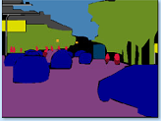
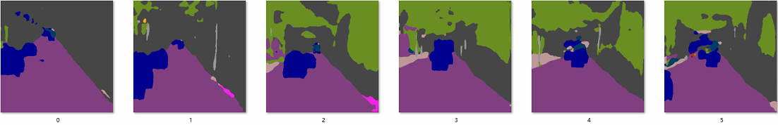
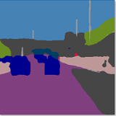
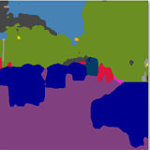
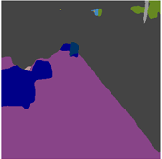
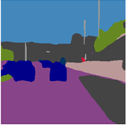

RGB-IR
Ground Truth
实验1
实验2

Slide 7
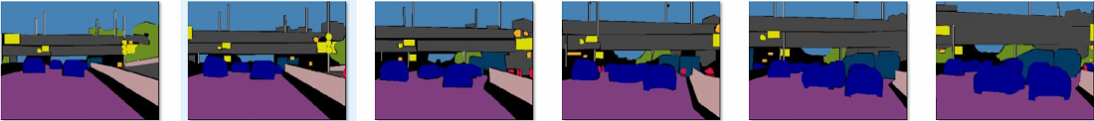
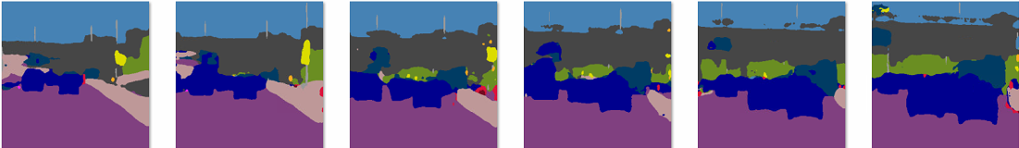
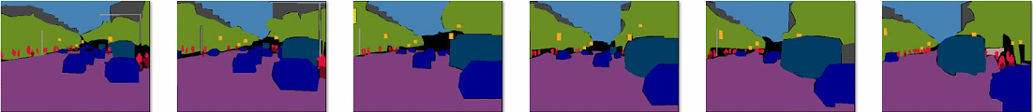
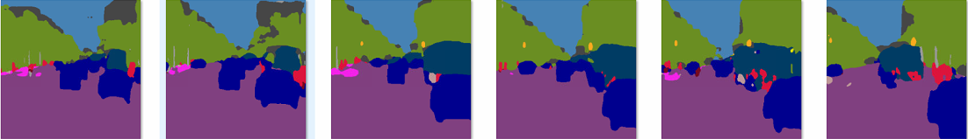

Slide 8
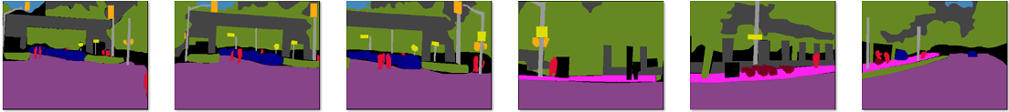
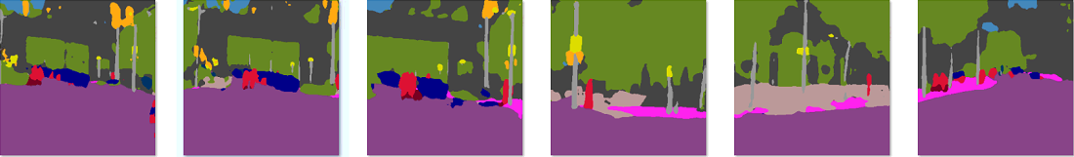
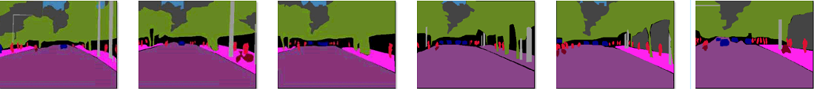
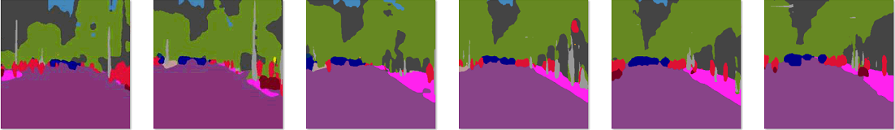

Slide 9
