Slide 1
组 会 报 告
蓝 鑫
2019年10月17日

Slide 2
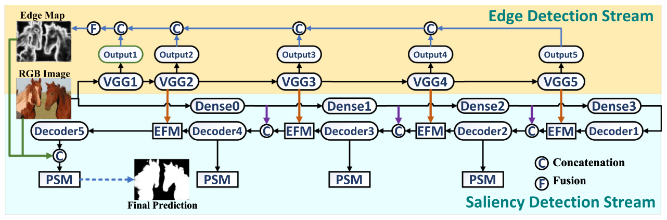
显著目标检测
Guan, W., Wang, T., Qi, J., Zhang, L., & Lu, H. (2019). Edge-Aware Convolution Neural Network Based Salient Object Detection. IEEE Signal Processing Letters, 26(1), 114-118.
现有网络不能有效保留目标边缘，因此引入边缘网络来增强目标边界。
VGG 作为边缘检测网络，先在边缘检测数据集上单独训练
Backbone 使用 DenseNet

Slide 3
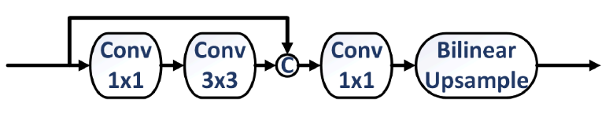

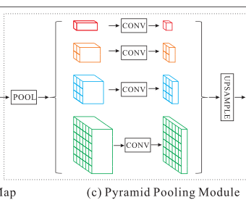
显著目标检测
Guan, W., Wang, T., Qi, J., Zhang, L., & Lu, H. (2019). Edge-Aware Convolution Neural Network Based Salient Object Detection. IEEE Signal Processing Letters, 26(1), 114-118.
解码器结构
EFM（Edge-Aware Fusing Module）模块，X 为 Decoder 输出，E 为 EdgeNet 输出
PSM（Pyramid-Based Supervision Module）模块，PP 表示不同级的金字塔池化操作，W 为 1x1 卷积

Slide 4
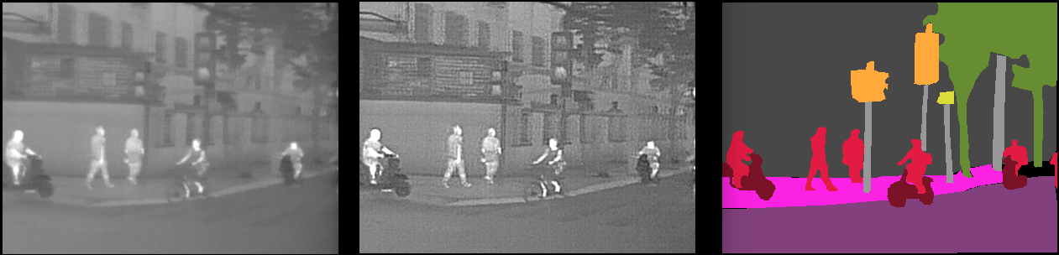
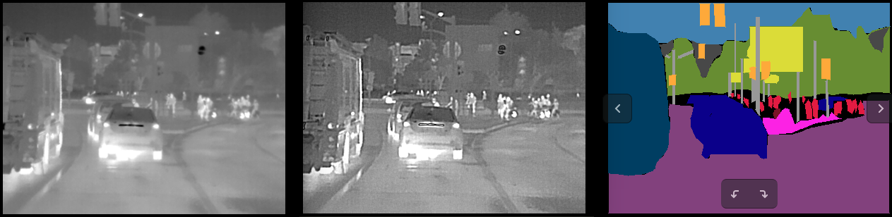
实验
car | bike | person | sky | tree | traffic lights | road | sidewalk | building | fence | sign | pole | bus | mIoU
60.02 | 17.31 | 43.71 | 81.82 | 77.16 | 13.22 | 86.86 | 39.64 | 65.82 | 15.91 | 0.03 | 6.62 | 44.62 | 42.5184 | Deeplab
54.02 | 20.84 | 45.61 | 82.74 | 77.56 | 4.97 | 86.97 | 39.6 | 66.42 | 11.83 | 0.04 | 6.89 | 53.53 | 42.3861 | Deeplab lap w guassian blur
55.09 | 19.89 | 47.13 | 83.19 | 77.95 | 8.05 | 87.34 | 38.29 | 66.42 | 15.34 | 0.31 | 4.91 | 45.28 | 42.2453 | Deeplab lap w/o guassian blur
无高斯模糊

Slide 5
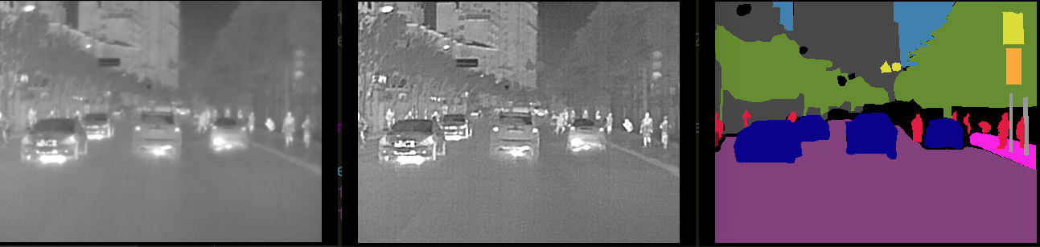
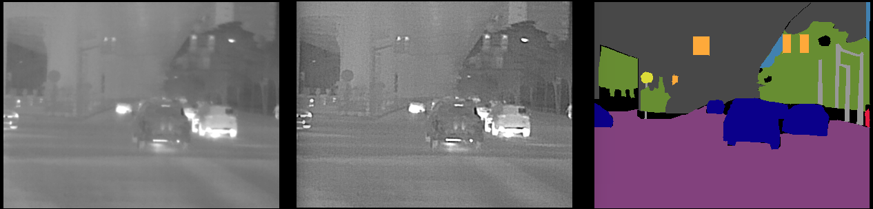
实验
car | bike | person | sky | tree | traffic lights | road | sidewalk | building | fence | sign | pole | bus | mIoU
60.02 | 17.31 | 43.71 | 81.82 | 77.16 | 13.22 | 86.86 | 39.64 | 65.82 | 15.91 | 0.03 | 6.62 | 44.62 | 42.5184 | Deeplab
54.02 | 20.84 | 45.61 | 82.74 | 77.56 | 4.97 | 86.97 | 39.6 | 66.42 | 11.83 | 0.04 | 6.89 | 53.53 | 42.3861 | Deeplab lap w guassian blur
55.09 | 19.89 | 47.13 | 83.19 | 77.95 | 8.05 | 87.34 | 38.29 | 66.42 | 15.34 | 0.31 | 4.91 | 45.28 | 42.2453 | Deeplab lap w/o guassian blur
无高斯模糊

Slide 6



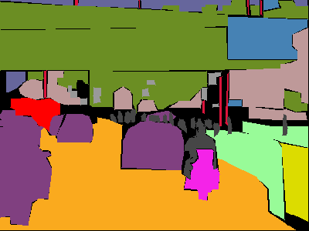
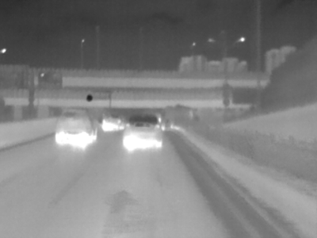




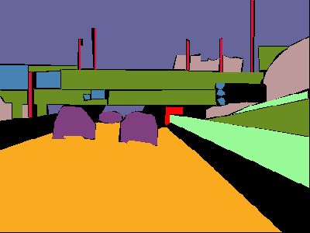
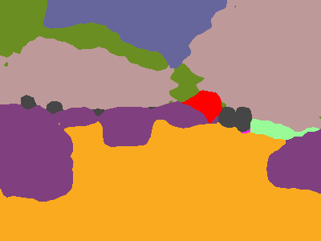
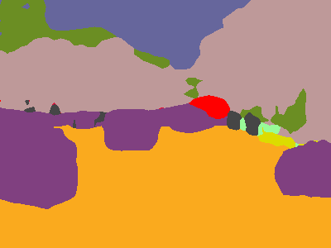

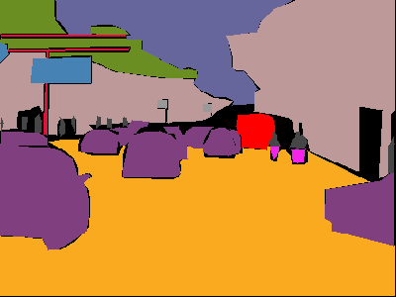
实验
DeepLab
DeepLab
lap w guassian blur
DeepLab
lap w/o guassian blur
GT

