Slide 1
文献汇报
胡敬玉
2019.10.17

Slide 2
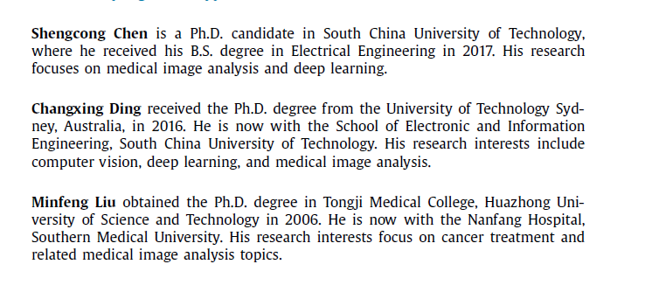
文献
S. Chen, C. Ding, M. Liu, Dual-force convolutional neural networks for accurate brain tumor segmentation, Pattern Recognition. 88 (2019) 90–100.

Slide 3
文章出发点
Accurate segmentation depends on multi-level information.
Exiting deep architectures for brain tumor segmentation fail to explicitly encourage the models to learn high-quality hierarchical features.
Dual-force training scheme
Label distribution-based loss function

Slide 4
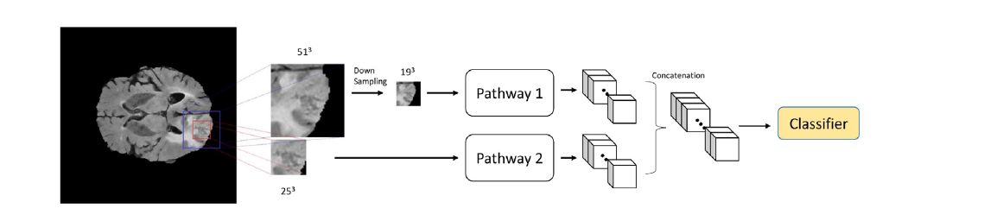
DeepMedic

Slide 5
U-Net

Slide 7
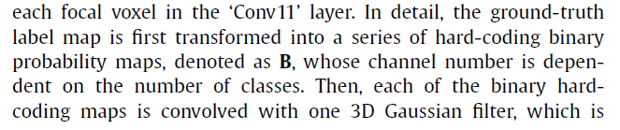
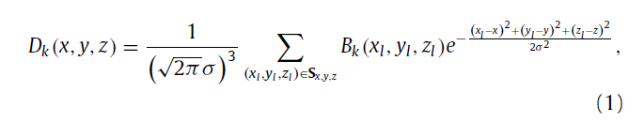


Label distribution-based loss function

Slide 8
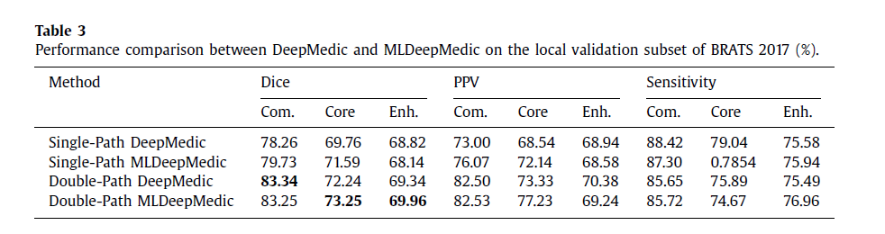
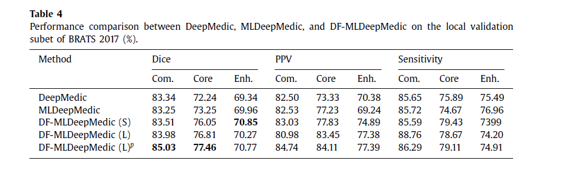
实验结果

Slide 9
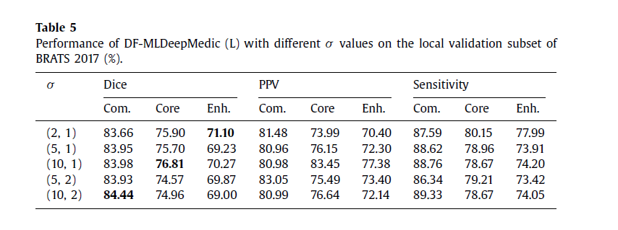
实验结果

Slide 10
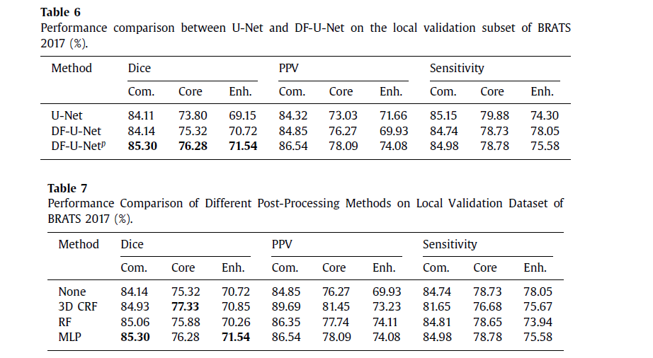
实验结果

Slide 11
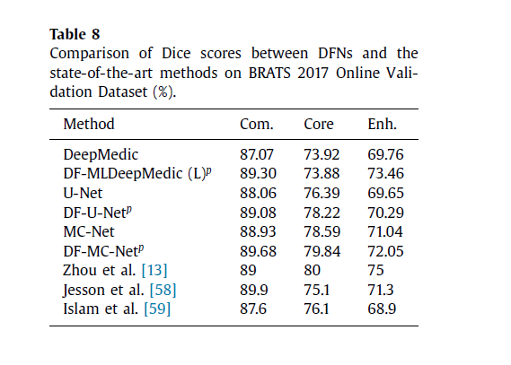
实验结果

Slide 12
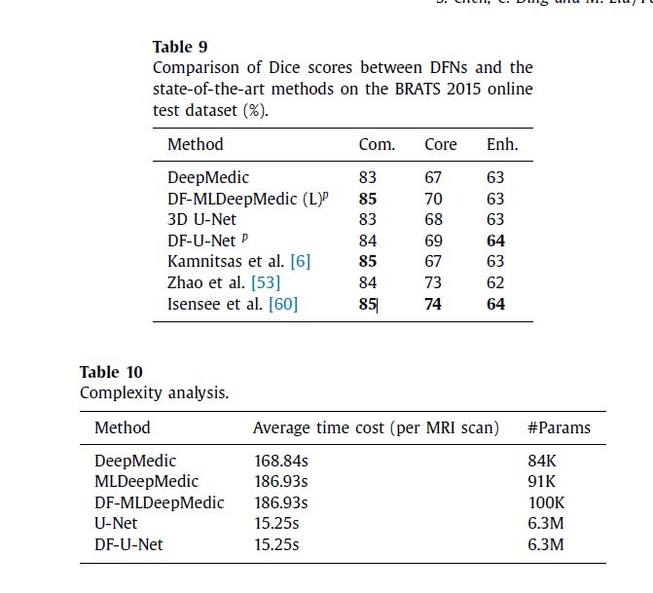
实验结果

Slide 13
Thank You!

