Slide 1
Uncertainty Estimation for Computer Vision
胡敬玉
2019.12.12

Slide 2
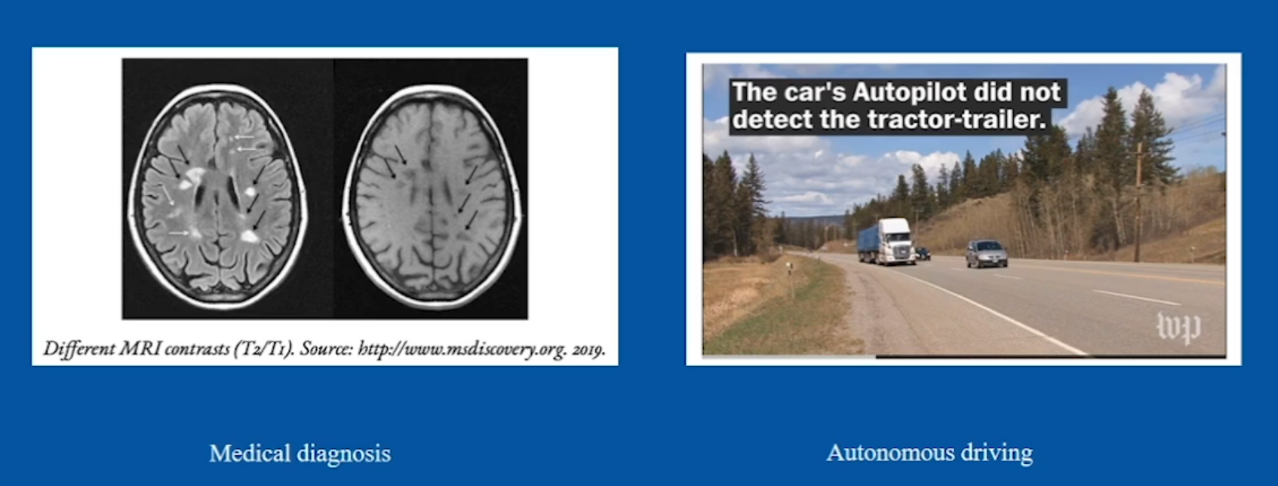
背景
针对难的样本给出不确定性
给出偏离分布的样本的不确定性

Slide 3
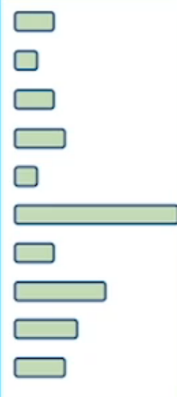
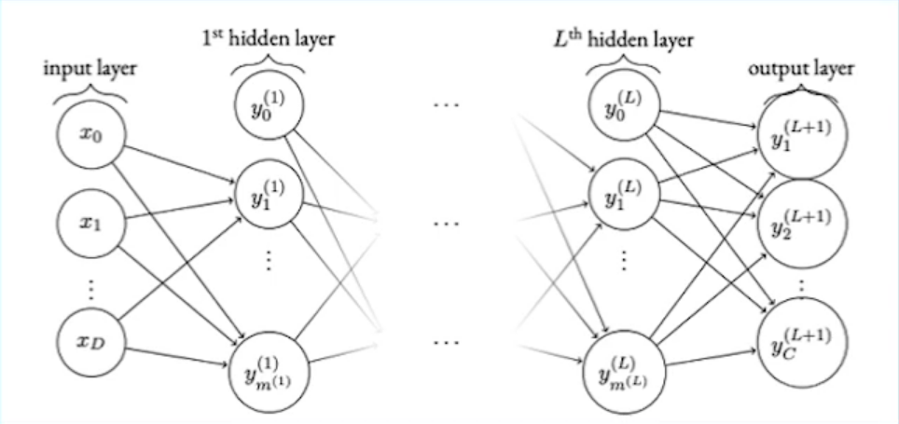
Deep Networks are deterministic
Deterministic Parameters
Deterministic Prediction

Slide 4
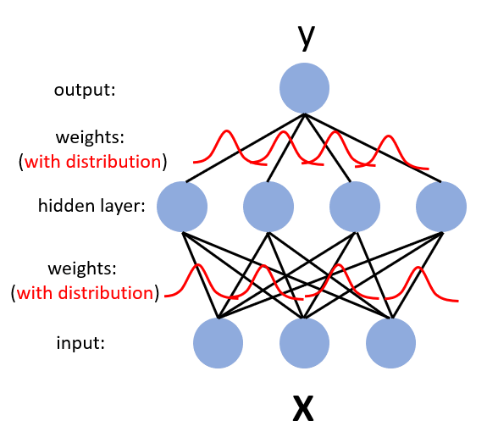
Bayesian Neural Network

Slide 5
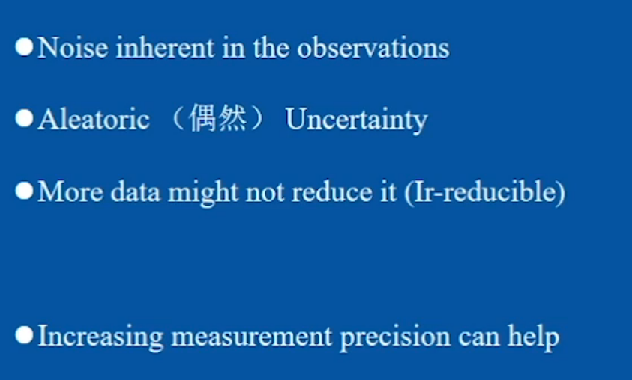
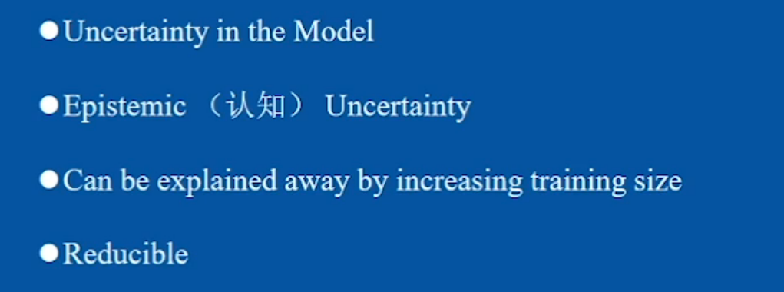
不确定性种类
Aleatoric Uncertainty
Epistemic Uncertainty

Slide 6
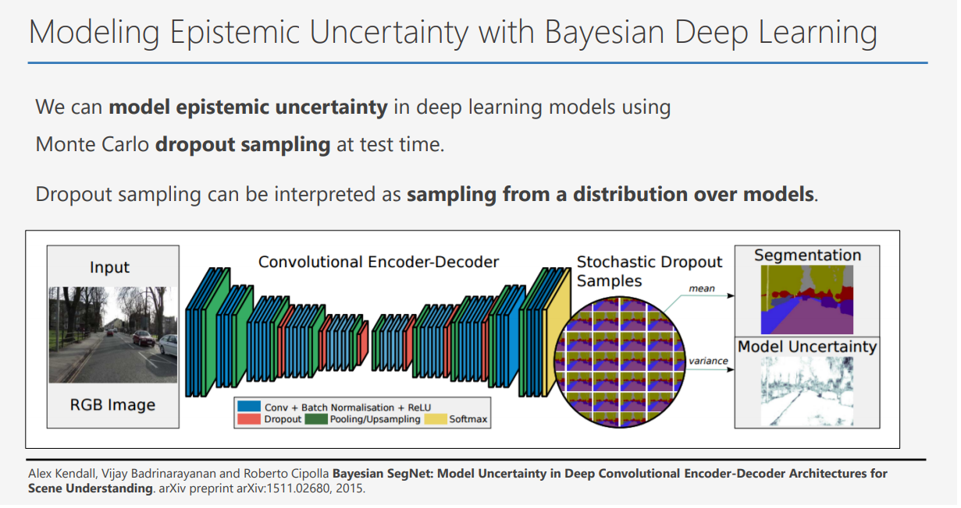

Slide 7
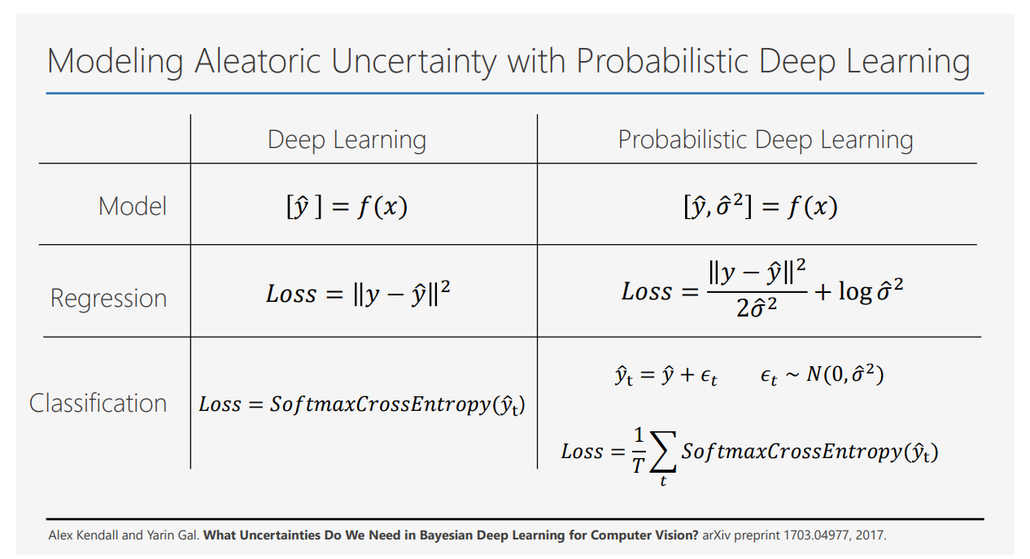

Slide 8
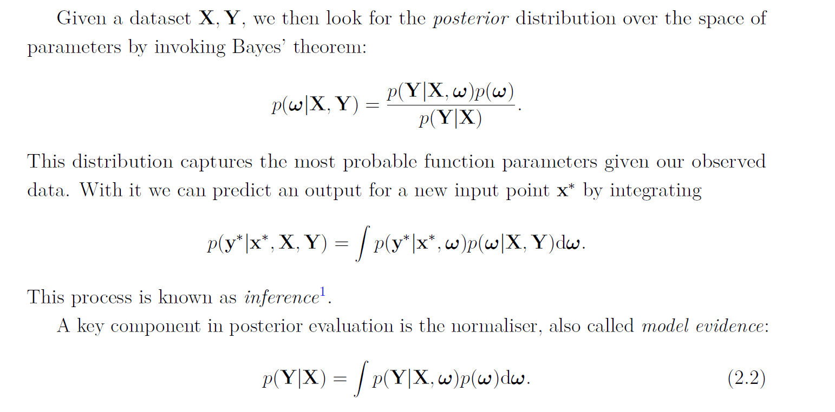
Dropout as Bayesian Approximation
Bayesian Modeling

Slide 9
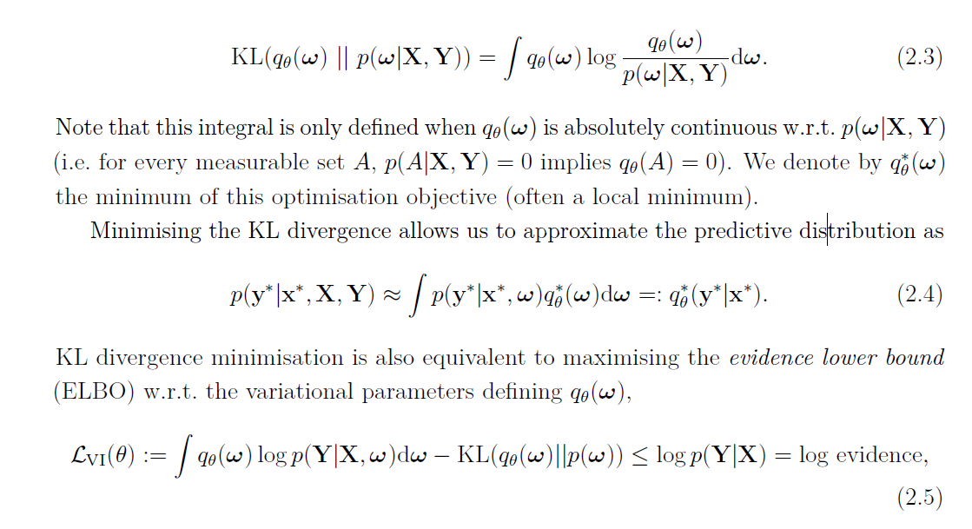
Variational Inference

Slide 10
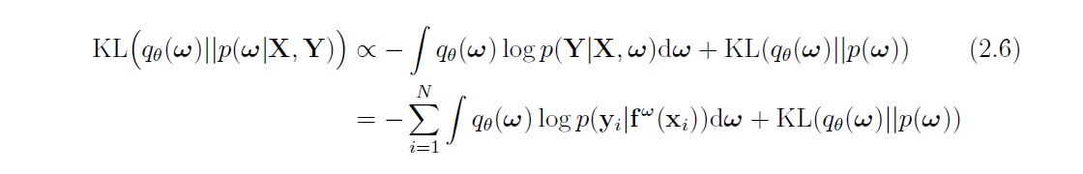

Slide 11
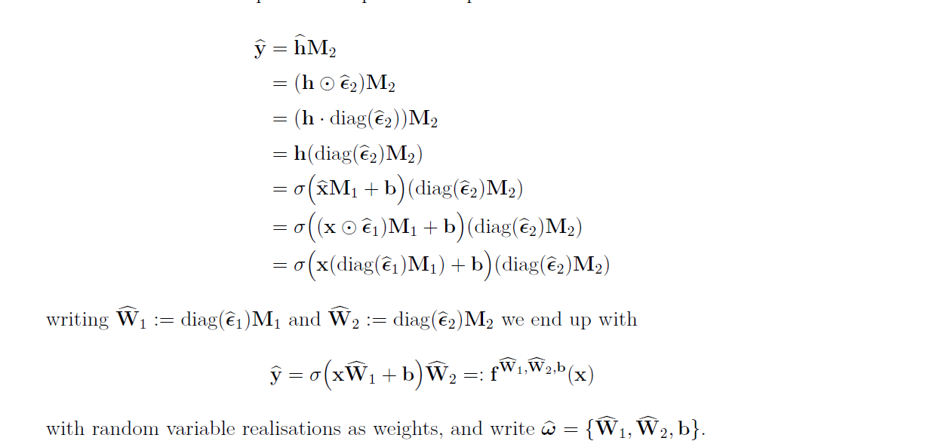
Neural Network with Dropout

Slide 12
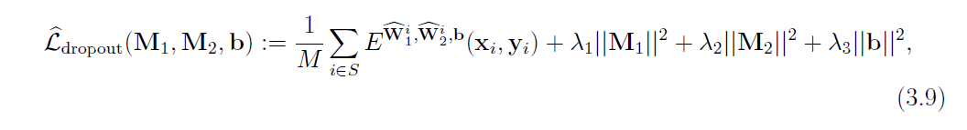
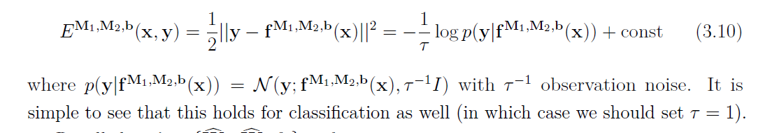
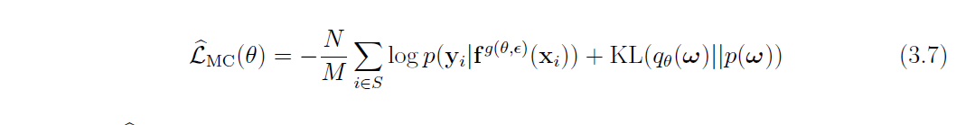

Slide 13
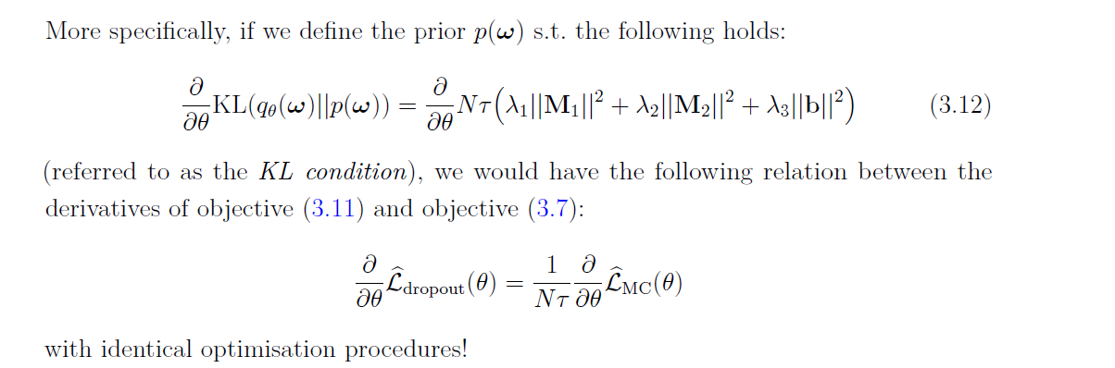

Slide 14
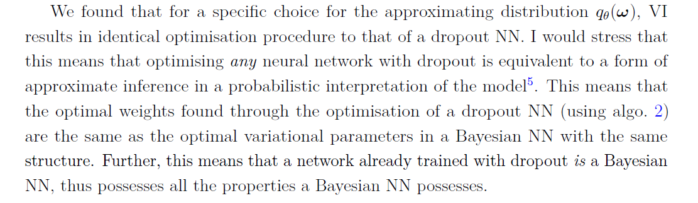
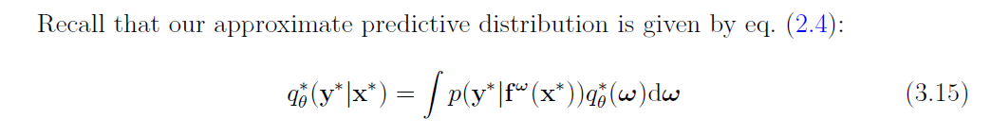

Slide 15
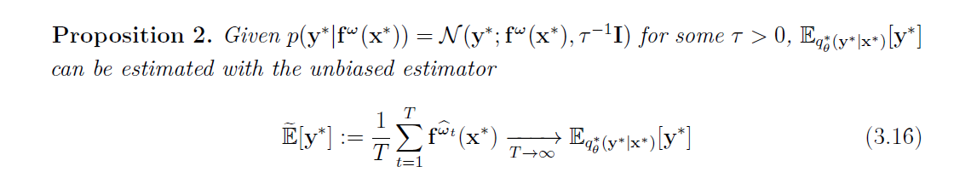
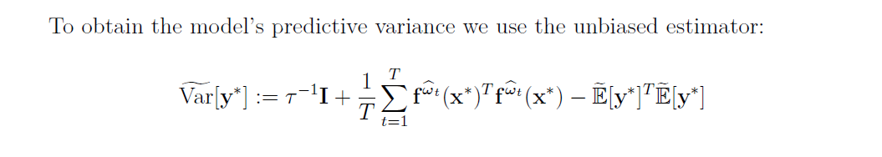

Slide 16
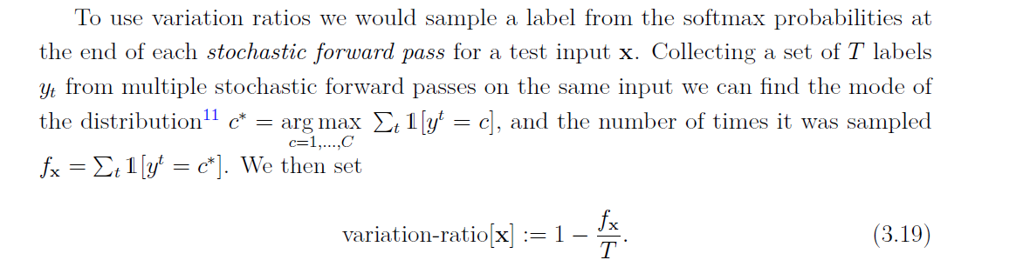
Variation Ratio

Slide 17
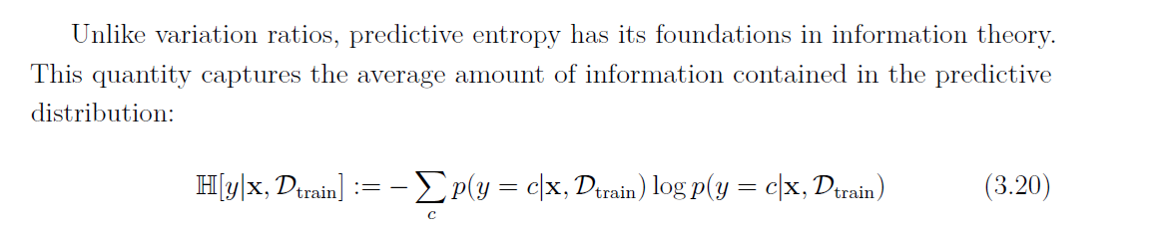
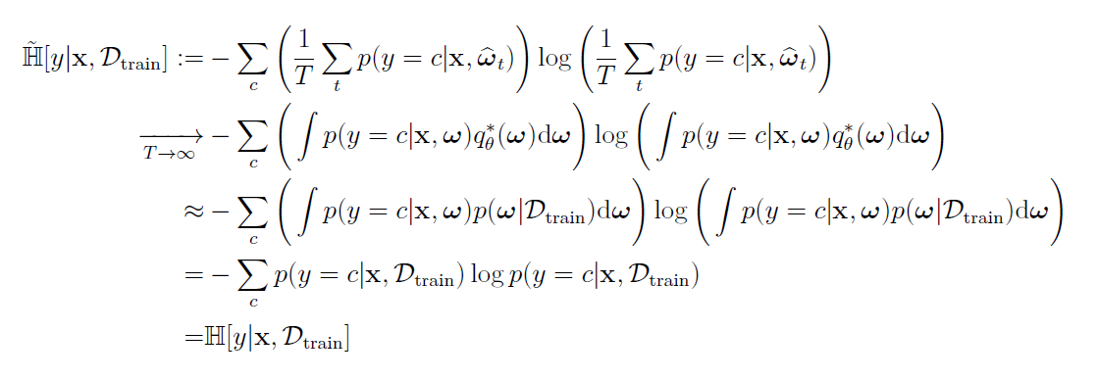
Predictive Entropy

Slide 18
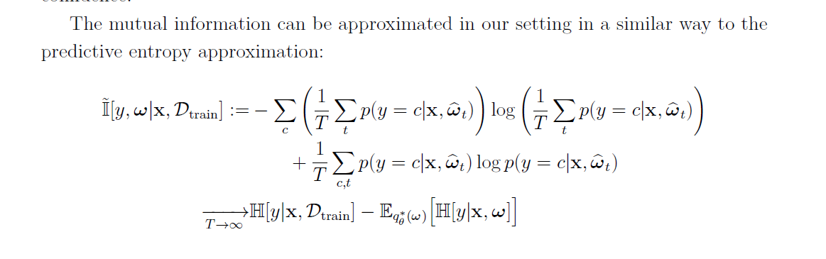
Mutual Information

Slide 19
Nair T, Precup D, Arnold D L, et al. Exploring uncertainty measures in deep networks for multiple sclerosis lesion detection and segmentation[J]. Medical image analysis, 2020, 59: 101557.
A. Jungo and M. Reyes, “Assessing Reliability and Challenges of Uncertainty Estimations for Medical Image Segmentation,” in MICCAI, 2019.

Slide 20
Thank You!

