Slide 1
进度汇报
胡敬玉
2019.12.19

Slide 2
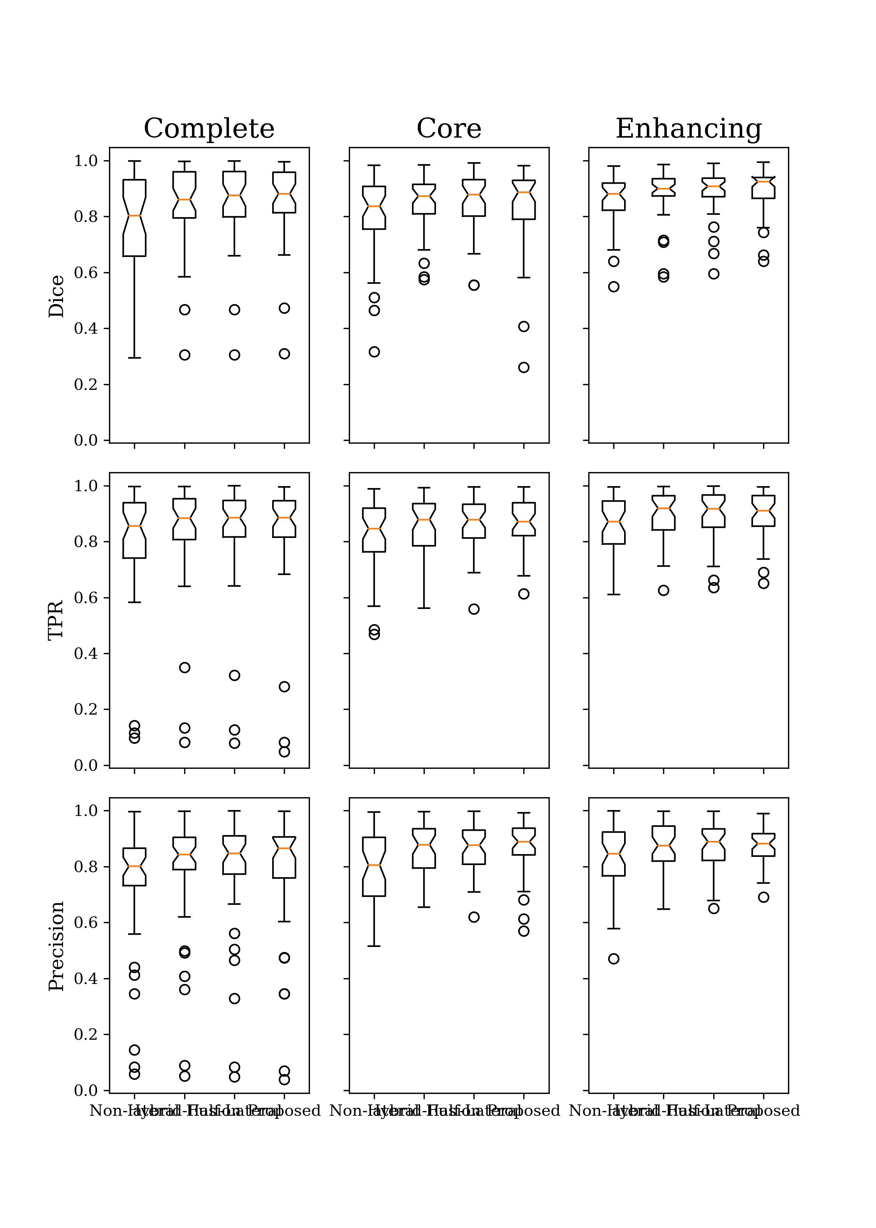

Slide 3
Origin

Slide 4
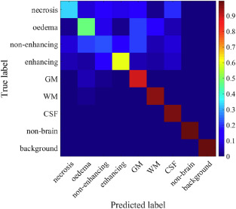

Slide 5
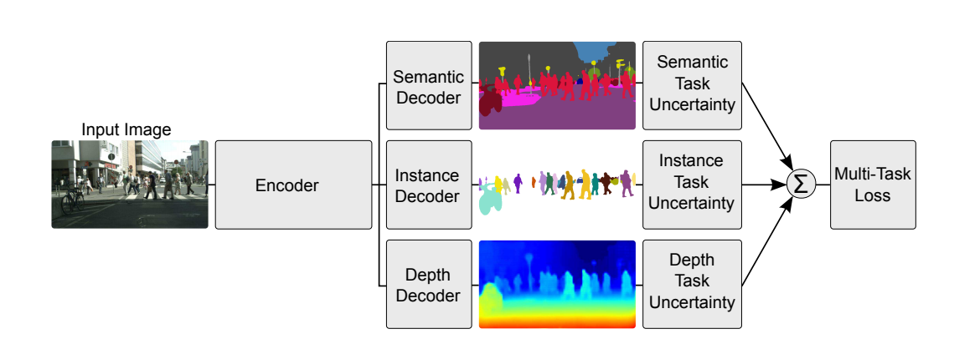
Kendall A, Gal Y, Cipolla R. Multi-task learning using uncertainty to weigh losses for scene geometry and semantics[C]//Proceedings of the IEEE Conference on Computer Vision and Pattern Recognition. 2018: 7482-7491.

Slide 6



为神经网络输出
条件独立
为了估计数据不确定性

Slide 7
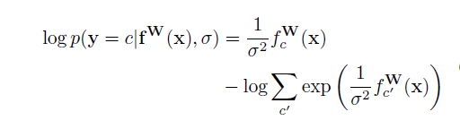

Slide 8
Thank You!

