Slide 1
Automatic alignment of infrared video frames for equipment leak detection Liming Zhou ∗, Yousheng Zeng
1980s
美国环保法
FID
人工成本高
IR
预处理需求

Slide 2
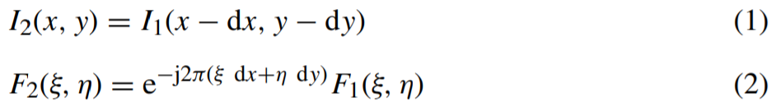
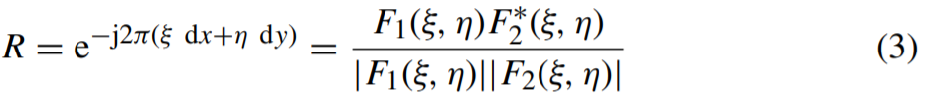
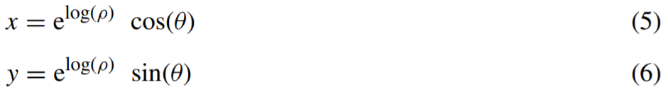
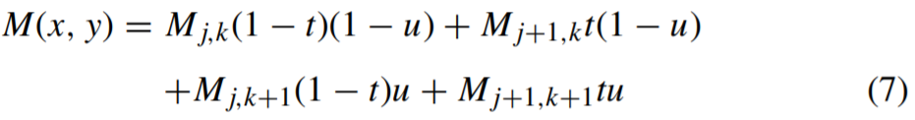
1.Choose a reference frame I1 for the video clip to be aligned. The frame I2 is to be aligned to I1.
2.Apply FFT to images I1 and I2 to obtain the Fourier transforms F1 and F2.
3.Transform the absolute values of F1 and F2 from Cartesian coordinates into log–polar coordinates to obtain F lp1 and F lp2.
4.Apply FFT to F lp1 and F lp2 and calculate the phase transfer R by Eq. (3) and then calculate P, the inverse Fourier transfer of R by Eq. (4).
4.1 Find the maximum |P| value at (x1, y1).
4.2 Among the four points (x1 ± 1, y1 ± 1), select point (x2, y2) with the largest |P| value.
4.3 Use Eqs. (8)–(11) with f(z) = zα and α = 1.55 to find the scaling and rotation factors. Rescale and rotate the original images to update I2.

Slide 3
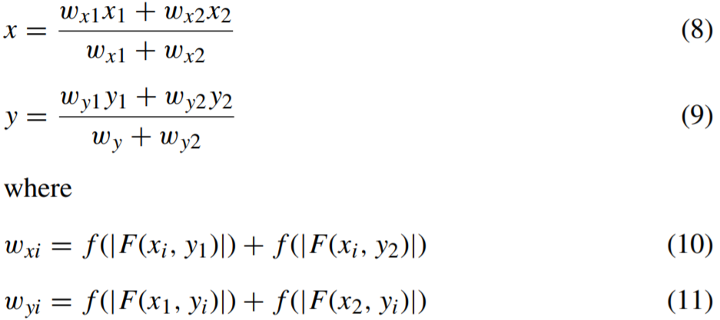
5. Apply FFT for I1 and I2 and calculate the phase transfer ratio of these two Fourier transforms.
6. Calculate the inverse Fourier transform obtained in Step 5. Use similar procedures in Steps 4.1–4.3 with α = 0.65 to calculate the shift. Then do reverse shift to image I2.
7. An erosion-dilation filter is used for the difference image ofI1 and I2. The erosion filter is a process using the minimum value of all eight neighboring pixels and the current pixel to replace the current pixel value. The dilation filter is a process using the maximum value of all eight neighboring pixels and the current pixel to replace the current pixel value. The filtered difference image is then added back to I1 to generate the finalized I2. This step is optional and different filter may be used for different processing purposes.
8. Replace I2 with the next frame to be aligned, go to 2. If no more frames to align, end.

Slide 4
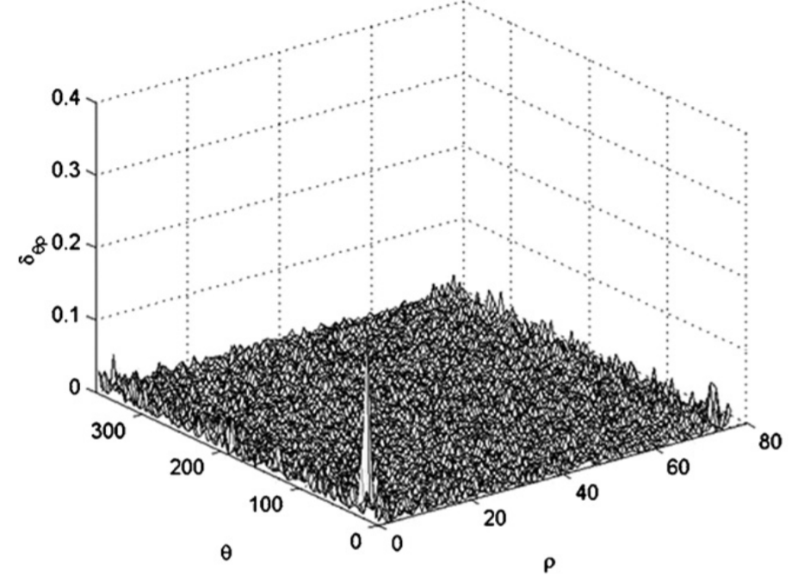
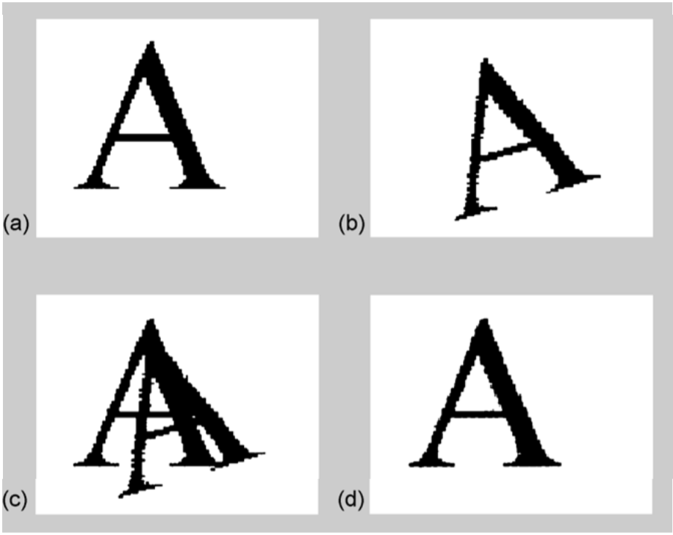
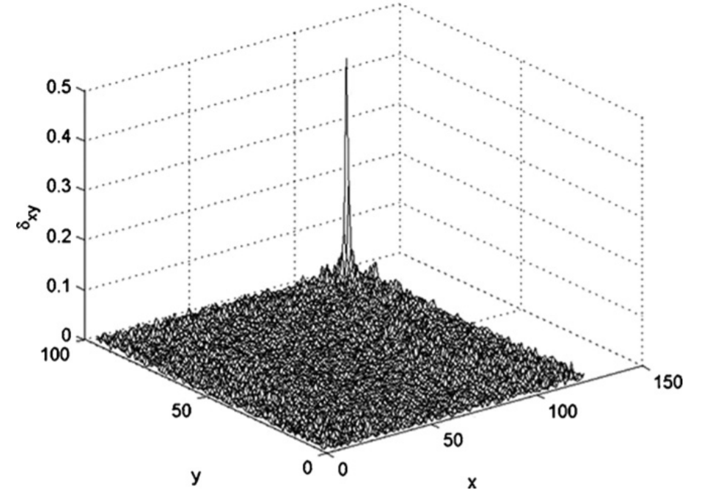
Delta functions of aligning simulated images:
(up) delta functions to determine rotation and scaling and
(down) delta functions to determine translation.
(a) target image
(b) image to be aligned
(c) overlay of target image and unaligned image
(d) overlay of target image and aligned image.

Slide 5
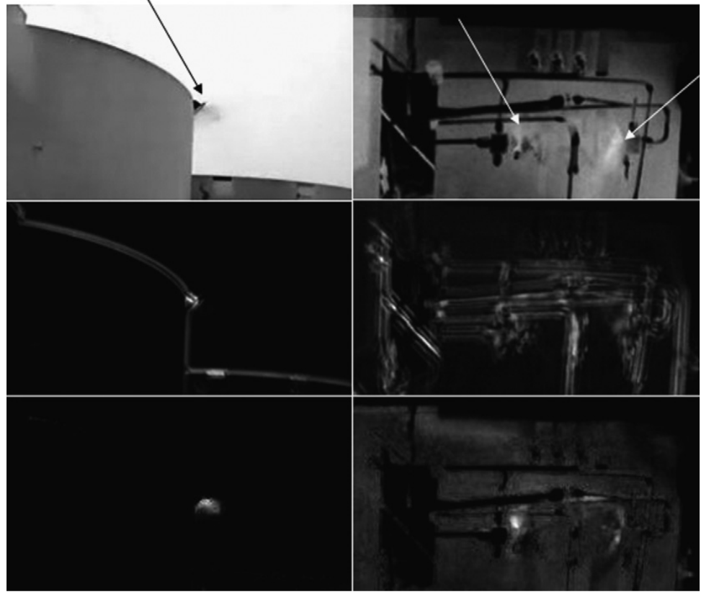
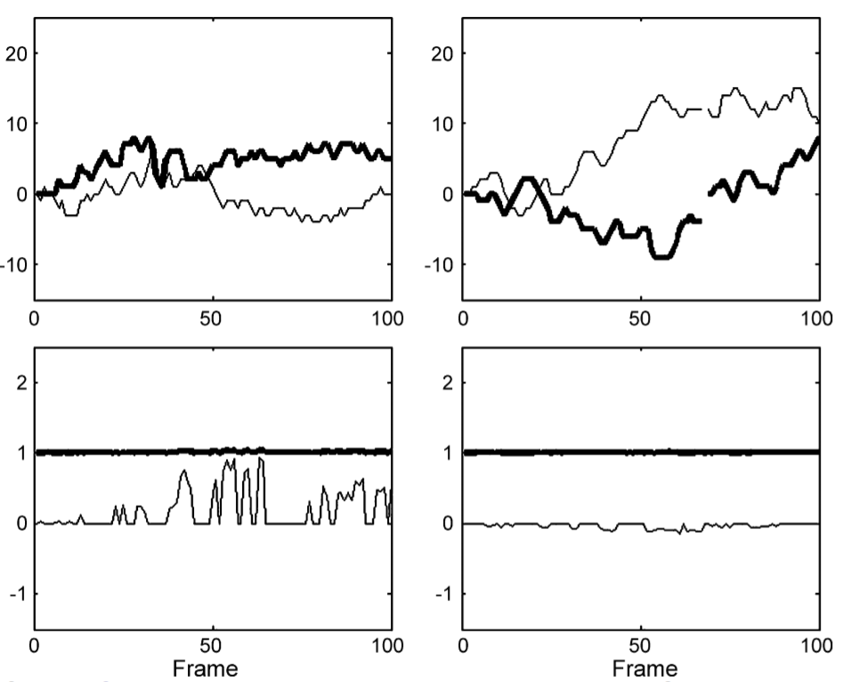
Alignment of actual IR videos—left column: “tank” video; right column: “pipe” video, (top) selected frame images from the videos, (middle) “Flickering” images without alignment, and (bottom) “Flickering” images with alignment.
Translational shift and rotational shift of actual IR videos—left column: “tank” video; right column: “pipe” video, (top) translational shift (thick line-vertical, thin line-horizontal), and (bottom) rotational and scaling shift (thick line-scaling, thin line-rotation).

