Slide 1
汇报
毛宽诚
2019/12/26

Slide 2
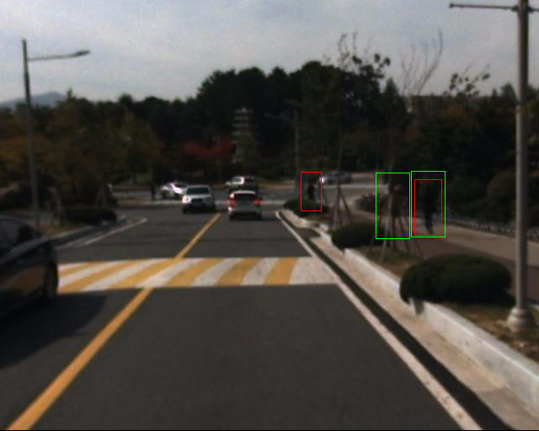
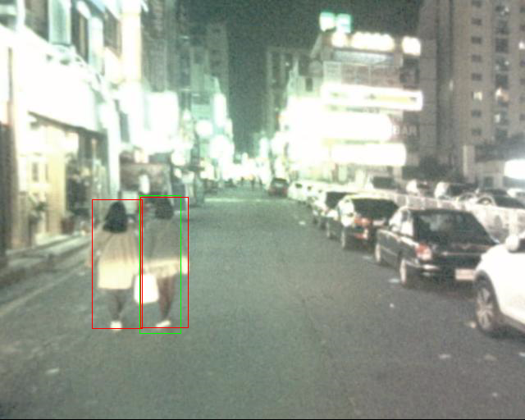

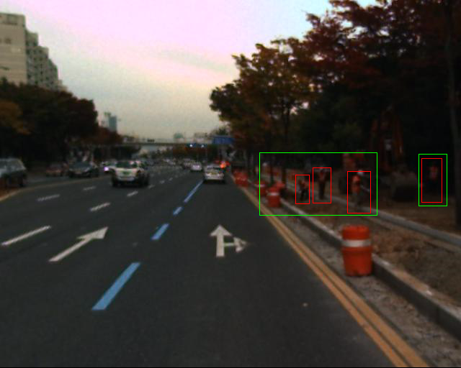
标注问题

Slide 3
测试集：test-all-20(set06-set11) 2252
方法 | Half fusion |  | rpn fusion |  | nms fusion
 | Roi pooling | Roi align | Roi pooling | Roi align | Roi align
All | 40.44%(28.11%) | 36.78%(22.91%) | 40.26%(27.90%) | 34.17%(19.17%) | 39.03% (26.46%)

Slide 4
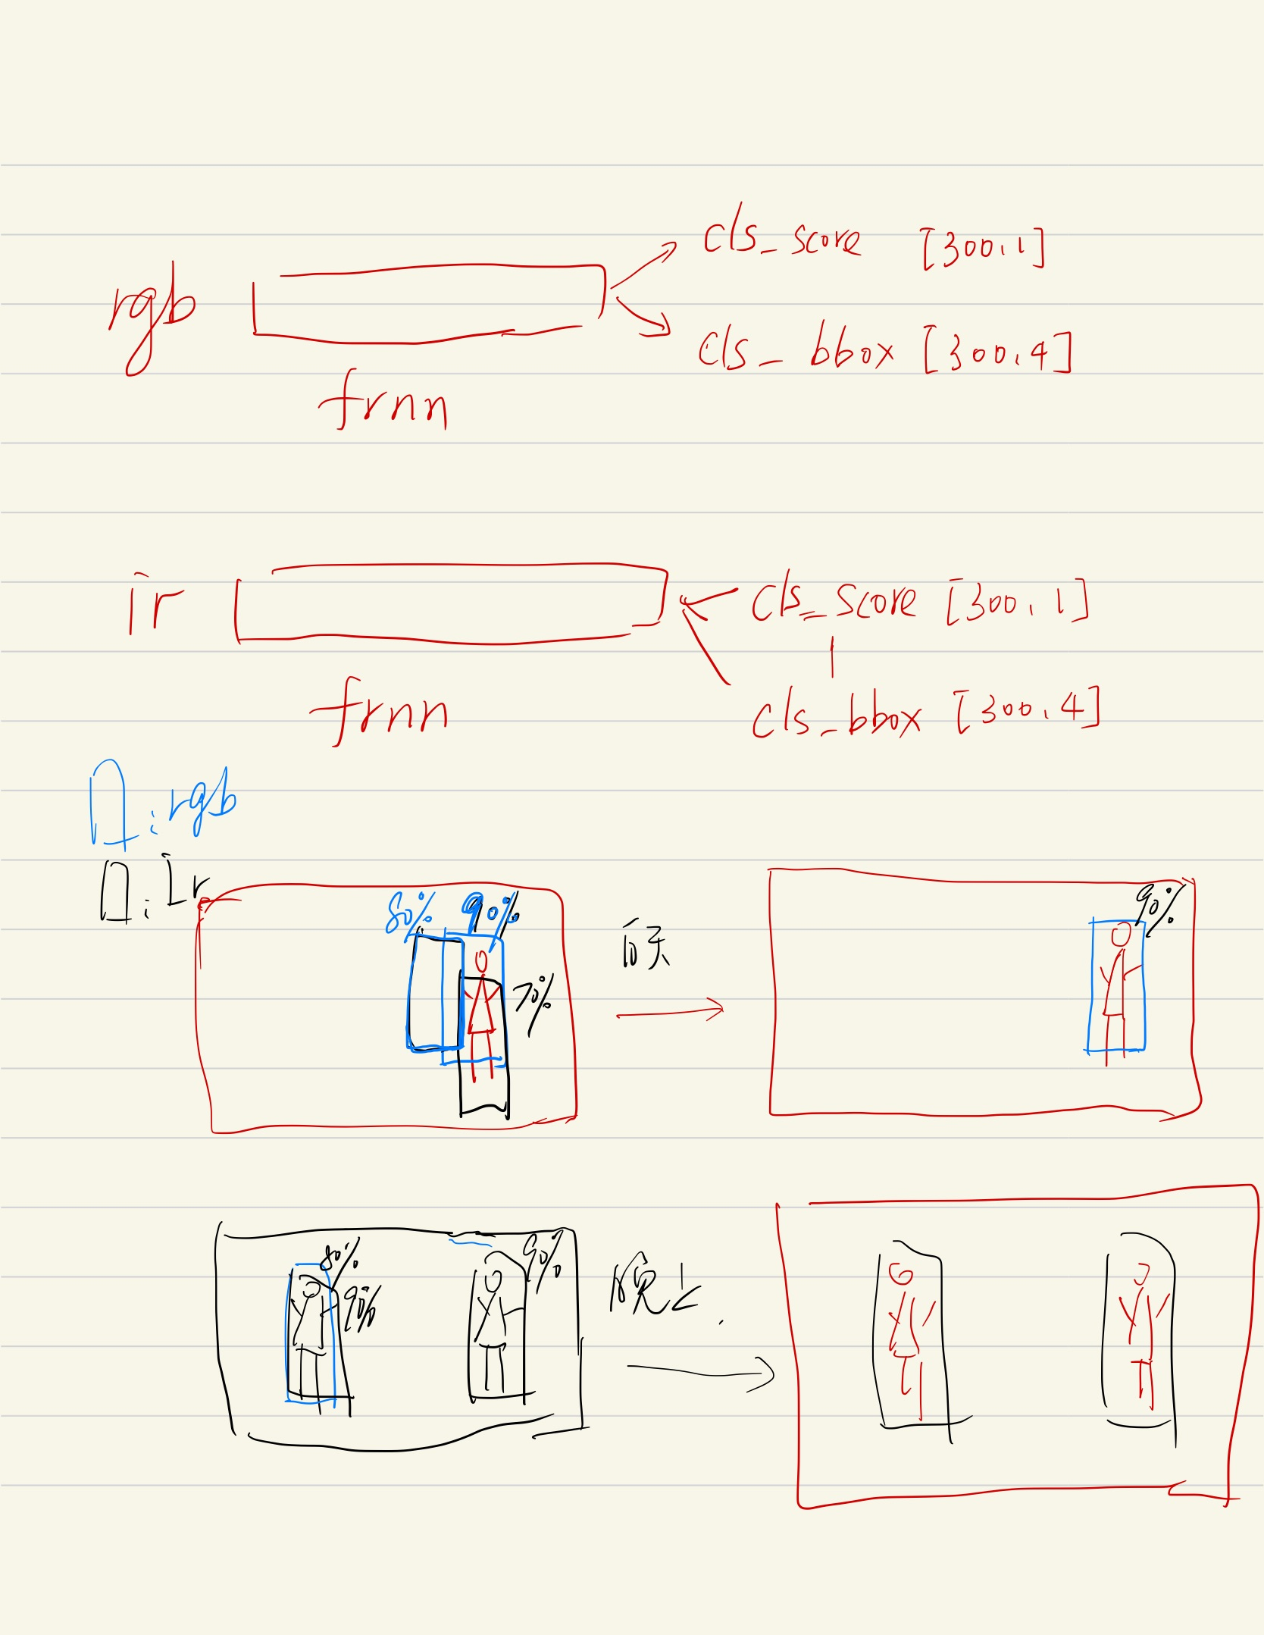
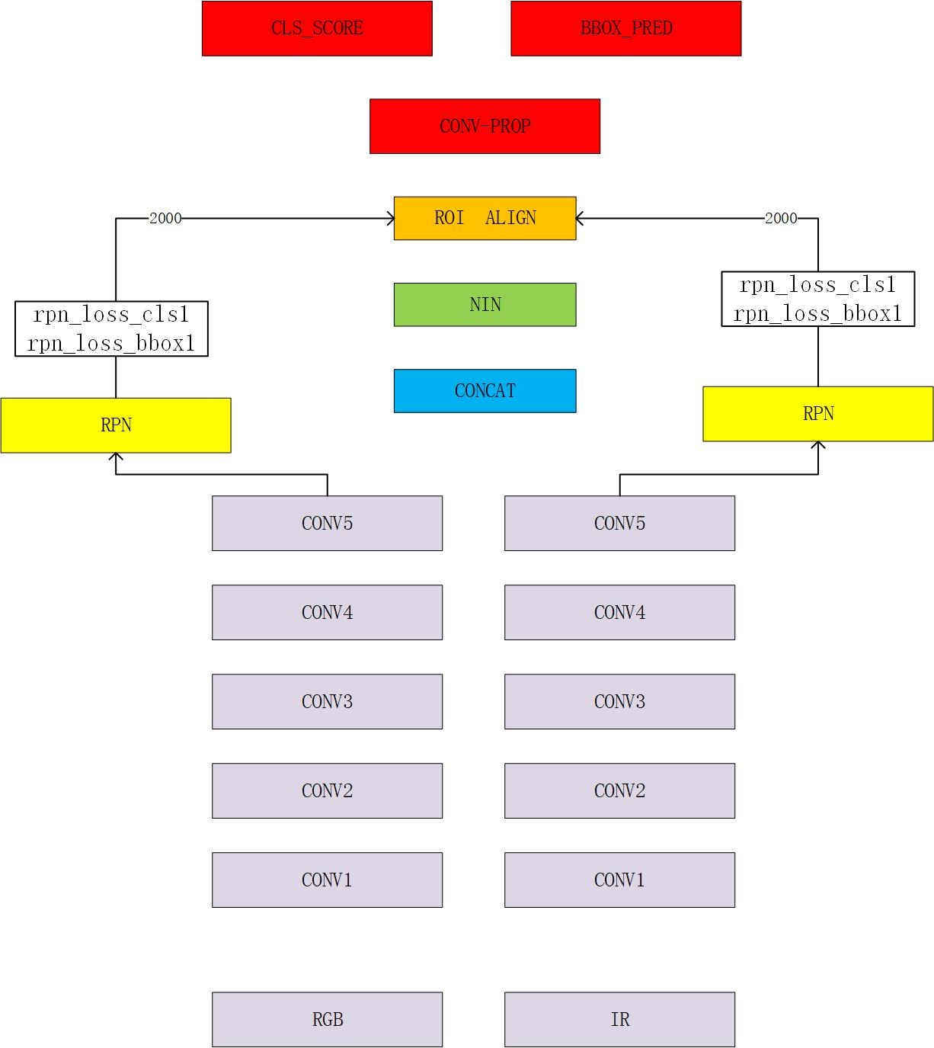
rpn fusion
nms fusion

Slide 5
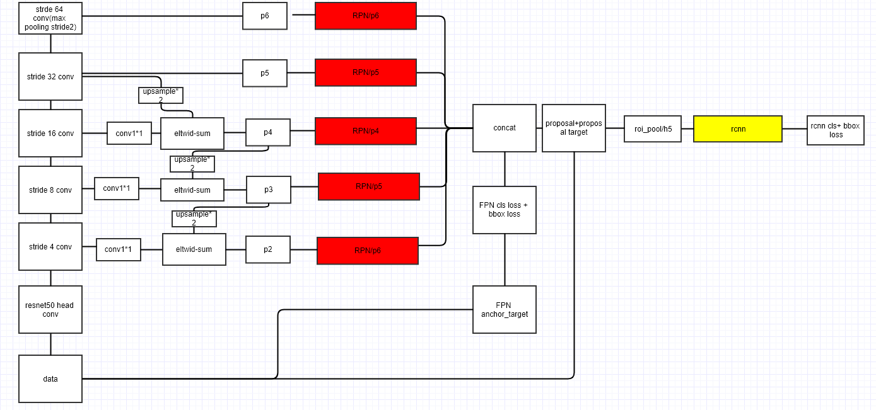
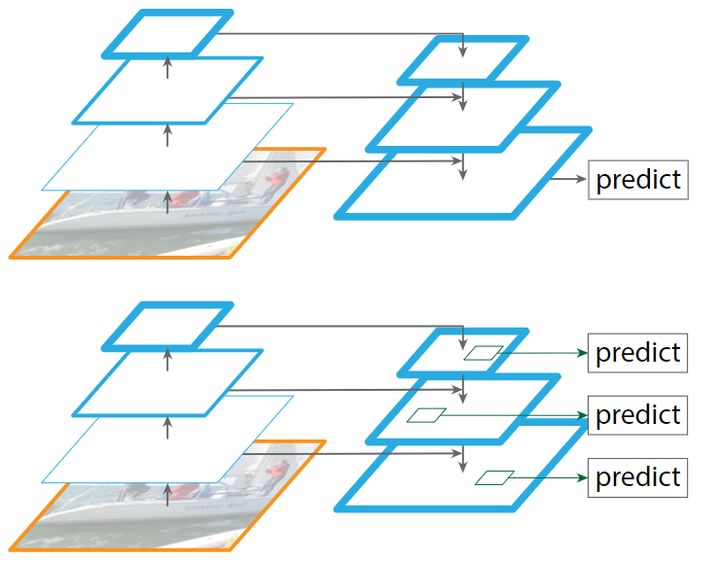
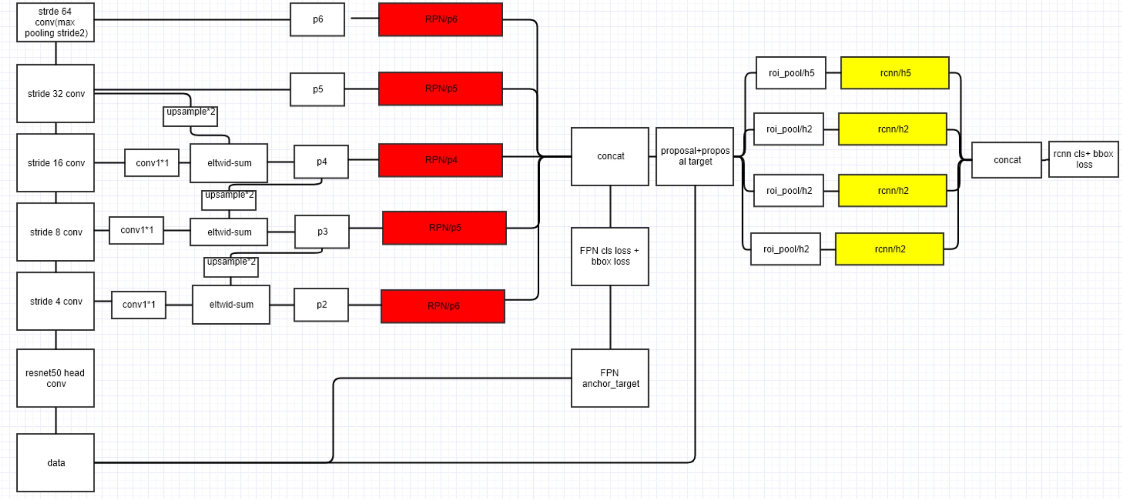

Slide 6
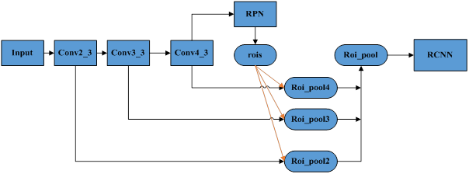
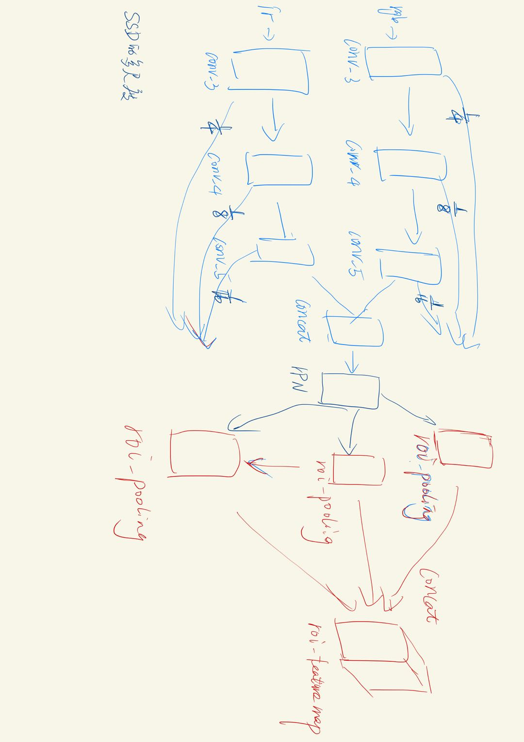
FPN

