Slide 1
汇报
毛宽诚
2020/01/02

Slide 2
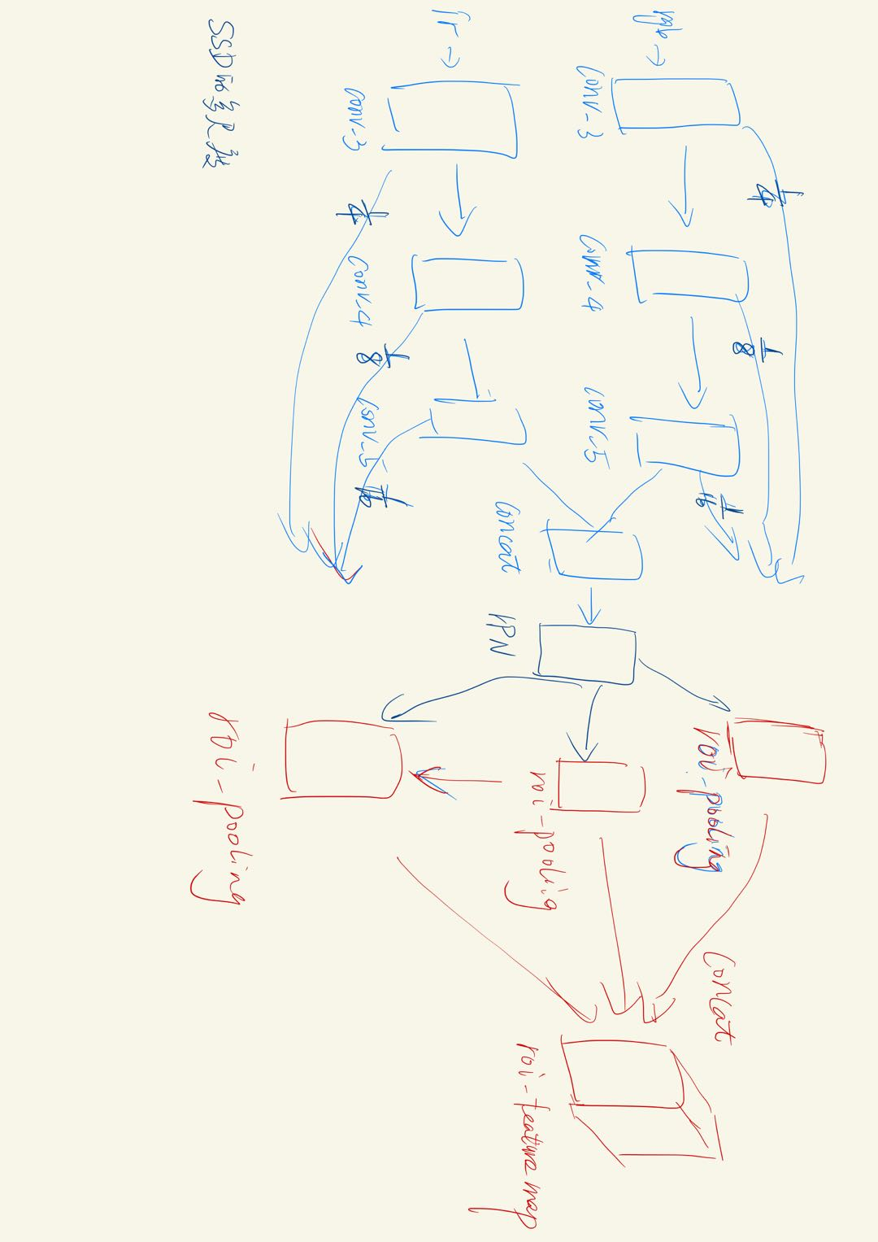
实验结果
Ratio: [1, 1.3, 1.7, 2.1, 2.3]
Scale:[8, 16, 24]
Resolution: 512 * 640
resize: 600 * 750
Downsample: x16
Conv5 feature map: 37 * 46
多分支roi-pooling:
Reasonable-all log-average miss rate = 38.15% (22.84%) recall = 83.76% (88.25%)
Reasonable-day log-average miss rate = 40.65% (24.12%) recall = 83.23% (87.97%)
Reasonable-night log-average miss rate = 33.04% (19.97%) recall = 85.07% (88.84%)
Scale=near log-average miss rate = 17.94% (2.46%) recall = 94.96% (99.50%)
Scale=medium log-average miss rate = 40.81% (29.21%) recall = 83.29% (85.50%)
Scale=far log-average miss rate = 72.75% (64.75%) recall = 66.38% (57.15%)
Occ=none log-average miss rate = 42.63% (39.73%) recall = 81.48% (77.30%)
Occ=partial log-average miss rate = 64.20% (52.66%) recall = 64.55% (68.49%)
Occ=heavy log-average miss rate = 79.24% (69.13%) recall = 40.74% (48.23%)

Slide 3
多分支roi pooling
Reasonable-all log-average miss rate = 38.15% (22.84%) recall = 83.76% (88.25%)
Reasonable-day log-average miss rate = 40.65% (24.12%) recall = 83.23% (87.97%)
Reasonable-night log-average miss rate = 33.04% (19.97%) recall = 85.07% (88.84%)
Scale=near log-average miss rate = 17.94% (2.46%) recall = 94.96% (99.50%)
Scale=medium log-average miss rate = 40.81% (29.21%) recall = 83.29% (85.50%)
Scale=far log-average miss rate = 72.75% (66.75%) recall = 66.38% (57.15%)
Occ=none log-average miss rate = 42.63% (39.73%) recall = 81.48% (77.30%)
Occ=partial log-average miss rate = 64.20% (52.66%) recall = 64.55% (68.49%)
Occ=heavy log-average miss rate = 79.24% (69.13%) recall = 40.74% (48.23%)
Nms fusion:
Reasonable-all log-average miss rate = 36.63% (23.63%) recall = 87.99% (92.23%)
Reasonable-day log-average miss rate = 39.21% (24.71%) recall = 87.48% (92.01%)
Reasonable-night log-average miss rate = 30.71% (21.16%) recall = 89.30% (92.70%)
Scale=near log-average miss rate = 14.54% (3.80%) recall = 94.96% (99.00%)
Scale=medium log-average miss rate = 41.00% (31.39%) recall = 85.20% (88.06%)
Scale=far log-average miss rate = 80.49% (72.11%) recall = 59.91% (62.45%)
Occ=none log-average miss rate = 42.90% (42.50%) recall = 83.52% (81.28%)
Occ=partial log-average miss rate = 63.53% (57.10%) recall = 79.39% (74.89%)
Occ=heavy log-average miss rate = 78.58% (71.84%) recall = 47.22% (54.87%)
Rpn fusion:
Reasonable-all log-average miss rate = 34.17% (19.17%) recall = 87.85% (91.68%)
Reasonable-day log-average miss rate = 34.62% (17.49%) recall = 88.07% (92.72%)
Reasonable-night log-average miss rate = 32.32% (22.32%) recall = 87.31% (89.48%)
Scale=near log-average miss rate = 12.21% (0.00%) recall = 97.06% (100.00%)
Scale=medium log-average miss rate = 37.77% (25.54%) recall = 85.87% (88.41%)
Scale=far log-average miss rate = 73.49% (66.47%) recall = 61.29% (56.51%)
Occ=none log-average miss rate = 39.53% (37.12%) recall = 84.38% (79.71%)
Occ=partial log-average miss rate = 59.36% (50.63%) recall = 73.94% (71.00%)
Occ=heavy log-average miss rate = 76.97% (69.11%) recall = 42.59% (53.98%)

Slide 4
分析：
1，评价方式 2，标注
3, 训练方法

Slide 5
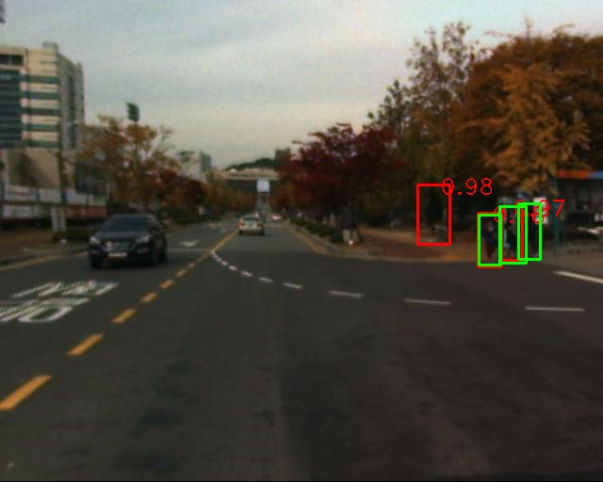
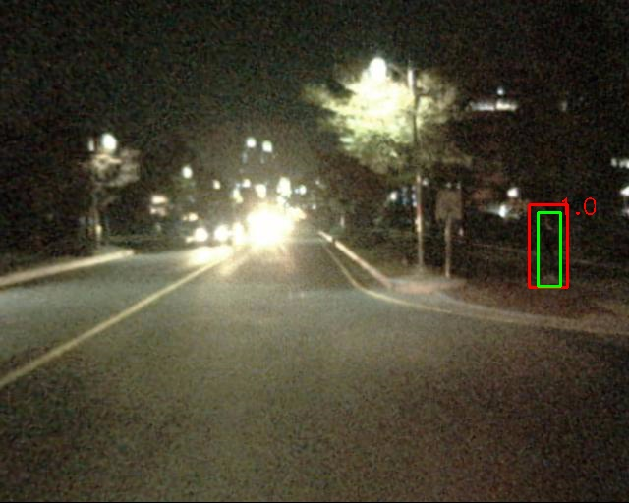
color图像模型，测试
训练集：train-all-02(set01-set05)
测试集：test-all-20(set06-set11)
2252张图片。
标签：person/people/people?/cyclist
训练：全部训练
测试：忽略 people/people?/cyclist
忽略 occlusion/小尺寸
仅统计person

Slide 6
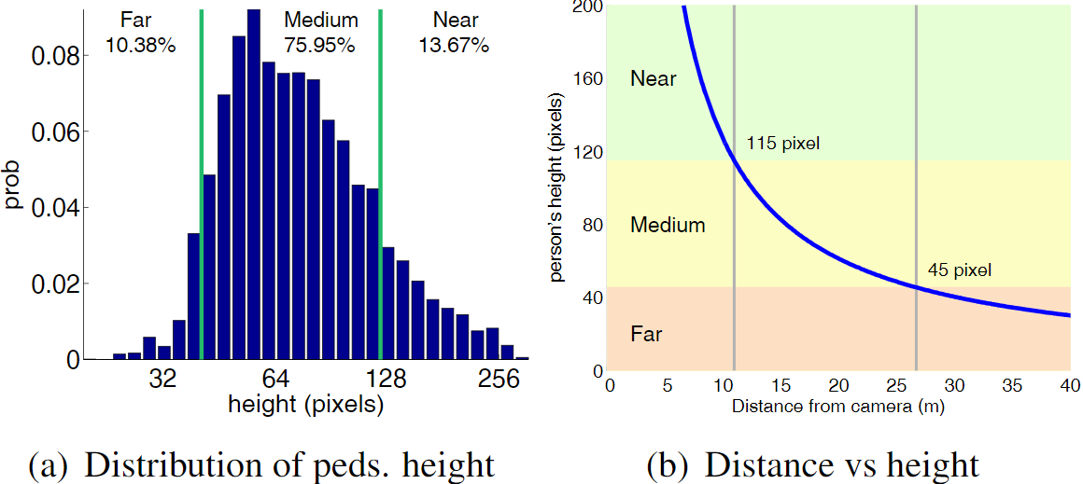
Occlusion
Not occluded | 78.6%
Partial occlusion | 12.6%
Heavy occlusion | 8.8%
Scale
Near | 13.67%
medium | 75.95%
far | 10.33%

Slide 7
方法及结果：
文献 | 方法 | Miss Rate (Resoonable-All)
[1] | ACF+T+THOG | 64.76%
[2] | LateFusion CNN | 43.80%
[3] | CMT-CNN | 49.55%
[4] | Halfway Fusion | 36.22%
[5] | FusionRPN + boost decision tree | 29.83%
[6] | CIAN | 30.74%
[7] | CWF+APF | 31.36%
[8] | FRPN+TSS | 26.67%
[9] | IATDNN+IAMSS | 26.37%
[10] | IAF-RCNN | 16.53%
[11] | MSDS-RCNN | 11.63%
[12] | HMFFN | 0.854(pixel -level ap)
[13]
[14] | SMDA | 0.8690(pixel-level ap)
[15] | AR-CNN | 9.34%
[16] | GFD-SSD | 28.00%

Slide 8
[1]Soonmin Hwang, Jaesik Park, Namil Kim, Yukyung Choi, and In So Kweon. Multispectral pedestrian detection: Benchmark dataset and baseline. In IEEE Conference on Computer Vision and Pattern Recognition, pages 1037¨C1045. IEEE, 2015.
[2]Wagner J, Fischer V, Herman M, et al. Multispectral Pedestrian Detection using Deep Fusion Convolutional Neural Networks
[3]Xu D, Ouyang W, Ricci E, et al. Learning cross-modal deep representations for robust pedestrian detection[C]//Proceedings of the IEEE Conference on Computer Vision and Pattern Recognition. 2017: 5363-5371.
[4]Liu J, Zhang S, Wang S, et al. Multispectral Deep Neural Networks for Pedestrian Detection[J]. 2016.
[5] König D, Adam M, Jarvers C, et al. Fully Convolutional Region Proposal Networks for Multispectral Person Detection[C]// IEEE Conference on Computer Vision and Pattern Recognition Workshops. IEEE Computer Society, 2017:243-250.
[6]hang L, Liu Z, Zhang S, et al. Cross-modality interactive attention network for multispectral pedestrian detection[J]. Information Fusion, 2019, 50: 20-29.
[7]Park K , Kim S , Sohn K . Unified Multi-spectral Pedestrian Detection Based on Probabilistic Fusion Networks[J]. Pattern Recognition, 2018:S0031320318300906.
[8]Guan D, Cao Y, Yang J, et al. Exploiting fusion architectures for multispectral pedestrian detection and segmentation[J]. Applied optics, 2018, 57(18): D108-D116.
[9]Guan D, Cao Y, Yang J, et al. Fusion of multispectral data through illumination-aware deep neural networks for pedestrian detection[J]. Information Fusion, 2019, 50: 148-157.
[10] Li C, Song D, Tong R, et al. Illumination-aware faster R-CNN for robust multispectral pedestrian detection[J]. Pattern Recognition, 2019, 85: 161-171.
[11]Li C, Song D, Tong R, et al. Multispectral pedestrian detection via simultaneous detection and segmentation[J]. arXiv preprint arXiv:1808.04818, 2018. （BMVC2018）
[12]Cao Y, Guan D, Wu Y, et al. Box-level segmentation supervised deep neural networks for accurate and real-time multispectral pedestrian detection[J]. ISPRS journal of photogrammetry and remote sensing, 2019, 150: 70-79.
[13] Cao Y, Guan D, Huang W, et al. Pedestrian detection with unsupervised multispectral feature learning using deep neural networks[J]. Information Fusion, 2019, 46: 206-217.
[14] Guan D, Luo X, Cao Y, et al. Unsupervised Domain Adaptation for Multispectral Pedestrian Detection[C]//Proceedings of the IEEE Conference on Computer Vision and Pattern Recognition Workshops. 2019: 0-0.
[15] Zhang L, Zhu X, Chen X, et al. Weakly aligned cross-modal learning for multispectral pedestrian detection[C]//Proceedings of the IEEE International Conference on Computer Vision. 2019: 5127-5137.
[16] Zheng Y, Izzat I H, Ziaee S. GFD-SSD: Gated Fusion Double SSD for Multispectral Pedestrian Detection[J]. arXiv preprint arXiv:1903.06999, 2019.

