Slide 1
进度汇报
康萌萌
2020.01.02

Slide 2
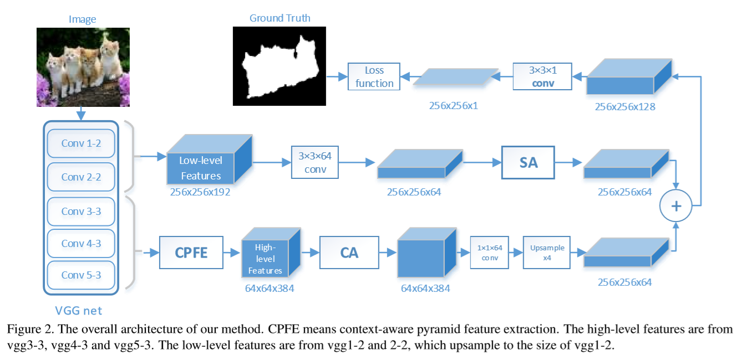
Pyramid Feature Attention Network

Slide 3
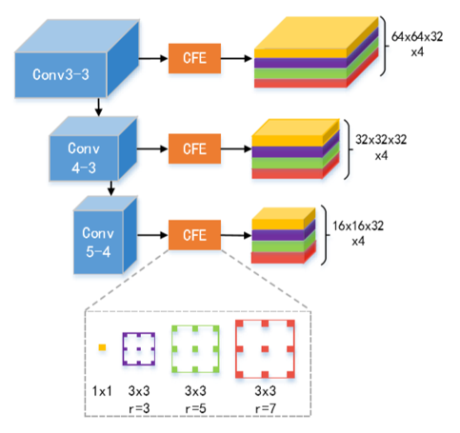
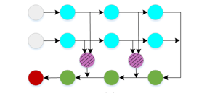
实验结果
Dataset B
Model | mIoU | mAcc
PFANet(RGB) | 46.3 | 57.2
PFANet(RGB-IR) | 48.2 | 59.6
Model | mIoU | mAcc
SegNet*(RGB-IR) | 52.8 | 65.9
SegNet*+CPFE+CA(RGB-IR) | 51.2 | 64.8
SegNet*+CA(RGB-IR) | 53.5 | 66.7
SegNet*
CPFE

