Slide 1
进度汇报
胡敬玉
2020.1.2

Slide 2
C. Chen, X. Liu, M. Ding, J. Zheng, and J. Li, “3D Dilated Multi-Fiber Network for Real-time Brain Tumor Segmentation in MRI,” In MICCAI , Sep. 2019.

Slide 3
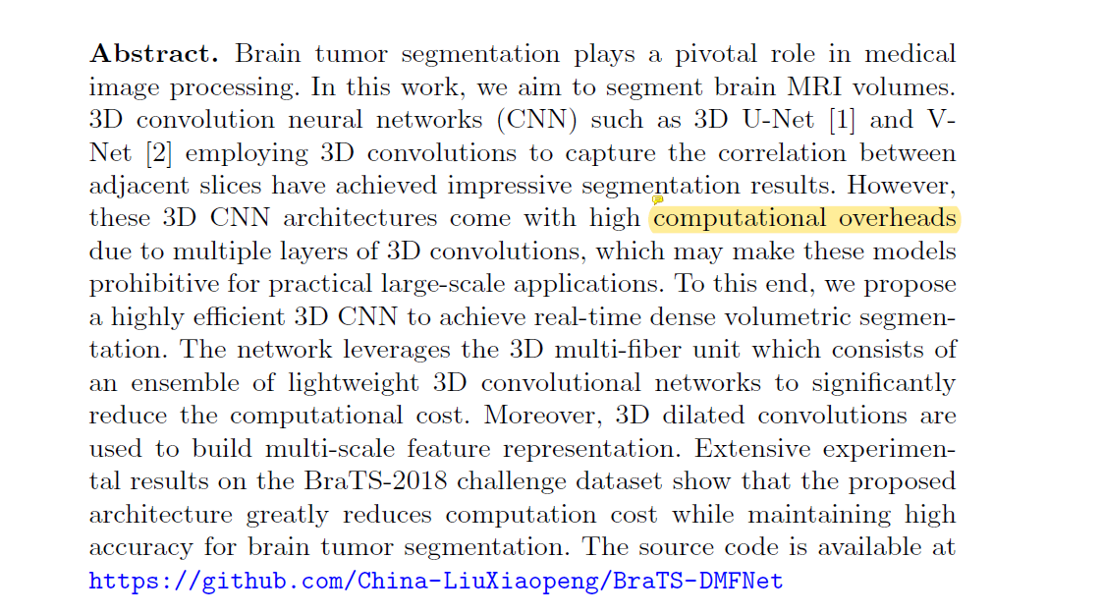

Slide 4
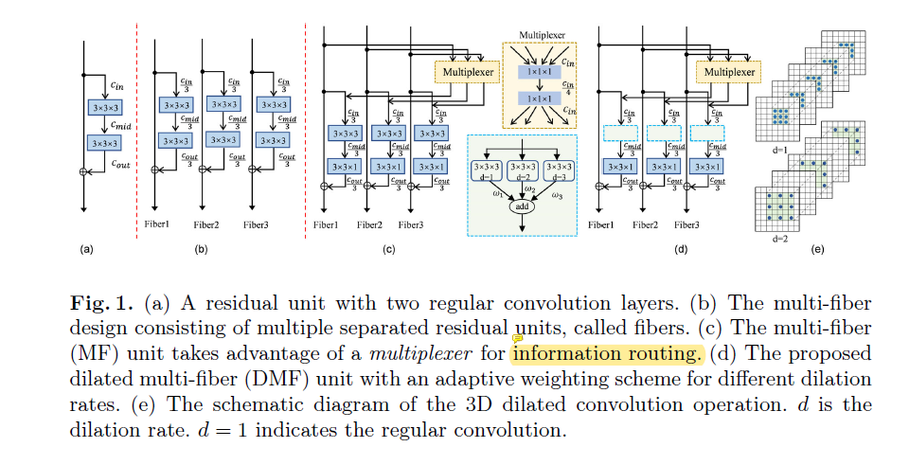
原理图

Slide 5
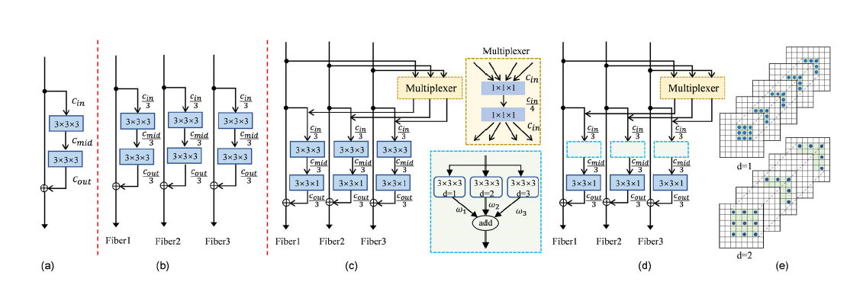


Slide 6
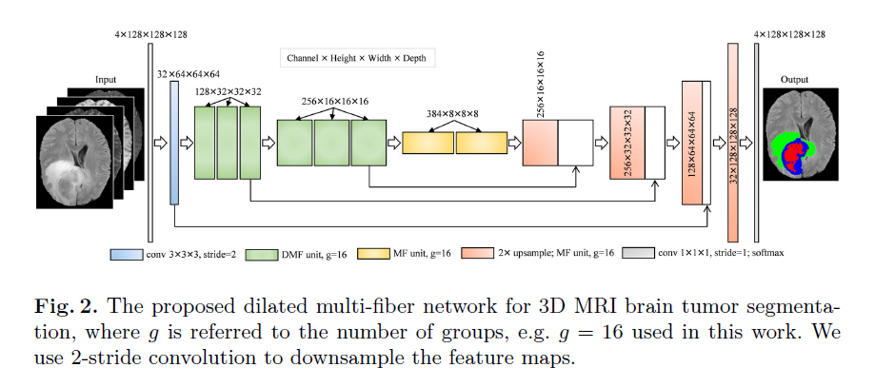
模型图

Slide 7
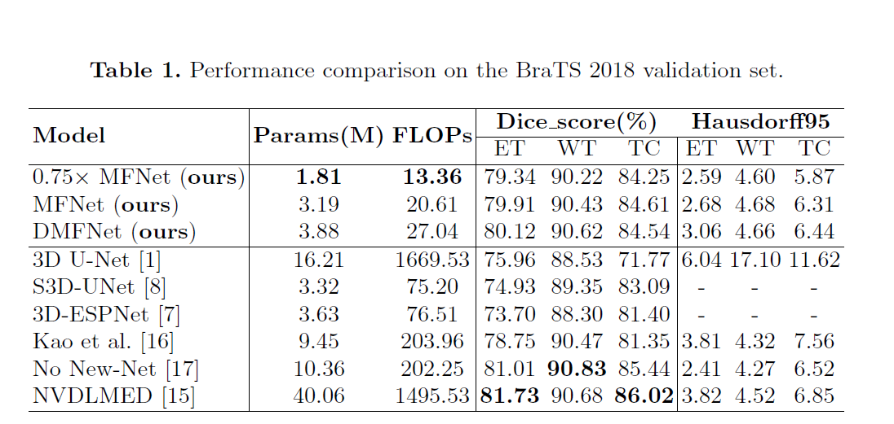
实验结果

Slide 8
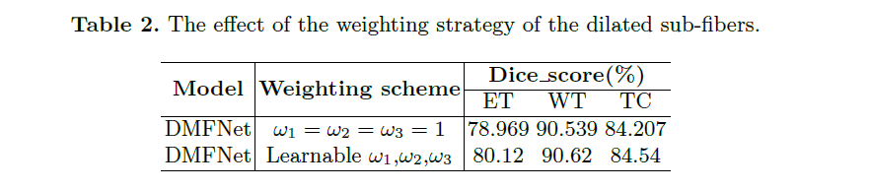

Slide 9
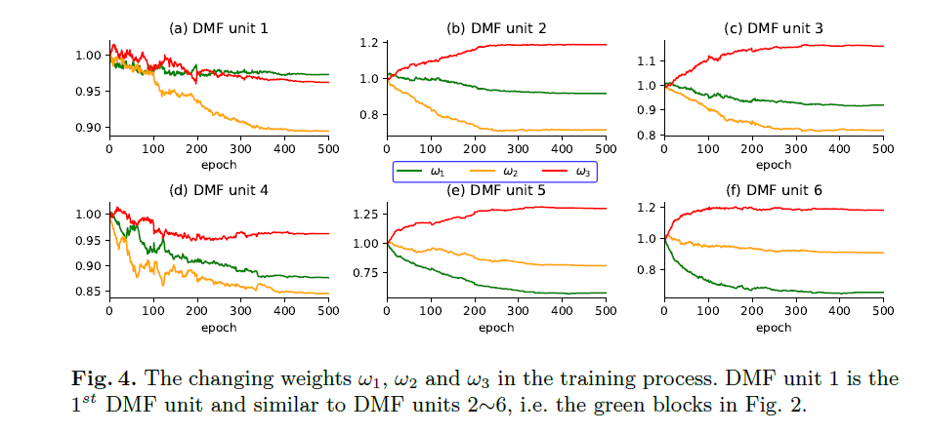

Slide 10
Thank You!

