Slide 1
汇报
毛宽诚
2020/01/09

Slide 2
参考文献
神经网络量化方法
Krishnamoorthi R. Quantizing deep convolutional networks for efficient inference: A whitepaper[J]. arXiv preprint arXiv:1806.08342, 2018.
TensorRT presentation http://on-demand.gputechconf.com/gtc/2017/presentation/s7310-8-bit-inference-with-tensorrt.pdf
.ncnn开源项目：https://github.com/Tencent/ncnn

Slide 3
神经网络量化方法
二值网络
三值网络
Int8
Tensorflow
Ncnn
tensorrt
Ristretto（一个框架）
定点法
动态定点法
迷你浮点法
乘法移位

Slide 4
Int8量化
将fp32的数据用int8来表示，用离散低精度整数表示连续高精度浮点数
优点：
占用更少的存储空间，理论上减少4倍
计算速度更快，利用硬件特性使用更加底层的优化手段
缺点：
精度丢失
训练后量化
只对权重量化
对权重和激活输出量化
训练时量化
逐层量化
量化后finetune
Int8(-127 - +127)
Uint8(0 - 255)

Slide 5
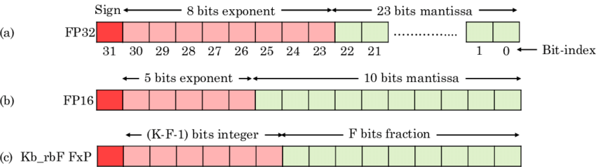
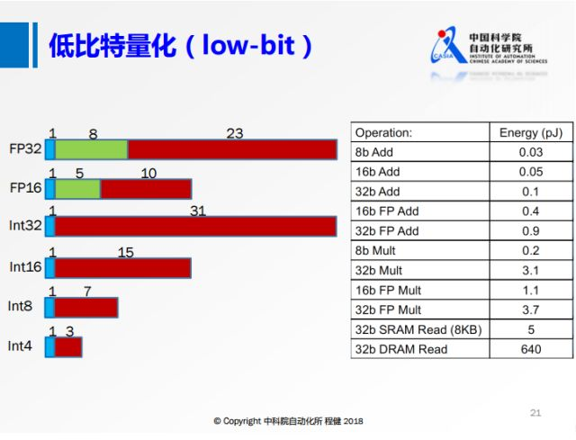

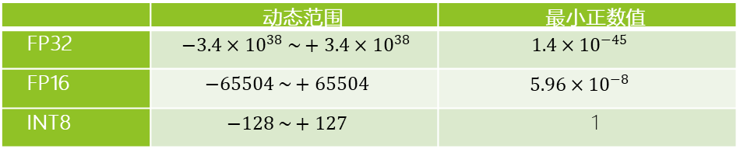



计算机数据表示
FP$={(−1)}^{S}{M∗2}^{E}$
FP32$={(−1)}^{S}{(2^{23})∗2}^{128}$
INT$={(−1)}^{S}2^{I}$
int8$=2^{8}$
 | 动态范围 | 最小正数值
FP32 | $−3.4×{10}^{38} \sim +3.4×{10}^{38}$ | $$1.4×{10}^{−45}$$
FP16 | $$−65504 \sim +65504$$ | $$5.96×{10}^{−8}$$
INT8 | $$−128 \sim +127$$ | 1

Slide 6
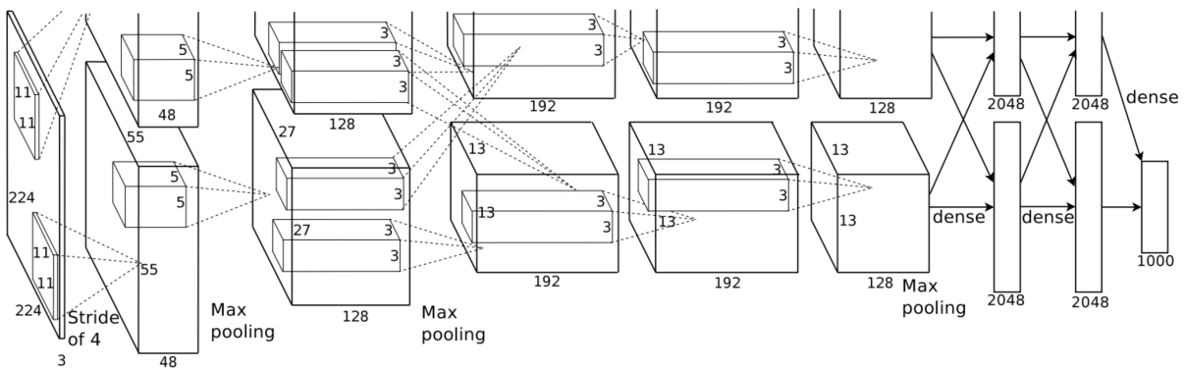
Int8量化原理
对权值和激活值(feature map)进行低int8表示

Slide 7
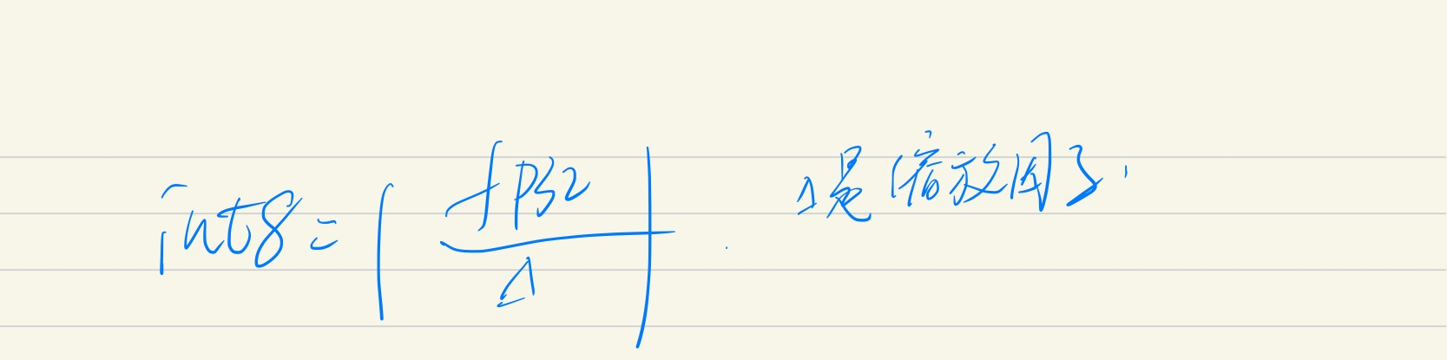


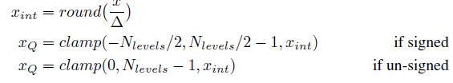


Int8量化原理
Uniform Affine Quantizer
Uniform symmetric quantizer
Stochastic quantizer

Slide 8
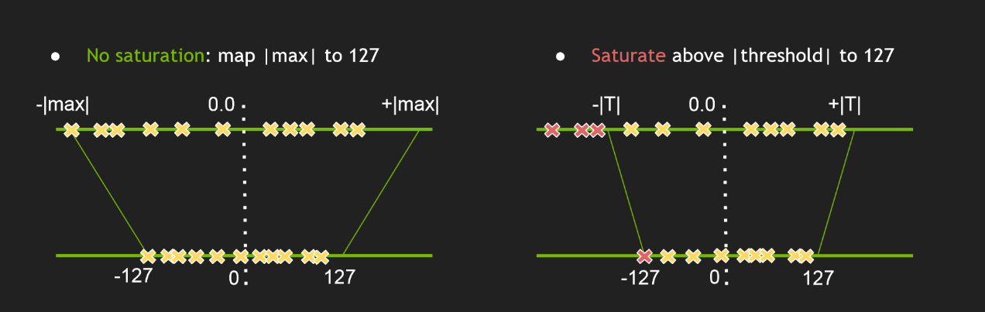
TensorRT int8
简单的将一个Tensor中的-|max|和|max| FP32 value 映射为 -127 和 127 ，中间值按照线性关系进行映射。称这种映射关系为不饱和映射，是对称的映射。
存在一个阈值|T|，将±|T|映射为±127，这里 |T|<|max|。超出阈值±|T| 外的直接映射为阈值±127。称这种映射关系为饱和映射，是不对称的映射

Slide 9
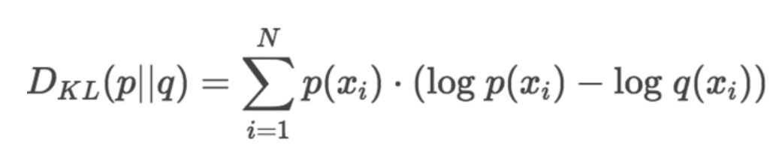
TensorRT int8
缩放参数Δ
饱和阈值T
使用KL散度来计算T
求出T，缩放参数就很好求了

Slide 10
NCNN int8 流程

Slide 11
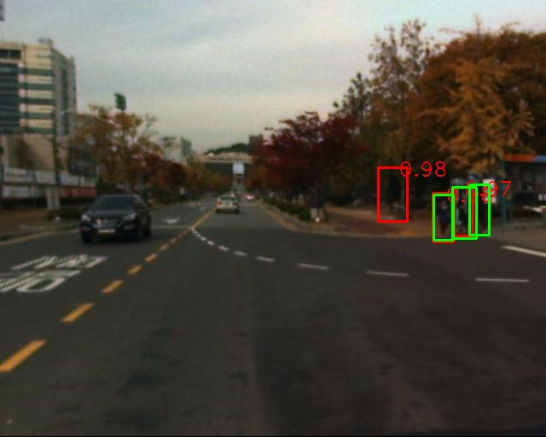
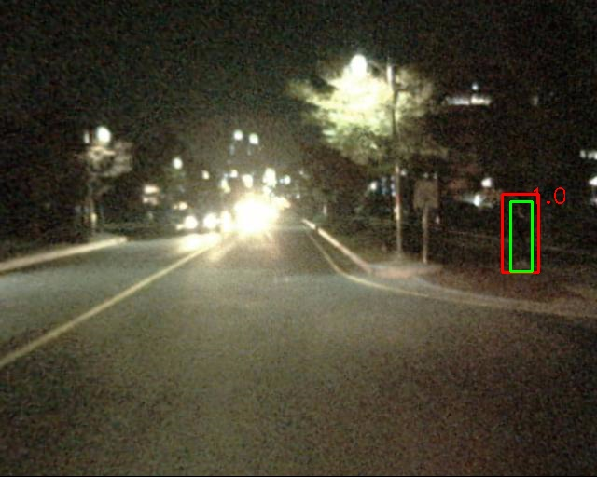
测试集
训练集：train-all-02(set01-set05)
测试集：test-all-20(set06-set11)
2252张图片。
标签：person/people/people?/cyclist
训练：全部训练
测试：忽略 people/people?/cyclist
忽略 occlusion/小尺寸
仅统计person

Slide 12
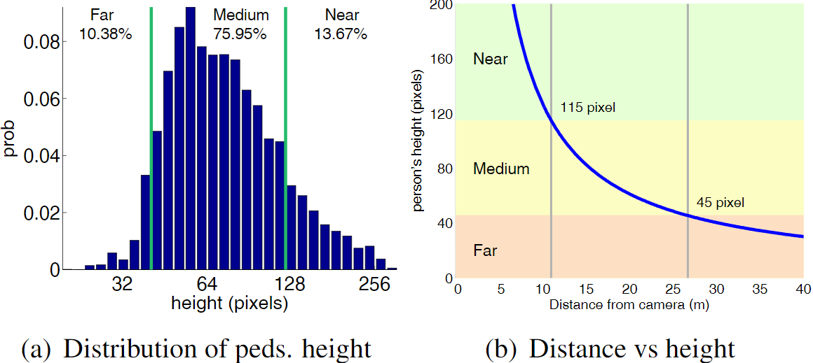
Occlusion
Not occluded | 78.6%
Partial occlusion | 12.6%
Heavy occlusion | 8.8%
Scale
Near | 13.67%
medium | 75.95%
far | 10.33%

Slide 13
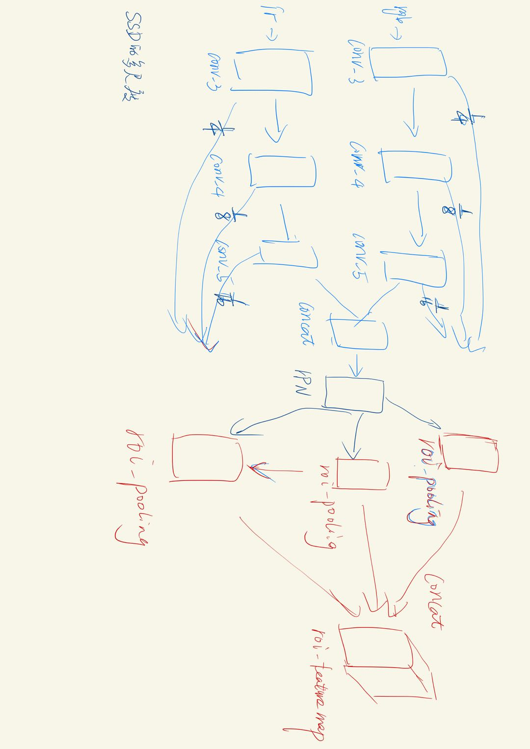
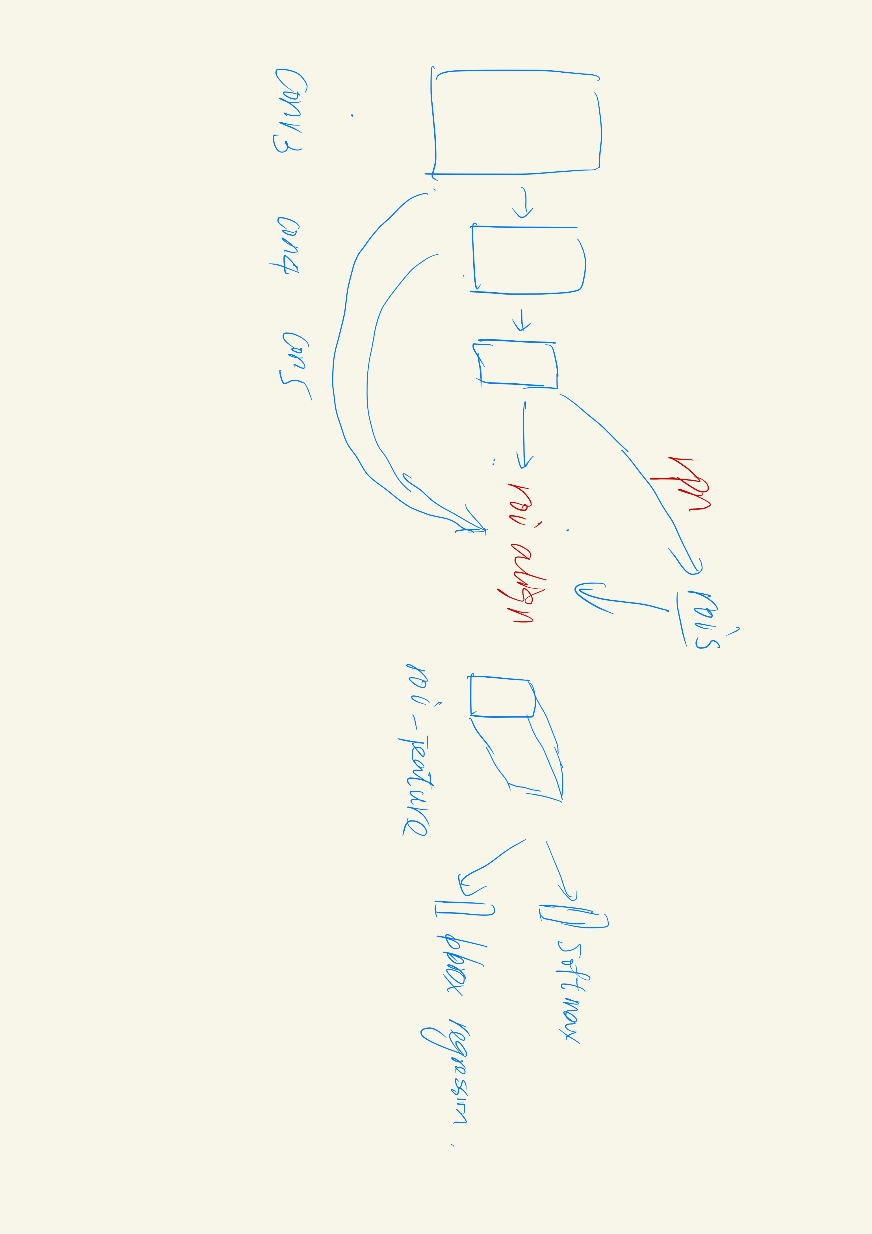
实验结果
多尺度双模态roi align:
Reasonable-all log-average miss rate = 38.15% (22.84%) recall = 83.76% (88.25%)
Reasonable-day log-average miss rate = 40.65% (24.12%) recall = 83.23% (87.97%)
Reasonable-night log-average miss rate = 33.04% (19.97%) recall = 85.07% (88.84%)
Scale=near log-average miss rate = 17.94% (2.46%) recall = 94.96% (99.50%)
Scale=medium log-average miss rate = 40.81% (29.21%) recall = 83.29% (85.50%)
Scale=far log-average miss rate = 72.75% (64.75%) recall = 66.38% (57.15%)
Occ=none log-average miss rate = 42.63% (39.73%) recall = 81.48% (77.30%)
Occ=partial log-average miss rate = 64.20% (52.66%) recall = 64.55% (68.49%)
Occ=heavy log-average miss rate = 79.24% (69.13%) recall = 40.74% (48.23%)
Reasonable-all log-average miss rate = 47.32% (44.42%) recall = 76.49% (7.08%)
Reasonable-day log-average miss rate = 44.03% (37.07%) recall = 80.67% (83.23%)
Reasonable-night log-average miss rate = 62.09% (59.46%) recall = 62.44% (65.45%)
Scale=near log-average miss rate = 22.32% (14.09%) recall = 90.76% (97.33%)
Scale=medium log-average miss rate = 53.41% (53.39%) recall = 72.78% (69.85%)
Scale=far log-average miss rate = 84.59% (83.32%) recall = 39.32% (35.66%)
Occ=none log-average miss rate = 54.50% (61.03%) recall = 70.62% (61.14%)
Occ=partial log-average miss rate = 79.66% (80.92%) recall = 52.12% (42.01%)
Occ=heavy log-average miss rate = 88.14% (83.60%) recall = 31.02% (34.07%)

