Slide 1
文献汇报
胡敬玉
2020.1.9

Slide 2
Guotai Wang, W. Li, S. Ourselin, and T. Vercauteren, “Automatic Brain Tumor Segmentation Based on Cascaded Convolutional Neural Networks With Uncertainty Estimation,” Frontiers in Computational Neuroscience, vol. 13, p. 56, Aug. 2019, doi: 10.3389/fncom.2019.00056.

Slide 3
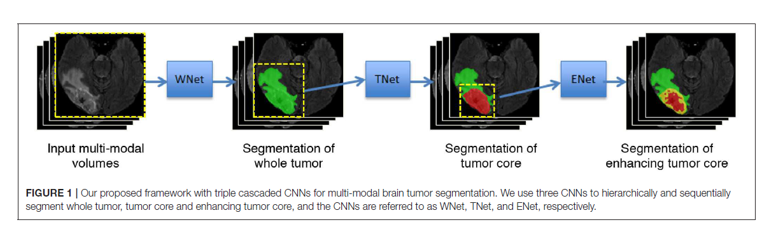
原理图

Slide 4
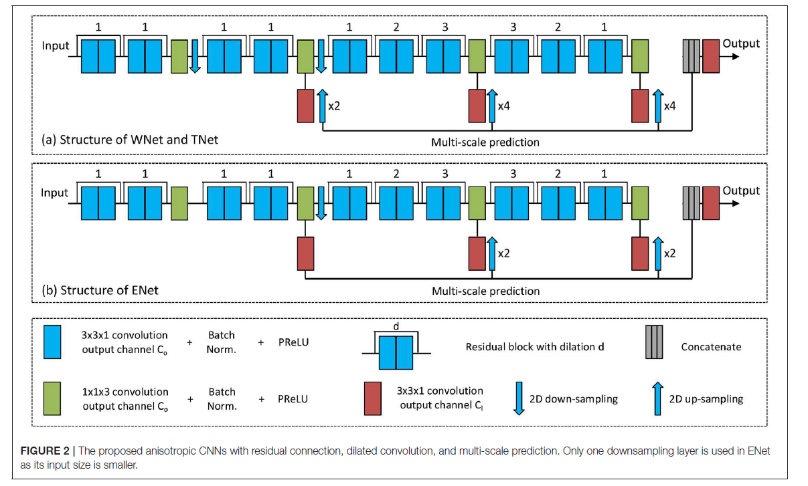
144x144x19
96x96x19
64x64x19
Intra-slice
Inter-slice

Slide 5
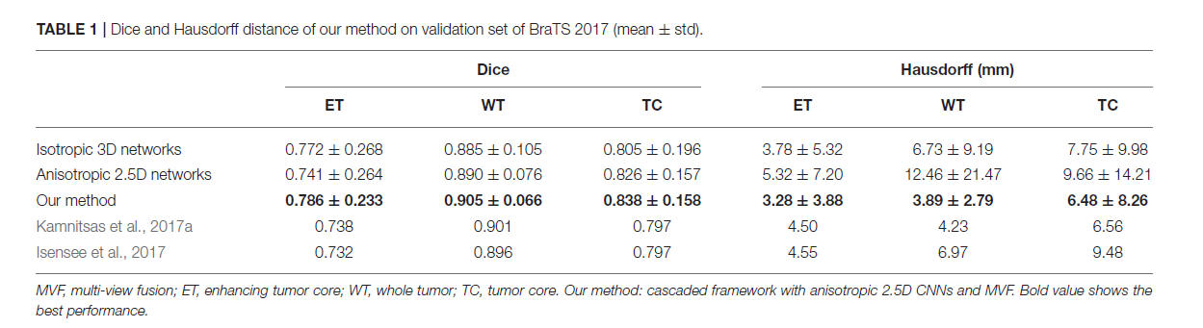

Slide 6
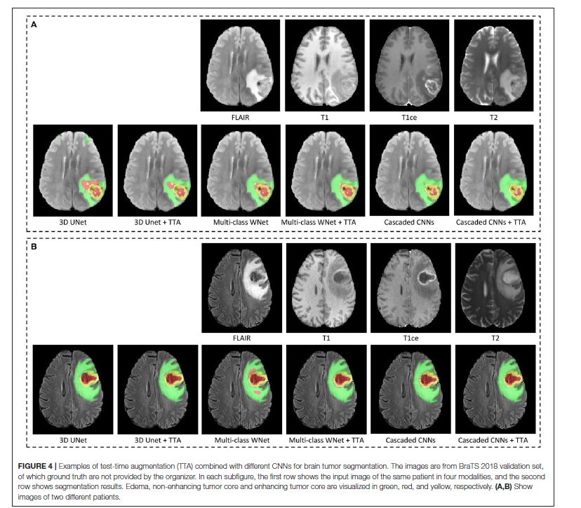

Slide 7
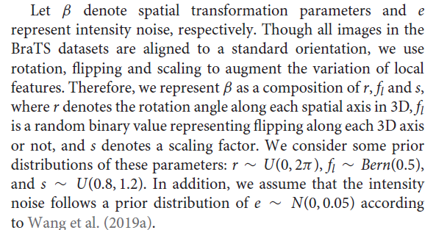
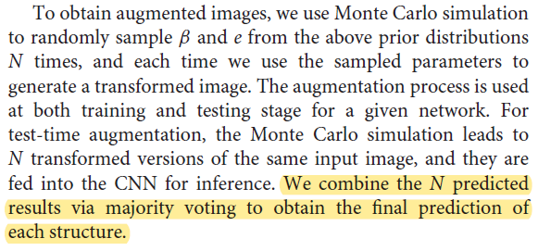
Uncertainty Estimation

Slide 8
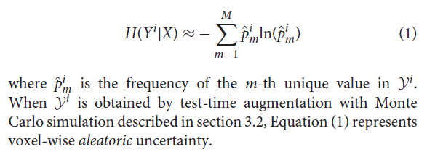
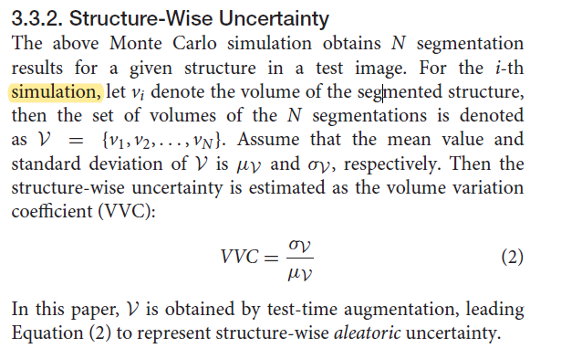
Voxel-Wise Uncertainty
Structure-Wise Uncertainty

Slide 9
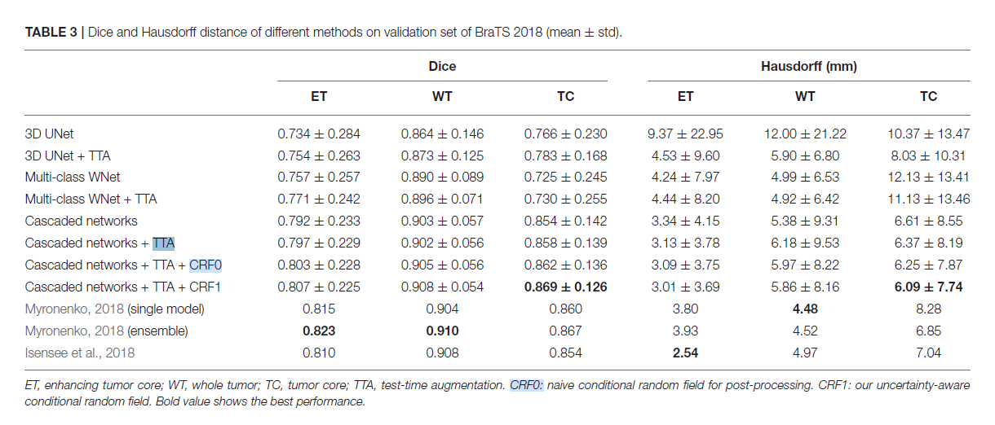

Slide 10
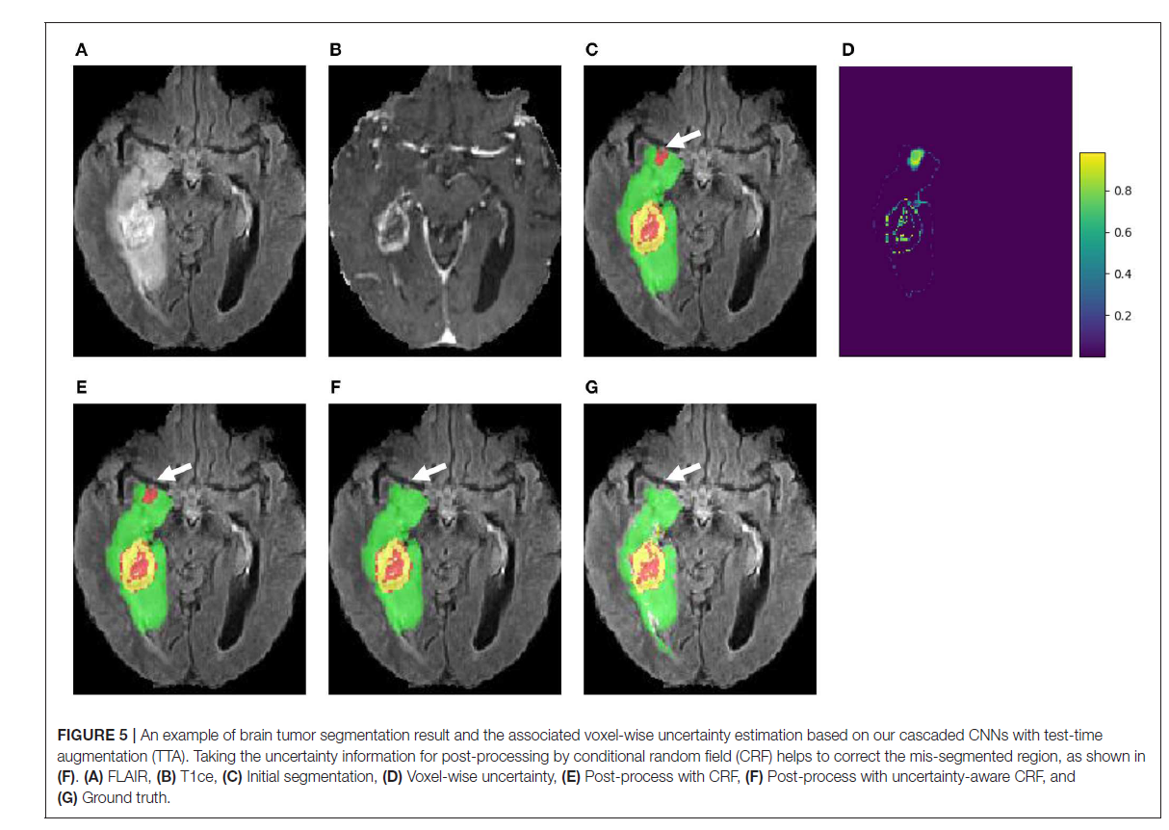

Slide 11
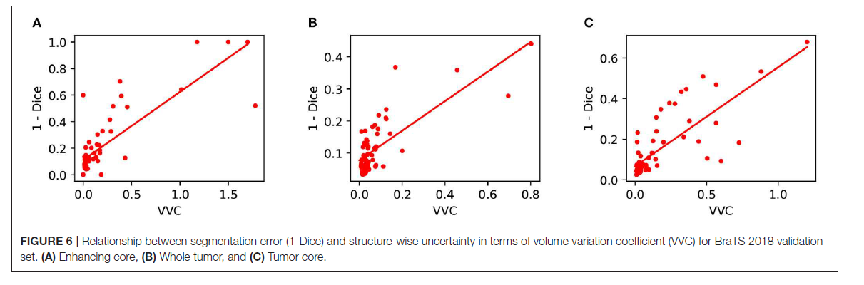

Slide 12
Thank You!

