Slide 1
文献汇报
胡敬玉
2019.7.20

Slide 2
文献
T. Nair, D. Precup, D. L. Arnold, and T. Arbel, “Exploring Uncertainty Measures in Deep Networks for Multiple Sclerosis Lesion Detection and Segmentation,” In Proc. MICCAI, 2018.
Nair T, Precup D, Arnold D L, et al. Exploring uncertainty measures in deep networks for multiple sclerosis lesion detection and segmentation[J]. Medical Image Analysis, 2019: 101557.
McGill University, Canada

Slide 3
问题阐述
1. 深度学习方法在较大的病变分割上超出其它机器学习方法，较小的病变上提升并不明显
2. 深度学习方法得到的是确定性的结果
1. 传统的贝叶斯神经网络可以得到结果的预测值，同时可以得到结果的不确定性
2. 实现困难，训练时间长
Gal 和 Ghahramani 提出 MC Dropout, 基于该方法的一些不确定性估计在许多视觉任务上取得了不错的表现。
Y. Gal and Z. Ghahramani, “Dropout as a Bayesian Approximation: Representing Model Uncertainty in Deep Learning,” In Proc. ICML, pp. 1050-1059, 2016
Kendall, A., et al.: Bayesian SegNet: Model uncertainty in deep convolutional encoder-decoder architectures for scene understanding. BMVC (2017)
Tanno, R., et al.: Bayesian image quality transfer with cnns: Exploring uncertainty in dmri super-resolution. In: MICCAI. pp. 611–619. Springer (2017)

Slide 4
本文贡献
定性和定量地比较目前基于MC Dropout 的不确定性估计方法，应用在多发性硬化病理分割上
Predictive variance
MC sample variance
Predictive entropy
Mutual information
Nair T, Precup D, Arnold D L, et al. Exploring uncertainty measures in deep networks for multiple sclerosis lesion detection and segmentation[J]. Medical Image Analysis, 2019: 101557.

Slide 5
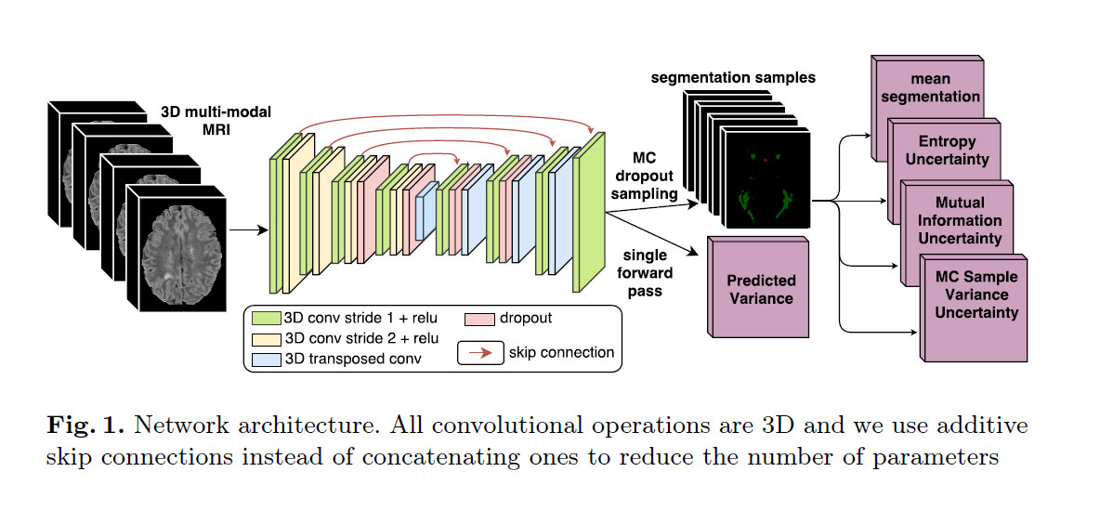

Slide 6
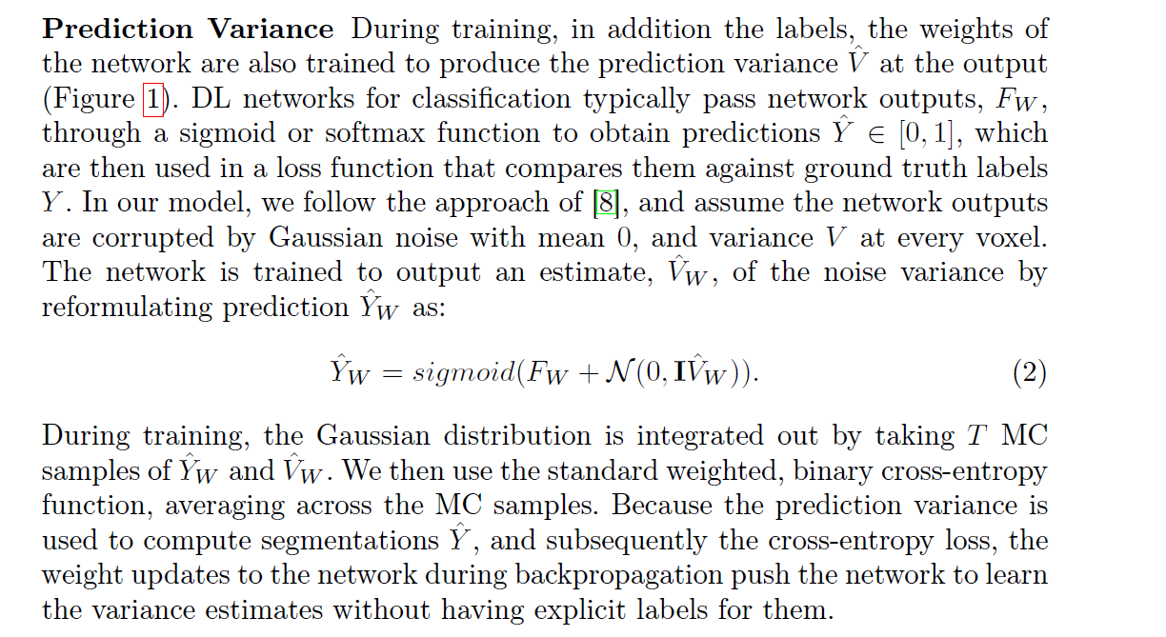
Predictive Variance

Slide 7
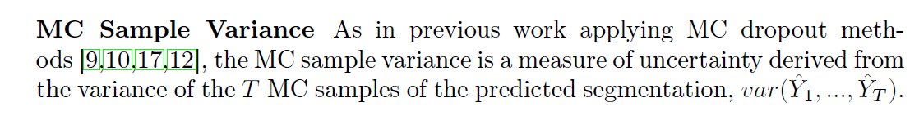
MC Sample Variance

Slide 8
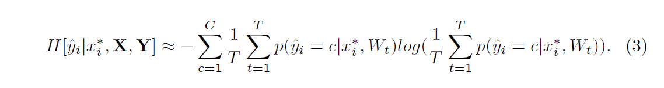
Predictive Entropy

Slide 9
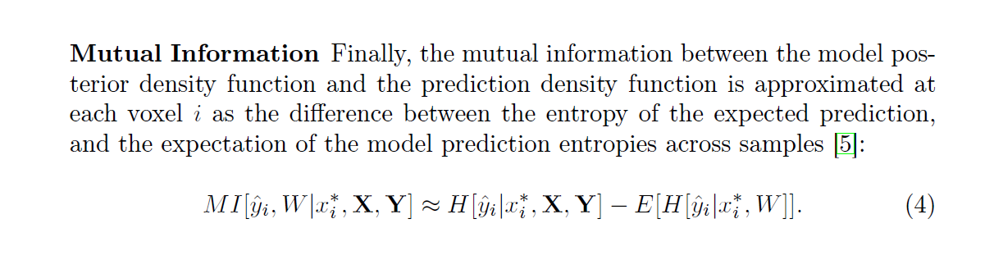
Mutual Information

Slide 10
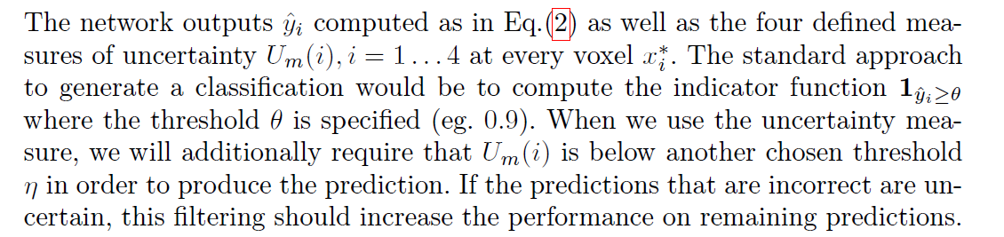
利用不确定性得到预测值

Slide 11
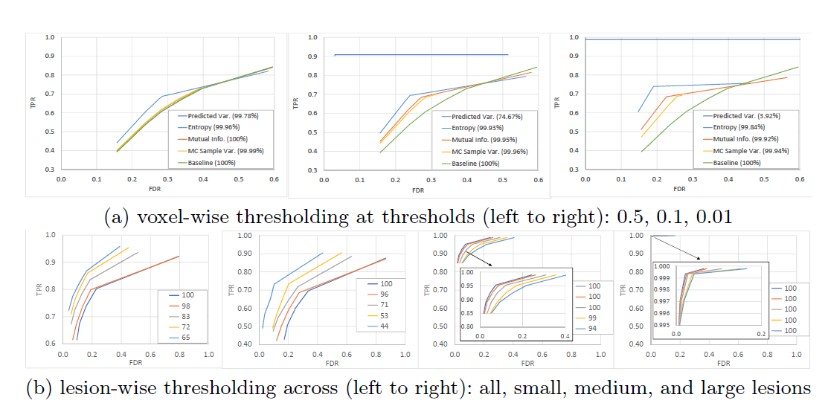

Slide 12
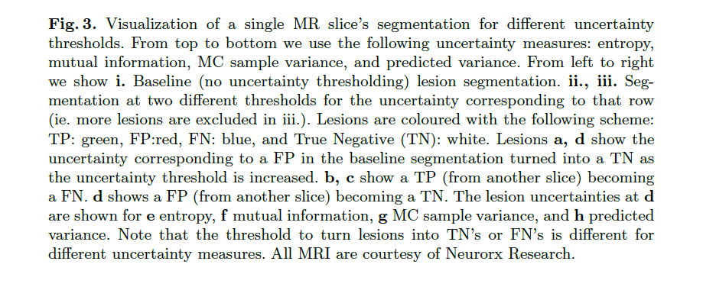

Slide 13
Thank You!

