Slide 1
进度汇报
毛宽诚
2019/10/31

Slide 2
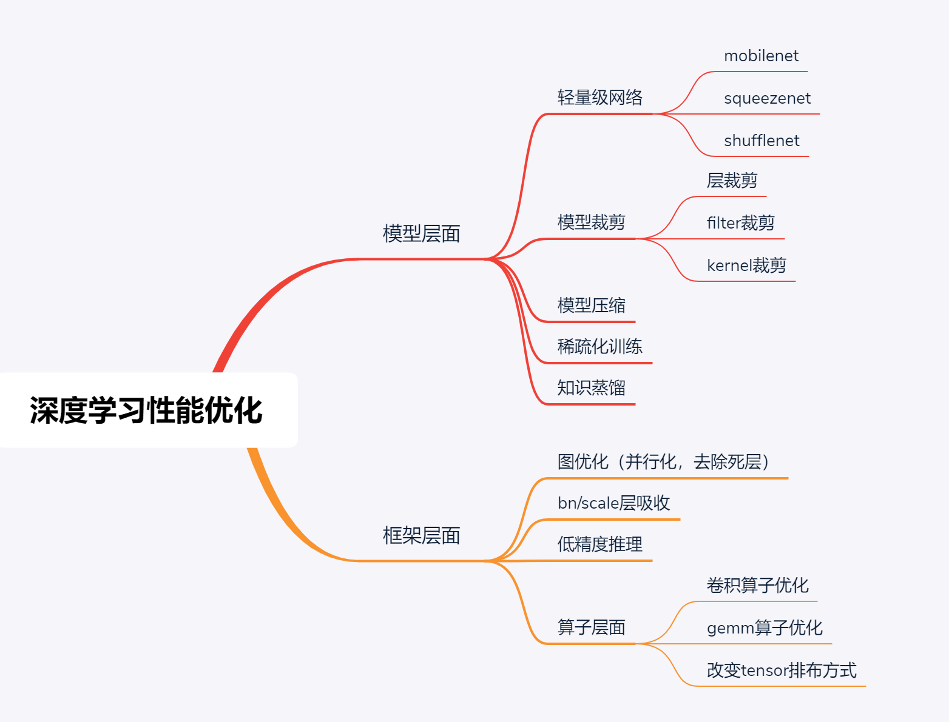

Slide 3
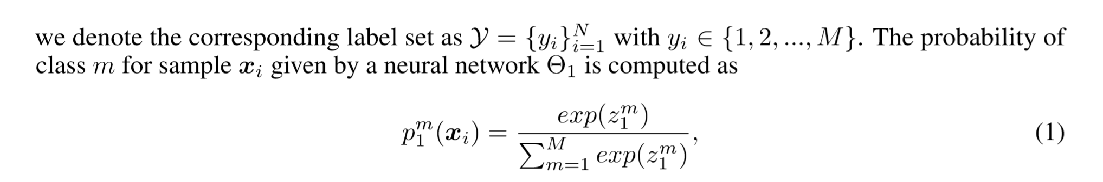
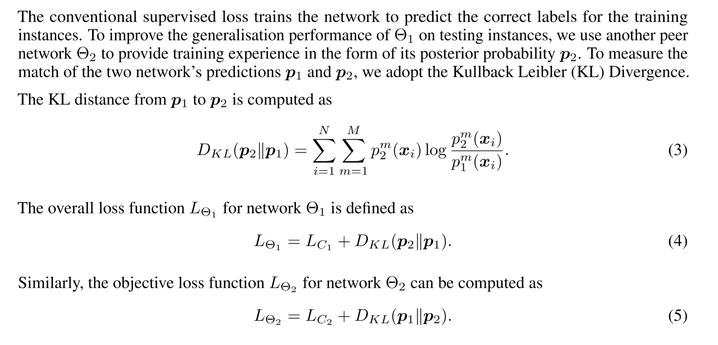

Slide 4
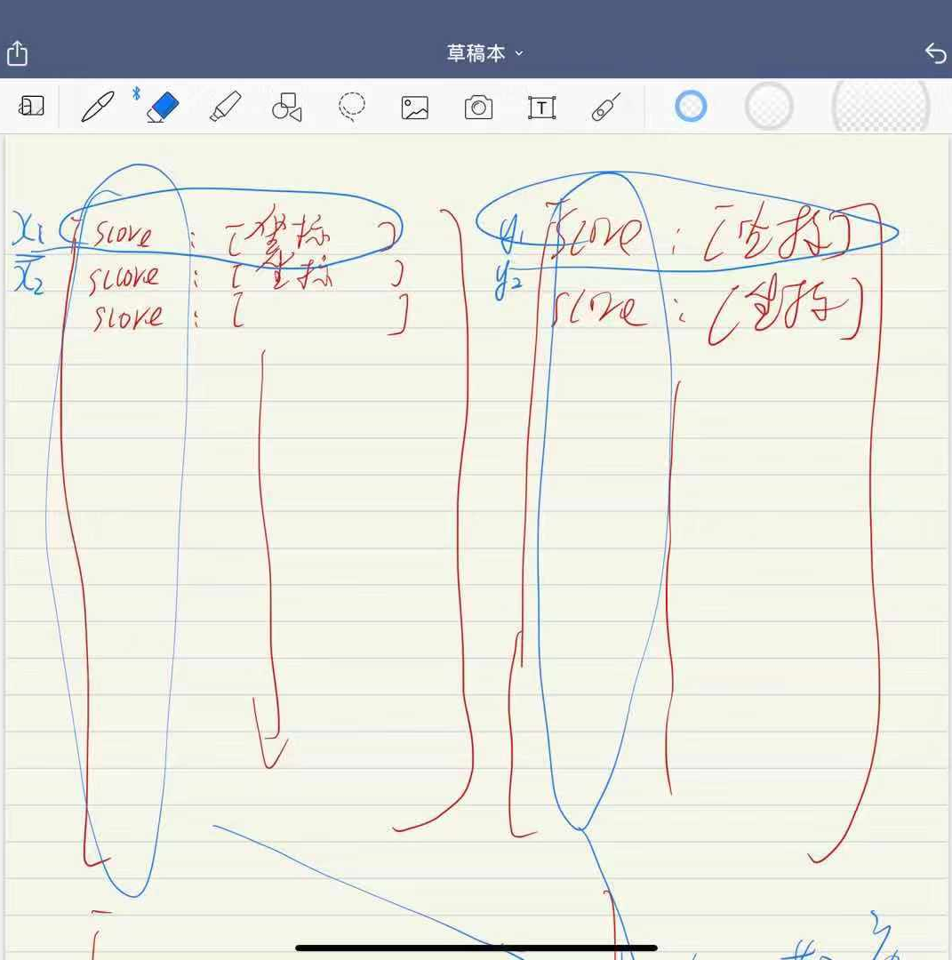
loss1 = rpn_loss_cls.mean() + rpn_loss_box.mean() +
RCNN_loss_cls.mean() + RCNN_loss_bbox.mean() +
kl_loss.mean()
RCNN_loss_cls = F.cross_entropy(cls_score, rois_label)
RCNN_loss_bbox = _smooth_l1_loss(bbox_pred, rois_target, rois_inside_ws,
rois_outside_ws)
kl_loss = self.loss_kl(cls_score[i], cls_score[j])

Slide 5
方法 | Rgb(res101)
 | Roi aglin
All | 42.67%
Day | 38.45%.
Night | 52.61%
方法 | Rgb(vgg16) | Ir(vgg16)
 | Roi aglin | Roi aglin
All | 46.20% | 46.04%
Day | 42..45%. | 50.33%
Night | 55.63% | 33.92%

Slide 6
方法 | Half fusion |  | rpn fusion |  | nms fusion
 | Roi pooling | Roi align | Roi pooling | Roi align | Roi align
All | 40.44% | 36.78% | 40.26% | 34.17% | 36.63%
Day | 40.61% | 38.33% | 41.48% | 34.62% | 39..21%
Night | 40.62% | 34.00% | 37.61% | 32.32% | 30.71%
方法 | Rgb(vgg16) | Ir(vgg16)
 | Roi aglin | Roi aglin
All | 46.20% | 46.04%
Day | 42..45%. | 50.33%
Night | 55.63% | 33.92%

