Slide 1
组 会 报 告
蓝 鑫
2019年11月21日

Slide 2
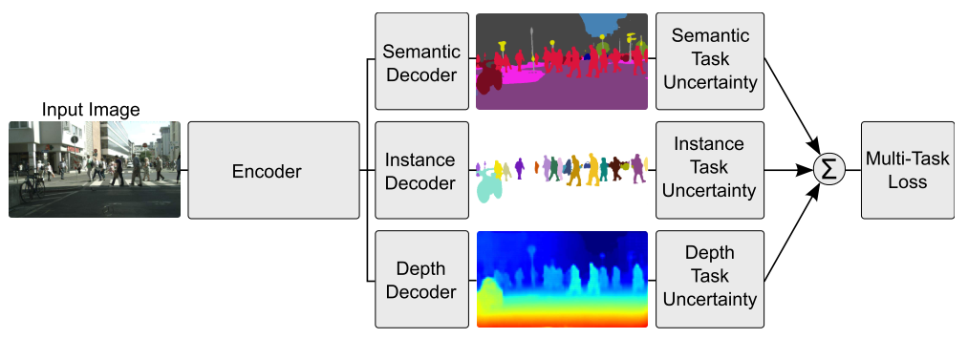

Multi-Task
Cipolla, R., et al. (2018). Multi-task Learning Using Uncertainty to Weigh Losses for Scene Geometry and Semantics. CVPR 2018.
传统多任务学习采用加权损失和：
该方法考虑贝叶斯建模中的不确定性

Slide 3
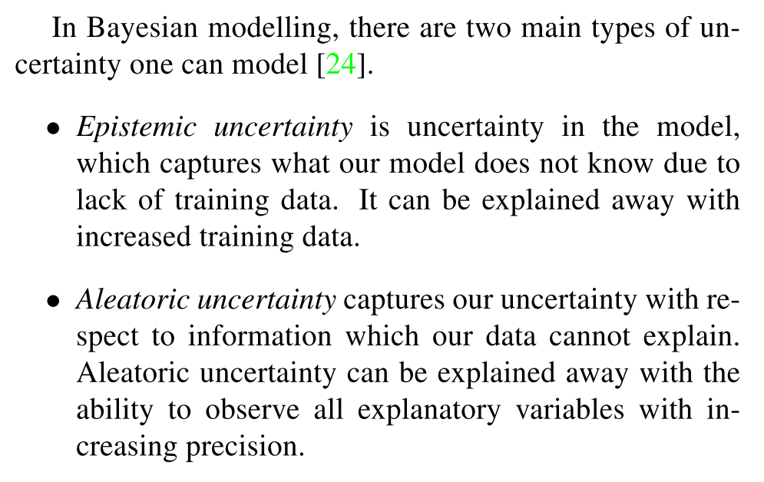
Multi-Task
Cipolla, R., et al. (2018). Multi-task Learning Using Uncertainty to Weigh Losses for Scene Geometry and Semantics. CVPR 2018.

Slide 4
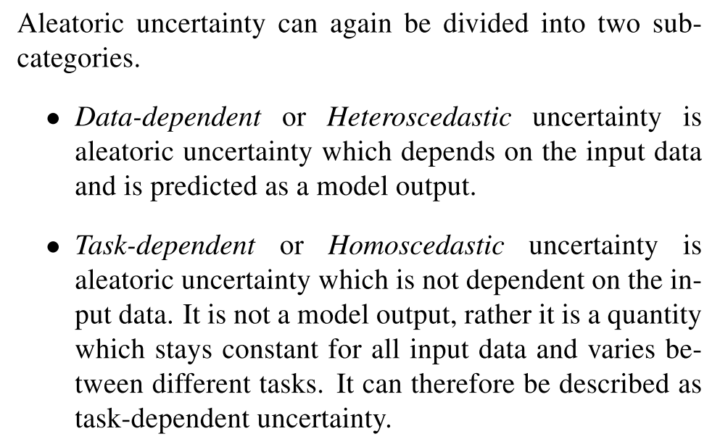
Multi-Task
Cipolla, R., et al. (2018). Multi-task Learning Using Uncertainty to Weigh Losses for Scene Geometry and Semantics. CVPR 2018.

Slide 5



多任务似然
Cipolla, R., et al. (2018). Multi-task Learning Using Uncertainty to Weigh Losses for Scene Geometry and Semantics. CVPR 2018.
模型输出：
对于回归任务：
对于分类任务：
多任务似然：

Slide 6

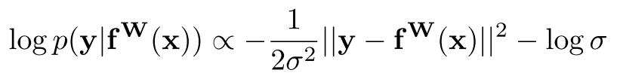
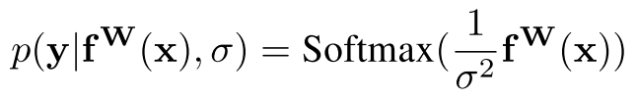
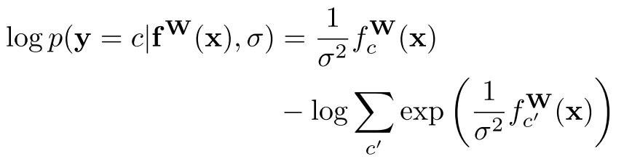

多任务似然
Cipolla, R., et al. (2018). Multi-task Learning Using Uncertainty to Weigh Losses for Scene Geometry and Semantics. CVPR 2018.
极大似然推断，最大化模型的对数似然（回归）：
扩展至分类，输入通过 sigma 缩放：

Slide 7
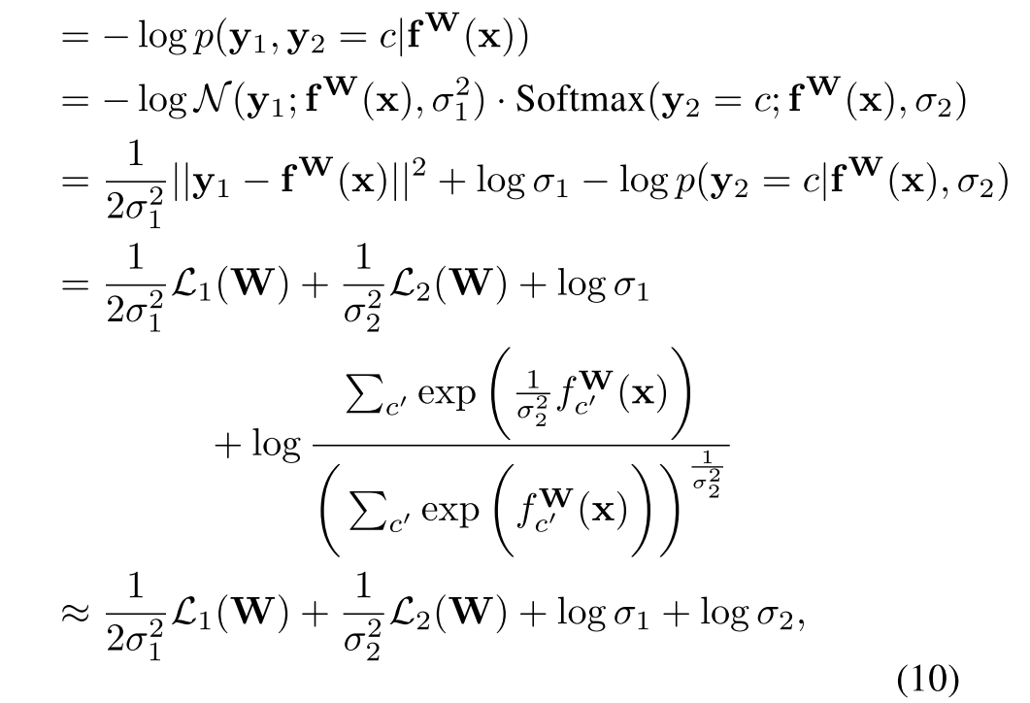



多任务似然
Cipolla, R., et al. (2018). Multi-task Learning Using Uncertainty to Weigh Losses for Scene Geometry and Semantics. CVPR 2018.
联合损失（回归+分类）：

Slide 8

多任务似然
Cipolla, R., et al. (2018). Multi-task Learning Using Uncertainty to Weigh Losses for Scene Geometry and Semantics. CVPR 2018.
联合损失（回归+分类）：

Slide 9
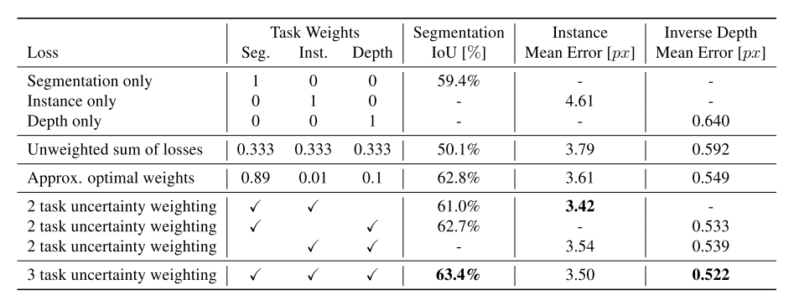
实验
Cipolla, R., et al. (2018). Multi-task Learning Using Uncertainty to Weigh Losses for Scene Geometry and Semantics. CVPR 2018.

