Slide 1
文献汇报
毛宽诚
2019/11/17

Slide 2
Cross-modality interactive attention network for multispectral pedestrian detection
State Key Laboratory of Management and Control for Complex systems, Institute of Automation, Chinese Academy of Science
Zhang L, Liu Z, Zhang S, et al. Cross-modality interactive attention network for multispectral pedestrian detection[J]. Information Fusion, 2019, 50: 20-29.

Slide 3
Architecutrue
Fusion skills
Context enchancement blocks(CEBs)
Cross-modality interactive attention
Train technique
Zhang L, Liu Z, Zhang S, et al. Cross-modality interactive attention network for multispectral pedestrian detection[J]. Information Fusion, 2019, 50: 20-29.

Slide 4
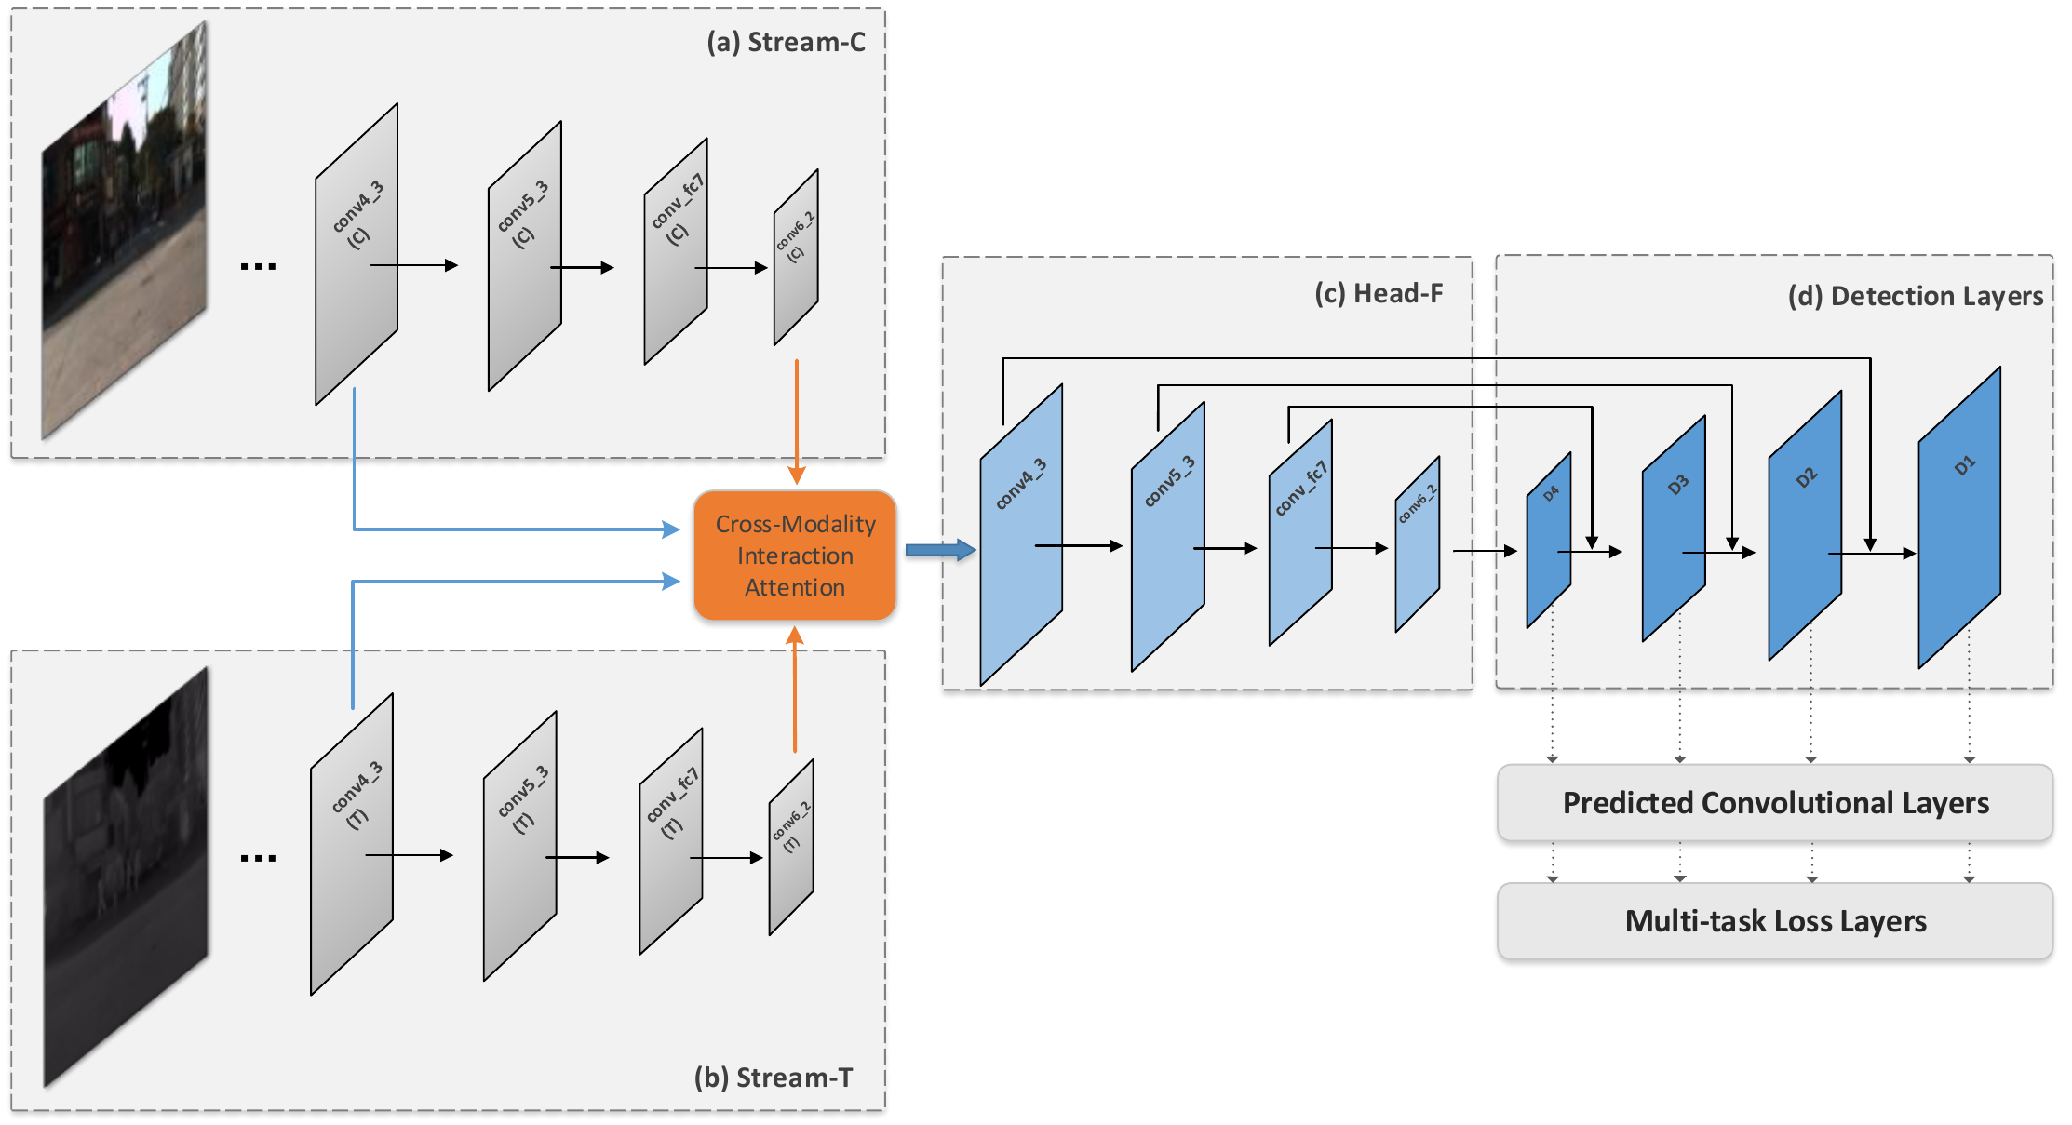
Architecutrue
大框架类似ssd
Backbone:vgg16
Zhang L, Liu Z, Zhang S, et al. Cross-modality interactive attention network for multispectral pedestrian detection[J]. Information Fusion, 2019, 50: 20-29.

Slide 5
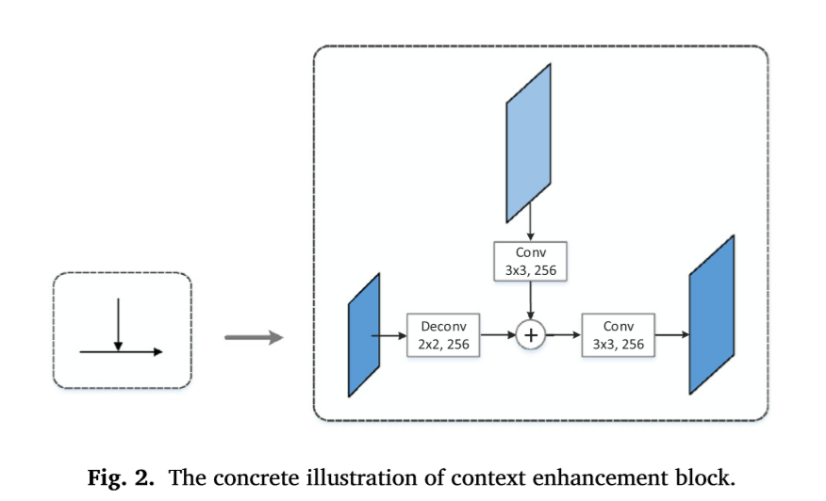
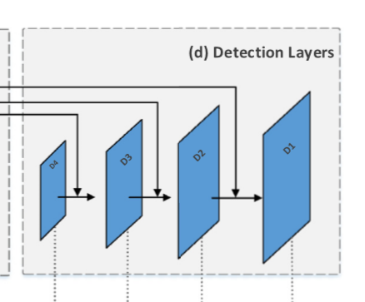
Context enchancement blocks(CEBs
CEBs
Zhang L, Liu Z, Zhang S, et al. Cross-modality interactive attention network for multispectral pedestrian detection[J]. Information Fusion, 2019, 50: 20-29.

Slide 6
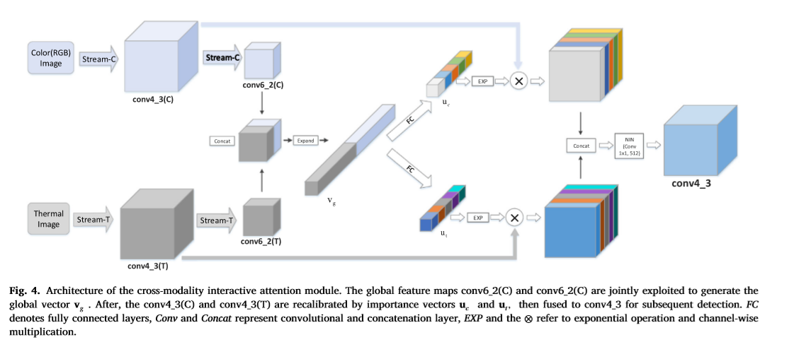
Cross-modality interactive attention
Vg：长度为64*2*80的一维向量
Uc: 长度为512的一维向量
Zhang L, Liu Z, Zhang S, et al. Cross-modality interactive attention network for multispectral pedestrian detection[J]. Information Fusion, 2019, 50: 20-29.

Slide 7
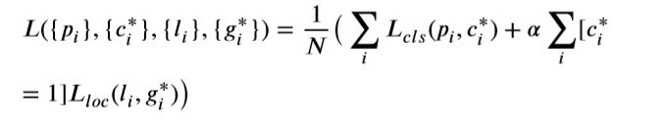
Train technique
Data augmentation
random crop
random padding
Ancor designing strategy
Aspect ratio: 0.41
Scale:32/32根号2
Hard negative mining
Muti-task loss
Zhang L, Liu Z, Zhang S, et al. Cross-modality interactive attention network for multispectral pedestrian detection[J]. Information Fusion, 2019, 50: 20-29.

Slide 8
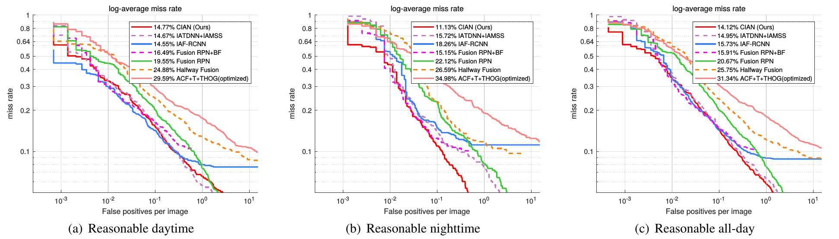
Results
Log-average missrate:14.12%(modified test sets)
Zhang L, Liu Z, Zhang S, et al. Cross-modality interactive attention network for multispectral pedestrian detection[J]. Information Fusion, 2019, 50: 20-29.

Slide 9
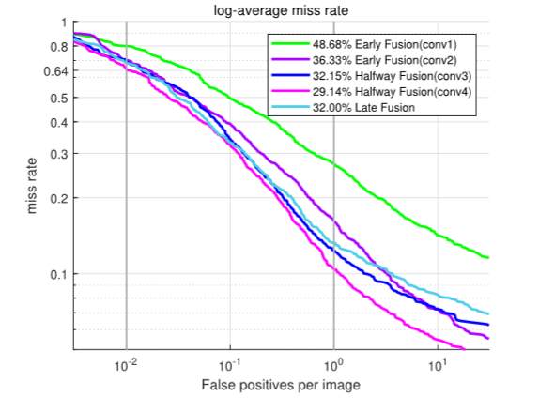
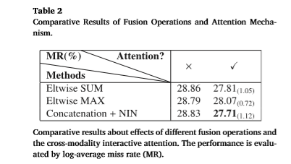
Zhang L, Liu Z, Zhang S, et al. Cross-modality interactive attention network for multispectral pedestrian detection[J]. Information Fusion, 2019, 50: 20-29.

