Slide 1
进度汇报
高铭阳
2019.11.21

Slide 2
Model | Backbone | Image Size | GPU | MAP | FPS | parameters (10⁶) | FLOPs (10⁹)
YOLOv3 | Darknet-53 | 320 | 2080ti | 0.651 |  | 61.55 | 38.68
SSD | VGG16 | 300 | 2080ti | 0.640 |  | 24.41 | 61.42
RefineDet | VGG16 | 320 | 2080ti | 0.681 |  | 34.05 | 74.93
RetinaNet | ResNet-50 | 300 | 2080ti | 0.613 |  | 35.84 | 37.43
Faster_RCNN (pool) | VGG16 | 300 | 2080ti | 0.669 |  | 136.79 | 127.64
Faster_RCNN (align) | VGG16 | 300 | 2080ti | 0.697 |  | 136.79 | 127.64
CenterNet | DLA34 | 320 | 2080ti | 0.653 |  | 20.17 | 20.09

Slide 3
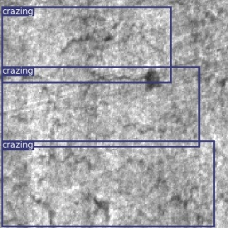
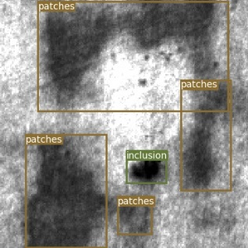
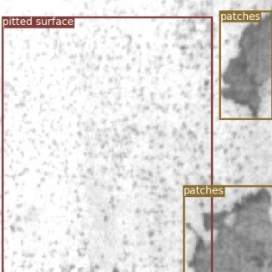
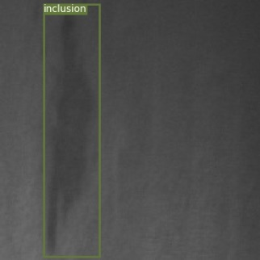
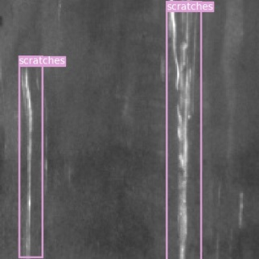
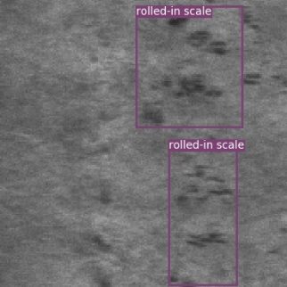
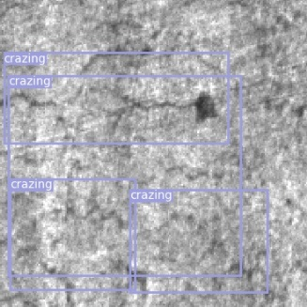
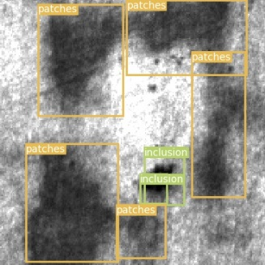
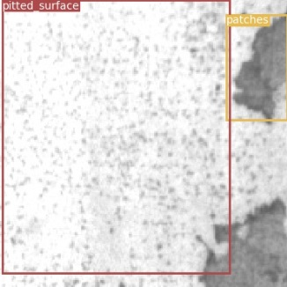
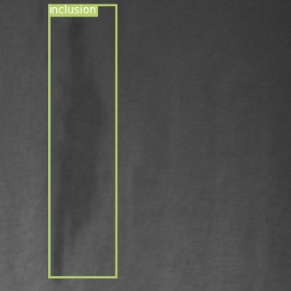
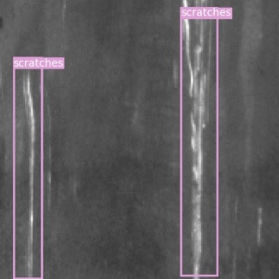
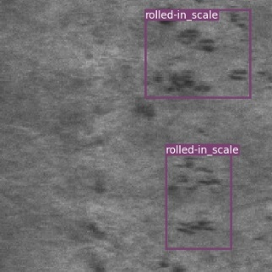
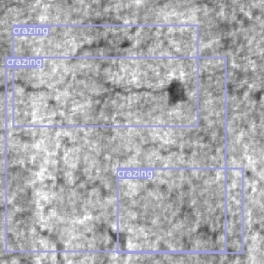
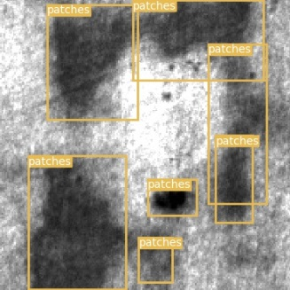
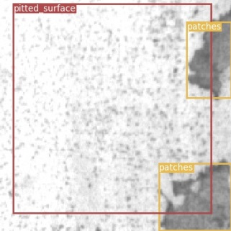
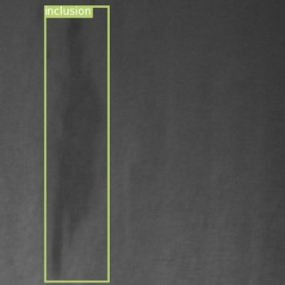
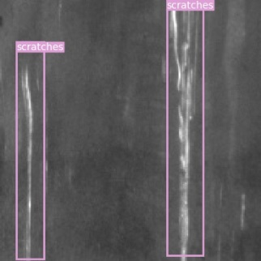
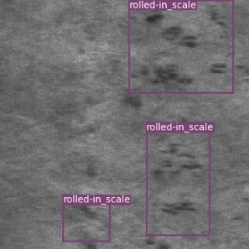
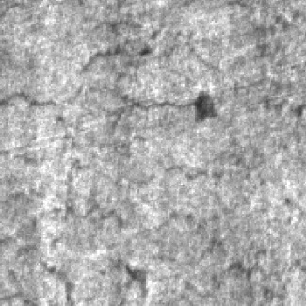
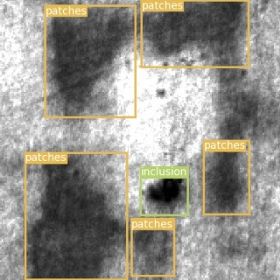
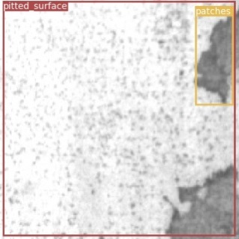
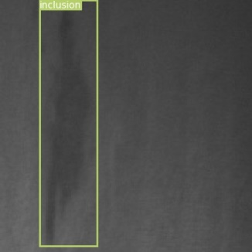
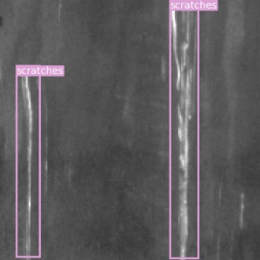

GT
Faster-RCNN(pool)
Faster-RCNN(align)
CenterNet

Slide 4
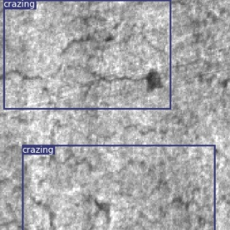
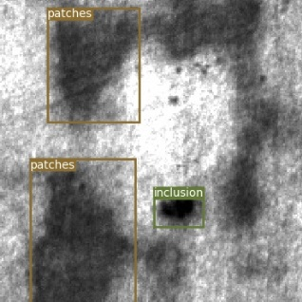
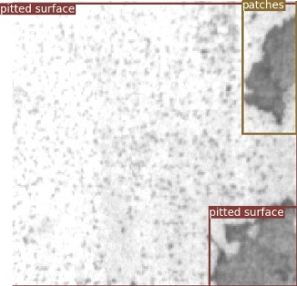
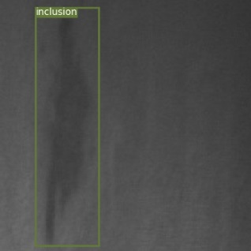
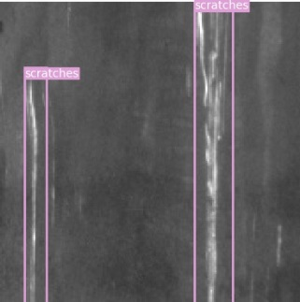
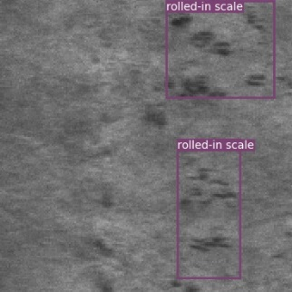
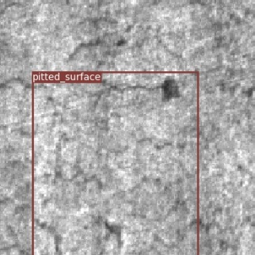
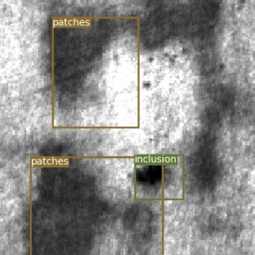
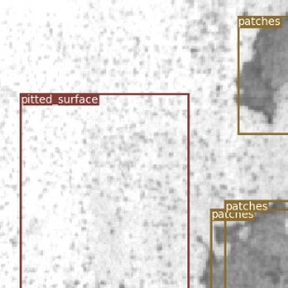
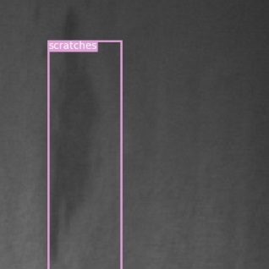
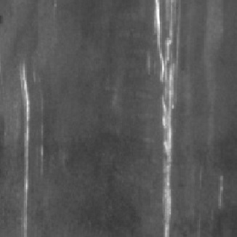
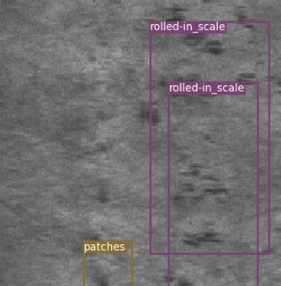
GT
YOLOv3
Retinanet

Slide 5

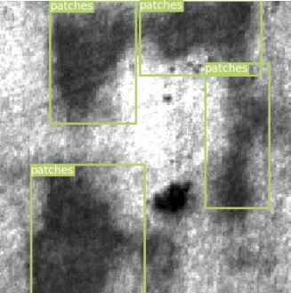
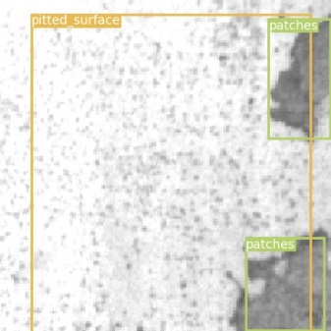
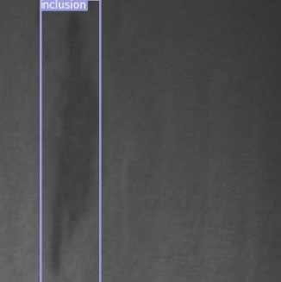
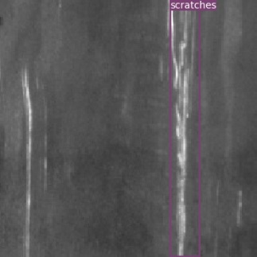
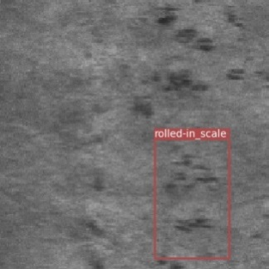
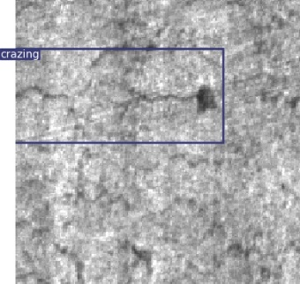
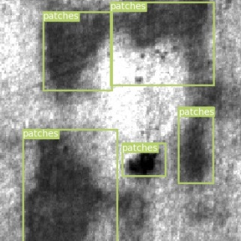
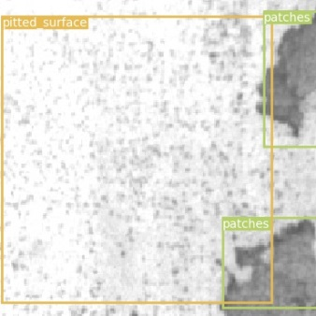
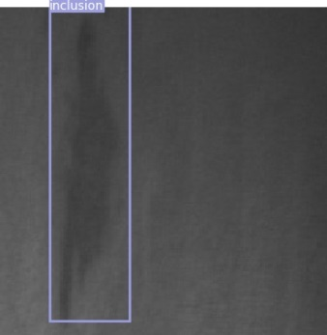
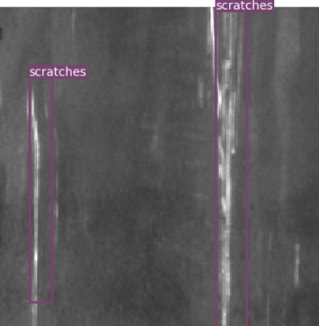
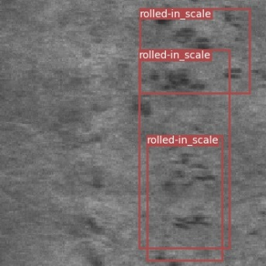
GT
SSD
RefineDet

Slide 6
 | Cr | In | Pa | PS | RS | Sc | MAP
SSD | 0.493 | 0.71 | 0.866 | 0.822 | 0.586 | 0.361 | 0.640
YOLO-v3 (320) | 0.422 | 0.720 | 0.810 | 0.776 | 0.440 | 0.736 | 0.651
RetinaNet | 0.520 | 0.688 | 0.840 | 0.827 | 0.672 | 0.131 | 0.613
RefineDet (320) | 0.556 | 0.761 | 0.862 | 0.862 | 0.61 | 0.437 | 0.681
Faster-RCNN (ROI Pooling) | 0.401 | 0.721 | 0.869 | 0.849 | 0.557 | 0.605 | 0.667
Faster-RCNN (ROI Align) | 0.436 | 0.767 | 0.866 | 0.810 | 0.533 | 0.711 | 0.687
CenterNet-DLA (320) | 0.399 | 0.760 | 0.863 | 0.774 | 0.517 | 0.604 | 0.653
CenterNet-ODLA (320) | 0.214 | 0.727 | 0.849 | 0.301 | 0.366 | 0.522 | 0.496
无数字注释的，图片输入大小为300
ODLA：original DLA

