Slide 1
进度报告
蓝鑫
2018.10

Slide 2
文献
Did Evolution get it right? An evaluation of Near-Infrared imaging in semantic scene segmentation
Semantic Segmentation of Earth Observation Data Using Multimodal and Multi-scale Deep Networks
Multi-task Learning using Multi-modal Encoder-Decoder Networks with Shared Skip Connections
Multi-modal RGB–Depth–Thermal Human Body Segmentation

Slide 3
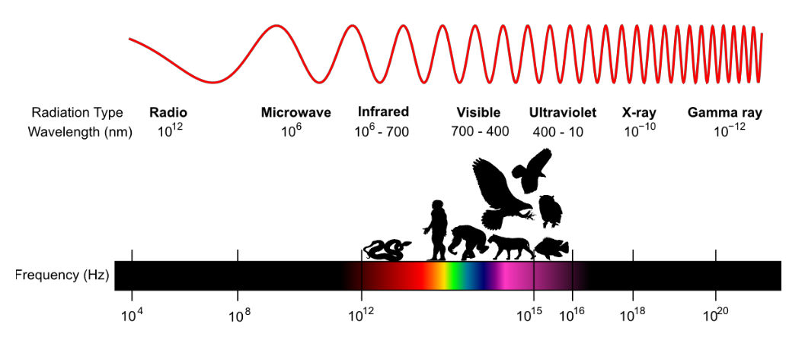
Did Evolution get it right? An evaluation of Near-Infrared imaging in semantic scene segmentation

Slide 4
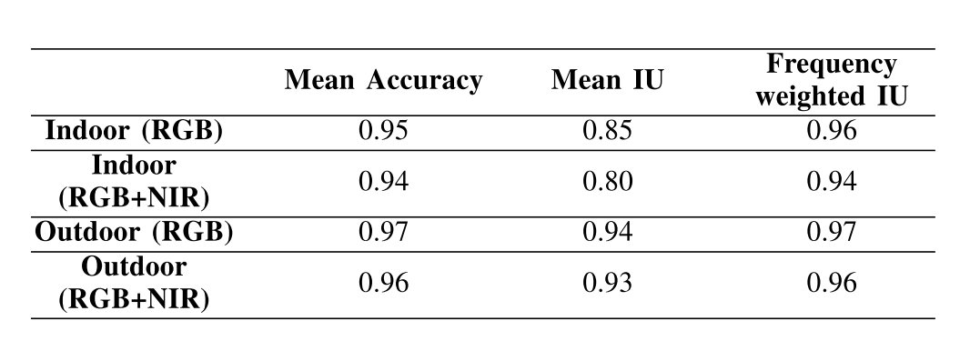
Did Evolution get it right? An evaluation of Near-Infrared imaging in semantic scene segmentation

Slide 5
Semantic Segmentation of Earth Observation Data Using Multimodal and Multi-scale Deep Networks
数据预处理
图像像素太大，因此使用滑动窗口将图像分成小块。重叠部分取预测的平均值。
使用近红外、红、绿三个通道，数据集还包括数字表面模型（DSM）、归一化数字表面模型（NDSM）以及近红外和红色通道的归一化植被差异指数（NDVI）
网络架构
SegNet
多核卷积层
带残差校正的异构数据融合

Slide 6
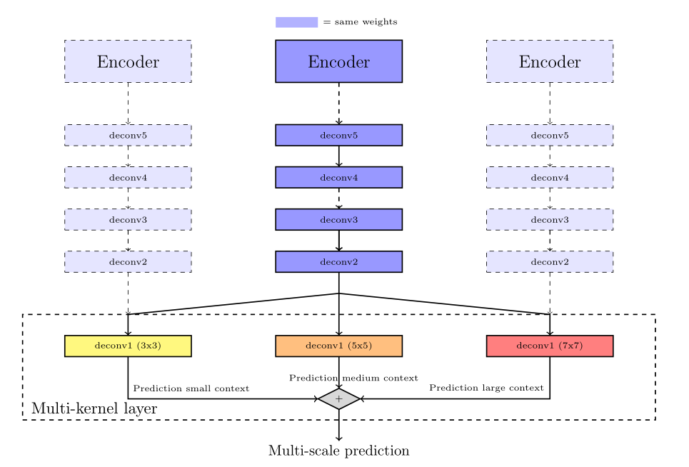
Semantic Segmentation of Earth Observation Data Using Multimodal and Multi-scale Deep Networks
多核卷积层

Slide 7
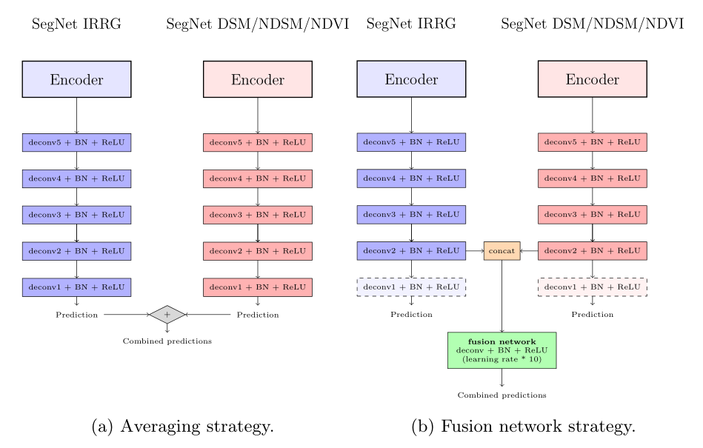
Semantic Segmentation of Earth Observation Data Using Multimodal and Multi-scale Deep Networks
带残差校正的异构数据融合
2 个策略：1. softmax 之后简单地平均，2. 神经网络融合。

Slide 8
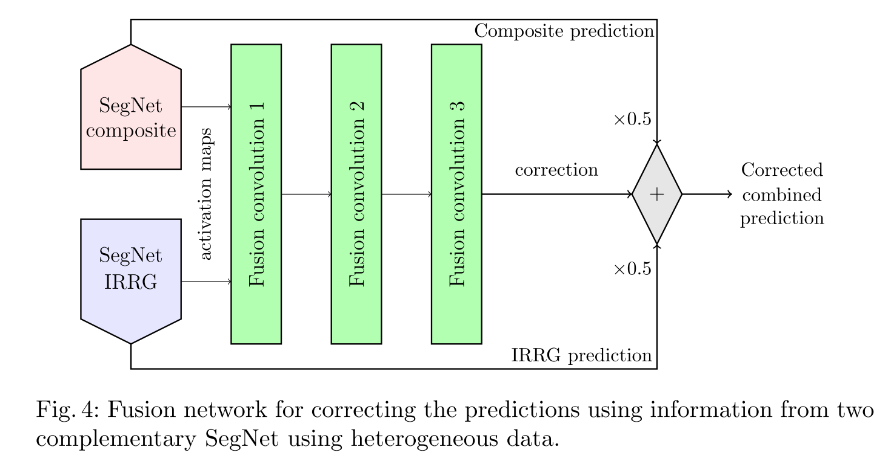
Semantic Segmentation of Earth Observation Data Using Multimodal and Multi-scale Deep Networks
带残差校正的异构数据融合
2 个策略：1. softmax 之后简单地平均，2. 神经网络融合。

Slide 9
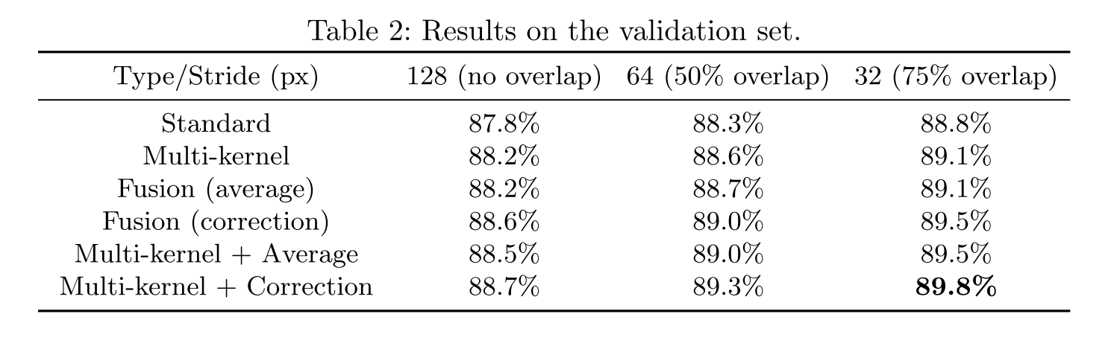
Semantic Segmentation of Earth Observation Data Using Multimodal and Multi-scale Deep Networks
实验结果

Slide 10
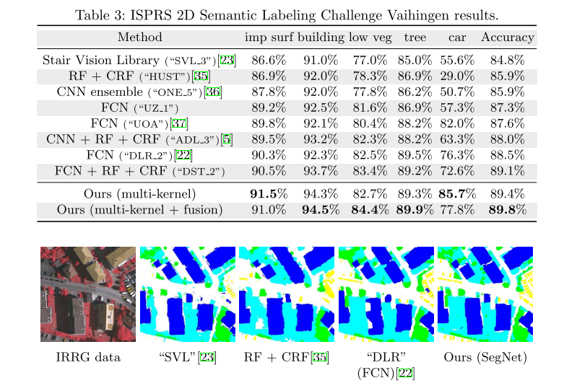
Semantic Segmentation of Earth Observation Data Using Multimodal and Multi-scale Deep Networks
实验结果

Slide 11
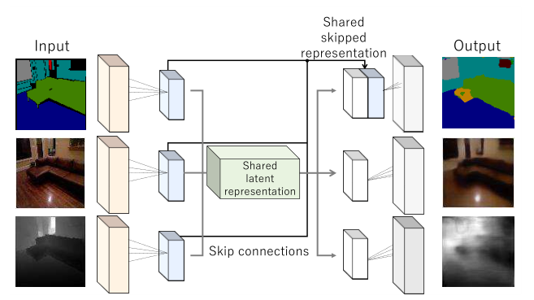
Multi-task Learning using Multi-modal Encoder-Decoder Networks with Shared Skip Connections
网络架构：基于 U-Net

Slide 12
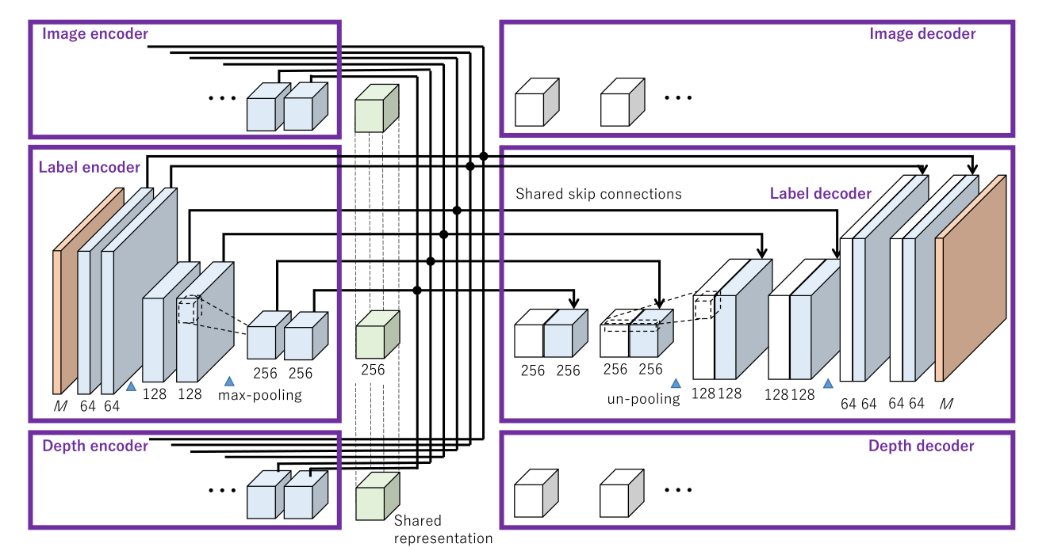
Multi-task Learning using Multi-modal Encoder-Decoder Networks with Shared Skip Connections
网络架构：基于 U-Net

Slide 13
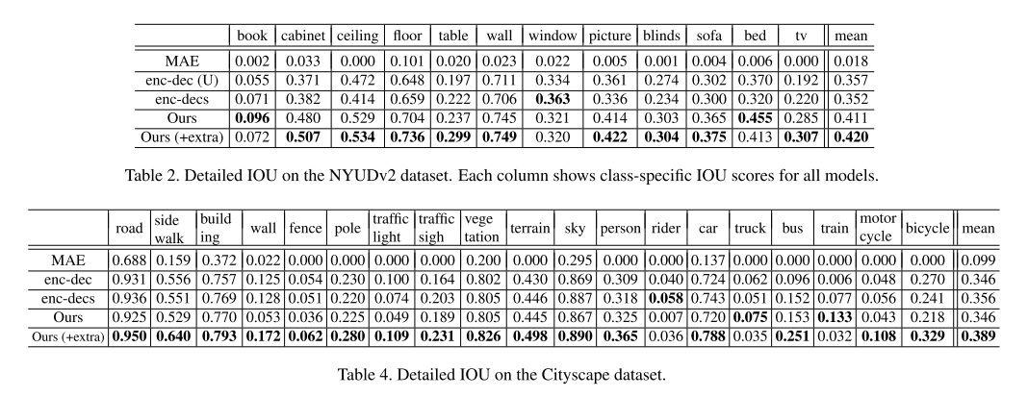
Multi-task Learning using Multi-modal Encoder-Decoder Networks with Shared Skip Connections
实验结果

Slide 14
Multi-modal RGB–Depth–Thermal Human Body Segmentation
使用传统方法，将RGB-深度-热成像图像进行融合。
遮罩和兴趣区提取
背景消减
兴趣区提取
与其他模态关联
标记兴趣区
网格划分
特征提取
彩色、深度、热成像模态
单模态分类
多模态融合（基于学习的融合方法）

Slide 15
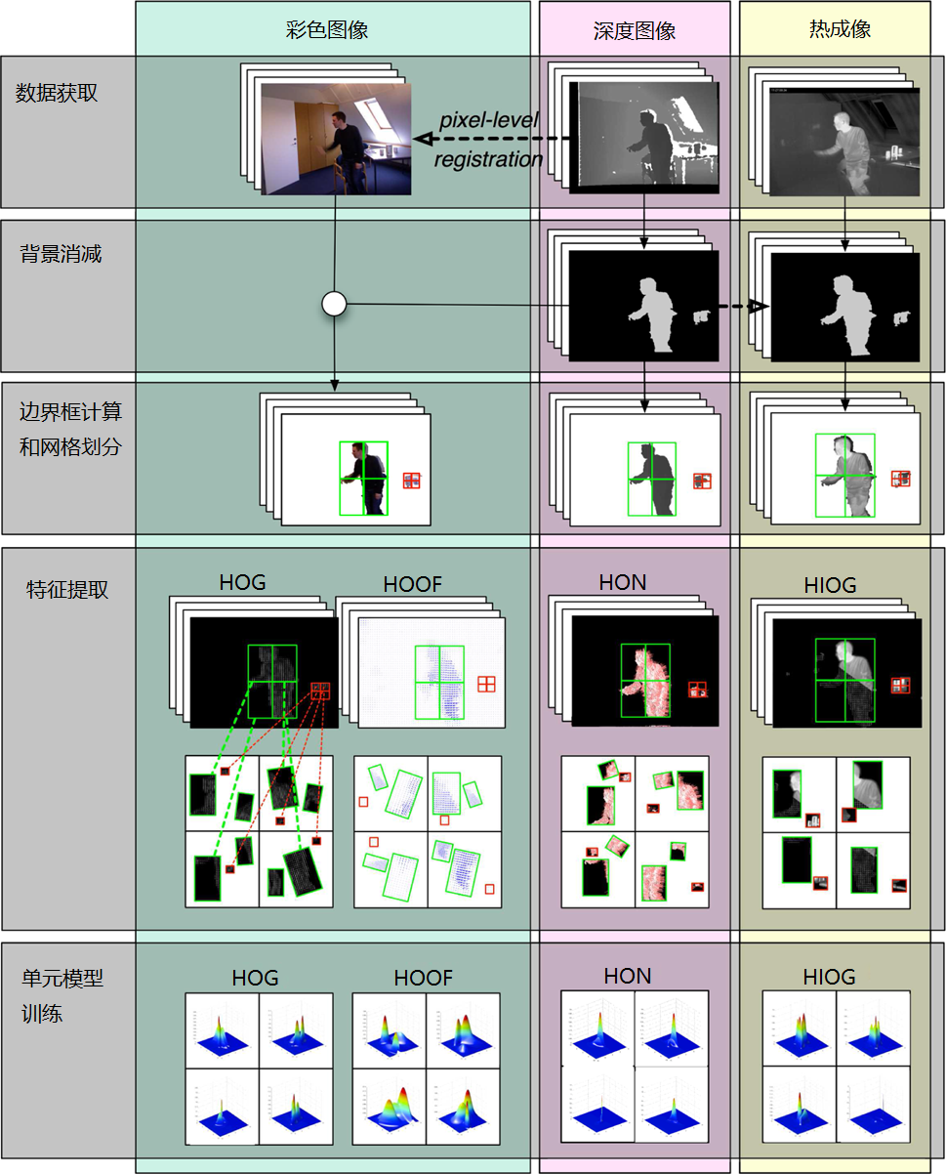

Slide 16
重构
tf.keras
eager exetuction

