Slide 1
进度报告
蓝鑫
2018.11.07

Slide 2
一、报告
GAN-based Synthetic Medical Image Augmentation for increased CNN Performance in Liver Lesion Classification
Pixel Level Data Augmentation for Semantic Image Segmentation Using Generative Adversarial Networks
二、TrimodalDataset 实验

Slide 3
传统数据增强
GAN-based Synthetic Medical Image Augmentation for increased CNN Performance in Liver Lesion Classification. arXiv preprint arXiv:1803.01229, 2018.
平移、旋转、缩放、翻转和剪切等
在经典数据增强中使用 9 组数据组，每组图像数量依次增加。
使用经典数据增强中的最优组来训练 GAN

Slide 4
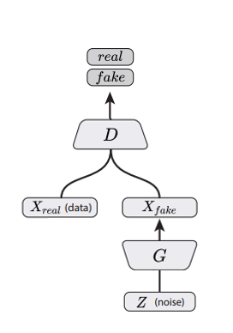
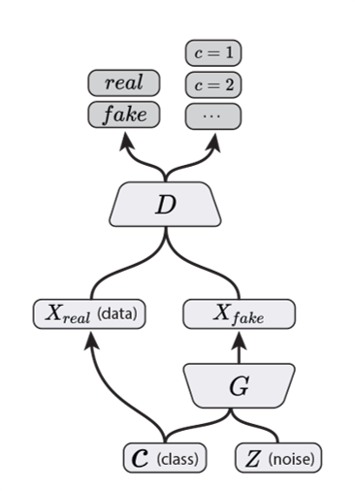
对抗生成
GAN-based Synthetic Medical Image Augmentation for increased CNN Performance in Liver Lesion Classification. arXiv preprint arXiv:1803.01229, 2018.
DCGAN
辅助分类 GAN

Slide 5
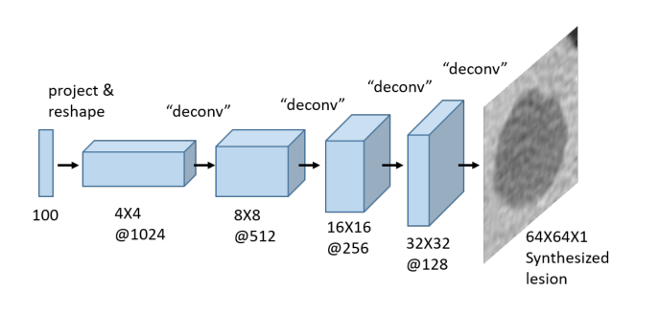
网络架构
GAN-based Synthetic Medical Image Augmentation for increased CNN Performance in Liver Lesion Classification. arXiv preprint arXiv:1803.01229, 2018.
判别器使用普通卷积，得到单一输出
生成器

Slide 6
训练
GAN-based Synthetic Medical Image Augmentation for increased CNN Performance in Liver Lesion Classification. arXiv preprint arXiv:1803.01229, 2018.
DCGAN 分别为每个类别训练生成器和判别器。
辅助分类 GAN 可以直接生成不同类别的病变图像。

Slide 7
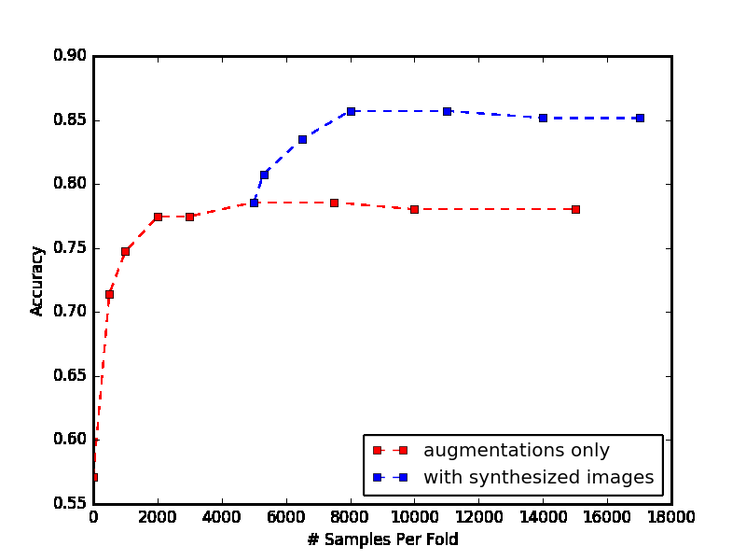
结果
GAN-based Synthetic Medical Image Augmentation for increased CNN Performance in Liver Lesion Classification. arXiv preprint arXiv:1803.01229, 2018.
结合标签信息训练 GAN 可以提升样本的可视化质量。
但是实验中发现 DCGAN 方法效果更好。

Slide 8
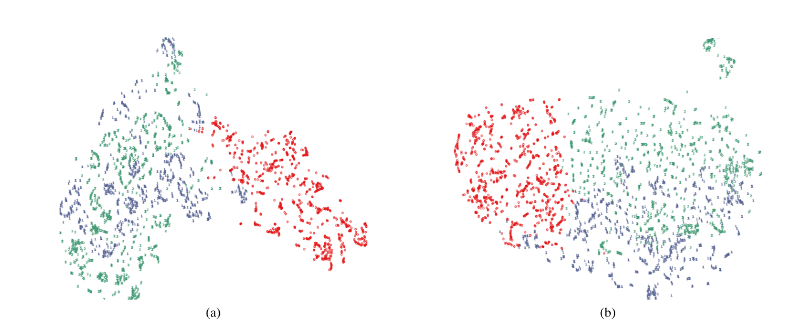
结果
GAN-based Synthetic Medical Image Augmentation for increased CNN Performance in Liver Lesion Classification. arXiv preprint arXiv:1803.01229, 2018.
原始分布和生成之后的分布

Slide 9
结论
GAN-based Synthetic Medical Image Augmentation for increased CNN Performance in Liver Lesion Classification. arXiv preprint arXiv:1803.01229, 2018.
似乎合成的数据样本可以为输入数据集添加额外的可变性，转而产生了更好的性能。

Slide 10
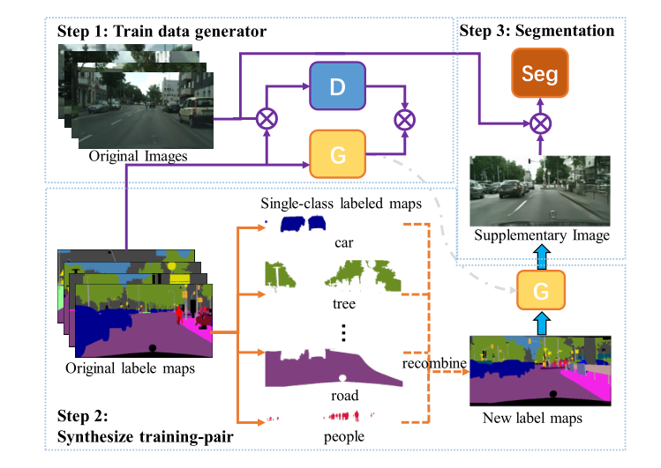
Pixel Level Data Augmentation for Semantic Image Segmentation Using Generative Adversarial Networks

Slide 11
TrimodalDataset
三个单一场景，以人为分割对象。
场景简单，单一数据集容易过拟合。
Scene 1 训练/Scene 1 测试 | epochs | 传统分割 | 引入对抗训练
T | 1000 | 98.7 | 98.1
 | 3000 | 98.9 | 98.7
RGB | 1000 | 98.4 | 93.8
 | 3000 | 99.2 | 97.4
Scene 1 训练/Scene 3 测试 | epochs | 传统分割 | 引入对抗训练
T | 1000 | 60.0 | 64.8
 | 3000 | 53.6 | 62.8
RGB | 1000 | 78.3 | 78.8
 | 3000 | 72.5 | 74.1

Slide 12
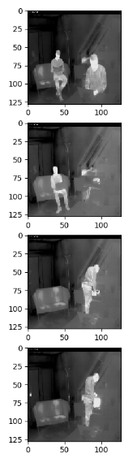
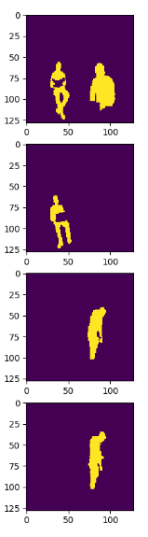
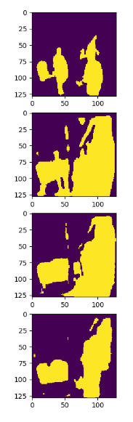
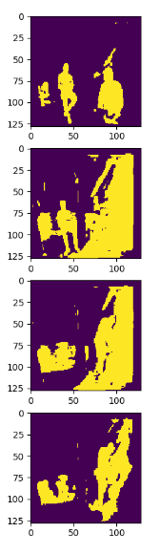
TrimodalDataset (train on scene1, test on scene3)
Thermal
GT
CNN
Adversarial training

Slide 13
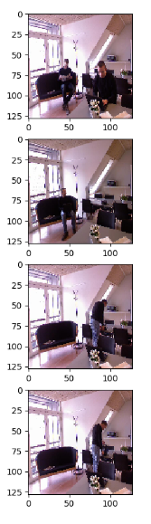
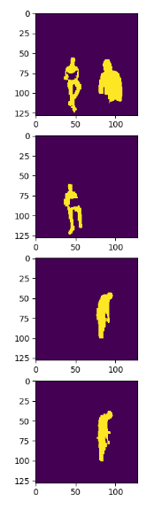
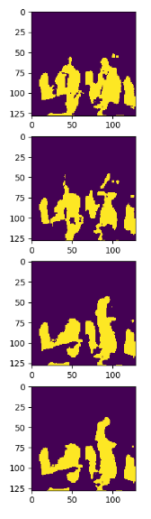
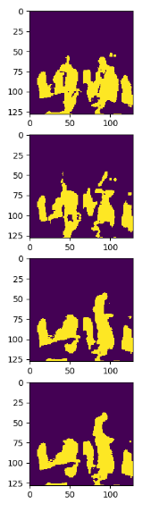
TrimodalDataset (train on scene1, test on scene3)
RGB
GT
CNN
Adversarial training

