Slide 1
进度汇报
胡敬玉
2018.12.20

Slide 2
Kamnitsas K, Ledig C, Newcombe V F J, et al. Efficient multi-scale 3D CNN with fully connected CRF for accurate brain lesion segmentation[J]. Medical image analysis, 2017, 36: 61-78.
Github: https://github.com/Kamnitsask/deepmedic
Biomedical Image Analysis Group, Imperial College London, UK

Slide 3
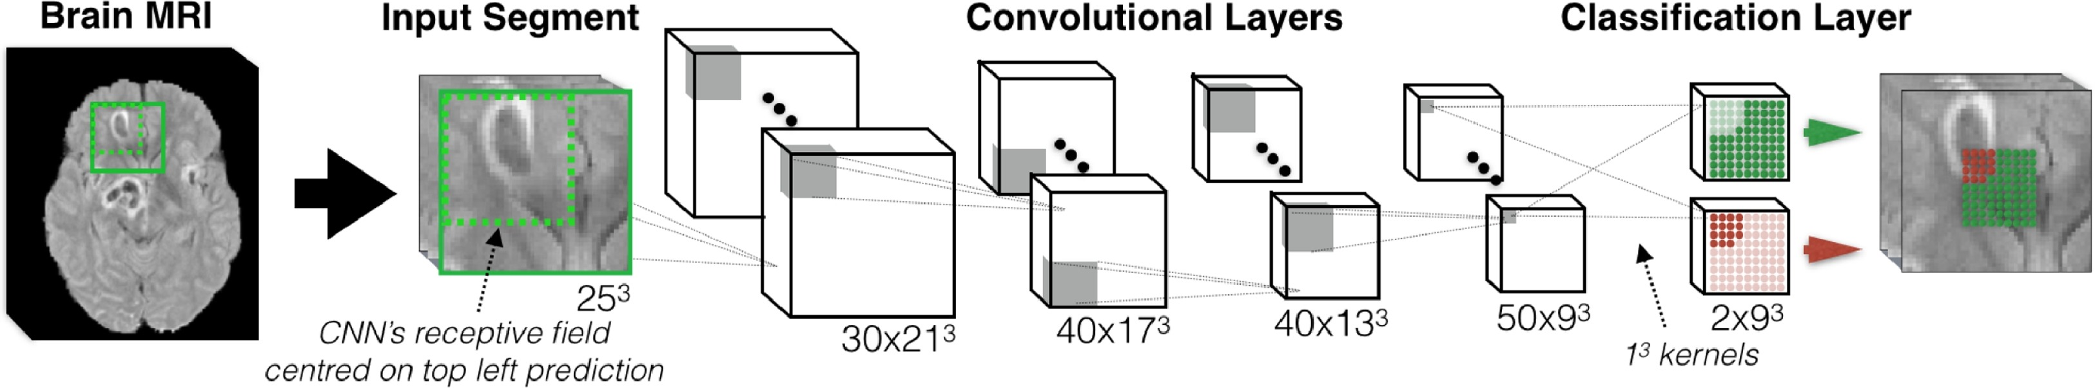
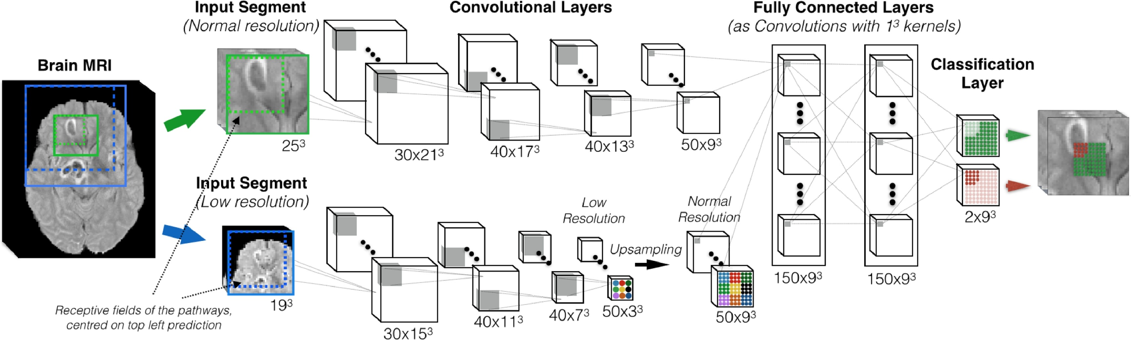

Slide 4
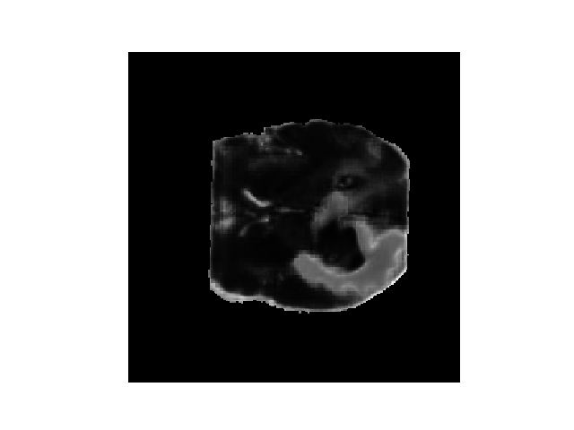
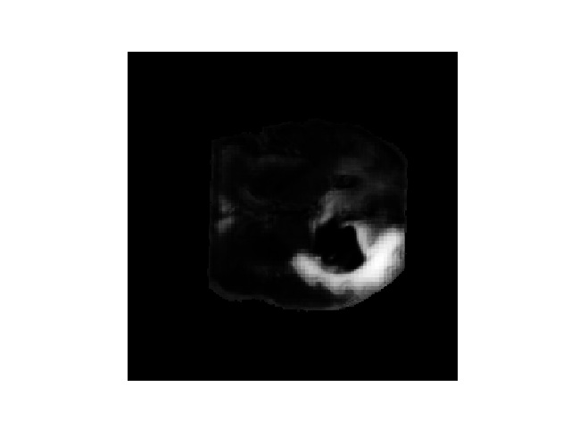
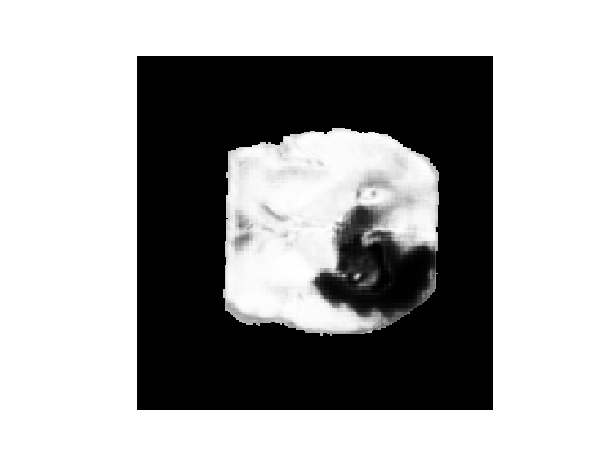
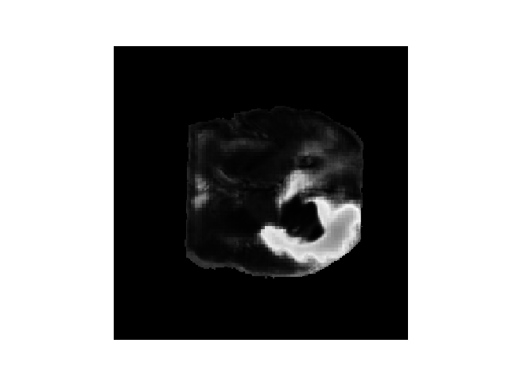
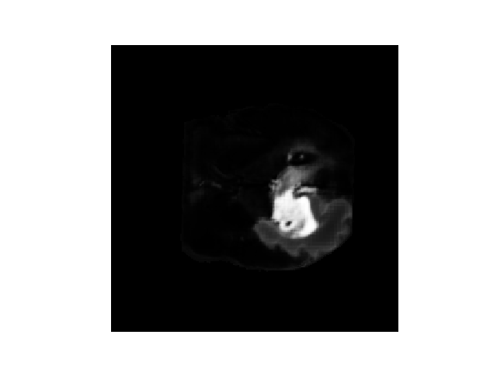

Brats 2015 Dataset
background
label 1：necrotic core
label 2：edema
label 3：non-enhancing
label 4：enhancing
Ground Truth

Slide 5
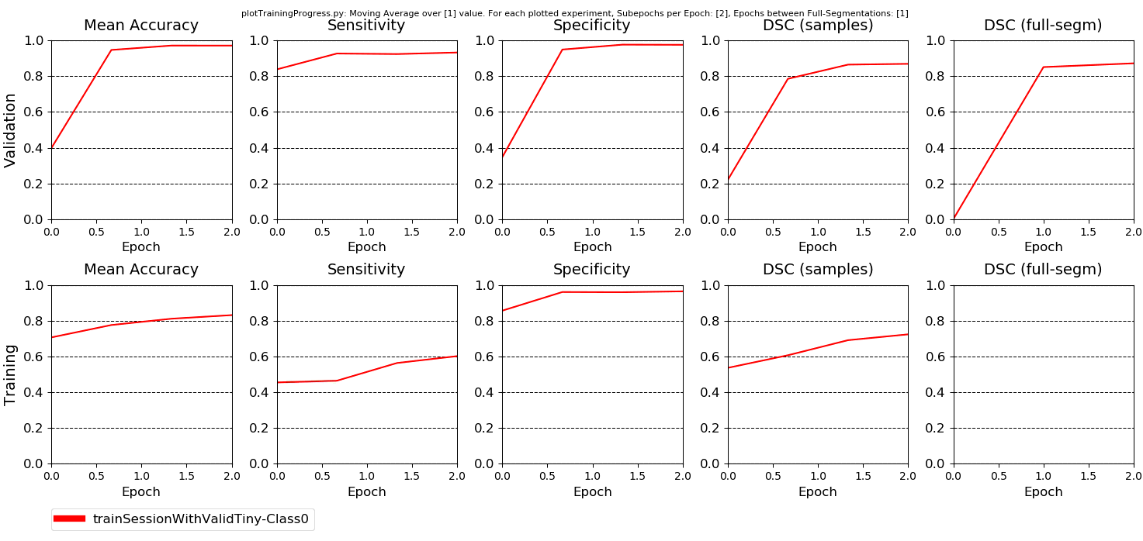

Slide 6
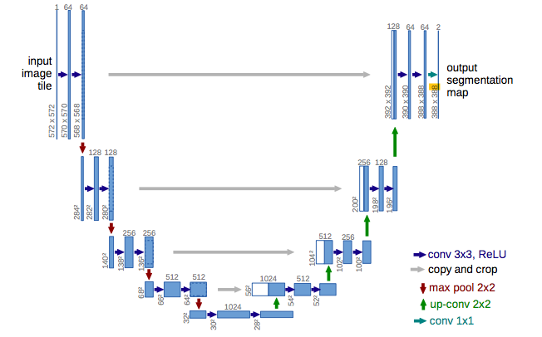
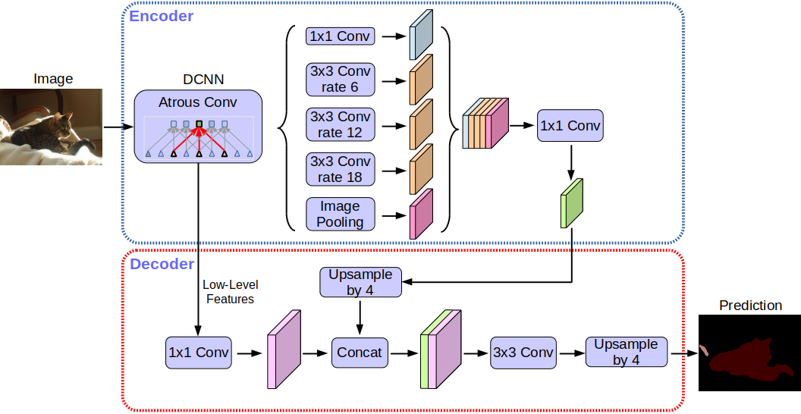
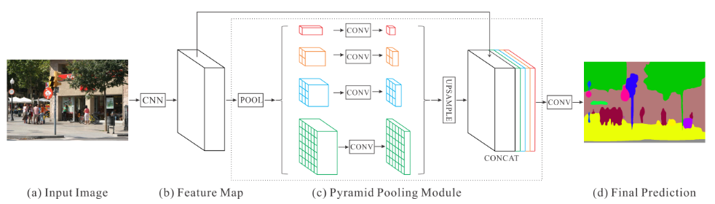
遇到的问题 1
https://github.com/JooHyun-Lee/BraTs
U-net
PSPNet
DeepLab V3+

Slide 7



遇到的问题 1
https://github.com/JooHyun-Lee/BraTs
U-net
PSPNet
DeepLab V3+

Slide 8
遇到的问题 2
Automatic Brain Tumor Detection and Segmentation Using U-Net Based Fully Convolutional Networks
2018-12-20 09:51:13.304790: E tensorflow/stream_executor/cuda/cuda_blas.cc:636]
failed to run cuBLAS routine cublasSgemm_v2: CUBLAS_STATUS_EXECUTION_FAILED
tensorflow.python.framework.errors_impl.InternalError: Blas SGEMM launch failed : m=57600, n=1,
改小batch size
限制使用显存
重新安装cuda

Slide 9
Thank You!

