Slide 1
多模态脑肿瘤分割
胡敬玉
2018.12.26

Slide 2
Medical image segmentation based on multi-modal convolutional neural network: Study on image fusion schemes
Zhe Guo ; Xiang Li ; Heng Huang ; Ning Guo ; Quanzheng Li
Department of Radiology, Massachusetts General Hospital, Harvard Medical School, Boston, MA
201Imaging8 IEEE 15th International Symposium on Biomedical (ISBI 2018)

Slide 3
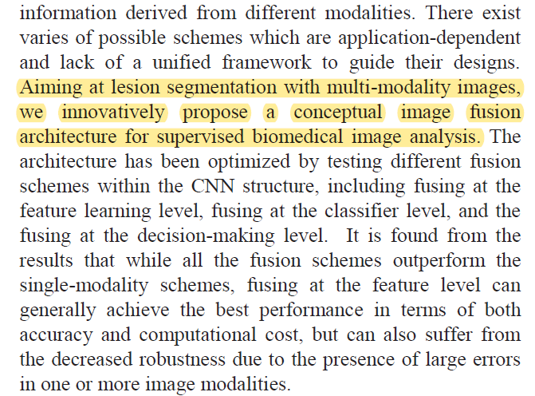
摘要

Slide 5
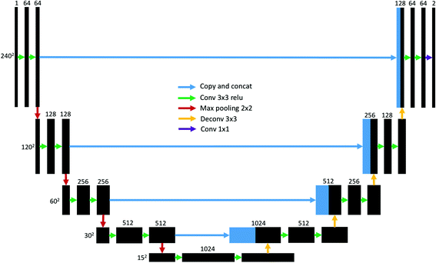
多模态脑肿瘤分割对于融合机制的研究比较少。
Dong H, Yang G, Liu F, et al. Automatic brain tumor detection and segmentation using U-Net based fully convolutional networks[C]//Annual Conference on Medical Image Understanding and Analysis. Springer, Cham, 2017: 506-517.
图片数量为1张

Slide 6
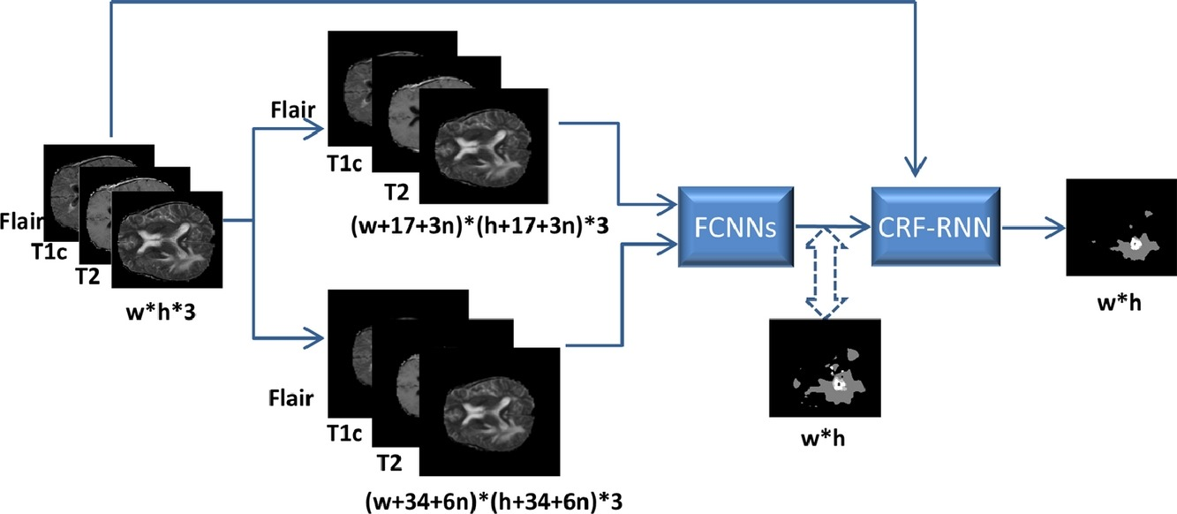
Zhao X, Wu Y, Song G, et al. A deep learning model integrating FCNNs and CRFs for brain tumor segmentation[J]. Medical image analysis, 2018, 43: 98-111.

Slide 7
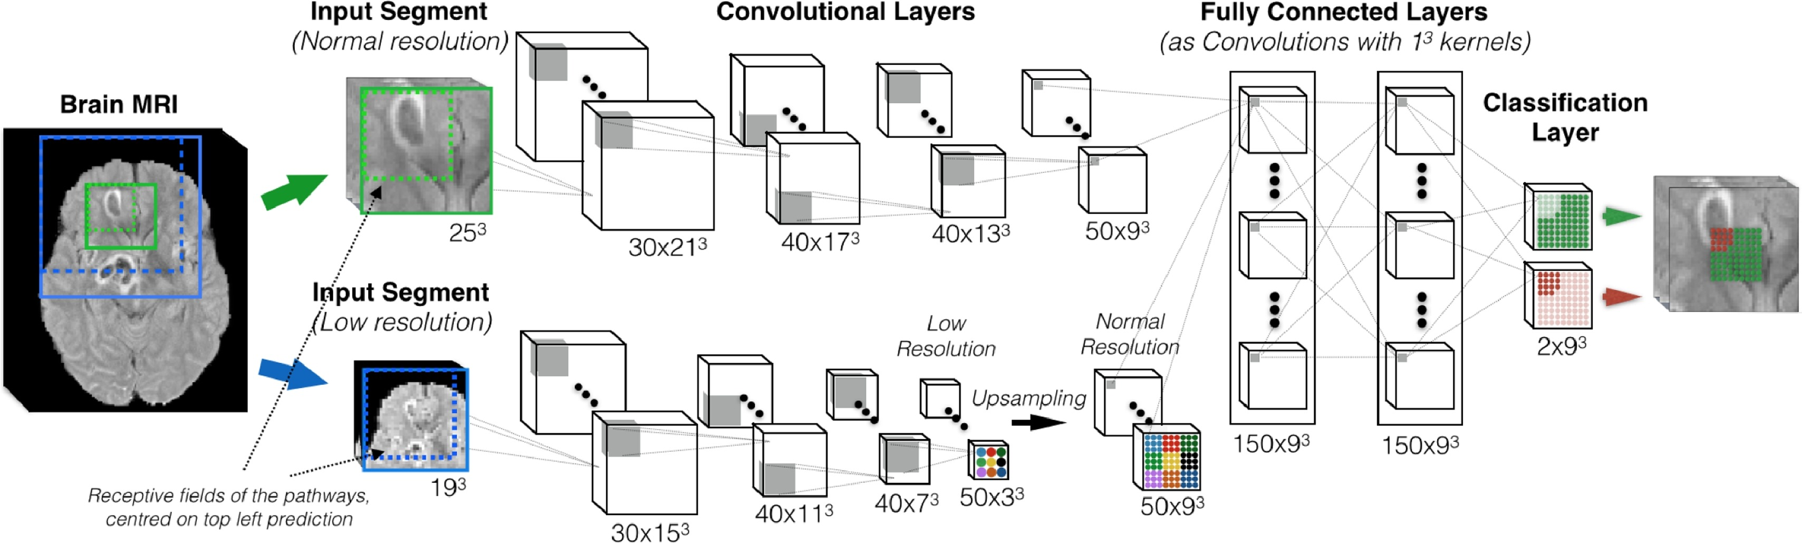
Kamnitsas K, Ledig C, Newcombe V F J, et al. Efficient multi-scale 3D CNN with fully connected CRF for accurate brain lesion segmentation[J]. Medical image analysis, 2017, 36: 61-78.

Slide 8
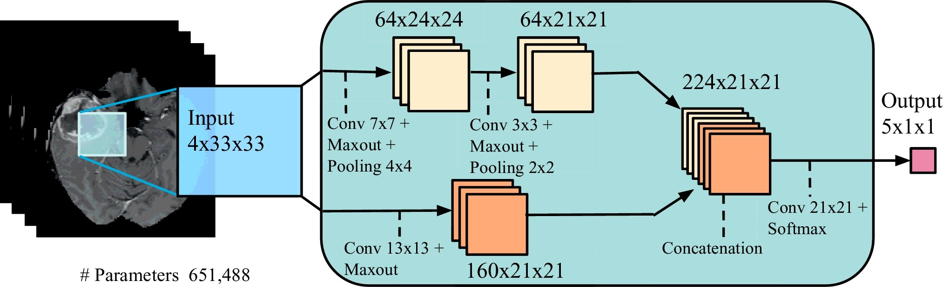
Havaei M, Davy A, Warde-Farley D, et al. Brain tumor segmentation with deep neural networks[J]. Medical image analysis, 2017, 35: 18-31.

Slide 9
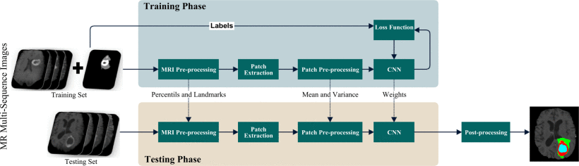
Pereira S, Pinto A, Alves V, et al. Brain tumor segmentation using convolutional neural networks in MRI images[J]. IEEE transactions on medical imaging, 2016, 35(5): 1240-1251.

Slide 10
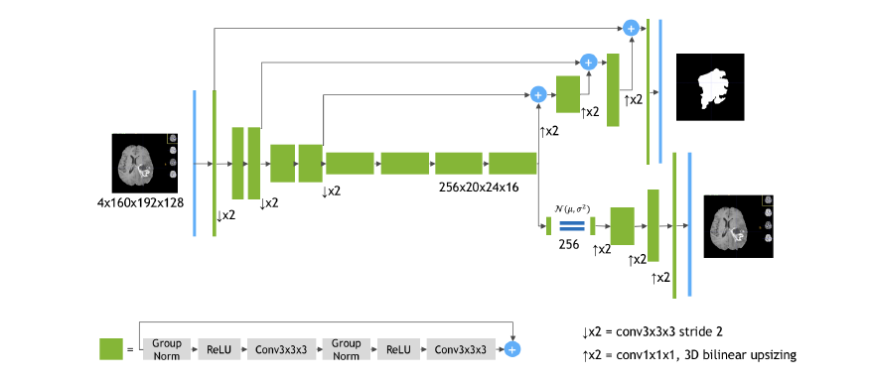
Myronenko A. 3D MRI brain tumor segmentation using autoencoder regularization[J]. arXiv preprint arXiv:1810.11654, 2018.·

Slide 11
Thank You!

