Slide 1
进度汇报
胡敬玉
2019.1.9

Slide 2
MRI Tumor Segmentation with Densely Connected 3D CNN
Medical Imaging 2018: Image Processing. International Society for Optics and Photonics(SPIE)
Lele Chen, Yue Wu, Adora M. DSouza, Anas Z. Abidin,Axel Wismuller, and Chenliang Xu
Department of Computer Science,University of Rochester, NY, USA

Slide 3
问题：
分割能够有效地监视神经胶质瘤的状况以及对治疗结果进行评估
手工分割MRI需要大量的人力
采用3D CNN进行自动分割
增加紧密连接卷积层
层级连接的方法

Slide 4
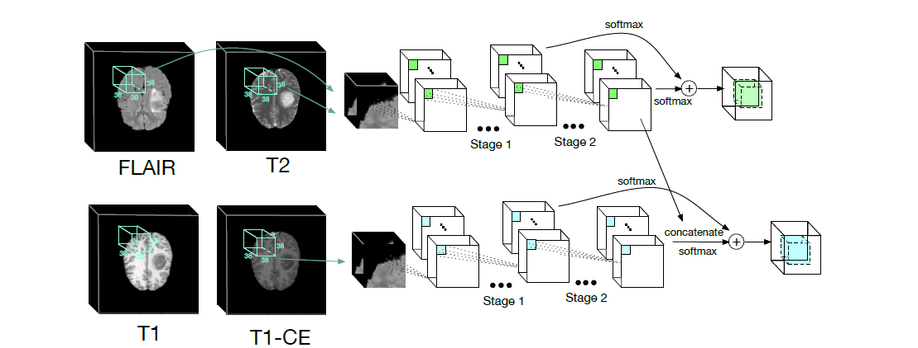
All tumor

Slide 5
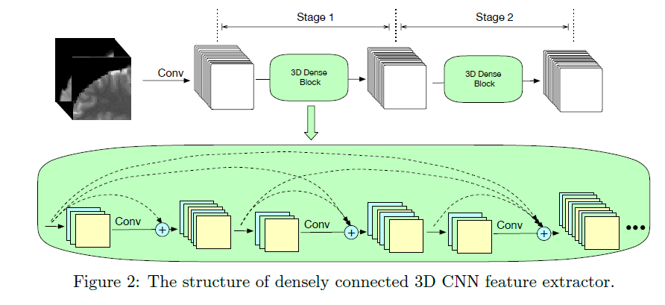

Slide 6
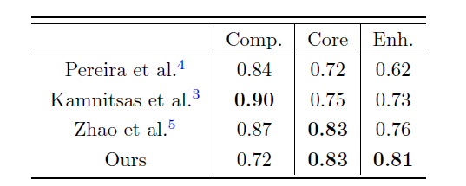
结果

Slide 8
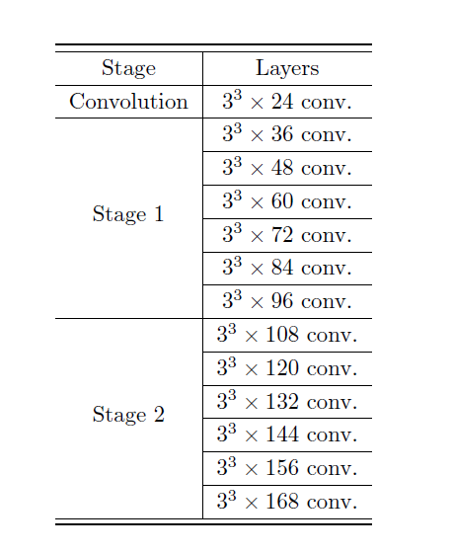
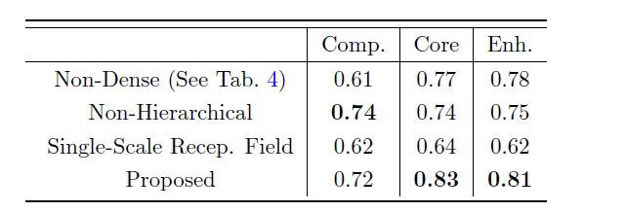

Slide 9
Thank You!

