Slide 1
进度汇报
胡敬玉
2019.4.10

Slide 3
比较
 | Whole Dice | Core Dice | Enhance Dice
1. DenseCNN (Brats 2017 HGG) | 0.72(0.8016) | 0.83(0.7497) | 0.81(0.7523)
2. HyperDense (Brats 2017 HGG) | 0.8389 | 0.7968 | 0.7987
反向连接(Brats 2017 HGG) | 0.8775 | 0.8271 | 0.8238
Dense 反向连接(Brats 2017 HGG) | 0.8701 | 0.8393 | 0.8322
Chen L, Wu Y, DSouza A M, et al. MRI tumor segmentation with densely connected 3D CNN[C]//Medical Imaging 2018: Image Processing. International Society for Optics and Photonics, 2018, 10574: 105741F.
Dolz J, Gopinath K, Yuan J, et al. HyperDense-Net: A hyper-densely connected CNN for multi-modal image segmentation[J]. arXiv preprint arXiv:1804.02967, 2018.

Slide 4
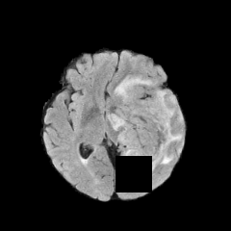
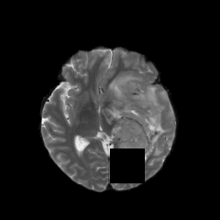
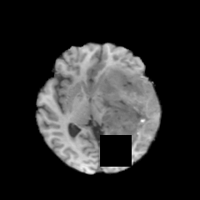
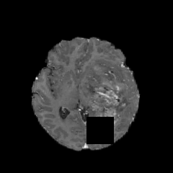




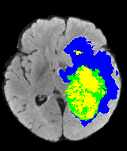
FLAIR
T2
T1
T1ce
③
②
①

Slide 5
































①
Bottom-up path
Top-down path

Slide 6
































②
Bottom-up path
Top-down path

Slide 7
















③
Bottom-up path
Top-down path

Slide 8
Thank You!

