Slide 1
研究综述（基于kaist数据集）
文献 | 方法 | Miss Rate (test-All-20) | source
[1] | ACF+T+THOG(benchmark) | 64.76% | CVPR, 2015
[2] | LateFusion CNN | 43.80% | ESANN, 2016
[3] | Halfway Fusion | 36.22% | BMVC, 2016
[4] | FusionRPN + boost decision tree | 29.83% | CVPR, 2017
[5] | Illumination-Aware Faster R-CNN (IAFR-CNN) | 15.73% | 2018(best)
[6] | FRPN-Sum+TSS | 26.67% | applied optics, 2018/11
[1] Hwang S, Park J, Kim N, et al. Multispectral pedestrian detection: Benchmark dataset and baseline[C]// Computer Vision and Pattern Recognition. IEEE, 2013:1037-1045.
[2]Wagner J, Fischer V, Herman M, et al. Multispectral Pedestrian Detection using Deep Fusion Convolutional Neural Networks
[3]Liu J, Zhang S, Wang S, et al. Multispectral Deep Neural Networks for Pedestrian Detection[J]. 2016.
[4] König D, Adam M, Jarvers C, et al. Fully Convolutional Region Proposal Networks for Multispectral Person Detection[C]// IEEE Conference on Computer Vision and Pattern Recognition Workshops. IEEE Computer Society, 2017:243-250.
[5]Li C, Song D, Tong R, et al. Illumination-aware Faster R-CNN for Robust Multispectral Pedestrian Detection[J]. 2018.
[6] Dayan G , Yanpeng C , Jiangxin Y , et al. Exploiting fusion architectures for multispectral pedestrian detection and segmentation[J]. Applied Optics, 2018, 57(18):D108-.

Slide 2
State Key Laboratory of Fluid Power and Mechatronic Systems
Key Laboratory of Advanced Manufacturing Technology
Exploiting fusion architectures for multispectral pedestrian detection and segmentation
[applied optics]:
FRPN-Sum+TSS:26.67%
Fusion of Multispectral Data Through Illumination-aware Deep Neural Networks for Pedestrian Detection
[Information Fusion]
IATDNN + IAMSS: 26.37%
Box-level segmentation supervised deep neural networks for accurate and real-time multispectral pedestrian detection
State Key Lab of CAD&CG, Zhejiang University,Hangzhou,Zhejiang,China
Illumination-aware Faster R-CNN for Robust Multispectral Pedestrian Detection
PatternRecognition 2019
Illumination-Aware Faster R-CNN (IAFR-CNN)：15.73%
e. Multispectral Pedestrian Detection via Simultaneous Detection and Segmentation
BMVC18
MSDS-RCNN :11.63%

Slide 3
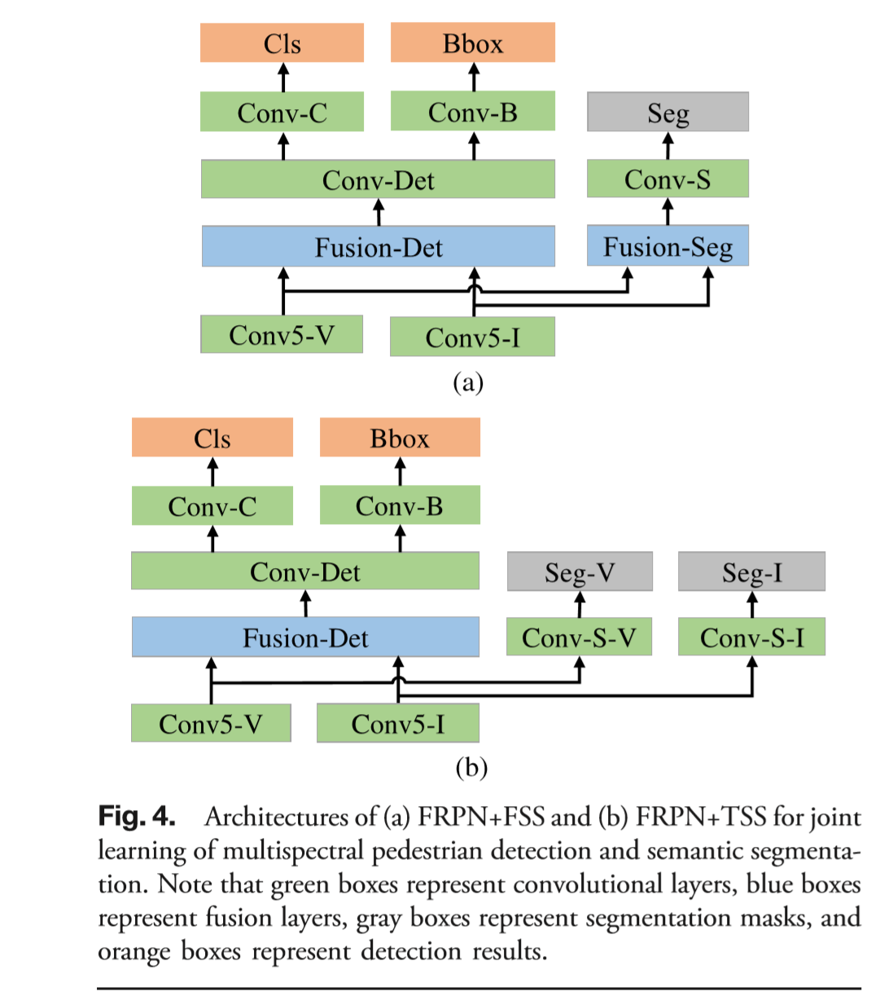
Exploiting fusion architectures for multispectral pedestrian detection and segmentation
[applied optics] FRPN-Sum+TSS:26.67%
提出了sum/concate/max
三种连接方式

Slide 4
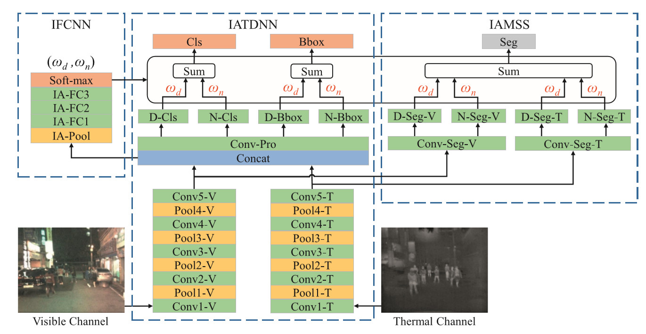
Fusion of Multispectral Data Through Illumination-aware Deep Neural Networks for Pedestrian Detection
[Information Fusion] IATDNN + IAMSS: 26.37%

Slide 5
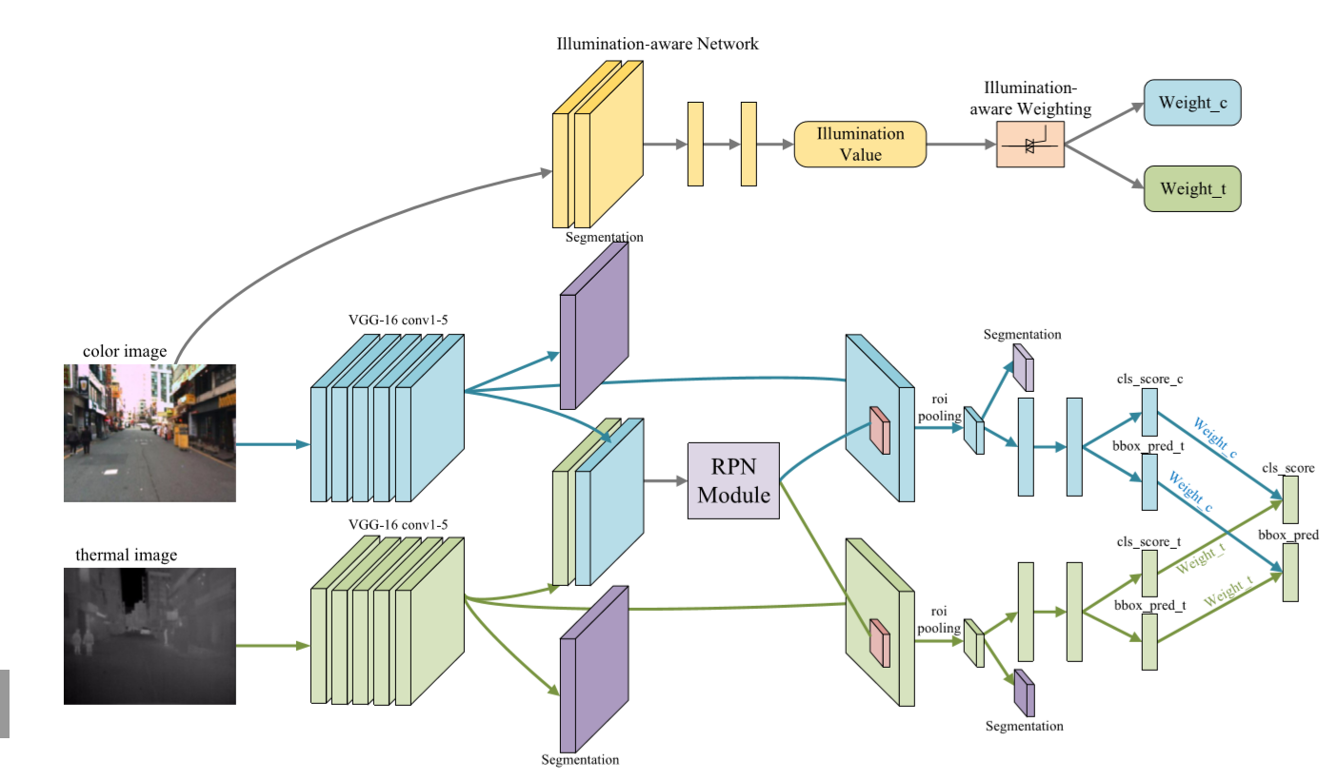
Illumination-aware Faster R-CNN for Robust Multispectral Pedestrian Detection
PatternRecognition 2019 Illumination-Aware Faster R-CNN (IAFR-CNN)：15.73%

Slide 6
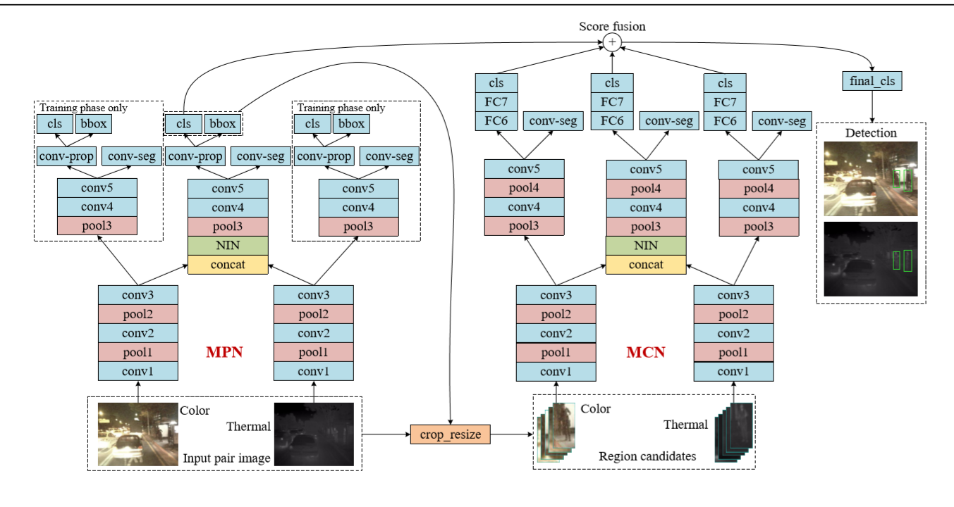
Multispectral Pedestrian Detection via Simultaneous Detection and Segmentation
BMVC18
MSDS-RCNN :11.63%

Slide 7
Thanks

