Slide 1
进度汇报
毛宽诚
2019/05/08

Slide 2
基于pytorch的单/双波段行人检测实验
训练集：train-all-02(set01-set05)
train-all-20(set01-set05)
测试集：test-all-20(set06-set11)
2252张图片。
标签：person/people/people?/cyclist
训练：全部训练/只取person
测试：忽略 people/people?/cyclist
忽略 occlusion/小尺寸
仅统计person

Slide 3
1，改于pytorch的fasterrcnn双通道代码。 2，实验几种不同双波段融合。
1，实验训练数据集大小对结果的影响。
2，训练集标签的选取。
3，超参：anchor选取
ANCHOR_RATIOS： 0.5,1,2
学习率 0.01/0.001
4，网络结构：
实验前端/中端融合/跳连的效果
。

Slide 4
实验结果： missrate-fppi
RGB(预训练)
Reasonable-all log-average miss rate = 44.57% (38.37%) recall = 74.72% (76.43%)
Reasonable-day log-average miss rate = 39.74% (50.28%) recall = 79.29% (56.29%)
Reasonable-night log-average miss rate = 56.39% (99.95%) recall = 63.18% (0.14%)
FUSION:
Half:
Reasonable-all log-average miss rate = 64.53% (59.32%) recall = 72.39% (77.11%)
Reasonable-day log-average miss rate = 62.21% (67.62%) recall = 76.82% (55.53%)
Reasonable-night log-average miss rate = 70.63% (99.94%) recall = 61.19% (0.76%)
Early:
Reasonable-all log-average miss rate = 67.38% (61.88%) recall = 73.09% (78.08%)
Reasonable-day log-average miss rate = 65.81% (69.87%) recall = 76.92% (56.08%)
Reasonable-night log-average miss rate = 71.44% (99.88%) recall = 63.43% (1.58%)
之前我caffe最好的效果： rgb:55% half way: 40%
问题：1.小目标检测不出来。
2.树/轮胎识别成人
后面尝试：将roi pooling ->roi align

Slide 5
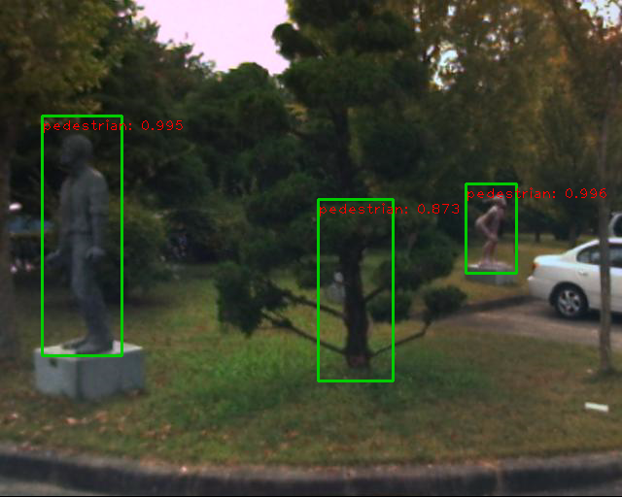
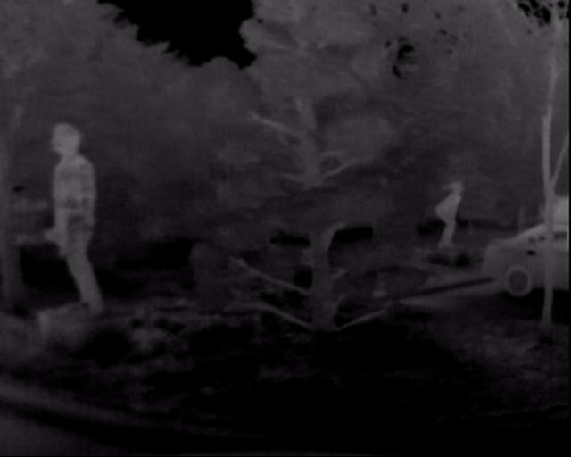
person 478 197 46 87 0 0 0 0 0 0 0
person? 39 130 83 249 0 0 0 0 0 0 0

Slide 6
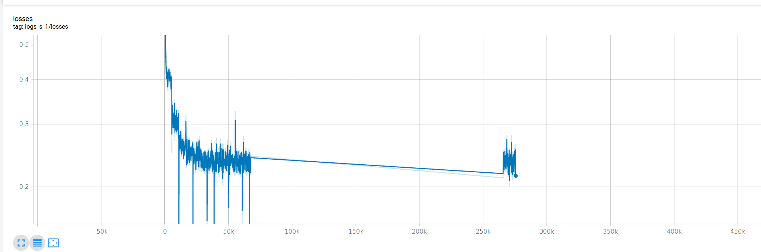
Loss: 0.22左右

Slide 8
Thanks

