Slide 1
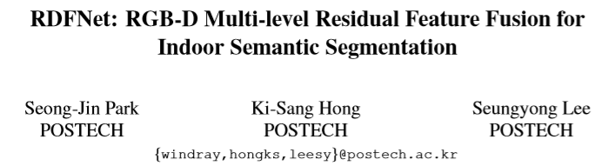
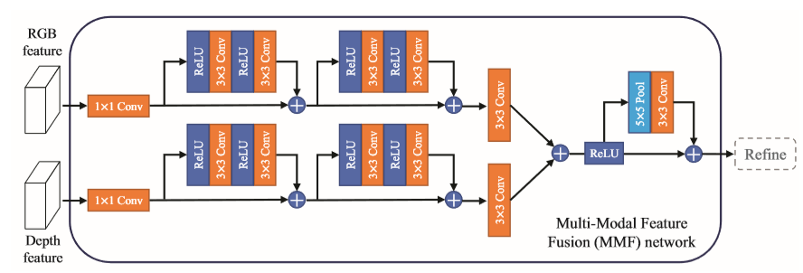
2017 IEEE International Conference on Computer Vision

Slide 2
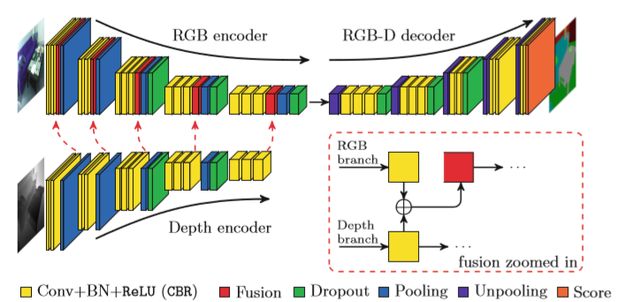
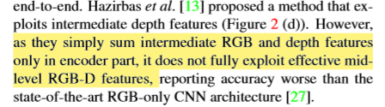
Fusenet: Incorporating depth into semantic segmentation via fusionbased cnn architecture.
C. Hazirbas, L. Ma, C. Domokos, and D. Cremers. In Proc. ACCV, volume 2, 2016. 1, 2, 3, 7

Slide 3
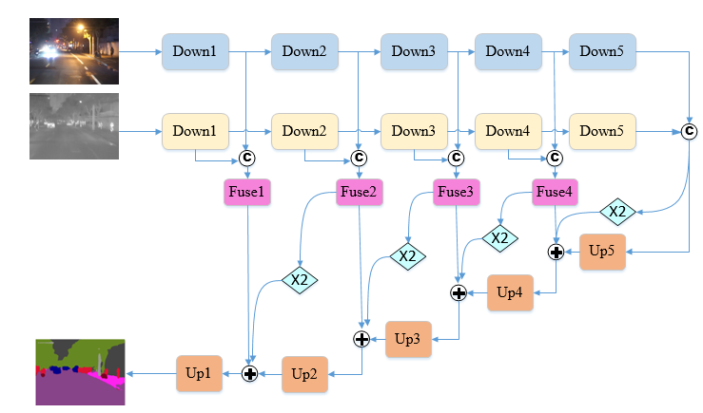
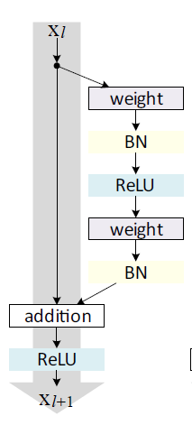

Slide 4
Fuse模块对比实验
Data:A_200 batchsize =2 size=320*320 epoch=140
网络 | 原始级联 | 级联+1X1 | 级联+3X3 | 级联+ResNet
Acc | 93.34 | 93.25 | 93.74 | 93.50
Miou | 69.61 | 69.93 | 70.59 | 71.36

Slide 5
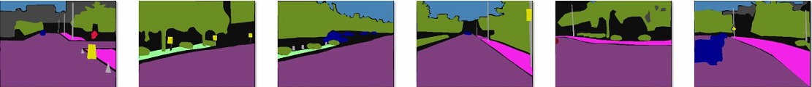
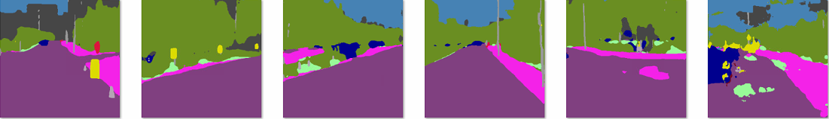
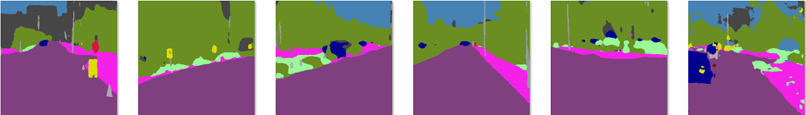
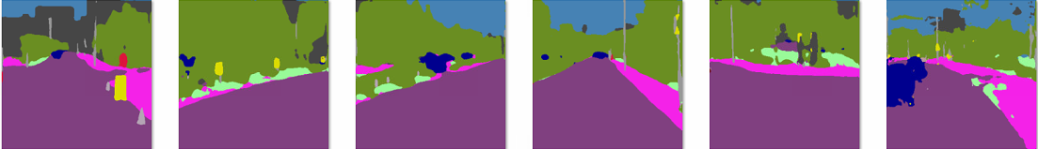
Ground Truth
原始级联
Fuse
1X1
Fuse
ResNet

Slide 6
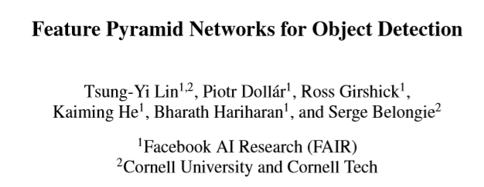
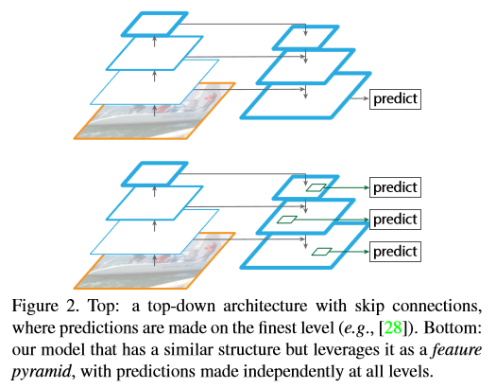

Slide 7
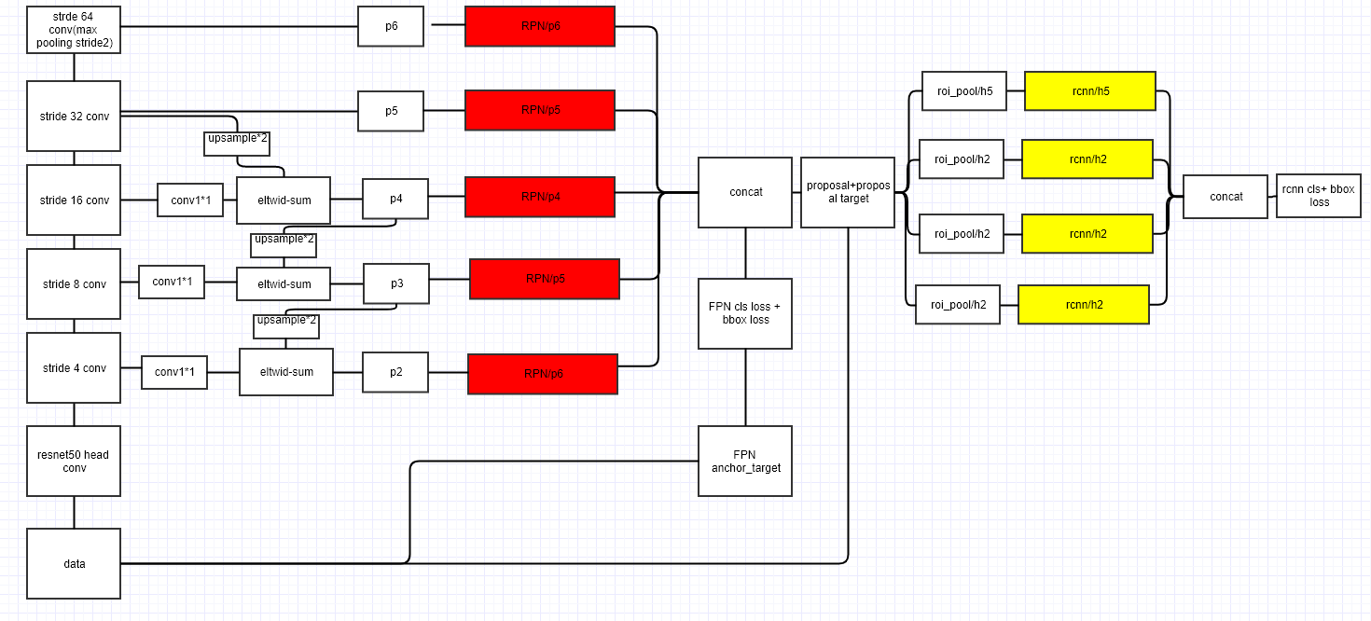

Slide 8
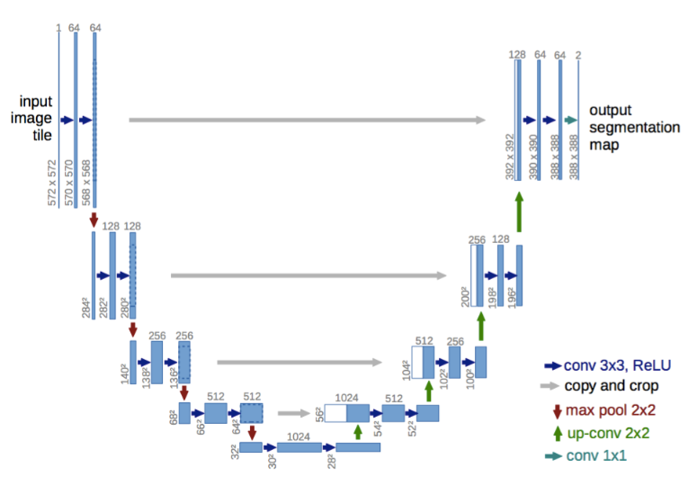

Slide 9
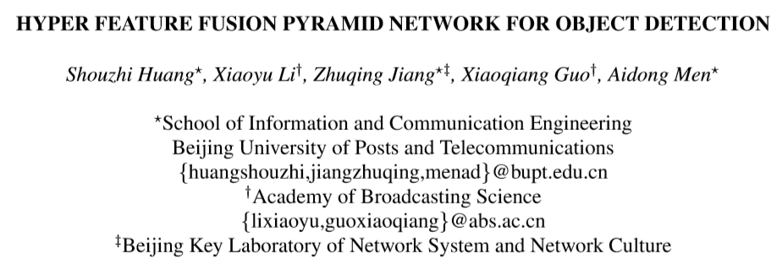
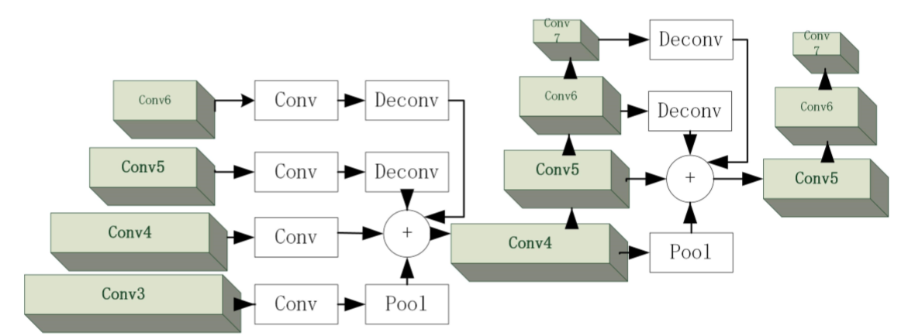
978-1-5386-1737-3/18/$31.00 c
2018 IEEE

Slide 10
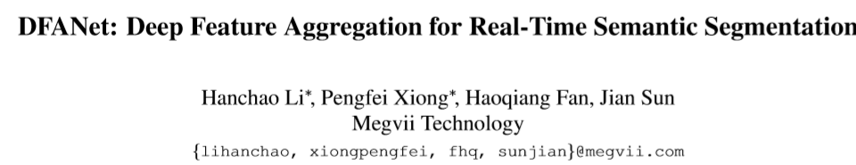
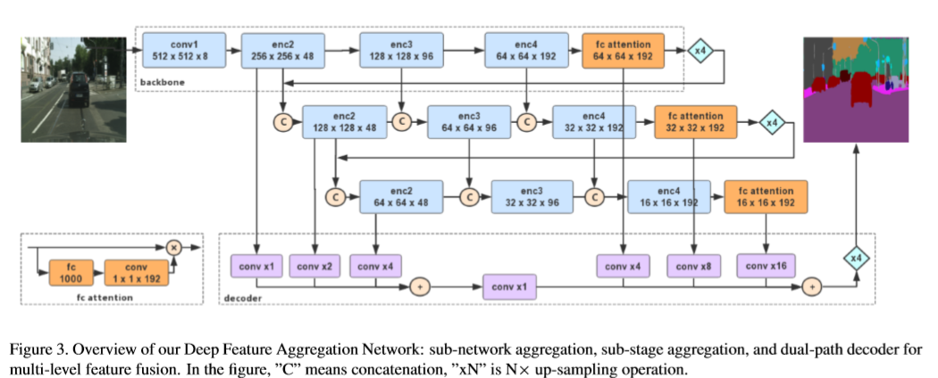
旷视科技

