Slide 1
进度汇报
毛宽诚
2019/05/29

Slide 2
基于pytorch的单/双波段行人检测实验
训练集：train-all-02(set01-set05)
train-all-20(set01-set05)
测试集：test-all-20(set06-set11)
2252张图片。
标签：person/people/people?/cyclist
训练：全部训练/只取person
测试：忽略 people/people?/cyclist
忽略 occlusion/小尺寸
仅统计person

Slide 3
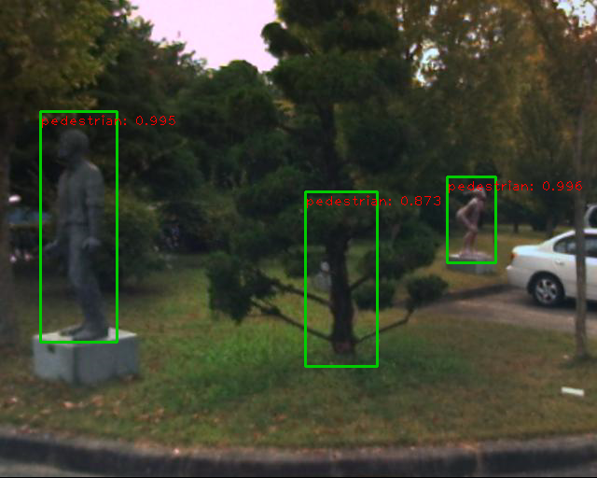
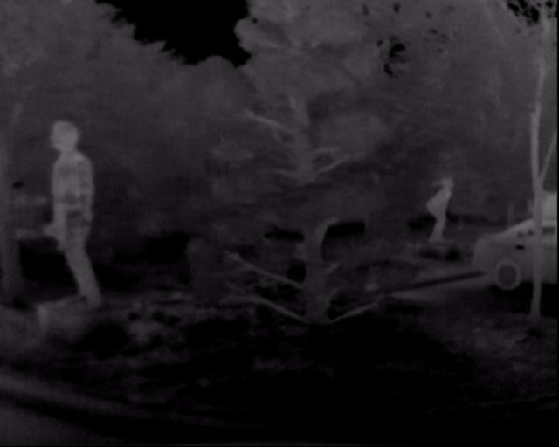
person 478 197 46 87 0 0 0 0 0 0 0
person? 39 130 83 249 0 0 0 0 0 0 0
2.树/轮胎识别成人 小目标效果更好了

Slide 4
RPN FUSION
ROI align origin annotation improved annotation
Reasonable-all log-average miss rate = 34.17% (19.17%) recall = 87.85% (91.68%)
Reasonable-day log-average miss rate = 34.62% (43.28%) recall = 88.07% (63.02%)
Reasonable-night log-average miss rate = 32.32% (99.90%) recall = 87.31% (0.21%)
ROI pooling
Reasonable-all log-average miss rate = 40.26% (27.90%) recall = 83.40% (86.87%)
Reasonable-day log-average miss rate = 41.48% (49.77%) recall = 83.73% (59.45%)
Reasonable-night log-average miss rate = 37.61% (99.95%) recall = 82.59% (0.14%)
HALF FUSION
ROI pooling
Reasonable-all log-average miss rate = 40.44% (28.11%) recall = 80.79% (84.67%)
Reasonable-day log-average miss rate = 40.62% (49.82%) recall = 81.56% (58.28%)
Reasonable-night log-average miss rate = 40.61% (99.95%) recall = 78.86% (0.14%)
Reasonable-all log-average miss rate = 36.78% (22.91%) recall = 83.90% (88.04%)
Reasonable-day log-average miss rate = 38.33% (46.72%) recall = 83.63% (60.00%)
Reasonable-night log-average miss rate = 34.00% (99.93%) recall = 84.58% (0.27%)

Slide 5
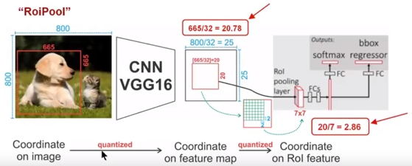
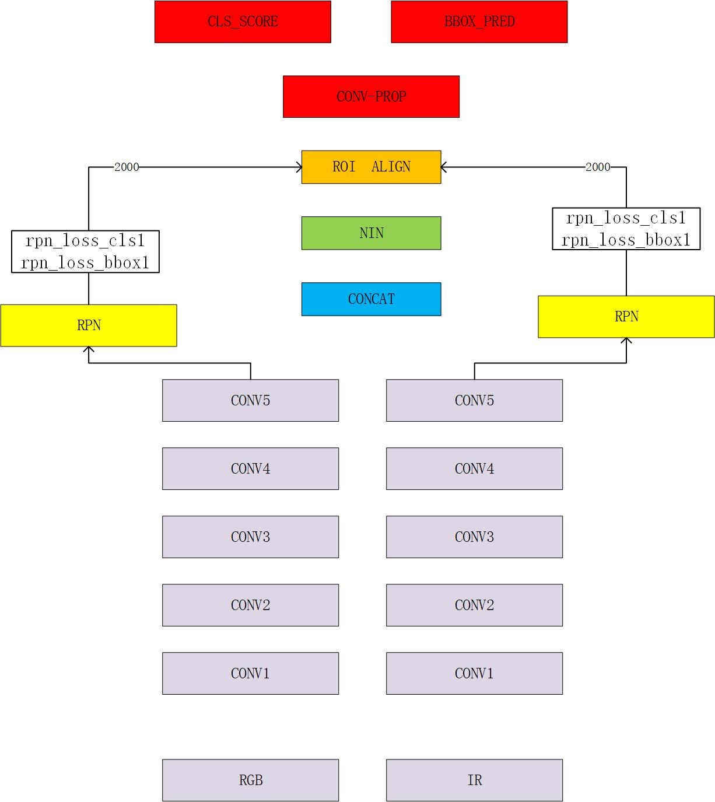
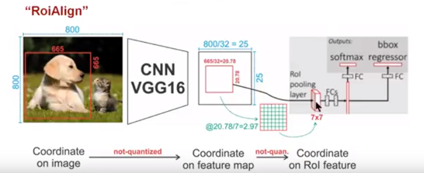
1, 改变网络 2，更改训练集标签：将训练集中people/people?/cyclist 3，roi pooling – roi algin

