Slide 1
医学图像分割中的损失函数
胡敬玉
2019.6.5

Slide 2
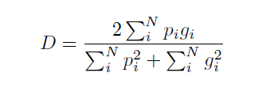

Cross Entropy and Dice Loss
二分类：
多分类：
类别不平衡
Dice是常用的评价指标
Dolz J, Gopinath K, Yuan J, et al. HyperDense-Net: A hyper-densely connected CNN for multi-modal image segmentation[J]. IEEE transactions on medical imaging, 2018.
Milletari F, Navab N, Ahmadi S A. V-net: Fully convolutional neural networks for volumetric medical image segmentation[C]//2016 Fourth International Conference on 3D Vision (3DV). IEEE, 2016: 565-571.

Slide 3
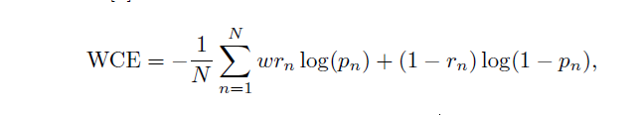
Weighted Cross Entropy
给予不同的类权重
Ronneberger O, Fischer P, Brox T. U-net: Convolutional networks for biomedical image segmentation[C]//International Conference on Medical image computing and computer-assisted intervention. Springer, Cham, 2015: 234-241.

Slide 4
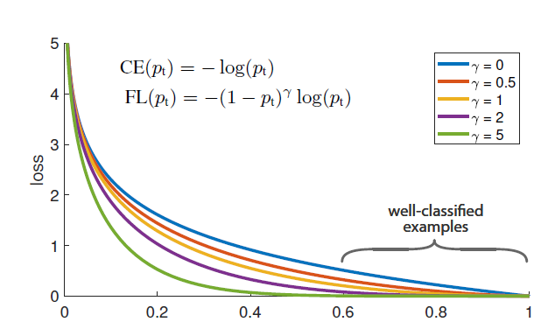
Focal Loss
Lin T Y, Goyal P, Girshick R, et al. Focal loss for dense object detection[C]//Proceedings of the IEEE international conference on computer vision. 2017: 2980-2988.

Slide 5
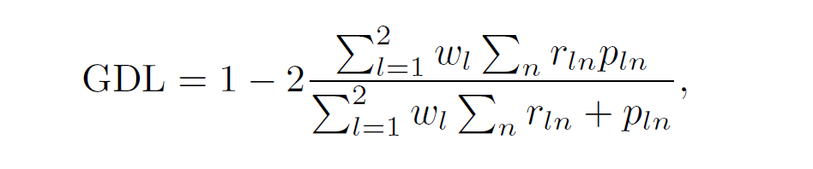
Generalized Dice Loss
Crum W R, Camara O, Hill D L G. Generalized overlap measures for evaluation and validation in medical image analysis[J]. IEEE transactions on medical imaging, 2006, 25(11): 1451-1461.
Sudre C H, Li W, Vercauteren T, et al. Generalised dice overlap as a deep learning loss function for highly unbalanced segmentations[M]//Deep learning in medical image analysis and multimodal learning for clinical decision support. Springer, Cham, 2017: 240-248.

Slide 6
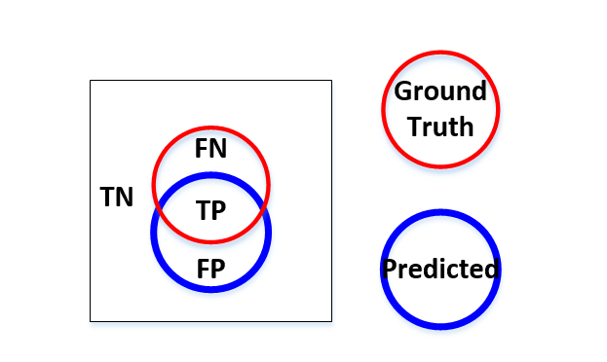


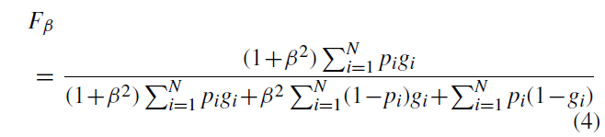
Asymmetric Loss
(F1 Score)
Hashemi S R, Salehi S S M, Erdogmus D, et al. Asymmetric loss functions and deep densely-connected networks for highly-imbalanced medical image segmentation: Application to multiple sclerosis lesion detection[J]. IEEE Access, 2019, 7: 1721-1735.

Slide 7
Thank You!

