Slide 1
进度汇报
毛宽诚
2019/06/26

Slide 2
基于pytorch的单/双波段行人检测实验
训练集：train-all-02(set01-set05)
train-all-20(set01-set05)
测试集：test-all-20(set06-set11)
2252张图片。
标签：person/people/people?/cyclist
训练：全部训练/只取person
测试：忽略 people/people?/cyclist
忽略 occlusion/小尺寸
仅统计person
person 478 197 46 87 0 0 0 0 0 0 0
person? 39 130 83 249 0 0 0 0 0 0 0

Slide 3
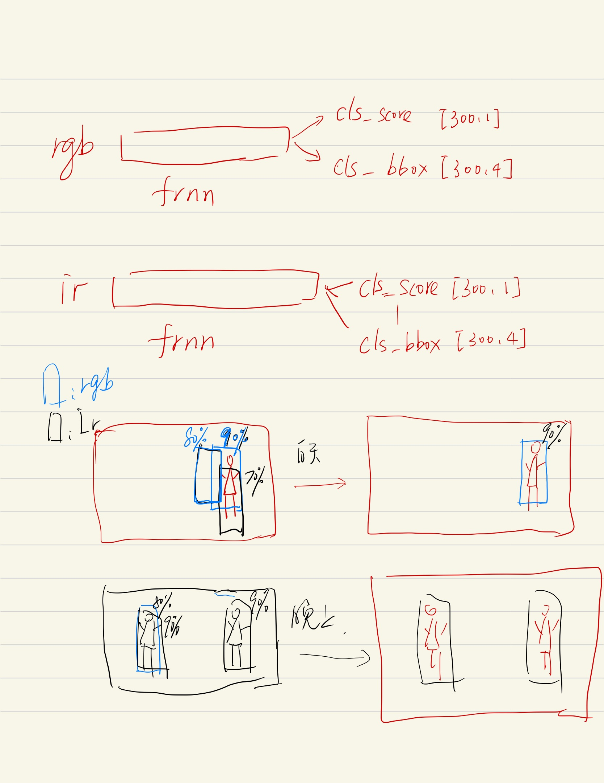
nms fusion

Slide 4
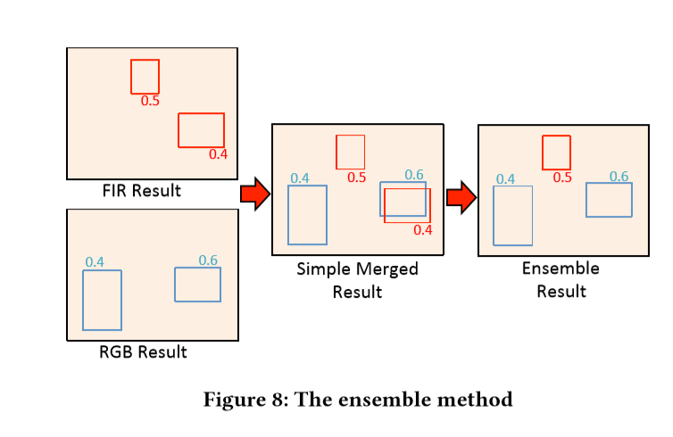
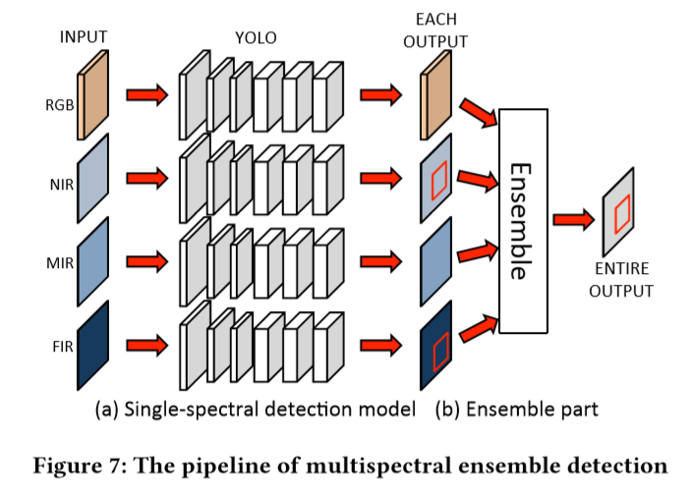
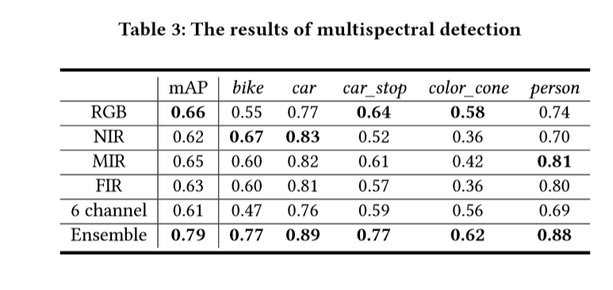
Takumi K , Watanabe K , Ha Q , et al. [ACM Press the - Mountain View, California, USA (2017.10.23-2017.10.27)] Proceedings of the on Thematic Workshops of ACM Multimedia 2017, - Thematic Workshops \"17 - Multispectral Object Detection for Autonomous Vehicles[C]// The. 2017:35-43.

Slide 5
方法 | Half fusion |  | rpn fusion |  | nms fusion
 | Roi pooling | Roi align | Roi pooling | Roi align
All | 40.44% | 36.78% | 40.26% | 34.17% | 36.63%
Day | 40.61% | 38.33% | 41.48% | 34.62% | 39..21%
Night | 40.62% | 34.00% | 37.61% | 32.32% | 30.71%
方法 | Nms fusion | Rgb | Ir
 |  | Roi aglin | Roi aglin
All | 36.63% | 46.20% | 46.04%
Day | 39..21% | 42..45%. | 50.33%
Night | 30.71% | 55.63% | 33.92%

Slide 6
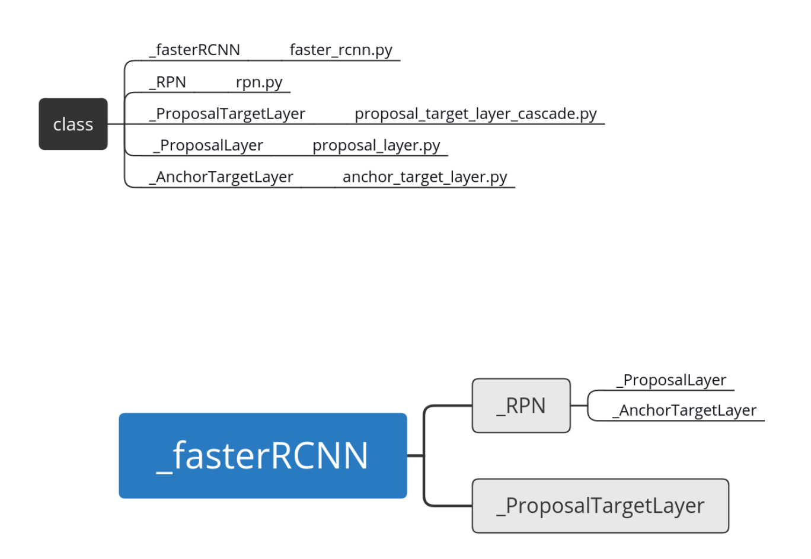
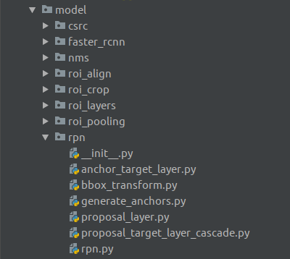
RPN

Slide 7
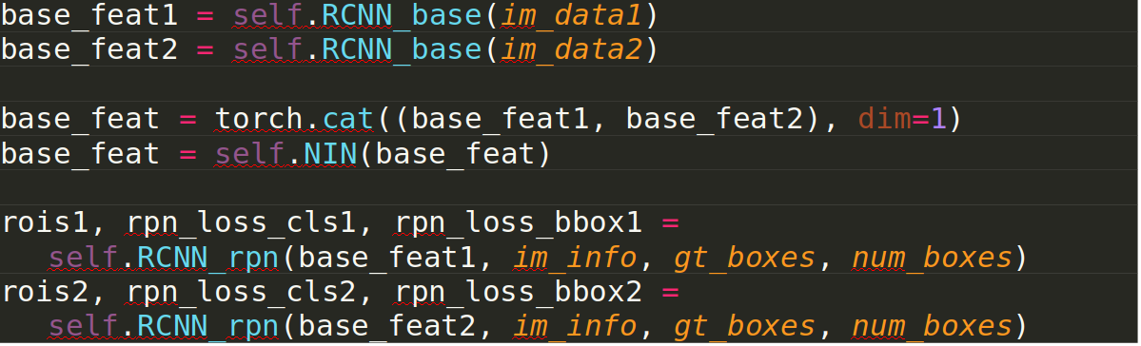
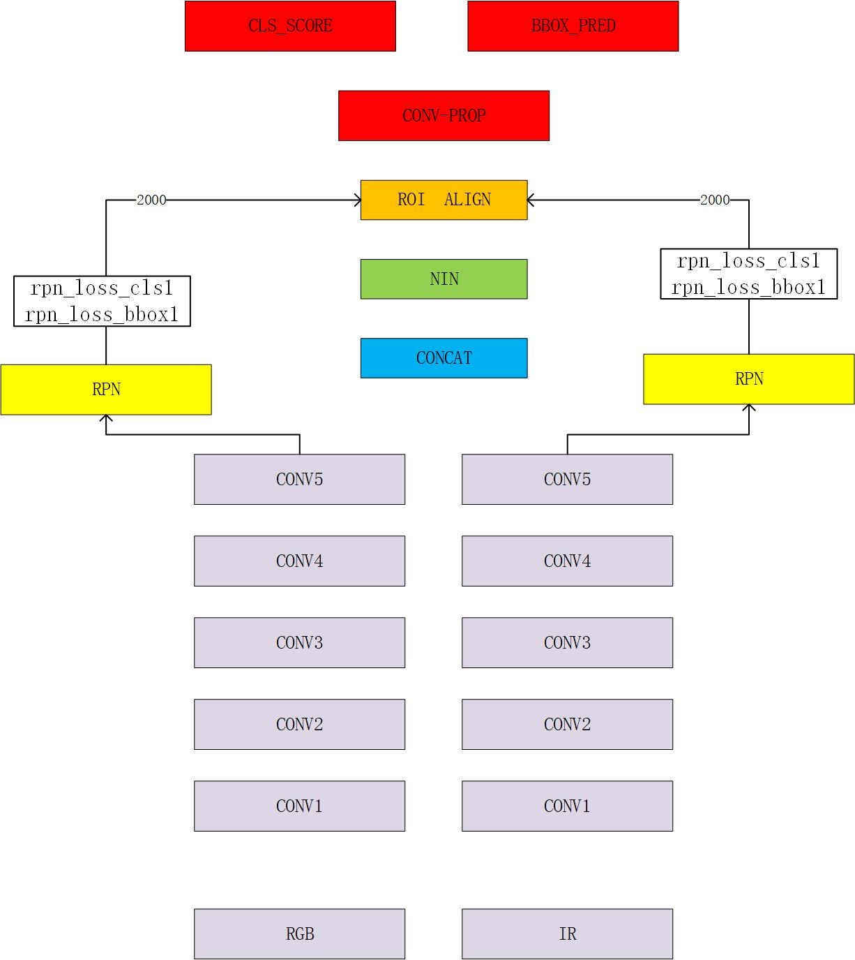

Slide 8
