Slide 1
进度汇报
康萌萌
2019.07.10

Slide 2

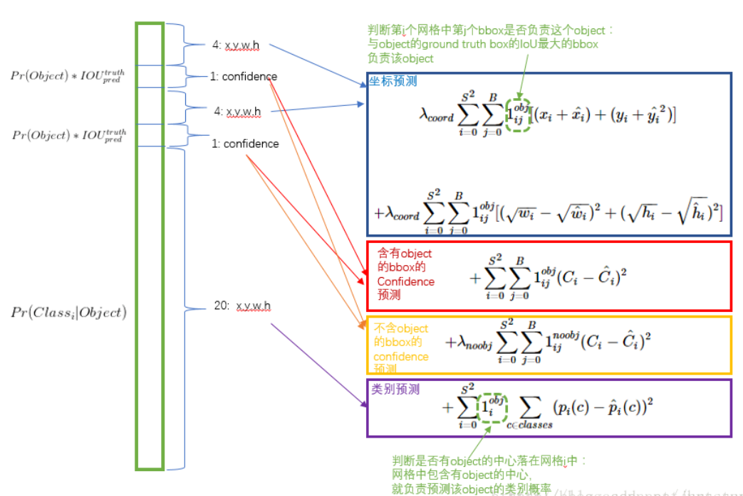
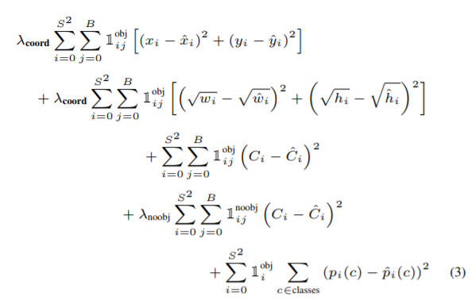
Training Loss
λcoord = 5
λnoobj = 0.5

Slide 3
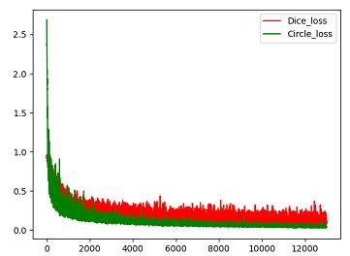
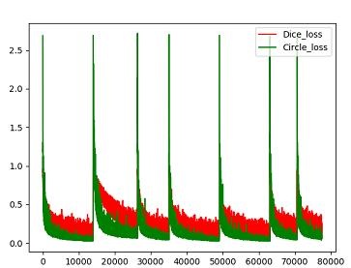
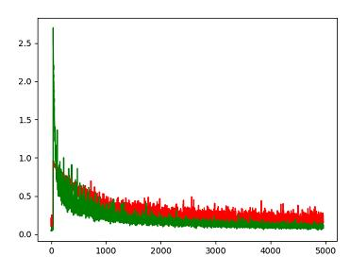
Training Loss
Dice_loss: 0.9534 Cicle_loss: 2.6863
0.3:0.7
1 : 1

Slide 4
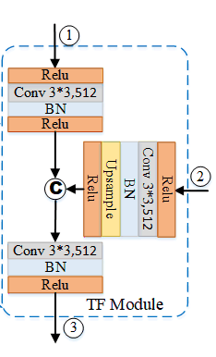

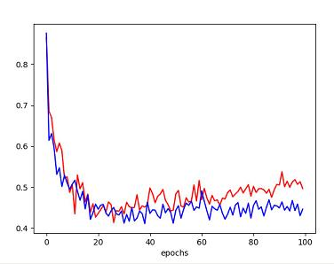
Training Loss
Relu + L2正则化

