Slide 1
组 会 报 告
蓝 鑫
2019年7月27日

Slide 2
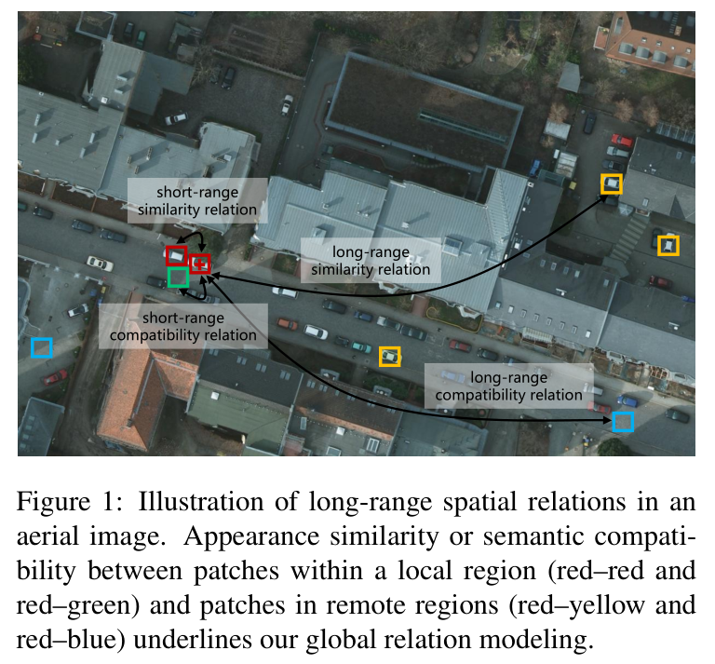
Relation-Augmented
Mou, L., Hua, Y., & Zhu, X. X. (2019). A Relation-Augmented Fully Convolutional Network for Semantic Segmentation in Aerial Scenes. Paper presented at the CVPR 2019.

Slide 3
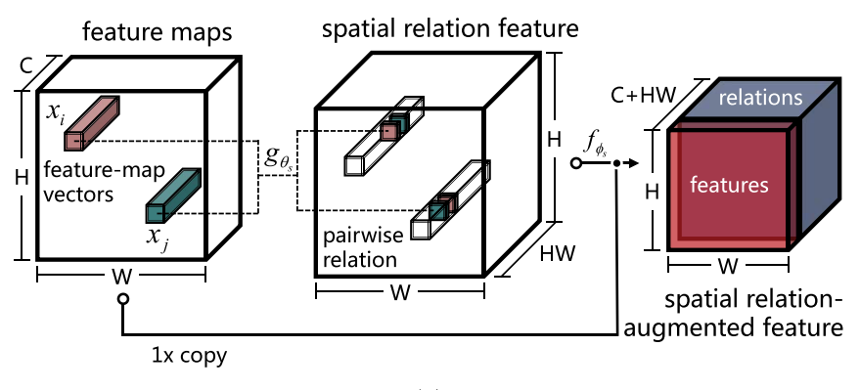


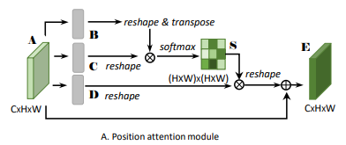
空间关系
Mou, L., Hua, Y., & Zhu, X. X. (2019). A Relation-Augmented Fully Convolutional Network for Semantic Segmentation in Aerial Scenes. Paper presented at the CVPR 2019.
和 DANet 对比：没有使用 softmax，和原始特征图级联而不是相加

Slide 4
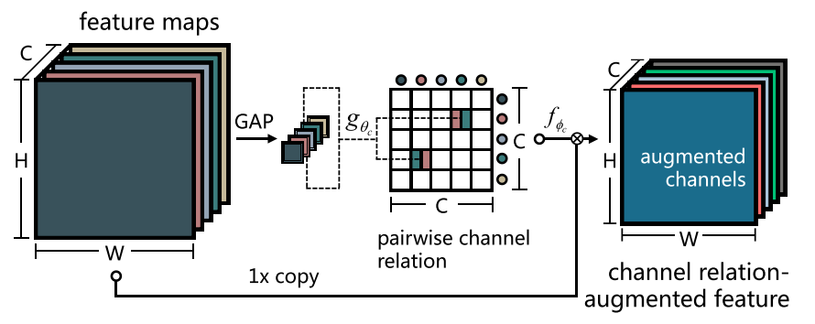


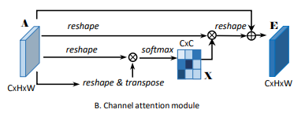
通道关系
Mou, L., Hua, Y., & Zhu, X. X. (2019). A Relation-Augmented Fully Convolutional Network for Semantic Segmentation in Aerial Scenes. Paper presented at the CVPR 2019.
和 DANet 对比：使用全局平均池化来得到 CxC 特征图

Slide 5
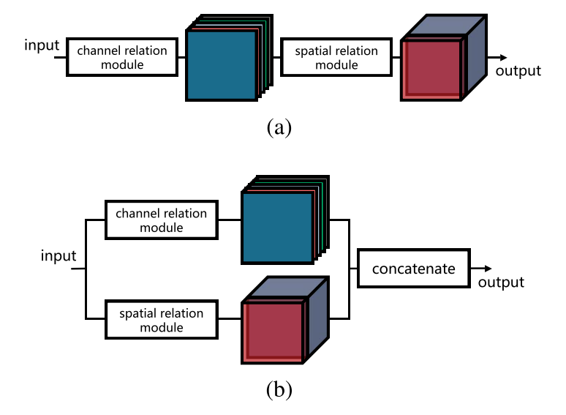
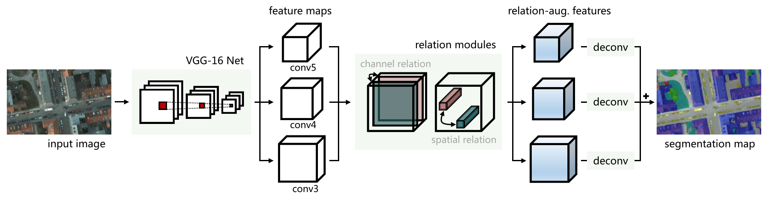
集成方式
Mou, L., Hua, Y., & Zhu, X. X. (2019). A Relation-Augmented Fully Convolutional Network for Semantic Segmentation in Aerial Scenes. Paper presented at the CVPR 2019.

