Slide 1
进度汇报
毛宽诚
2019/07/10

Slide 2
基于pytorch的单/双波段行人检测实验
训练集：train-all-02(set01-set05)
train-all-20(set01-set05)
测试集：test-all-20(set06-set11)
2252张图片。
标签：person/people/people?/cyclist
训练：全部训练/只取person
测试：忽略 people/people?/cyclist
忽略 occlusion/小尺寸
仅统计person
person 478 197 46 87 0 0 0 0 0 0 0
person? 39 130 83 249 0 0 0 0 0 0 0

Slide 3
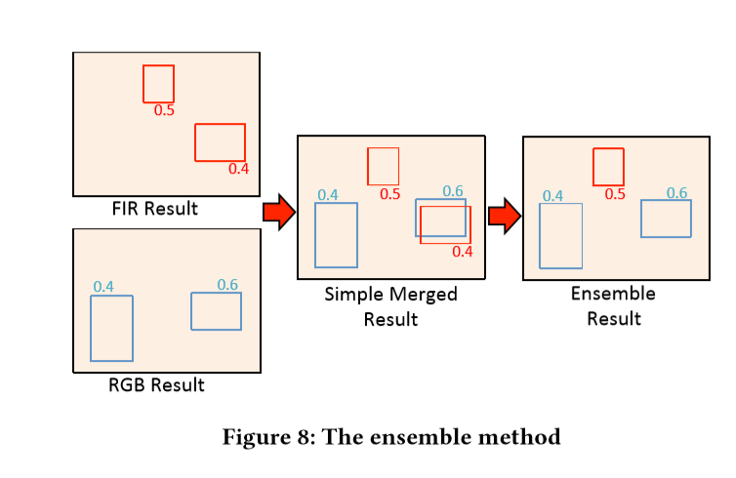
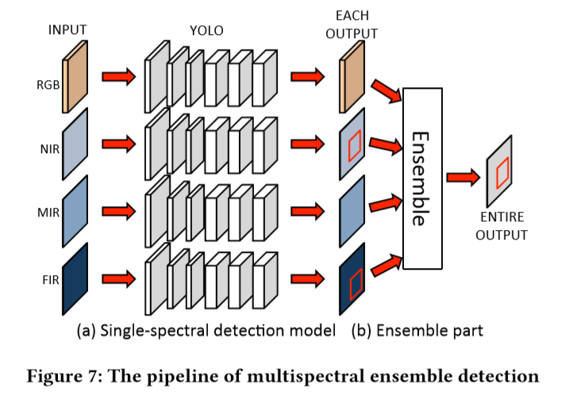
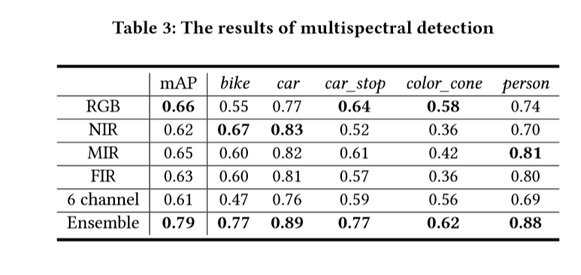
Takumi K , Watanabe K , Ha Q , et al. [ACM Press the - Mountain View, California, USA (2017.10.23-2017.10.27)] Proceedings of the on Thematic Workshops of ACM Multimedia 2017, - Thematic Workshops \"17 - Multispectral Object Detection for Autonomous Vehicles[C]// The. 2017:35-43.

Slide 4
方法 | Half fusion |  | rpn fusion |  | nms fusion
 | Roi pooling | Roi align | Roi pooling | Roi align
All | 40.44% | 36.78% | 40.26% | 34.17% | 36.63%
Day | 40.61% | 38.33% | 41.48% | 34.62% | 39..21%
Night | 40.62% | 34.00% | 37.61% | 32.32% | 30.71%
方法 | Nms fusion | Rgb | Ir
 |  | Roi aglin | Roi aglin
All | 36.63% | 46.20% | 46.04%
Day | 39..21% | 42..45%. | 50.33%
Night | 30.71% | 55.63% | 33.92%

Slide 5
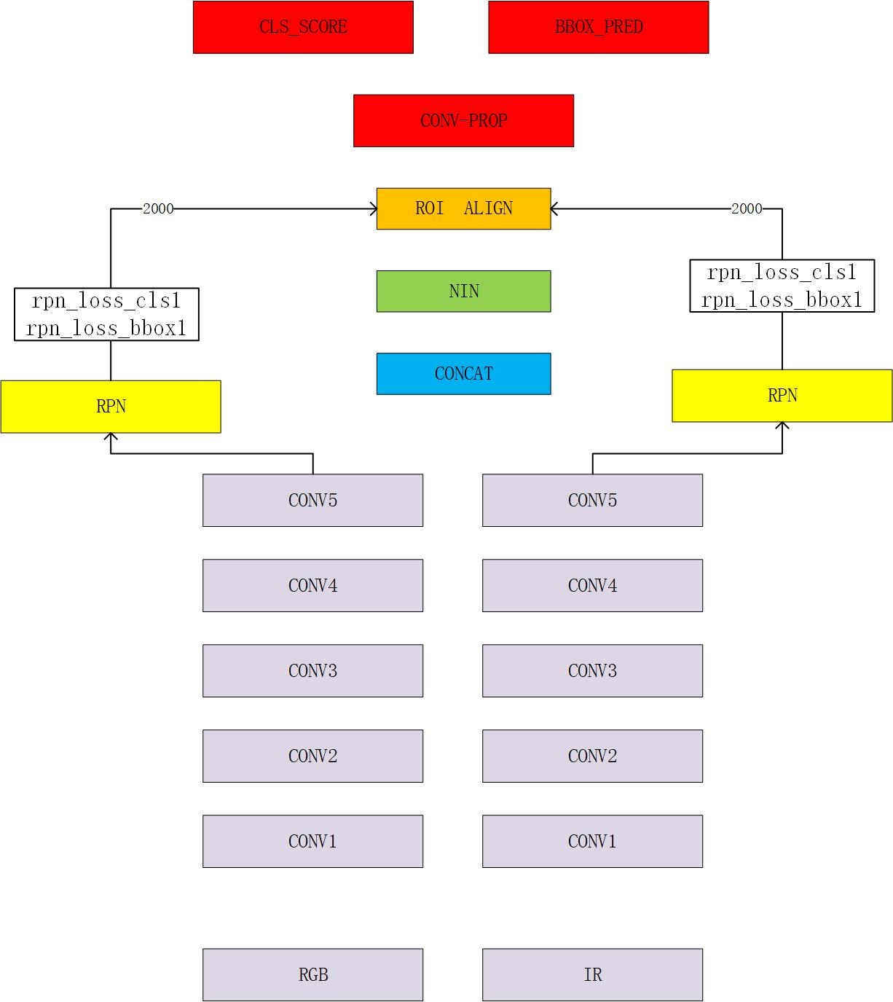
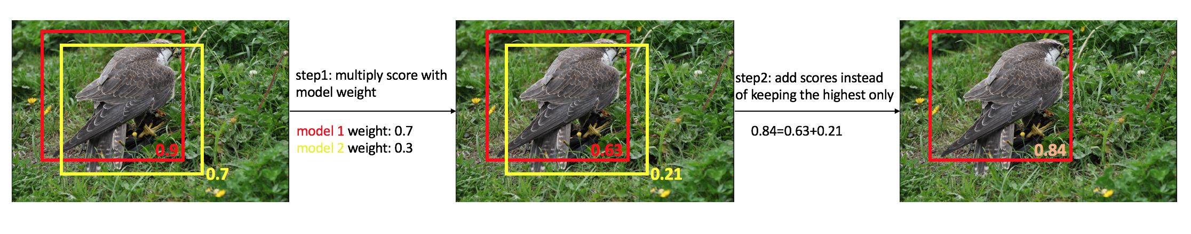
nms
方法 | Rpn fusion | Rpn nms fusion
All | 34.17% | 37.11%
Day | 34.62% | 36.77%.
Night | 32.32% | 37.74%
方法 | 后Nms fusion | 后ensemble nms
All | 36.63% | 39.03%
Day | 39..21% | 39.55%
Night | 30.71% | 35.03%

Slide 6
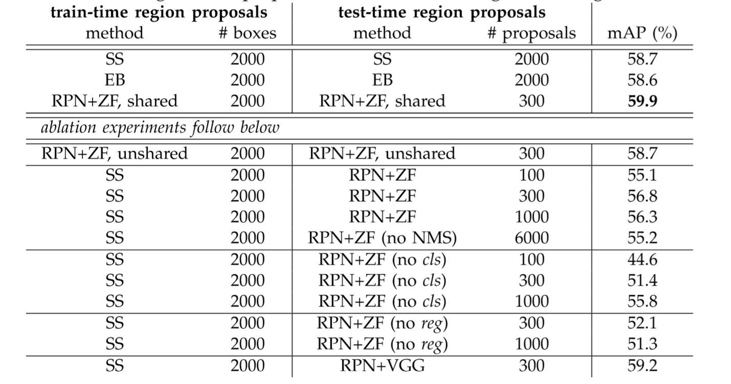
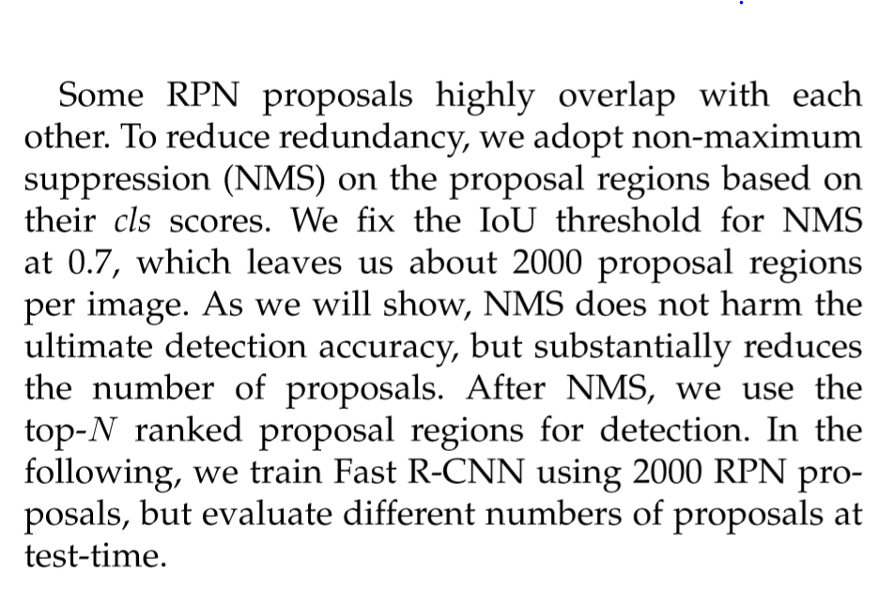

Slide 7
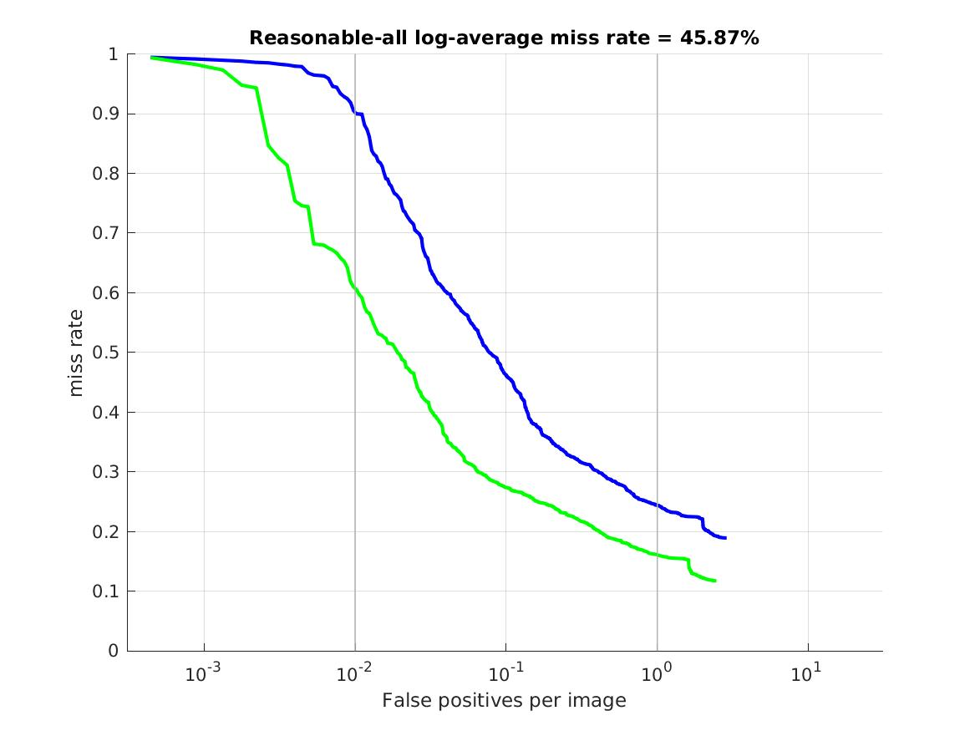
后ensemble nms
Reasonable-all log-average miss rate = 39.03% (26.46%) recall = 85.88% (90.31%)
Reasonable-day log-average miss rate = 39.55% (48.65%) recall = 84.91% (60.96%)
Reasonable-night log-average miss rate = 35.03% (99.89%) recall = 88.31% (0.41%)
Scale=near log-average miss rate = 15.24% (5.80%) recall = 94.96% (98.51%)、
Scale=medium log-average miss rate = 43.55% (34.15%) recall = 83.54% (86.16%)、
Scale=far log-average miss rate = 81.08% (72.42%) recall = 59.45% (61.34%)
Occ=none log-average miss rate = 44.92% (44.62%) recall = 82.28% (79.75%)
Occ=partial log-average miss rate = 63.97% (57.40%) recall = 74.85% (73.74%)
Occ=heavy log-average miss rate = 78.34% (71.43%) recall = 44.44% (50.88%)

Slide 8
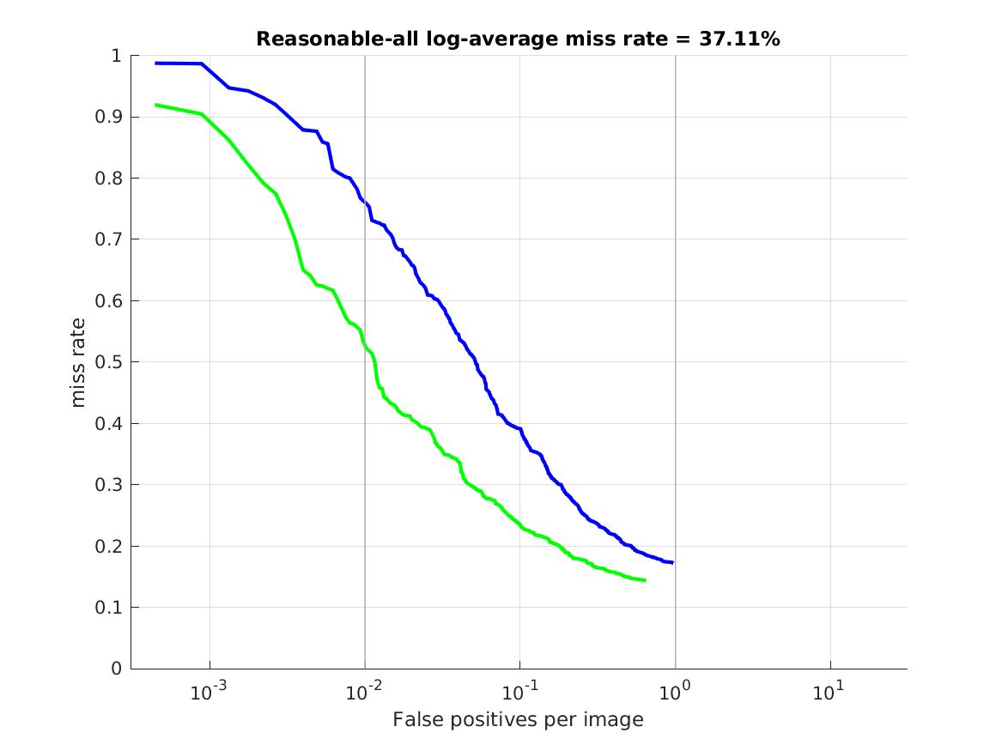
Rpn nms fusion
Reasonable-all log-average miss rate = 37.11% (24.93%) recall = 82.77% (85.64%)
Reasonable-day log-average miss rate = 36.77% (46.48%) recall = 83.63% (59.52%)
Reasonable-night log-average miss rate = 37.74% (99.89%) recall = 80.60% (0.21%)
Scale=near log-average miss rate = 13.78% (4.23%) recall = 95.38% (98.01%)
Scale=medium log-average miss rate = 42.24% (33.42%) recall = 79.88% (80.45%)
Scale=far log-average miss rate = 75.16% (71.53%) recall = 53.00% (46.84%)
Occ=none log-average miss rate = 42.97% (43.56%) recall = 79.01% (71.94%)
Occ=partial log-average miss rate = 61.41% (57.78%) recall = 65.45% (59.13%)
Occ=heavy log-average miss rate = 79.21% (72.75%) recall = 35.65% (42.92%)

Slide 9
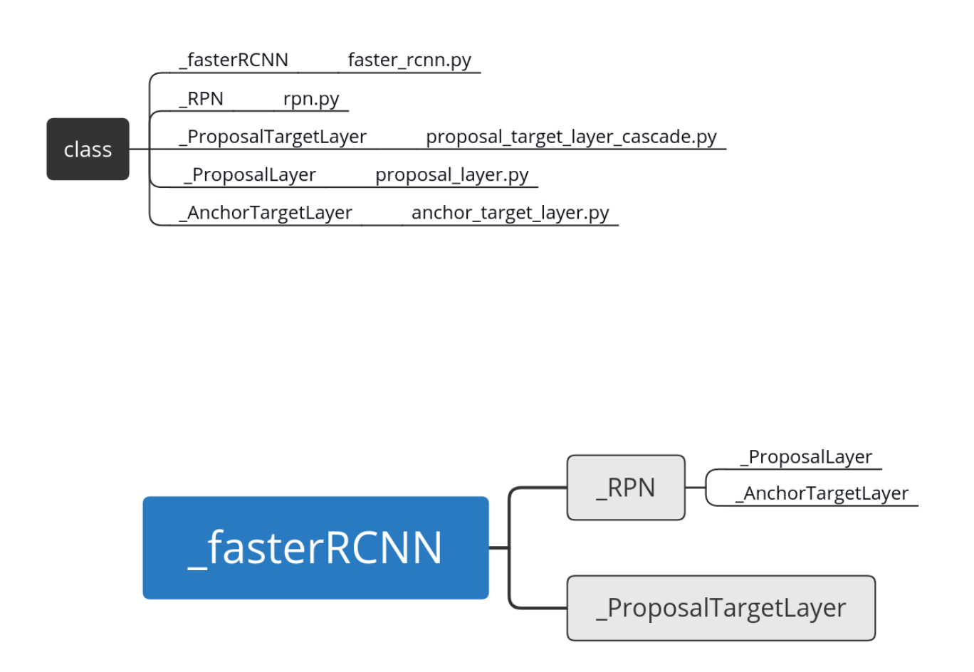
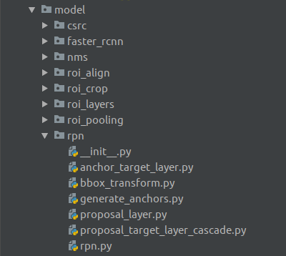
RPN

Slide 10
