Slide 1
Analysis and predictions on fraudulent job postings in the us
BY
Jonathan yoon
MAHA JAYAPAL
Yi wang

Slide 2

dataset objective
Online recruitment fraud
More traffic in the job market because of covid
Not only helps job seekers but also companies

Slide 3
Attributes of the Dataset
JOB-ID
TITLE
LOCATION
DEPARTMENT
SALARY-RANGE
COMPANY-PROFILE
DESCRIPTION
REQUIREMENTS
BENEFITS
TELECOMMuTING
HAS-COMPANY-LOGO
HAS-QUESTIONS
EMPLOYMENT-TYPE
REQUIRED-EXPERIENCE
REQUIRED-EDUCATION
INDUSTRY
FUNCTION
FRAUDULENT

Slide 4
Preliminary analysis
17880 records with 18 attributes
Location of records spread across the world including us and nz
Target attribute – fraudulent
More missing values in salary-range and department
No missing values in the target variable
Data types of the records are integers and objects

Slide 5
Interested attributes
Employment-type
Required-education
Required-experience
Has-company-logo
Fraudulent
location – to select data only from united states

Slide 6
Data pre-processing
Replace nan to “ “ to specify they are missing values
From the location attribute separate country, state and city
Separate the united states data from the dataset
10593 records in the us dataset
Replaced missing values with the mode of the attributes
Converting the categorical variables to numeric with cat.code

Slide 7
Missing values
Replaced missing values with the modes of those attributes
Missing data in employment type with other
Missing data in required-experience with not-applicable
Missing data in required-education with unspecified
Dropped missing values in locations

Slide 8
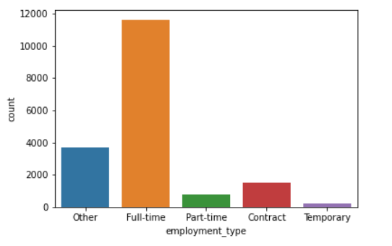
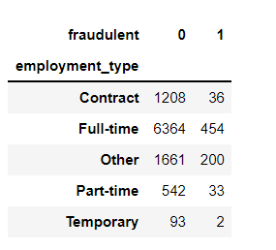
Employment-type
Employment-type spreads from full-time to temporary

Slide 9
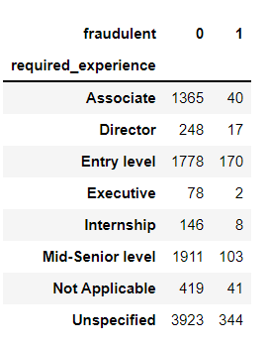
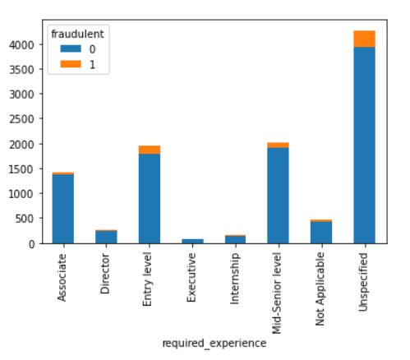
Required experience

Slide 10
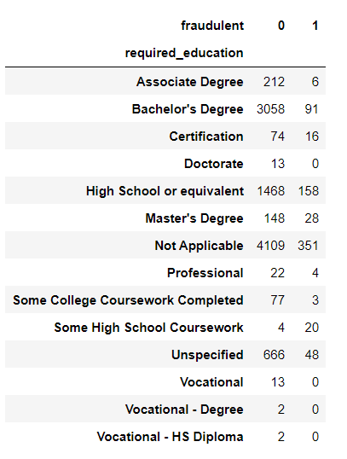
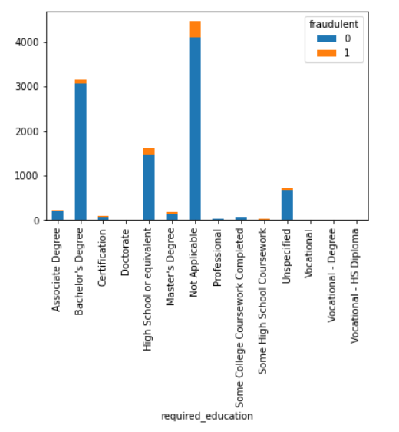
Required-education

Slide 11
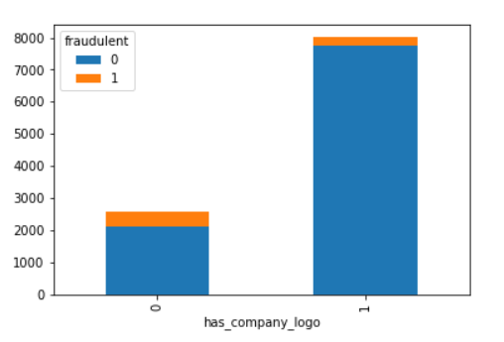
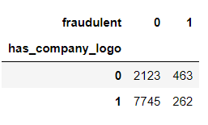
Has-company-logo
Correlation coefficient to the target variable: -0.25
Moderate negative correlation

Slide 12
Models and metrics
Naïve bayes model
Decision tree classifier
K-nearest neighbors
Random forest
ACCURACY
F1 SCORE
PRECISION
RECALL
Sensitivity
specificity

Slide 13
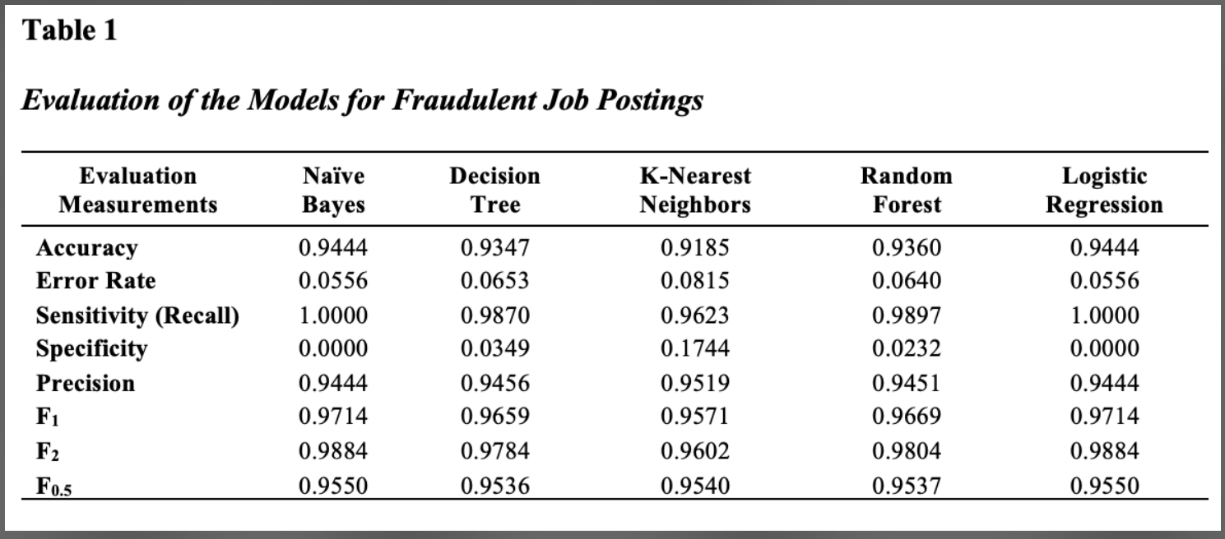
Models evaluation

